Slide 1


Slide 2
Avoiding the maladaptation trap - integrity and cross-sectoral collaboration in climate finance
An introduction to integrity and maladaptation in water sector climate financing

Slide 3
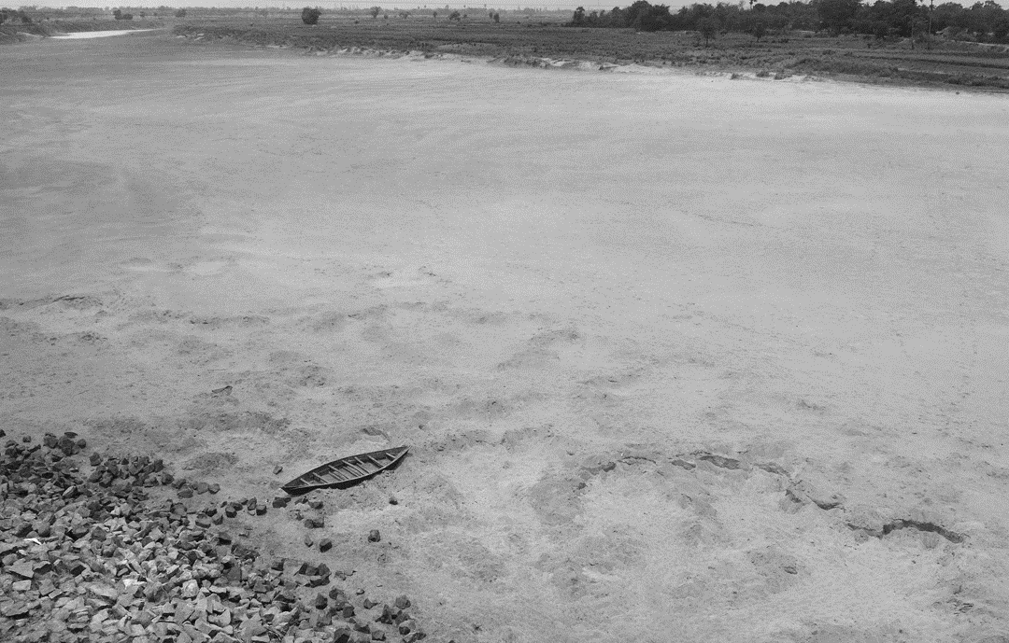
The climate crisis: a water crisis
Extreme weather events: worsening floods, droughts, more intense storms, rising sea levels, shrinking ice fields
Water as a resource: scarcity, quality, access
Water across sectors and demands: sectoral (Water-Energy-Food-Industries-Ecosystem), conflicts, transboundary cooperation
Vulnerable communities: access to basic water and sanitation and water for productive purposes
Climate induced displacement: cross border, rural to cities and informal settlements
= the urgency of adaptation!

Slide 4
Water at the heart of climate adaptation – an influx of finance into a corruption-vulnerable sector
Water sector is most vulnerable and highest in planned adaptation in NDC adaptation components (Adaptation Community)​
80% of climate adaptation funding absorbed by water and sectors linked to water (U4)​
54% of estimated adaptation infrastructure costs through 2050 are in the water sector (UNOPS)
Climate finance overall is lagging but massive amounts of money are expected to flow into adaptation-related projects

Slide 5
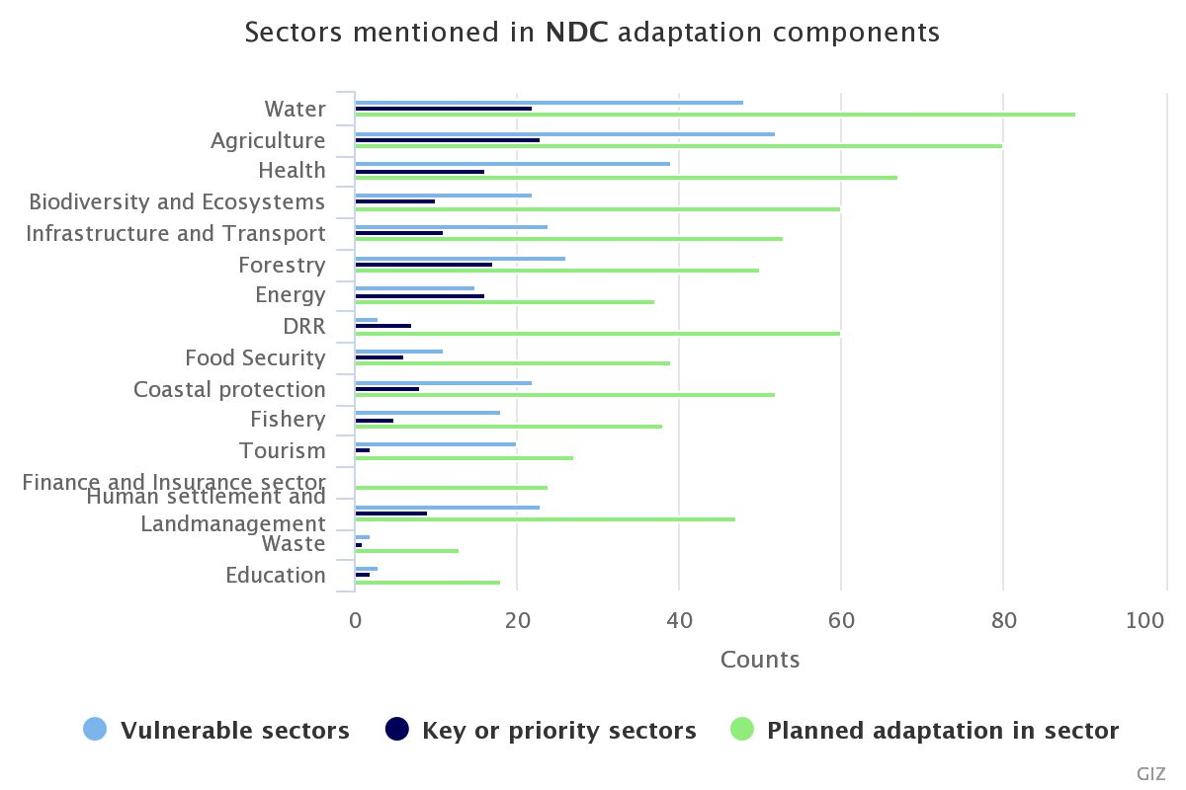
Sectors mentioned in NDC adaptation components
Source: Adaptation Community

Slide 6
How does one ensure that all of this finance really delivers adaptation solutions?
What is the link with integrity and corruption?
40% of all climate-related ODA received by initiatives in countries among the riskiest places in the world for corruption (U4 Brief 2020:14)

Slide 7
Adaptation vs Maladaptation
  Adaptation: changes in processes, practices and structures to mitigate potential damages or to benefit from opportunities associated with climate change now and in
  the future
  Maladaptation: ‘actions, or inaction that may lead to increased risk of adverse climate-related outcomes, increased vulnerability to climate change, or diminished welfare, now or in the future’ (Noble et al., 2014, p. 857)
    May reinforce existing vulnerabilities, redistribute vulnerability, or create new vulnerabilities
  Can arise from
    prioritizing short-term outcomes over risks associated with longer-term threats;
    insufficient understanding of local cultural, socio-economic, and political contexts;
    technology dumping;
    donor agenda pressure;
    poor analysis of situation;
    working in a context of significant uncertainty, or
    poor integrity and corruption

Slide 8
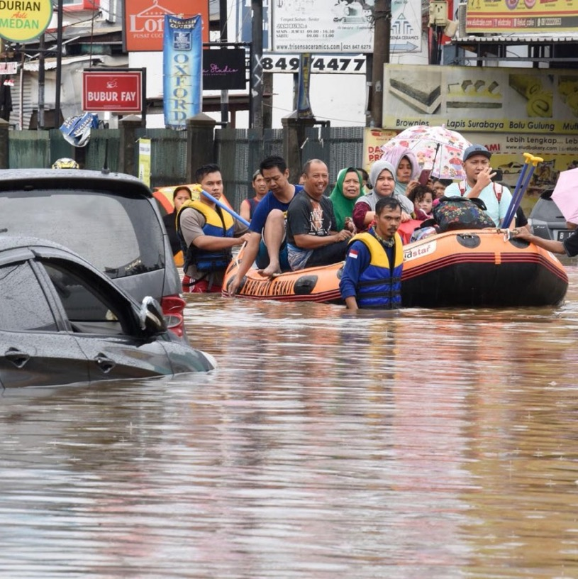

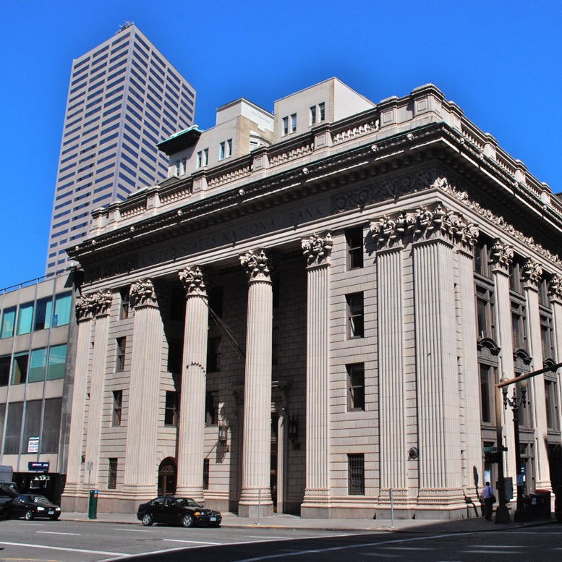
Increased cost
Unintended risks
Affecting vulnerable communities
CORRUPTION, POOR INTEGRITY
MALADAPTATION
TRAP
Climate Adaptation Objectives
Climate Finance
Uncertainty!
Planning
TRANSPARENCY
INTEGRITY
ACCOUNTABILITY
Notes:
The diagram illustrates how climate finance may lead to maladaptation in the absence of integrity safeguards/practices. Maladaptation delays climate action and diverges from the path towards achieving our climate targets. We can also speak about cases studies here.

Slide 9
Increased cost
Unintended risks
Affecting vulnerable communities
Corruption, Poor Integrity
MALADAPTATION
TRAP
Climate Adaptation Objectives
Climate
Finance
Uncertainty!
Planning
Notes:
The diagram illustrates how corruption may lead to maladaptation in the absence of integrity safeguards/practices. For example Bangladesh flood platform – in Headman’s property on wrong side of river

Slide 10
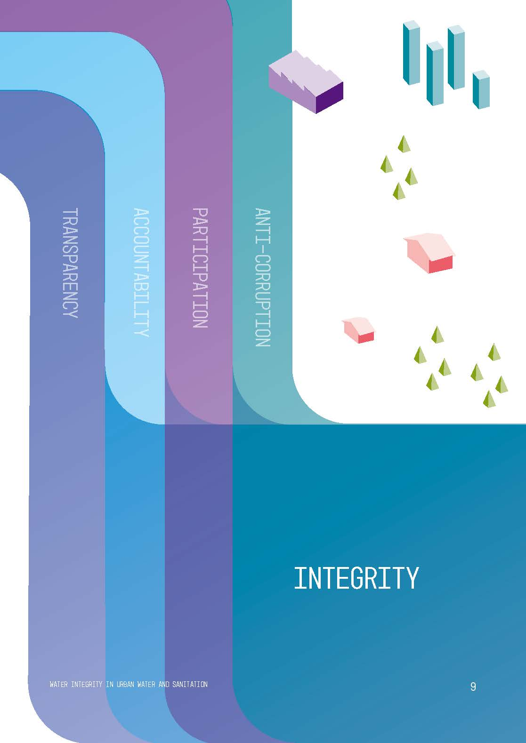

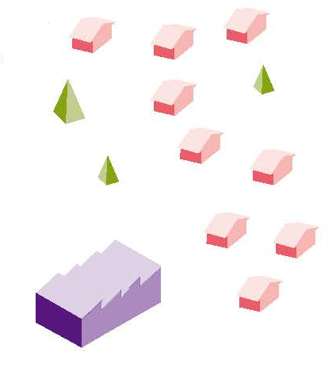

TRANSPARENCY
ACCOUNTABILITY
PARTICIPATION
ANTI-CORRUPTION
BE OPEN:
Ensuring people know their rights, see how decisions are taken, and how money is spent.
MAKE SURE IT’S DONE:
Clarifying responsibilities and making sure stakeholders uphold their mandate.
HAVE YOUR SAY:
Engaging with people when making decisions that affect them.
PLAY BY THE RULES:
Leaving no space for corruption or impunity, with clear, enforced rules.
INTEGRITY
Notes:
Integrity for WIN means using vested powers and resources ethically and honestly, ensuring services and resources go where they are intended and most needed. Practically this is done by building up Transparency, Accountability, Participation and implementing preventive Anti-Corruption measures.
Integrity is an aspirational goal where the public interest, honesty and fairness override the personal desire for gain. In the water and sanitation sectors, it has substantial social, economic, and environmental benefits. Building integrity can improve services to people who need them for a life with dignity.

Slide 11
WIN’s focus
CLIMATE FINANCE
(more effective and fair use of financing)
CLIMATE ADAPTATION
(reduced planning risks and accountability in implementation)
CLIMATE GOVERNANCE
(participatory decision-making, avoidance of capture)
WHAT WE DO:
Advocacy for integrity and climate justice
Community and civil society engagement, including for social accountability and community monitoring
Research on risks (e.g. maladaptation) and solutions
Integrity assessments
Integrity readiness of organisations and of cross-sector or multi-stakeholder initiatives

Slide 12

Resources and more info
Integrity Readiness for Climate Finance (WIN, GCF)
Water Integrity as an Opportunity – the Relationship between Climate Change Finance and the Water Sector (WIN,GIZ policy brief)
Water Integrity is Missing from the Climate Debate (WIN)
GCF Independent Integrity Unit

