Slide 1


Slide 2
Building Resilient Watersheds with Accountability and Integrity
Africa

Slide 3
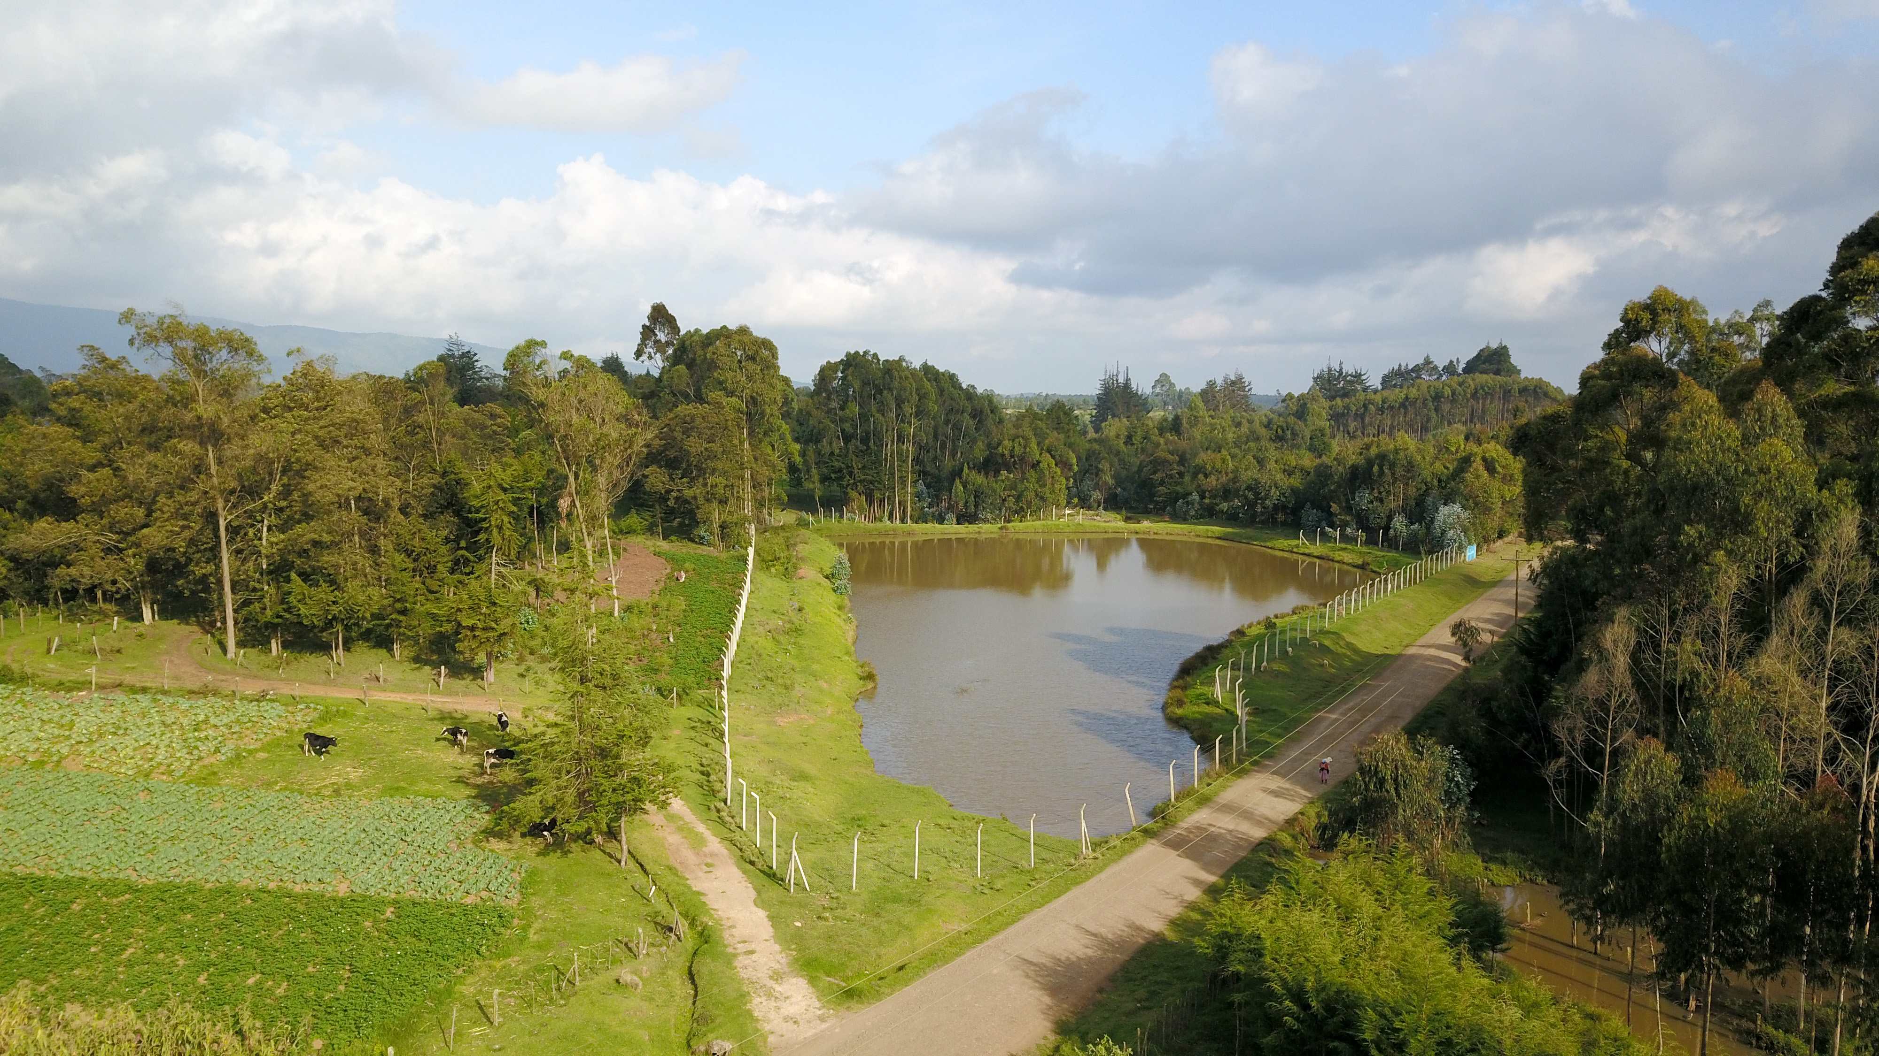
©️Solomon Karanja/UTNWF

Slide 4
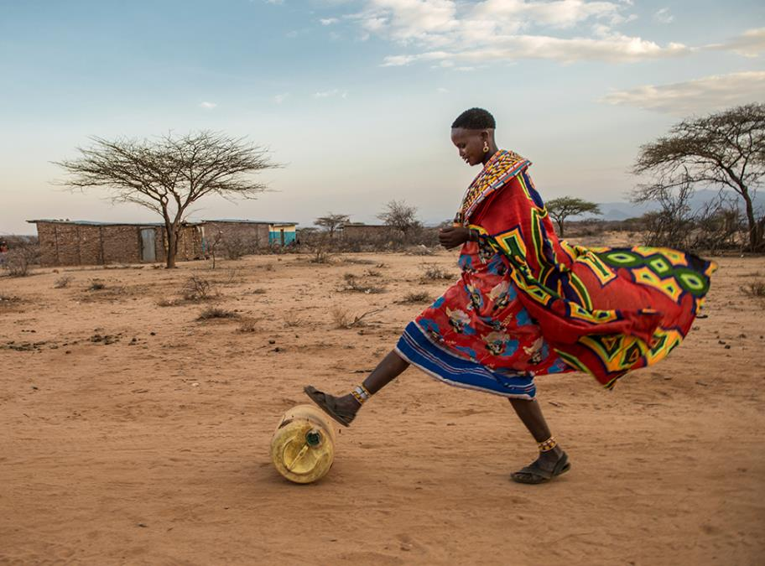
LIKE THE REST OF THE WORLD, MOST AFRICANS
GET OUR WATER FROM
RIVERS & LAKES
Notes:
It’s important to understand how rain works in East Africa. The seasons are defined not by the temperature, but by the rain. There is a short rainy season and a long rainy season – and in between it can be very, very dry. In fact, Kenya is a “water scarce” country. For many people in rural areas, taking jerry cans, like the one in this photo, to rivers is a fact of life. But this is not an ideal solution: dry riverbeds, long walks for women and girls, and dirty water all present massive challenges to water security. That’s why water wells in rural villages are so important and can change lives.
Photo © Ami Vitale for The Nature Conservancy

Slide 5
Water Fund Governance | Unique model, ensures lasting results
The Model
Nairobi Water Fund – Impacts
  54,500 upstream landowners with mature conservation outcomes
  100,000+additional farmers in ongoing agroforestry investments
  142,850 farmers in mobile phone SMS based education
  3.7million agroforestry trees growing in watershed
  1.3m fruit trees yield $50m fruits annually, create 17,400 green jobs
  1900 freshwater fauna species positively impacted
  2 high biodiverse water towers [1 World Heritage Site) protected
  11% more water for city, 16% less sediments in rivers
  Durable governance and legal mechanism in place

Slide 6

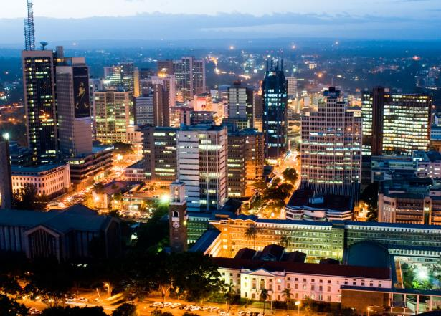
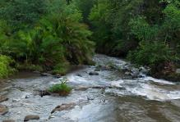
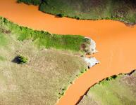

KENYA | NAIROBI water fund
TANA RIVER
KENYA’S LARGEST
50%
OF KENYA’S ENERGY
95%
OF DRINKING WATER
9 MILLION PEOPLE
Notes:
The Tana River runs 1,000 kilometers from the Aberdare Mountain Range to the Indian Ocean, creating essential habitats and nurturing important ecosystems along its entire length.
For example:
The Tana River sustains the Tana delta RAMSAR site, a wetland of recognized international importance. Our conservation work will help ensure cleaner and more abundant water heads downstream and that the ecological integrity of the delta will endure for generations to come.
The Aberdare Range and national park is home to some of the most rare endemic wildlife species, including the Africa indigenous black rhinos, endangered Mountain Bongo antelopes, leopards and Columbus monkeys.
The water fund will provide conservation benefits to the Mt. Kenya National Park and forest reserve area, a UNESCO World Heritage Site. The adjacent lands have an important spiritual importance for the indigenous communities who live there.
The Tana River supplies:
95% of the water for Nairobi’s 4 million residents, and an additional 5 million people in the watershed
70% of the country’s hydropower, which accounts for almost half the country’s electrical production
98% of the raw material that goes into Coca-Cola’s products at 7 bottling plants around Nairobi
But the river is being choked with sediment: filling up the reservoirs, reducing hydropower output, and putting economic growth at risk.
Where is it coming from?
Photos © Thomas Cockrem / Alamy Stock Photo, The Africa Image Library / Alamy Stock Photo, National Geographic Creative / Alamy Stock Photo and Nature Picture Library / Alamy Stock Photo (from top to bottom, counter clockwise)

Slide 7
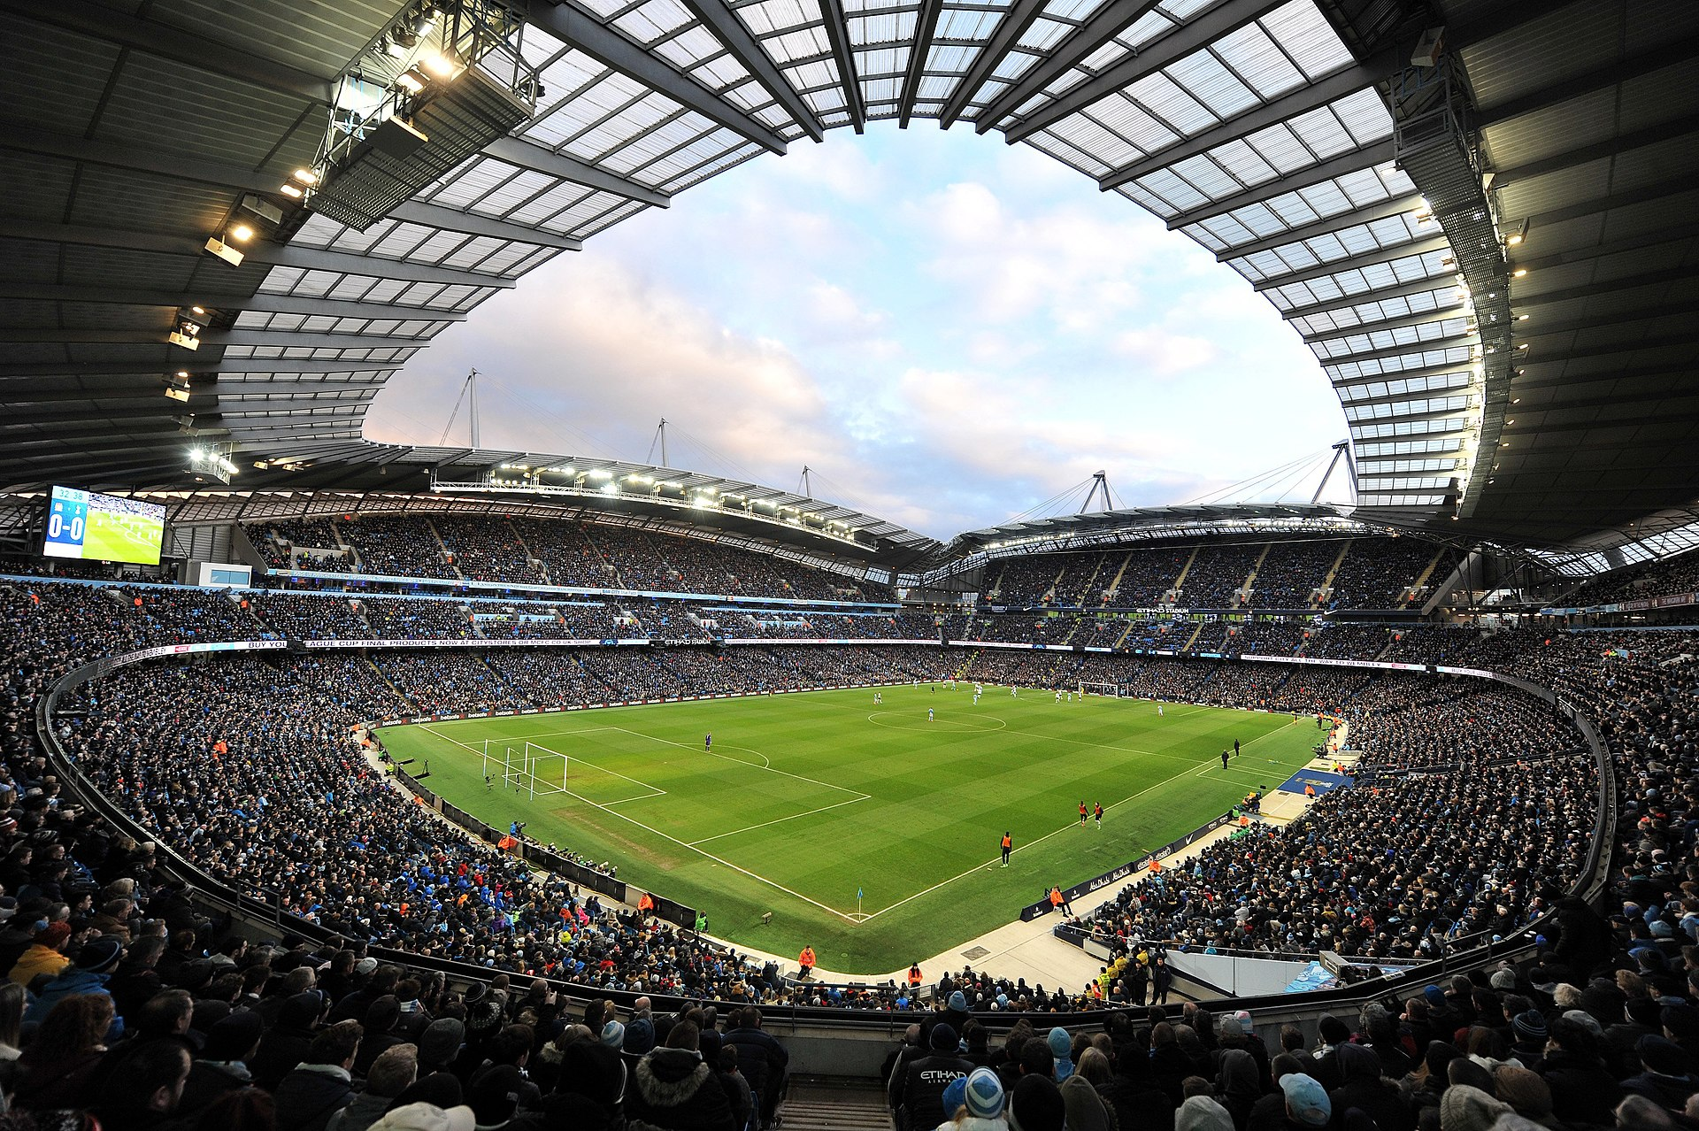
Upper Tana- Nairobi Water Fund
54,500 farmers are mitigating effects of climate change in Upper Tana
-we need to sustain the work-
Notes:
This illustration from those who love soccer or know Manchester teams well, helps illustrates the farmers we have mobilized in just one of the Water Funds- Nairobi to help us fight the battle.

Slide 8
Challenges to integrity
Subsidies for Farmers
Doubled amount of subsidy for
Women led households
Elderly farmers above 60 years
Challenges to Integrity
Farmers were already making >50% in kind contribution in labour input
Farmers registered their wives as beneficiaries
Younger farmers entered elderly parents’
names as beneficiaries
Collusion to deceive on age
Challenges in following up cases

Slide 9
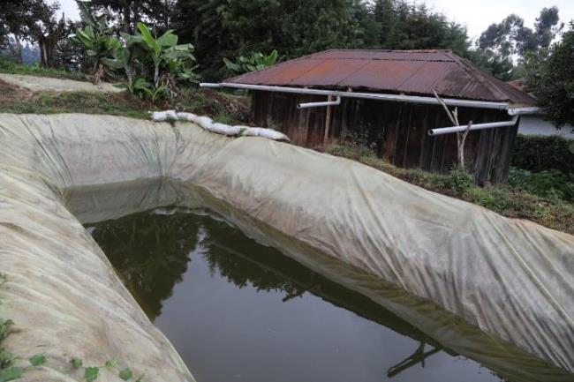
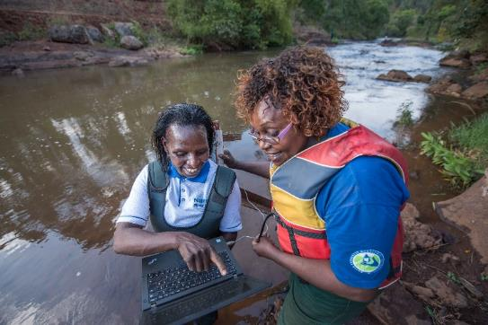
Avoiding Maladaptation| investing in factual data
We track
Actual chemical usage before and after interventions for urban water treatment
Tree growing and care. Timely beating up (replacing any dry seedlings)
Macro invertebrates, fish, amphibians' population and trends
We track river water quality periodically (season after season)
We track river flows at 26 automated monitoring stations with Kenya government. Management Effectiveness (METT) for protected areas
We track training and capacity development for field staff, group leaders
and farmers
Avoiding Maladaptation
Following up on tree growing to ensure success
Investigating rainwater harvesting structures to ensure efficacy
Estimating the actual amounts of rainwater harvesting and percentage used for improving farm productivity
Using failure as lessons for others
© Roshni Lodhia
Notes:
…. and counting…

Slide 10
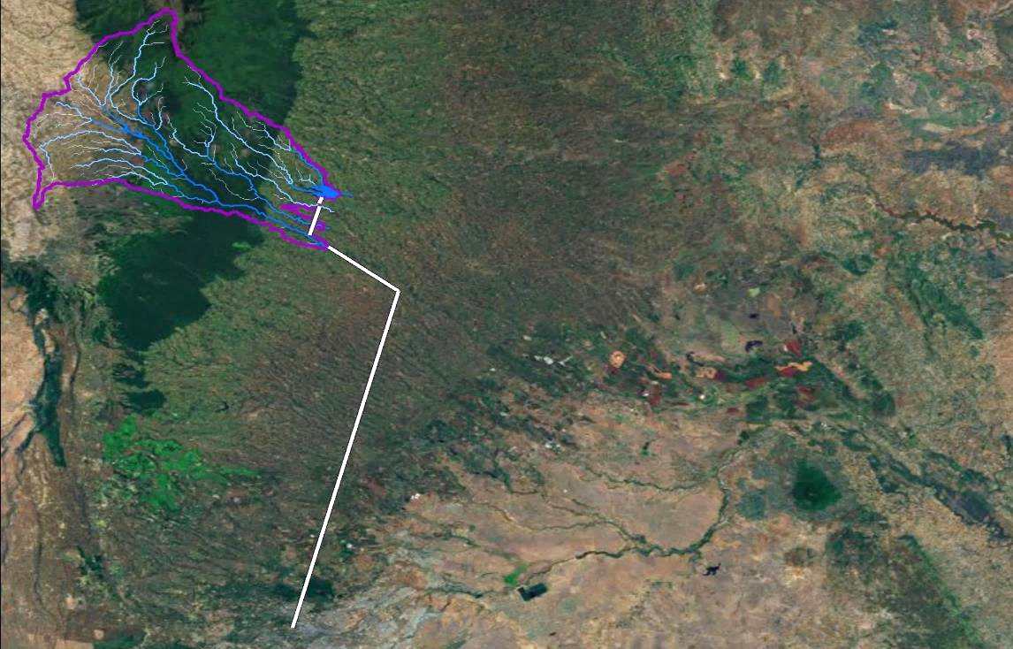

Abadare Ranges
Nairobi Water Supply Catchment
Ndakaini Dam
UTNWF:
Long-term conservation actions to secure source
Ng’ethu Water Treatment Plant
Nairobi

Slide 11
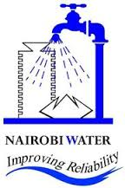
IMPACTS | Using water treatment chemical use as a proxy
Abadare Ranges
NCWSC - Chemical usage at the water treatment plant (2013-2022)
Nairobi

Slide 12
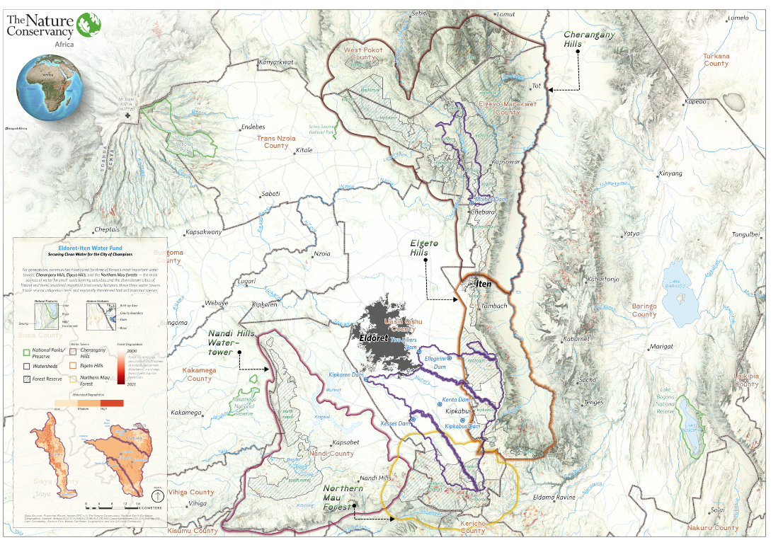
Replicating in country
  5 more water towers
  320,000 hectares
  6 municipalities
  Foodscape possibility
  Sanitation in watersheds and urban centres downstream
  Expanding Agric potential
  Capacity development

Slide 13
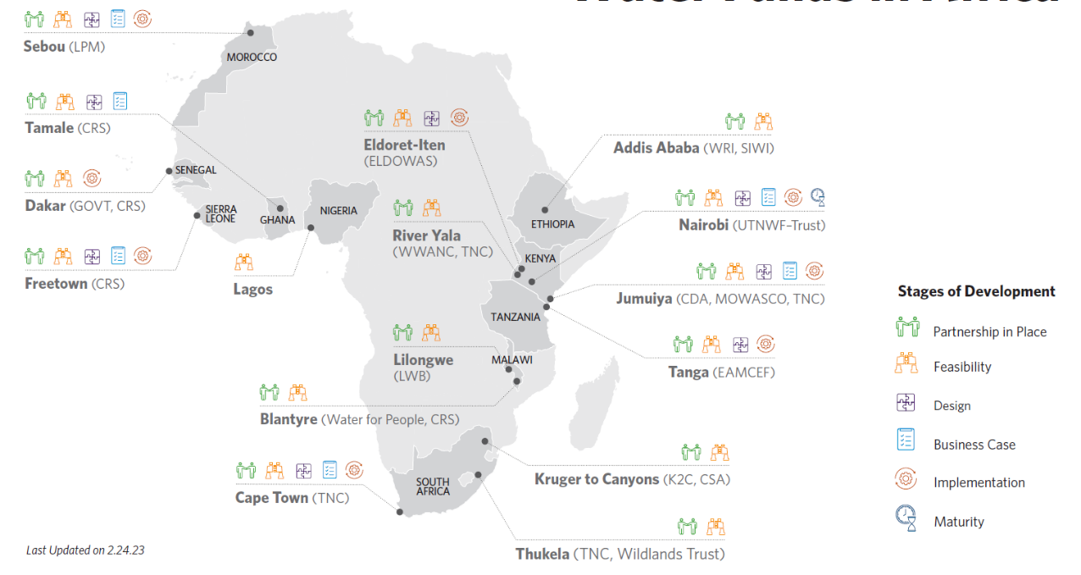
Water funds in Africa
Regional focus
  Watershed conservation
  Livelihoods for those responsible of source waters
  Sanitation in watersheds and urban centres downstream
  Working together. A partnership for the region
  Share knowledge from Latin America, Nairobi, Cape Town, TIARA, S2S, IWRM
  Capacity development

Slide 14
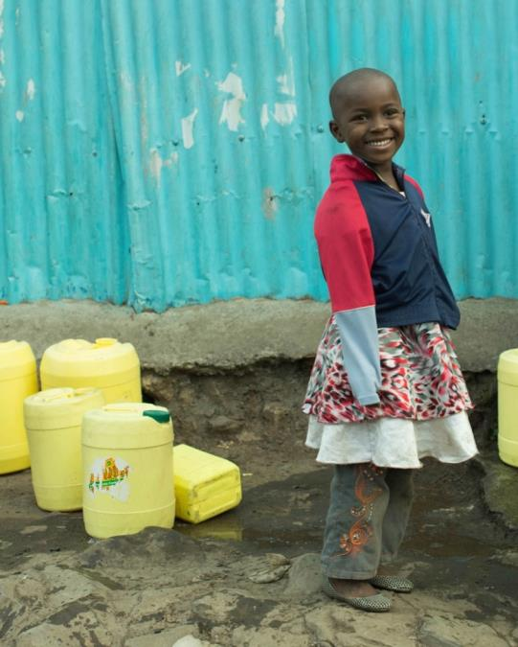
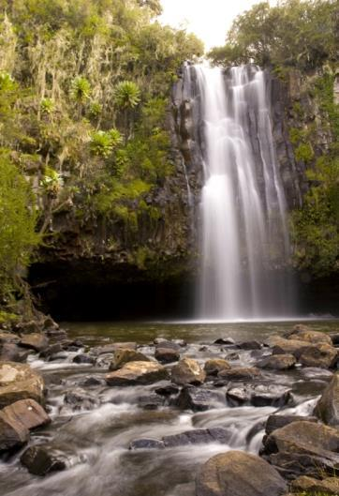
"I have seen rivers that were brown with silt become clean-flowing again. The job is hardly over, but it no longer seems impossible.”
Wangari Maathai
Notes:
Ultimately, it all comes down to what’s in that yellow jerry can. We’re doing what we do best: conserve rivers. As nations build water infrastructure, we want to help ensure that there’s a healthy source to draw from – so that in the future, mothers can turn on the tap, everyday, and clean water will come out.
We believe that nature can endure, even as economies grow and nations become more prosperous and modern. Every person who has supported a freshwater project over the past 60 years has gotten us here. Today, thanks to these investments, we are capable of amazing things – together.
We hope that when you turn on the tap next, that you will think of Africa – and that you will decide to work with our partners here in this exciting and urgent work.
Asante sana!
Photos © Nick Hall for The Nature Conservancy (left) and Africanmoose / Shutterstock (right)

