Slide 1


Slide 2
Carbon credits for water projects When should it be considered?
Climate mitigation: Looking for win-win opportunities for the WASH sector and for populations living in vulnerable situations

Slide 3
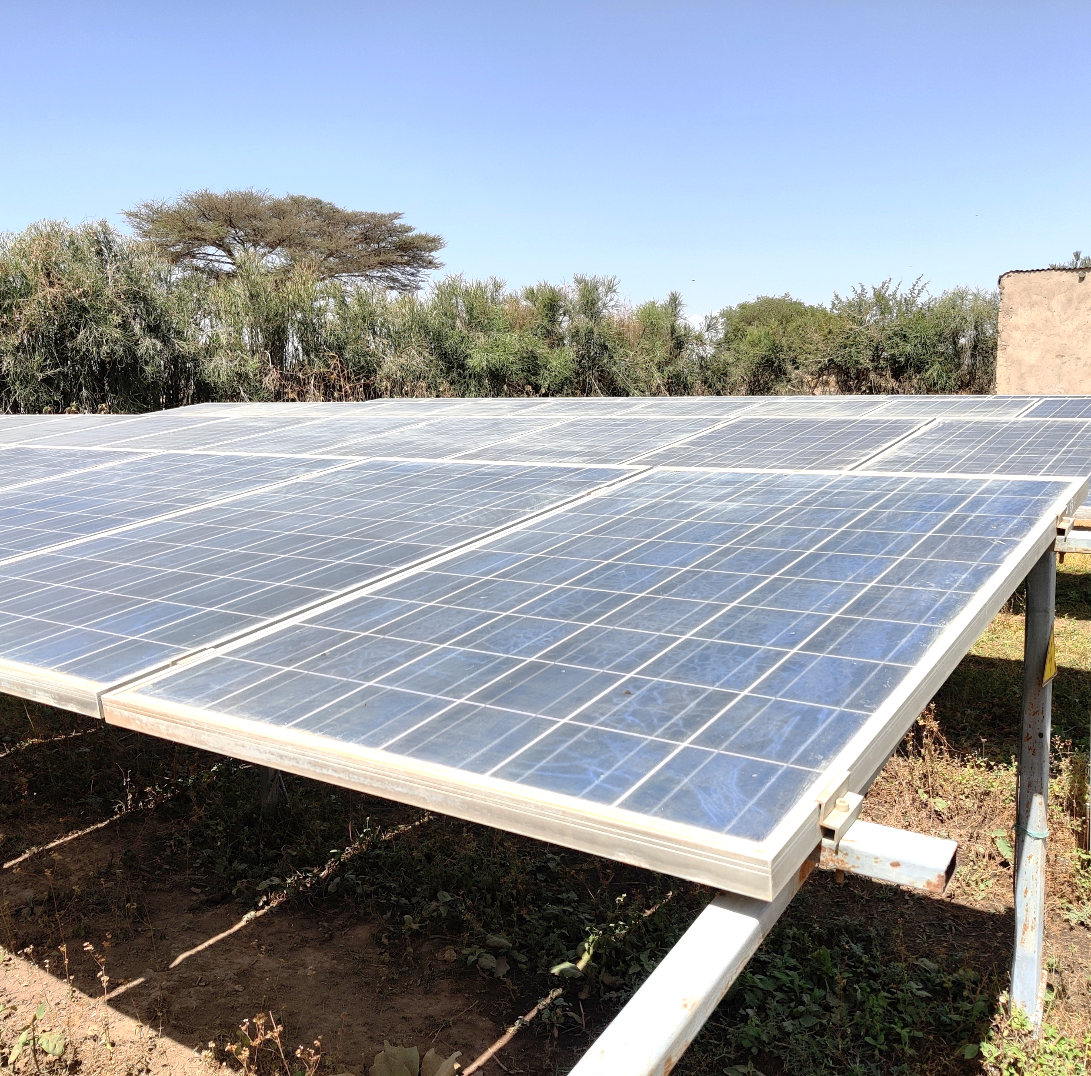
Greenhouse gas (GHG) emissions related to
water supply
Emissions from energy generation for water abstraction, treatment and distribution
Emissions from boiling drinking water
for making it safe for consumption
Notes:
White paper “MAPPING WATER’S CARBON FOOTPRINT” by Global Water Intelligence. Total of 323 MtCO2-eq per year from water supply. Switching from fossil fuel to renewables energy sources has significant potential to reduce global greenhouse gas emissions. However, contribution to these emissions from low-income countries is low. If you are supporting the solar schemes to replace diesel-powered boreholes, that could work for carbon credits. However, it only gets interesting if you save 10 million liter of diesel per year (which is about 500 individual schemes). [Diesel consumption: 50 L/day/scheme, 2.7 kg CO2-eq/L]

Slide 4
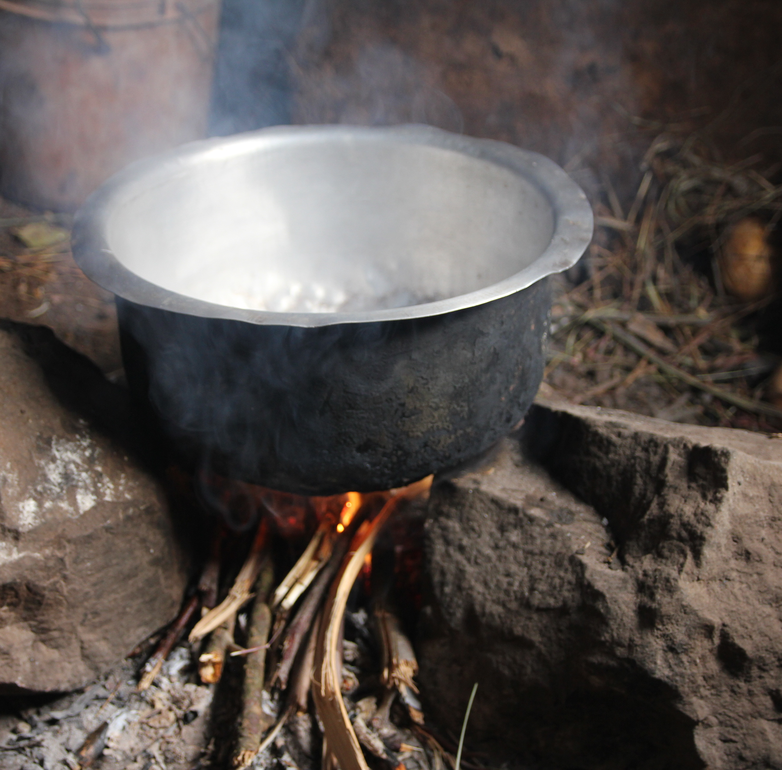
Greenhouse gas (GHG) emissions related to
water supply
Emissions from energy generation for water abstraction, treatment and distribution
Emissions from boiling drinking water
for making it safe for consumption
Notes:
The commonly used emission reduction pathway for carbon projects is based on boiling drinking water for making it safe for consumption. Therefore, we will focus on this in today’s session.

Slide 5
Boiling of drinking water
About 600 million people in low- and medium-income countries report boiling their drinking water.
Mainly in the Western Pacific and Southeast Asia.
Source: Rosa, G. and Clasen, T. (2010) ‘Estimating the scope of household water treatment in low-and medium-income countries’,
American Journal of Tropical Medicine and Hygiene 82(2): 289–300 <http://dx.doi.org/10.4269/ ajtmh.2010.09-0382>

Slide 6

Emission reduction
Baseline scenario:
boiling water
Project scenario:
e.g. use of water filter
-CO₂
Carbon credits
-CO₂
GHG emissions
before intervention
GHG emissions after intervention
Emission
reductions

Slide 7
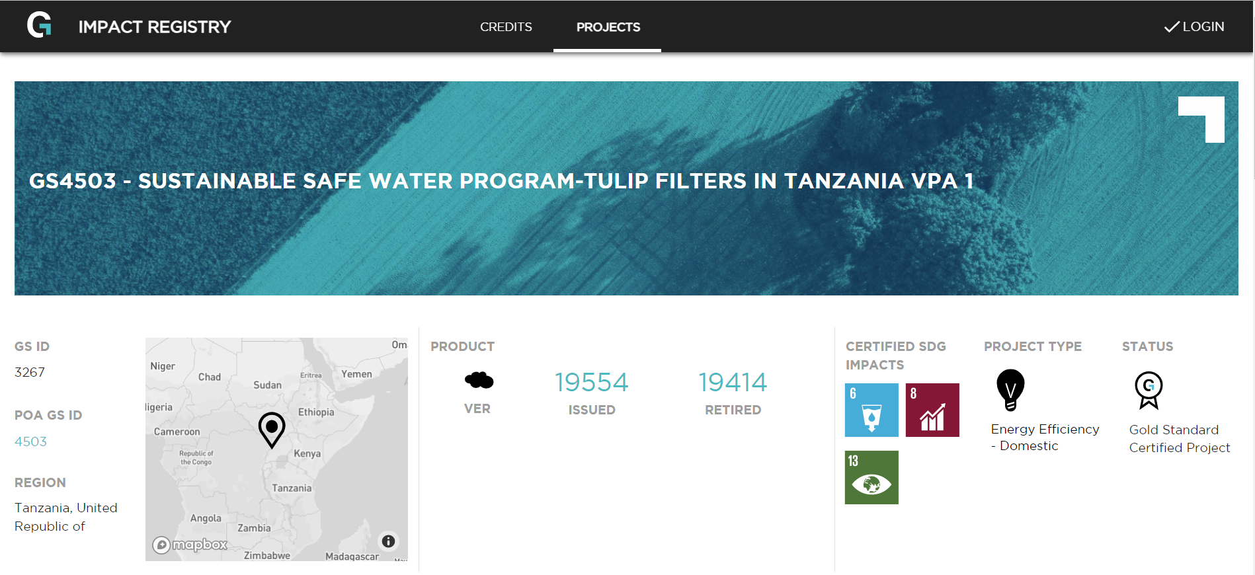
Carbon credits
  Example of a project in the project registry of the Gold Standard
A carbon credit stands for
1 tonne of carbon dioxide
equivalent (tCO₂e) emissions reduced,
removed or avoided
Carbon credits are issued by
carbon standards against a set of
rules, procedures and carbon quantification methodologies
Carbon credits can be sold and generate revenue for an intervention

Slide 8
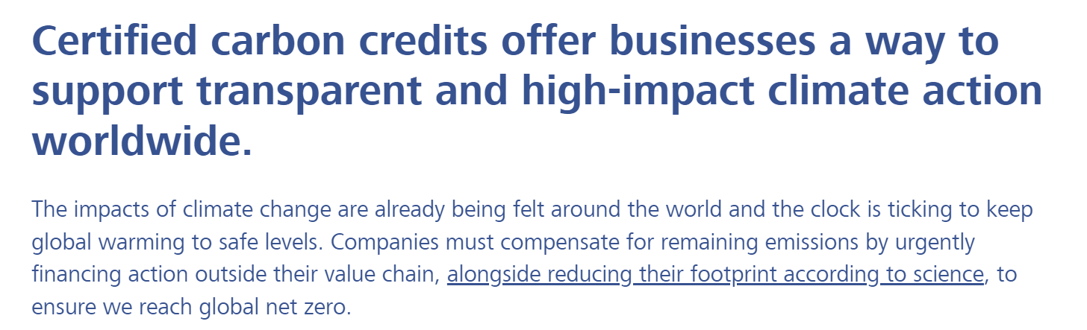
Claims related to carbon credits
Move from “offsetting emissions” to “paying for your verified climate contributions”
Notes:
Screenshot from South Pole website.

Slide 9
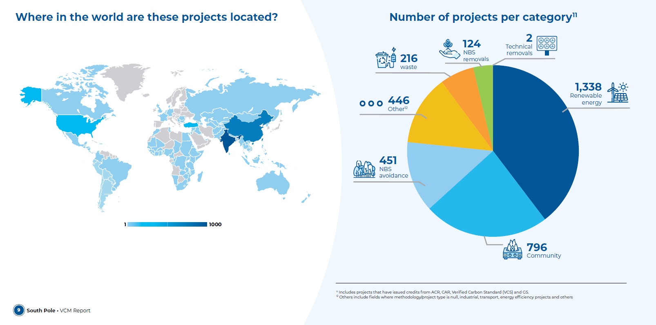
Overview of carbon market
Source: South Pole (2023)
Notes:
About 800 community projects registered. Mainly for fuel-efficient cookstoves but also including about 100 safe water projects.

Slide 10

Who is involved in a carbon project?
Water users
Project owner
Project developer
Credit retailer
Third-party auditor
Certification standard

Slide 11
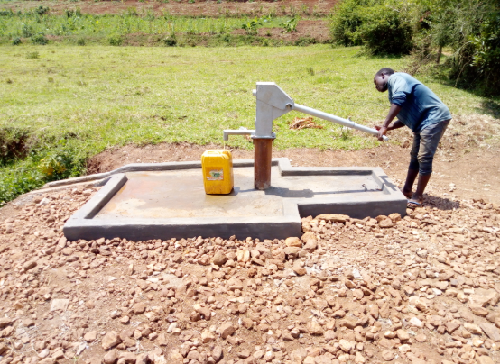
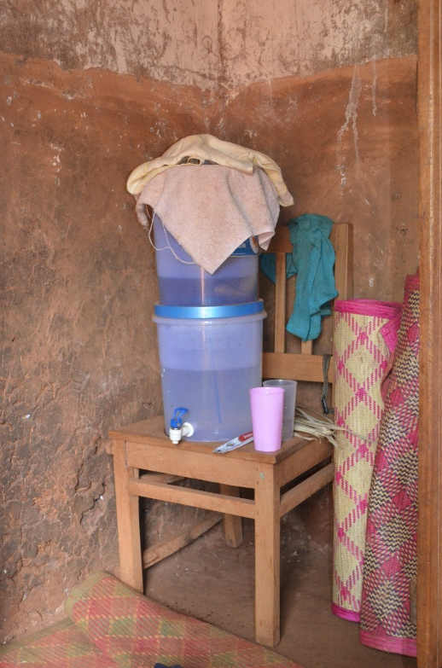
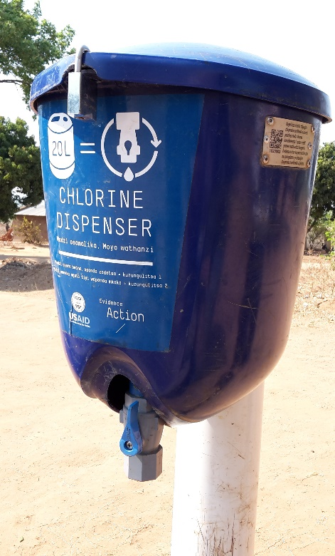
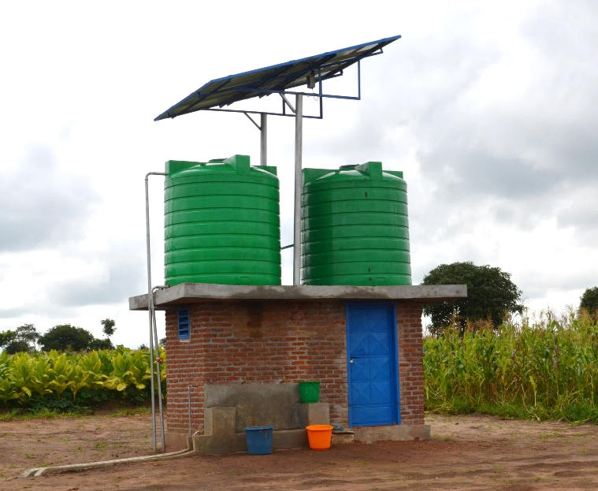
Project technologies
Water supply
Water treatment
Rehabilitation of boreholes, installation of solar pumps…
Filters, chlorine, UV…

Slide 12
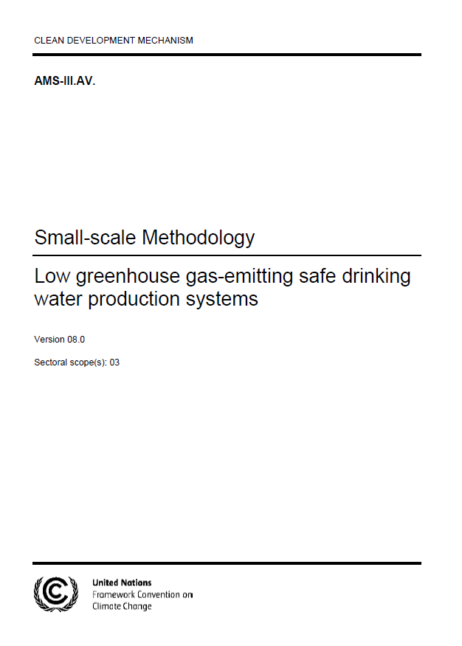
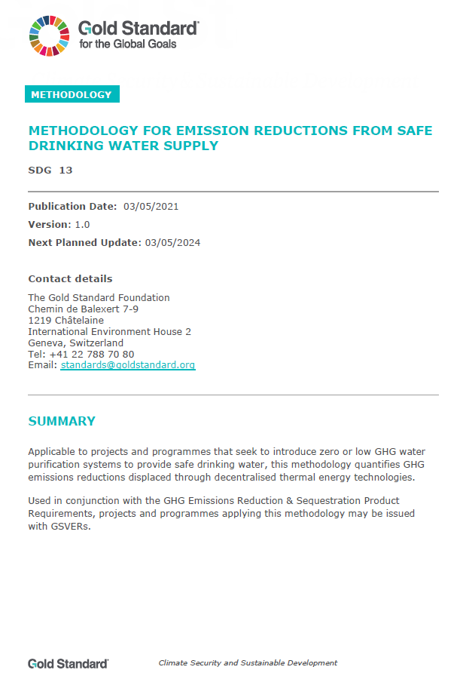




Carbon standards & methodologies

Slide 13




Project technologies
Technology level | Water supply | Water treatment
Household | X | HWT HH filters, chlorine, UV
Institutional | X | IWT larger scale filters, chlorine, UV
Community | CWS borehole, handpump, solar | CWT Filtration, chlorination, UV
  Technology should achieve
  3-star or 2-star level as per WHO International Scheme to Evaluate Household Water Treatment Technologies
  or comply with relevant National Standards
  Maximum 1 km away from end user, demonstrated by satellite imaging or GPS, alternatively demonstration that round trip for collection is maximum 30 minutes
  No fossil fuel powered pumps except with backup generators <10% of operating hours
  Project must include operation & maintenance
Notes:
As per the Gold Standard methodology.

Slide 14



Process for generating carbon credits
Feasibility
Prefeasibility study
Stakeholder consultation
Business plan
Project design document (PDD)
Monitoring plan
Validation/
registration
Ex-ante impacts of the project are validated by external entity
Carbon project listed in public registries of carbon standard
Monitoring
Application of the monitoring plan to track project impacts
Periodic monitoring (usually annually)
Verification
Detailed review of methods and calculations by Validation and Verification Bodies (VVB)
Issuance
Credits are issued on project owner registry with a unique serial number
They can be retired (i.e. used for offset, climate contribution claim)
Re-validation after 5 years
2 – 3 years

Slide 15
Monitoring
Database/inventory
List of all units credited (e.g. water filters, households, water points)
Unique ID for each unit
Monitoring surveys
(based on random sample from database)
Usage rate
Water quality
Water consumption
Baseline survey
(representative for the units in the database)
Prevalence of boiling in project area/ suppressed demand
Efficiency of stoves used for boiling
About 1 to 1.5 tCO₂e per household per year for “users”
Notes:
A default of 4 L/pers/day can be used for water consumption.

Slide 16
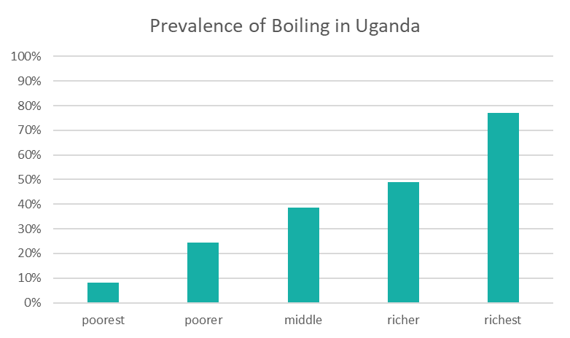
Suppressed demand
“For household end-users currently drinking unsafe water, the principles of suppressed demand are applied, such that the general baseline scenario is assumed to be that users would have boiled water for drinking in the absence of the project activity.”
Suppressed demand is not applicable for large scale projects with more than 60,000 voluntary emission reductions per year (VERs/year).
Source: Uganda DHS (2011)

Slide 17
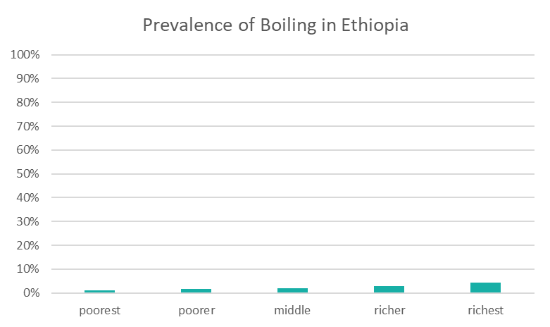
Suppressed demand
“For household end-users currently drinking unsafe water, the principles of suppressed demand are applied, such that the general baseline scenario is assumed to be that users would have boiled water for drinking in the absence of the project activity.”
Suppressed demand is not applicable for large scale projects with more than 60,000 voluntary emission reductions per year (VERs/year).
Source: Uganda DHS (2011)

Slide 18
Worth noting
Local stakeholder consultation: the Gold Standard requires a consultation with all relevant stakeholders prior to implementation and establishment of a grievance mechanism
Water quality threshold: the current version of the Gold Standard methodology requires that 90%+ of the water samples have less than 1 colony-forming unit (CFU) E. Coli / 100 ml, otherwise no carbon credits will be issued
Retroactive registration: there are strict rules about registering projects that are already under implementation. Carbon credits should considered before starting implementation
Additionality: project needs to demonstrate that it could not or would not take place without carbon finance
Notes:
Retroactive registration: project documentation must be submitted for review within a year of project start date.
Additionality: under GS, micro-scale and projects in LDC, LLDC, SIDS automatically deemed additional.

Slide 19
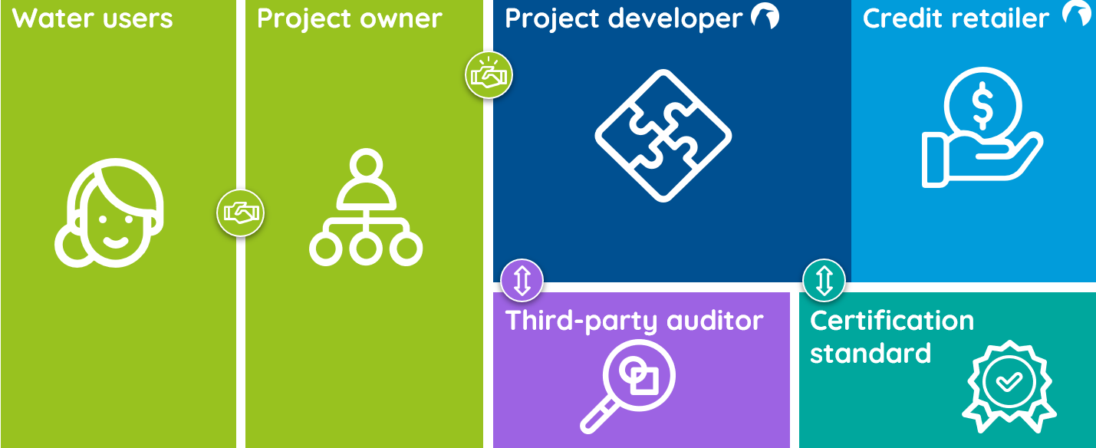
Financial model (I)
Typical contract types between project owner and project developer/credit retailer
Service contract to support registration of project and/or sales of carbon credits
Investment by project developer in project registration
Investment by project developer in project registration and project implementation
“Transaction costs” for a 5-year certification cycle are typically around EUR 100,000 plus a sales margin for carbon credit trading

Slide 20
Financial model (II)
Typical agreements between project owner and water users
Carbon waiver against reduced cost of HWT products
Carbon waiver against management/operation of water supply
Carbon waiver against direct financial payments for using water (not common)

Slide 21
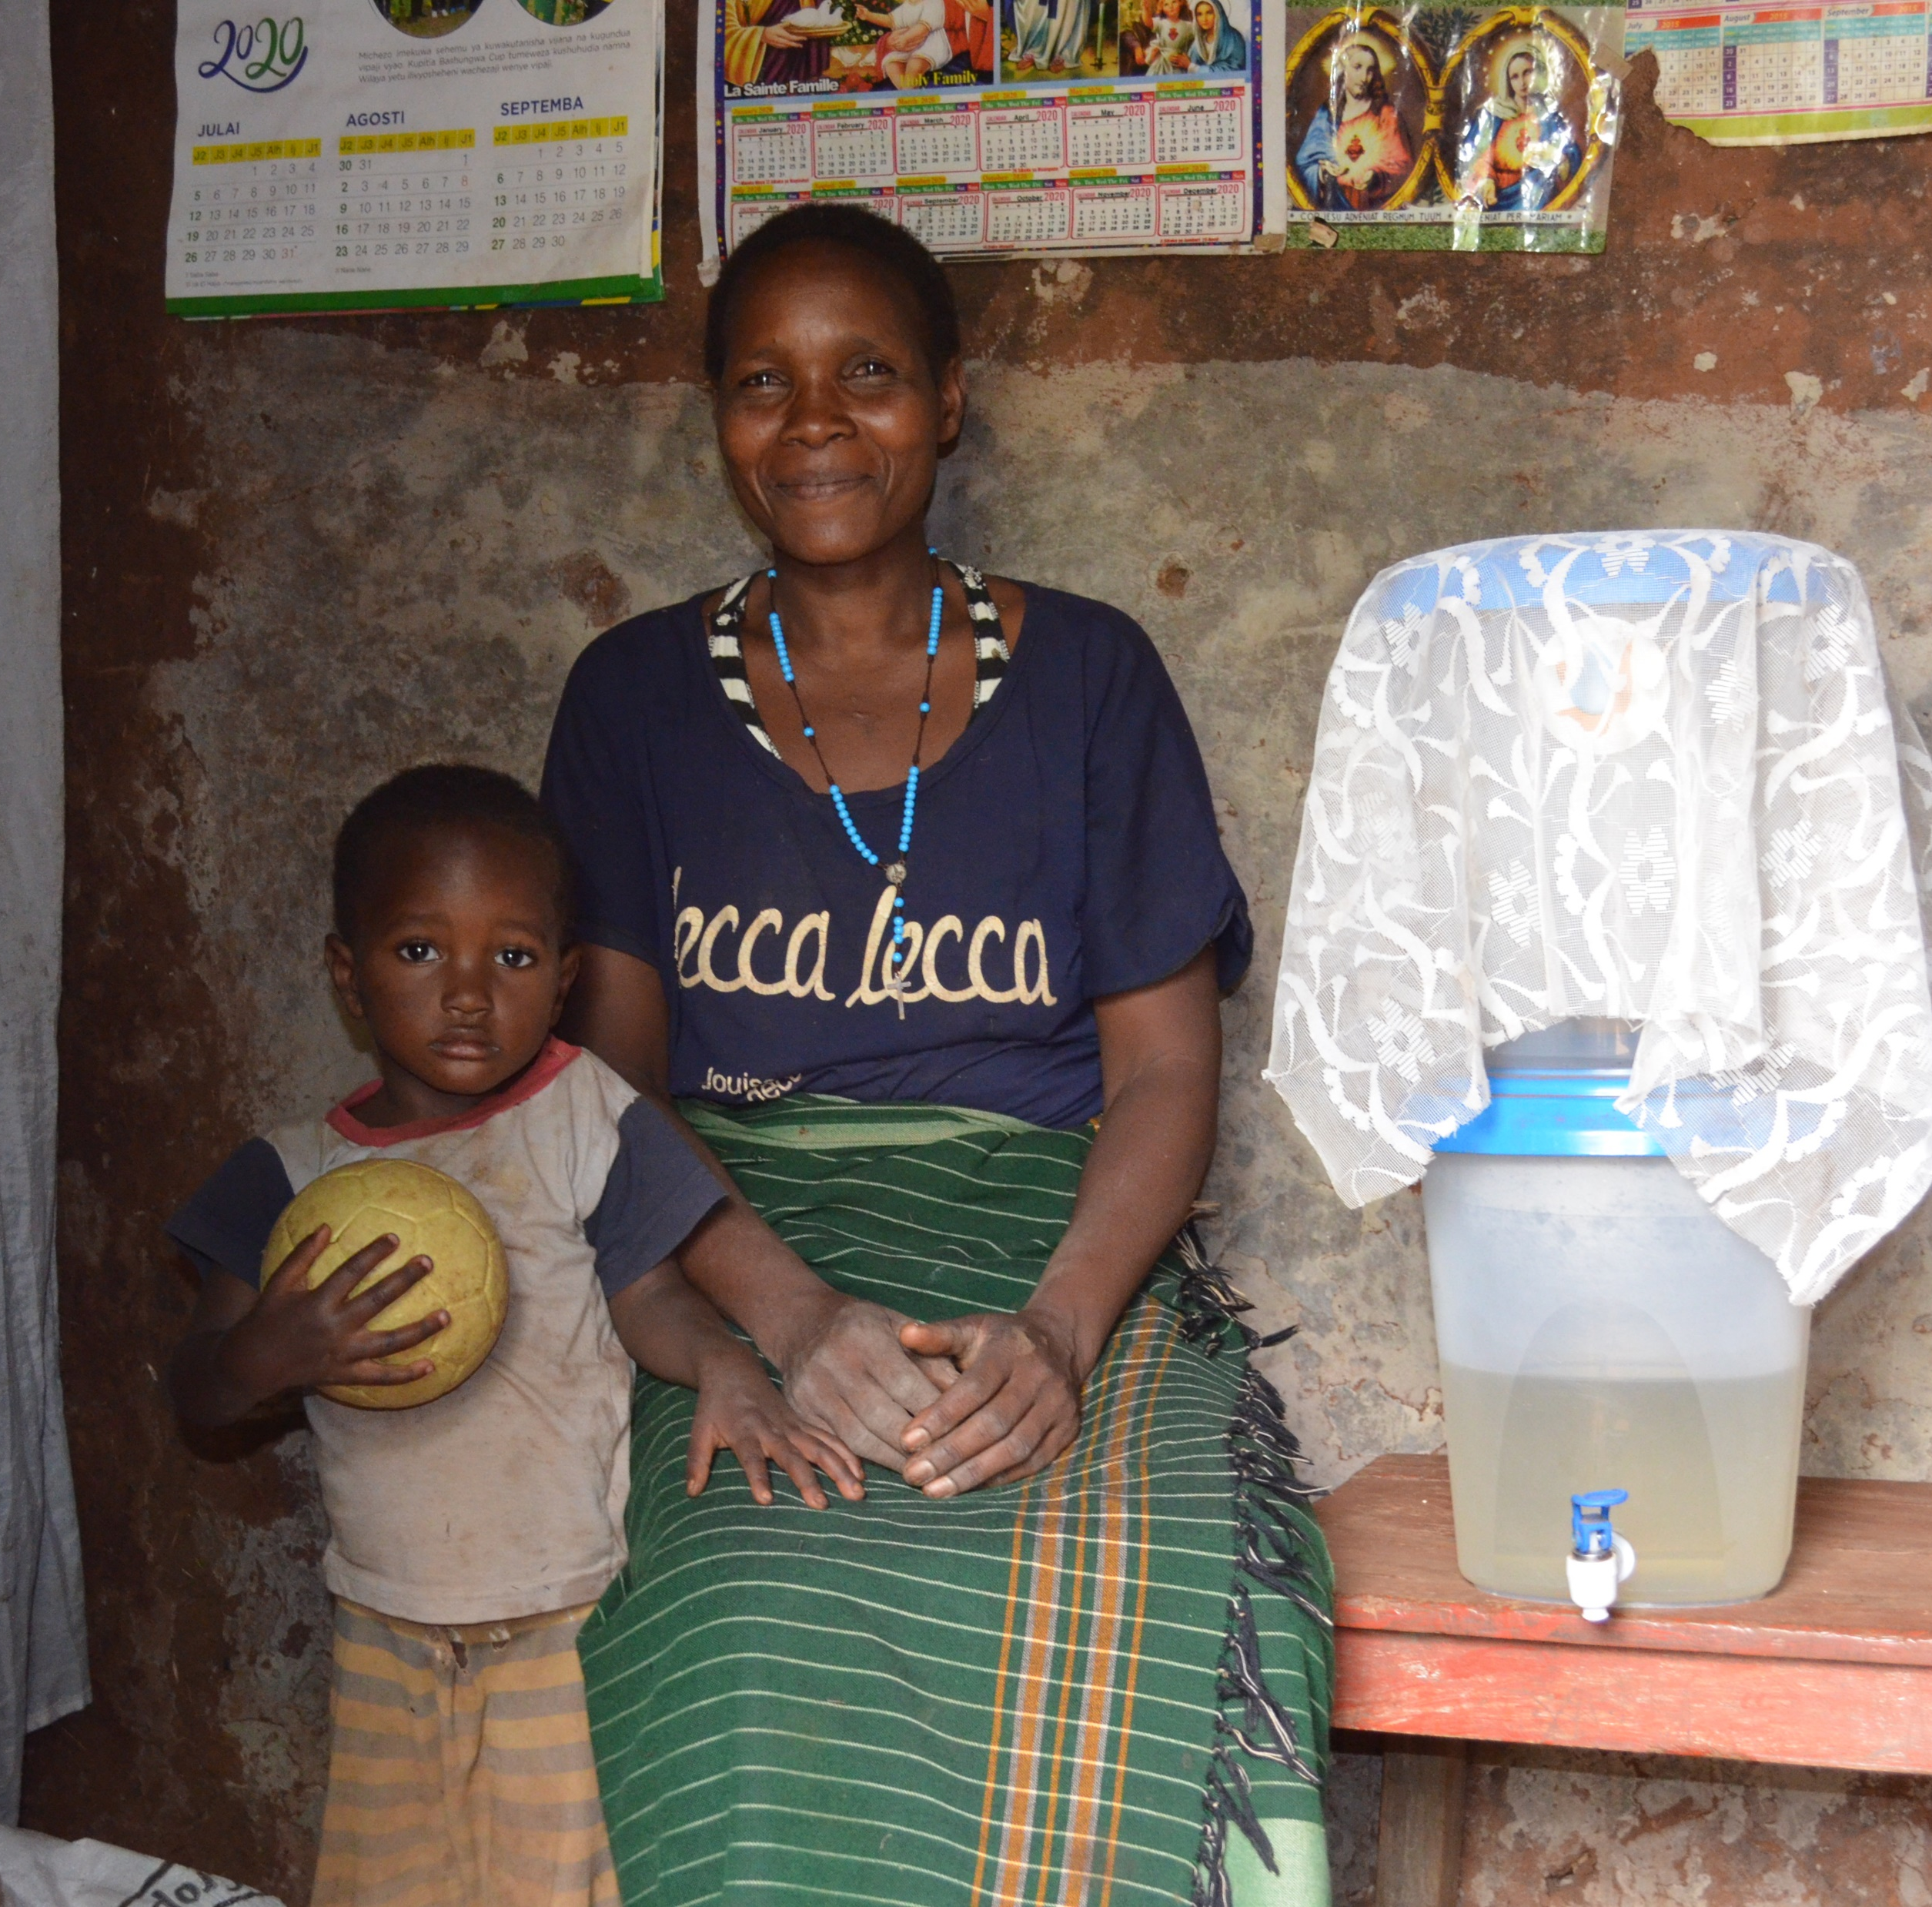
When should carbon credits
be considered?
Implementation of non-piped systems
providing safe water at end-user premises
Reaching at least 20,000 households
Where boiling (with solid fuels) is the
most common household water
treatment method
Robust monitoring system in place

Slide 22

Thank you
Aude Perrine
South Pole
a.perrine@southpole.com
www.southpole.com

Slide 23






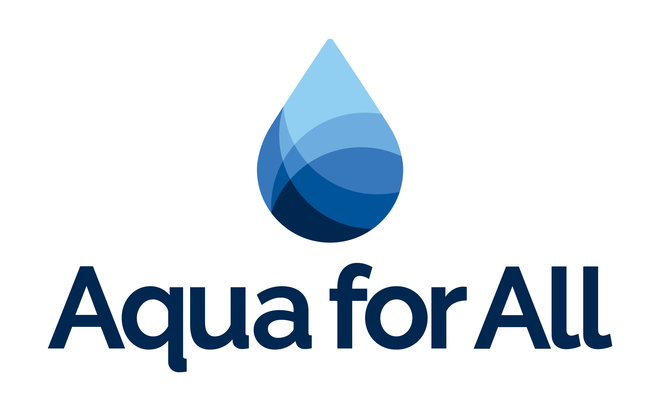









All Systems Connect 2023 is made possible thanks to the generous support of our partners including the World Health Organization and :

