Slide 1


Slide 2

Informal Trade
A South African Perspective

Slide 3
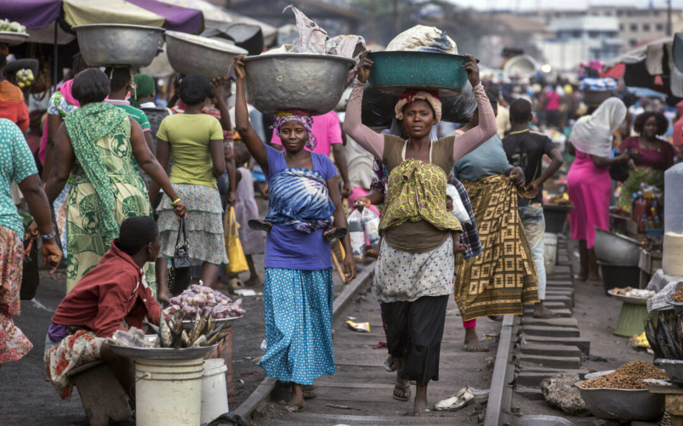
What do you see?

Slide 4
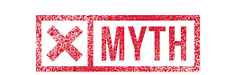

Misconceptions about the Informal Economy
1
The informal economy will shrink with economic growth
Informal employment is likely to remain the main source of employment in developing countries
2
The informal economy is comprised of plucky entrepreneurs who seek to avoid tax and regulation
The majority of informal workers are not employers and just aim to survive rather than evade regulation
3
Informal businesses provide unfair competition to formal ones as they don’t pay taxes, rent or utility fees
Many informal workers have to pay various fees, taxes and bribes in order to operate
4
The informal economy is not linked to the formal economy
There are many links between the informal and formal economies
5
The informal economy is comprised of traditional activities which are not part of the modern economy
Many informal workers are integral parts of modern chains of production and distribution
6
The informal economy does not contribute to the overall economy
Informal workers produce and distribute goods and services in many branches of the economy and make a large contribution
7
The informal economy is outside of the reach of the State and its laws
Informal workers are regularly subjected to punitive laws and regulations
Source: WIEGO

Slide 5
South Africa’s Developmental Challenges
South Africa Employment Landscape (Mn, 2022)
Comments
South Africa’s official unemployment rate is 32.7% (Q4 2022)
  This doesn’t take into account discouraged job seekers (~3.4 million people)
  Women and youth are disproportionally impacted
South Africa is one of the most unequal countries in the world
  It had the highest Gini coefficient globally in 2023
  Poverty level was an estimated 63% in 2022 (based on the upper middle income poverty line of the World Bank)
The informal economy is a significant contributor to the GDP and to employment in South Africa:
  The informal economy contributes 28.8% to the GDP of
  South Africa (as compared with 10% in the Netherlands and 64% in Zimbabwe)
  Almost a third of people with jobs in South Africa work in the informal sector
  Of the people working in the informal sector,
  ~1.1 million work as informal traders
* Informal employment category includes precarious workers such as those in private households as well as those employed in the agriculture sector as they typically work
under informal conditions
Source: Statistics SA, Quarterly Informal Economy Survey by World Economics

Slide 6
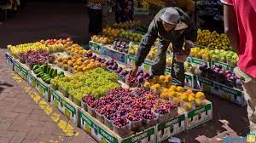
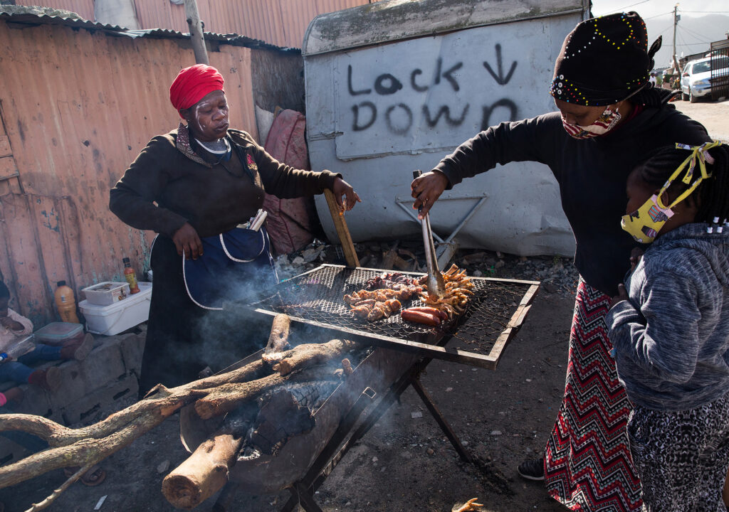
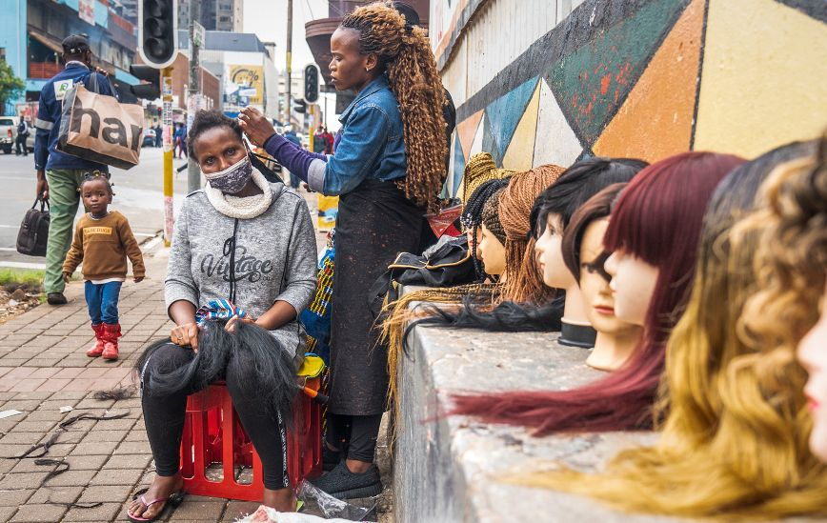
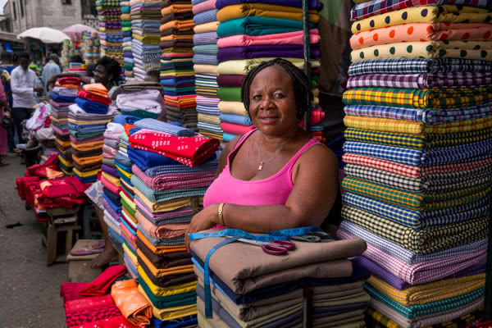
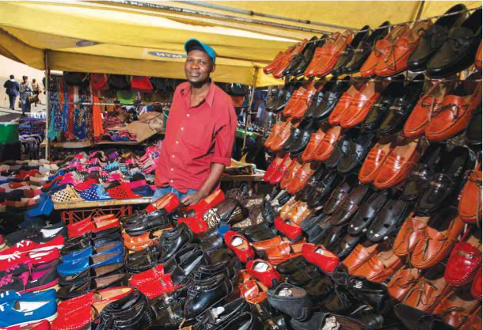
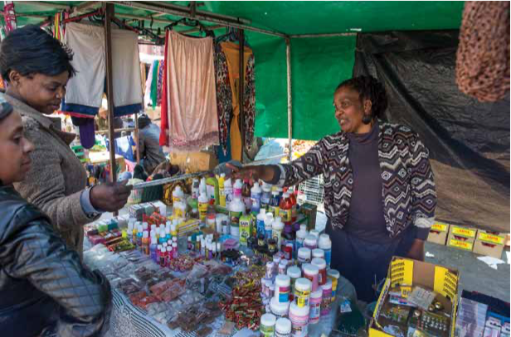
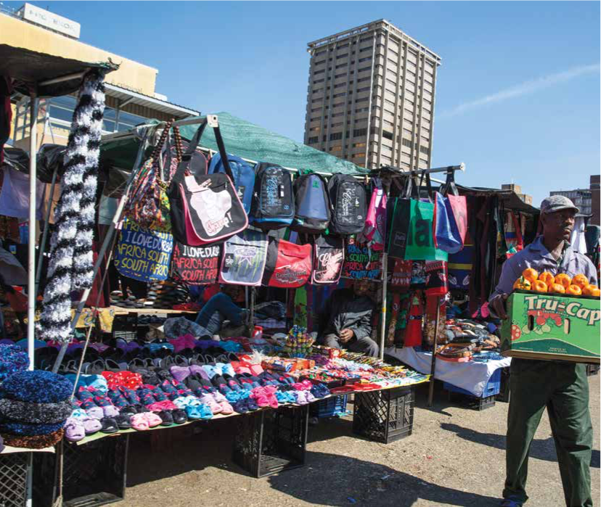
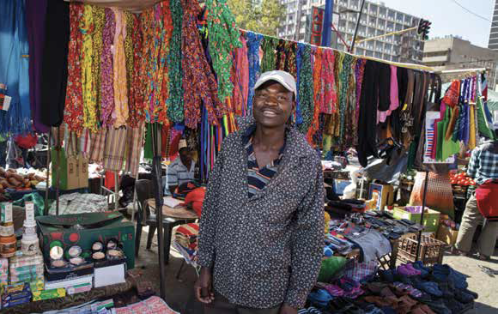
Informal Trade in South Africa
Fruit and vegetable vendors
Cooked food vendor
Hair dresser
Clothing vendor
Shoe salesman
Cosmetics vendor
Bag sales at the market
Small wares trader

Slide 7
Regulation of Informal Trade in South Africa
Hierarchy of Laws
Laws and Policies Relating to Informal Trade
The Constitution of South Africa
  The Constitution is the supreme law in South Africa and all other laws get their power from it
  It contains a number of fundamental rights for informal trade including the rights to human dignity, equality, to choose one’s trade and just administrative action
The Businesses Act (72 of 1991)
  This gives effect to the rights in the Constitution
  It creates a shifts in how informal trade is governed – from a repressive framework to one which recognizes informal trade as a critical sector
Municipal By-laws
  The Businesses Act gives municipal councils the power to adopt by-laws to enable and regulate informal trade
Constitution
Business act & policies
Municipal by-laws & policies
Actions of municipal councils & local government officials
Despite these protections informal traders often remain vulnerable
Source: Hodgson and Clark, Socio-Economic Rights Institute in collaboration with SALGA

Slide 8
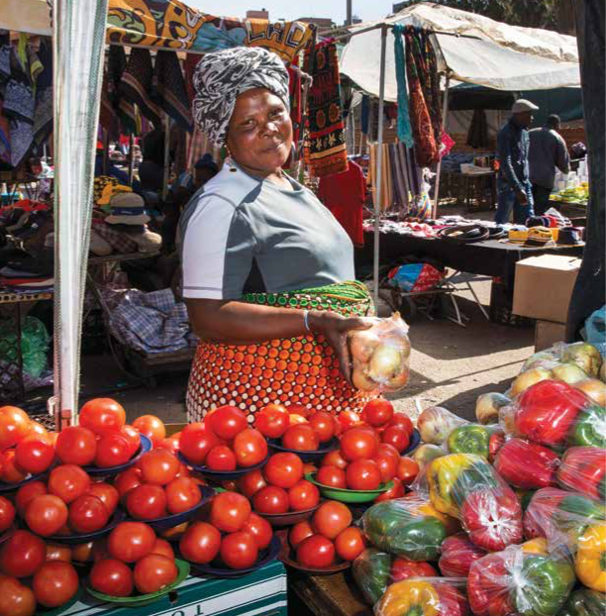
Challenges of Informal Trade (1 of 2)
Typical Challenges Experienced by Informal Traders
Challenges relating to all informal traders are mainly related to a lack of decent working conditions. These include:
  a fair income
  secure employment
  safe working conditions
  social protections
  freedom to organise
Challenges particular to women traders include:
  lack of affordable child-care – women often have to manage child-care responsibilities while trading
  no maternity protection
  vulnerability to violence while operating in the inner city – this affects working hours and therefore results in a decrease in income
  household responsibilities limit women’s participation in
  trader committees
Source: Hodgson and Clark, Socio-Economic Rights Institute in collaboration with SALGA

Slide 9
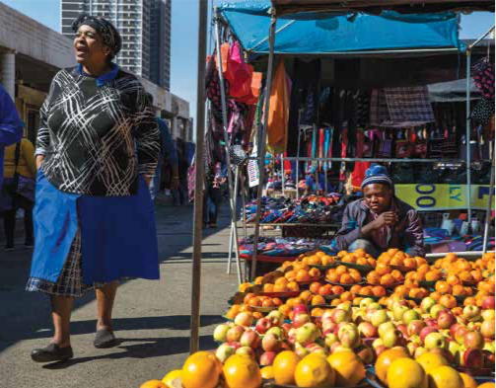
Challenges of Informal Trade (2 of 2)
Typical Challenges Experienced by Informal Traders
Challenges relating to the restrictive regulatory environment in South Africa:
  Municipal by-laws are focused more on “don’ts” than ”do’s”
  Unfair treatment of informal traders by the law enforcement officials on a regular basis. Examples of this include:
    Unlawful confiscations and impoundment of goods
    Requests for bribes
    General harassment
  Unlawful evictions and relocations
“Operation Clean Sweep” is an example of a forced recent eviction and relocation in Johannesburg
Source: Hodgson and Clark, Socio-Economic Rights Institute in collaboration with SALGA

Slide 10
“Operation Clean Sweep” Example

Slide 11
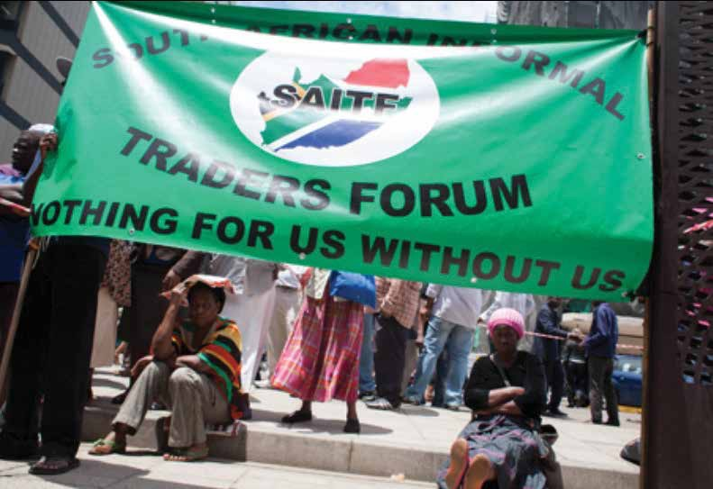
Strategies Employed by Informal Workers
Tactics Used by Informal Workers in Response to Challenges
Informal traders use various strategies to deal with the challenges which they face on a daily basis. These include:
  Formation of informal traders’ organisations such as South African Informal Traders Forum, Johannesburg Informal Traders Platform and South African National Retail Traders Association (SANTRA)
Litigation – examples include:
  South African Informal Traders Forum and others v City of Johannesburg and others
  Somali Association of South Africa v Limpopo Department of Economic Development, Environment and Tourism
  Makwickana v Ethekwini Municipality
Research and advocacy:
  Engagement with Government
  Development of material for rights education and
  conducting workshops

Slide 12
Recommendations for Informal Trade Regulation
1
Municipal by-laws governing informal trade and actions of local government officials should be in line with the Constitution and based on a better understanding of the nature, structure and composition of the informal trading sector
2
These by-laws and policies should create an enabling environment for informal trade and should distinguish between the severity of contraventions of by-laws and provide for a variety of measures to encourage informal traders to comply
3
Any relocation or eviction of informal traders from their trading spaces must comply with the legal provisions governing informal trade (in particular section 6A(2) of the Businesses Act)
4
Municipalities should ensure that informal trade areas have the necessary infrastructure and level of access to basic services, including water, sanitation, refuse removal and cleaning services
5
Municipal by-laws and policies governing informal trade should create genuinely participatory and inclusive spaces through which informal traders can participate in decision-making processes
6
Municipal by-laws governing informal trade should ensure that the conduct of the local government officials complies with the standards of administrative law
7
Municipal by-laws governing informal trade should include mechanisms to hold local government officials responsible for the implementation of the by-laws and accountable for any unlawful actions
Source: Hodgson and Clark, Socio-Economic Rights Institute in collaboration with SALGA

Slide 13



Conclusion
The informal economy is here to stay and will have a positive impact
“The pivotal role of the urban informal sector is expected to continue in the foreseeable future in light of Africa’s growing population”
In South Africa, the informal sector will create between 1.2 and 2 million new jobs by 2030
Governments need to actively support informal workers
Government should adhere to international labour standards – in particular the realisation of rights at work and social protections
Government should remove constraints to create an enabling environment for informal work
As we strengthen our systems we should include informal workers
We need to look at how to incorporate the “informal” and the “excluded” into our conversations as well as into the decision-making processes relating to the strengthening of the various societal systems
Source: Hodgson and Clark, Socio-Economic Rights Institute in collaboration with SALGA

Slide 14
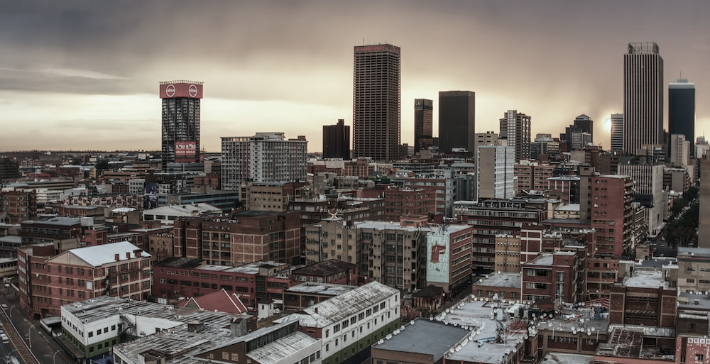
Thank you!

Slide 15
















All Systems Connect 2023 is made possible thanks to the generous support of our partners including the World Health Organization and :

