Slide 1
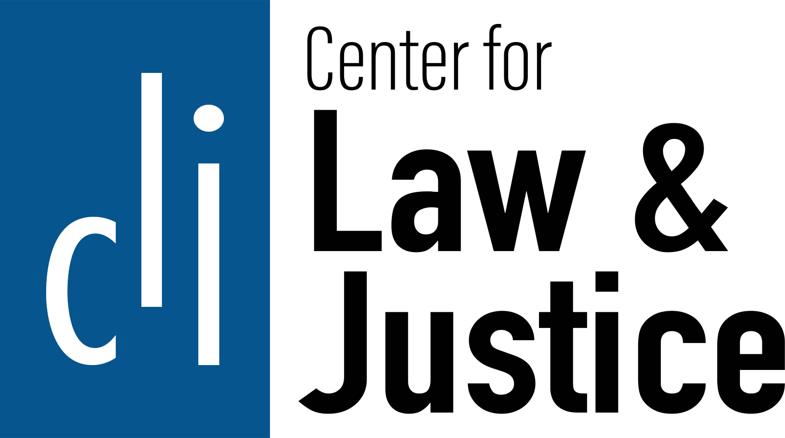

From Sinful to Safe Sanitation:
A Case of Pakistan’s Sanitation Workers

Slide 2
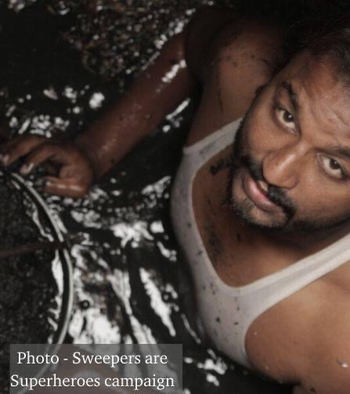
Being a Christian in Pakistan may be breathtaking in quite a different sense: it may mean cleaning up other people's urine and bowel movements for the rest of one's life ...
God's Foreign Policy: Practical Ways to Help the World's Poor (1984) By American anthropologist and missionary Professor Miriam Adeney

Slide 3

The country context
Pakistan is in South Asia.
It is the fifth most populous country with 243 Million.
It is the second-largest Muslim population in the world.
The country is composed of five provinces with entirely different languages, cultures and topography.
Islam is the state religion.
About 96.47% population is Muslim.
Hindu (1.74%), Christian (1.27%), Scheduled Caste (0.4%), Ahmadiyya (0.1%), Others (0.2)

Slide 4
Sanitation work in Pakistan
Sanitation labor is institutionalized as well as done by individuals
Districts have municipalities to collect waste and provide sanitation.
The number of workers in a municipality depends on the size and topography of the district.

Slide 5
Persistent patterns of discrimination and neglect in sanitation work
The Overlapping of Christian Faith, Caste, and Sanitation Occupation in Colloquial Language
A Continuation of the Indian Caste System: entrenched discrimination, enduring despite conversions.
Discrimination based on Work and Descent: derogatory terms, Christian overrepresentation, caste patterns, and overlooked policies descent.
An Occupation for the Ritually Impure and Untouchables: severe exclusion, denied opportunities, ritually impure, and untouchable.
An Occupation of Religious Discrimination: Christian-majority workforce, deaths as "minority issue,” religious hierarchy, caste influence, and biased state policies.
Christian
Chuhra
Sanitation worker

Slide 6
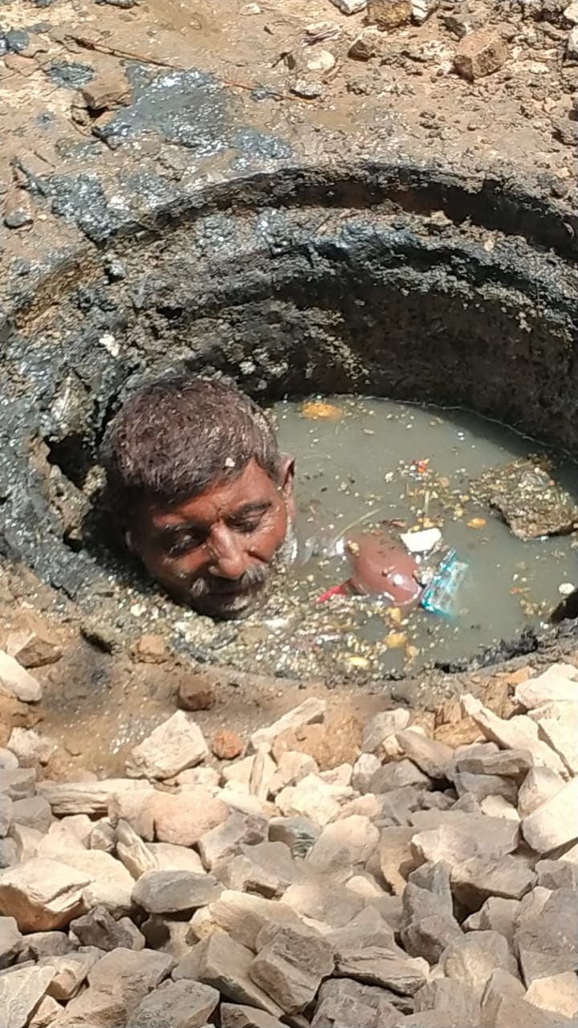
Persistent patterns of discrimination and neglect in sanitation work
An Unhygienic and Unsafe Labour: frequent exposure to hazardous substances without proper protective equipment, resulting in widespread health issues and injuries.
A Life-Threatening and Dangerous Work: numerous fatalities due to lack of safety equipment, protocols, reporting, and training.
Live of a sanitation worker is cheap: lives considered less valuable, with legal action rarely taken against those responsible for their safety; inadequate emergency response in some incidents.
A Precarious Labour: insufficient income and job stability, limited access to essential services for families.

Slide 7
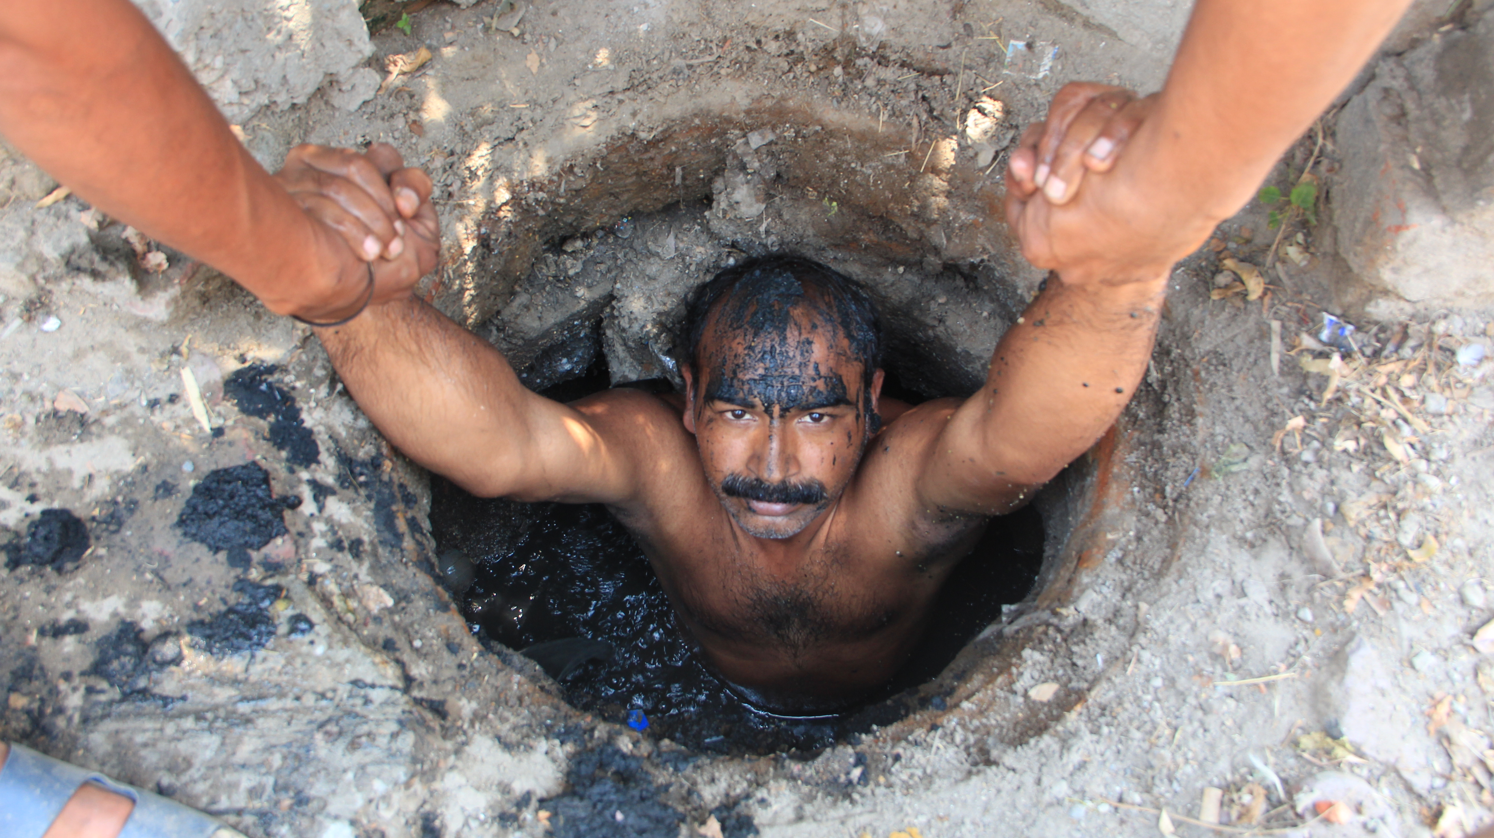
Persistent patterns of discrimination and neglect in sanitation work
Sanitation is hierarchical: supervisors exploit authority over low-status workers; religious discrimination evident in workplace assignments.
A Forced Labour: workers are coerced into dangerous situations and lack alternative employment options, making them vulnerable to exploitation.
Kinship-based rescuing: workers risk their lives to save colleagues due to shared caste-based kinship relations, while supervisors and emergency services may fail to provide adequate assistance.
Society
State
Task masters
Enslavement of Sanitation Workers

Slide 8
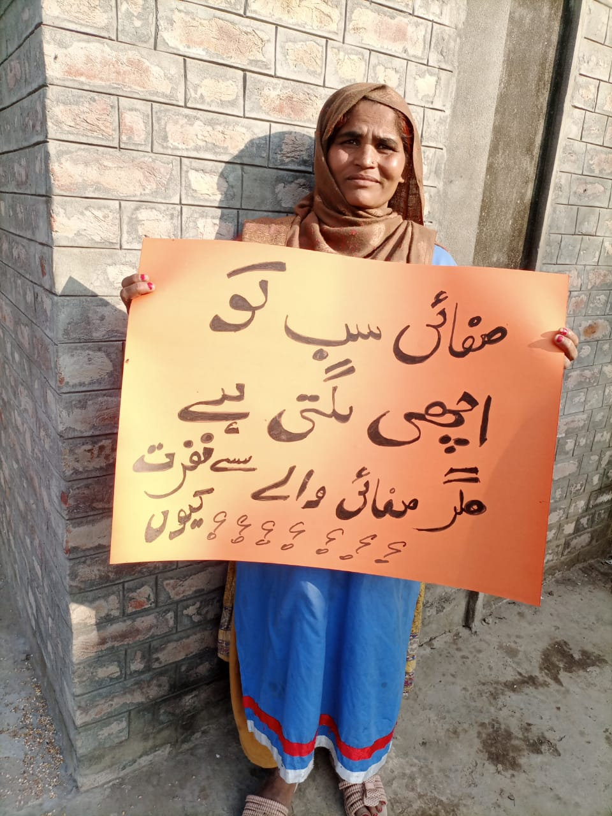
Manifesto for making sanitation a decent work: Addressing Discrimination and Social Stigma
Launch
Launch public awareness campaigns
Highlight the importance of sanitation work in maintaining public health
Challenge stereotypes and misconceptions about sanitation workers
Foster
Foster inclusive environments and equal treatment
Encourage social integration through community events and gatherings
Implement policies that promote respect and dignity in the workplace
Implement and enforce
Implement and enforce anti-discrimination policies
Adopt clear guidelines to prevent discrimination based on caste, religion, or ethnicity
Establish reporting mechanisms for incidents of discrimination
Everyone wants #cleanliness, but why do they #hate #cleaners?

Slide 9
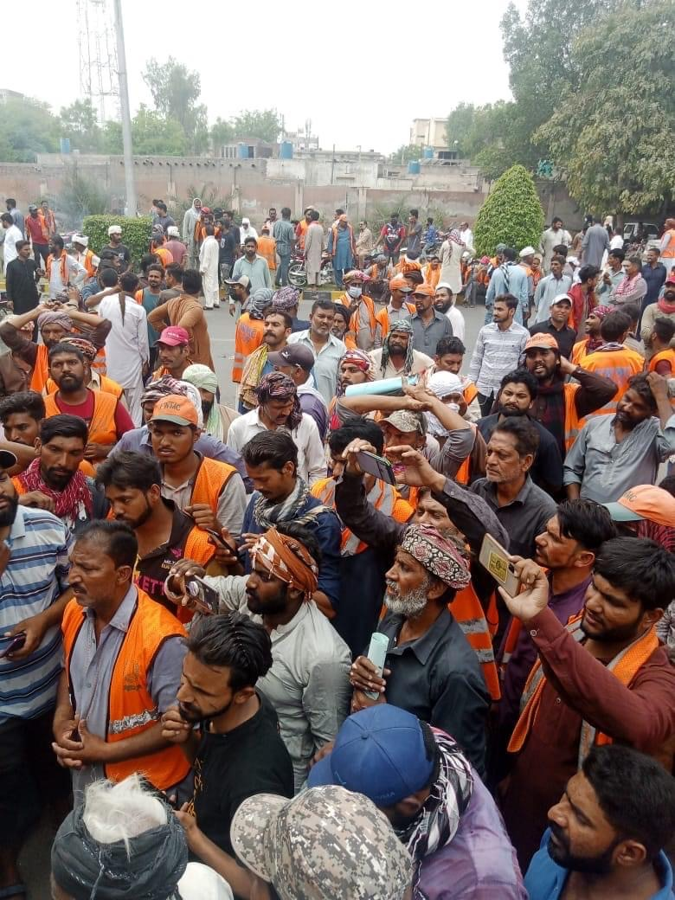
Manifesto for making sanitation a decent work: Fostering Economic Stability and Security
Offer
Offer fair wages and benefits
Ensure salaries are commensurate with the importance and risk of the job
Provide healthcare, retirement, and other essential benefits
Encourage
Encourage job stability and security
Transition from daily wage or temporary contracts to permanent employment
Implement clear and transparent promotion pathways
Support
Support access to essential services
Offer educational and vocational training opportunities
Provide assistance with housing, transportation, and childcare

Slide 10
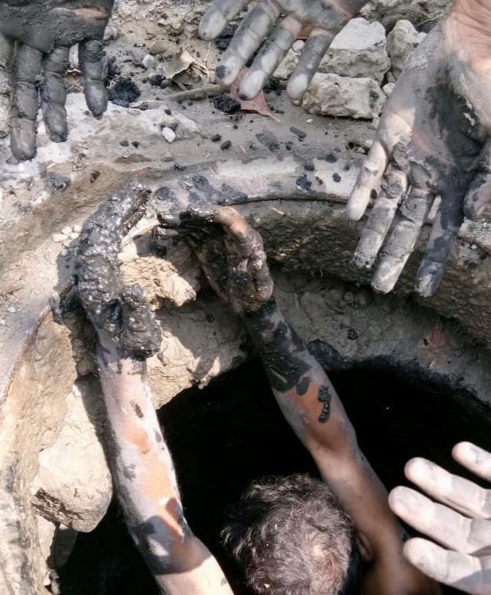
Manifesto for making sanitation a decent work: Enhancing Safety and Working Conditions
Provide
Provide appropriate personal protective equipment (PPE)
Supply masks, gloves, goggles, and other necessary gear
Regularly update and maintain PPE for optimal safety
Implement
Implement comprehensive safety training programs
Teach workers about workplace hazards and prevention measures
Provide first aid and emergency response training
Establish
Establish safe and hygienic facilities for workers
Create clean and accessible restrooms, changing areas, and break rooms
Provide access to handwashing stations and sanitation supplies

Slide 11
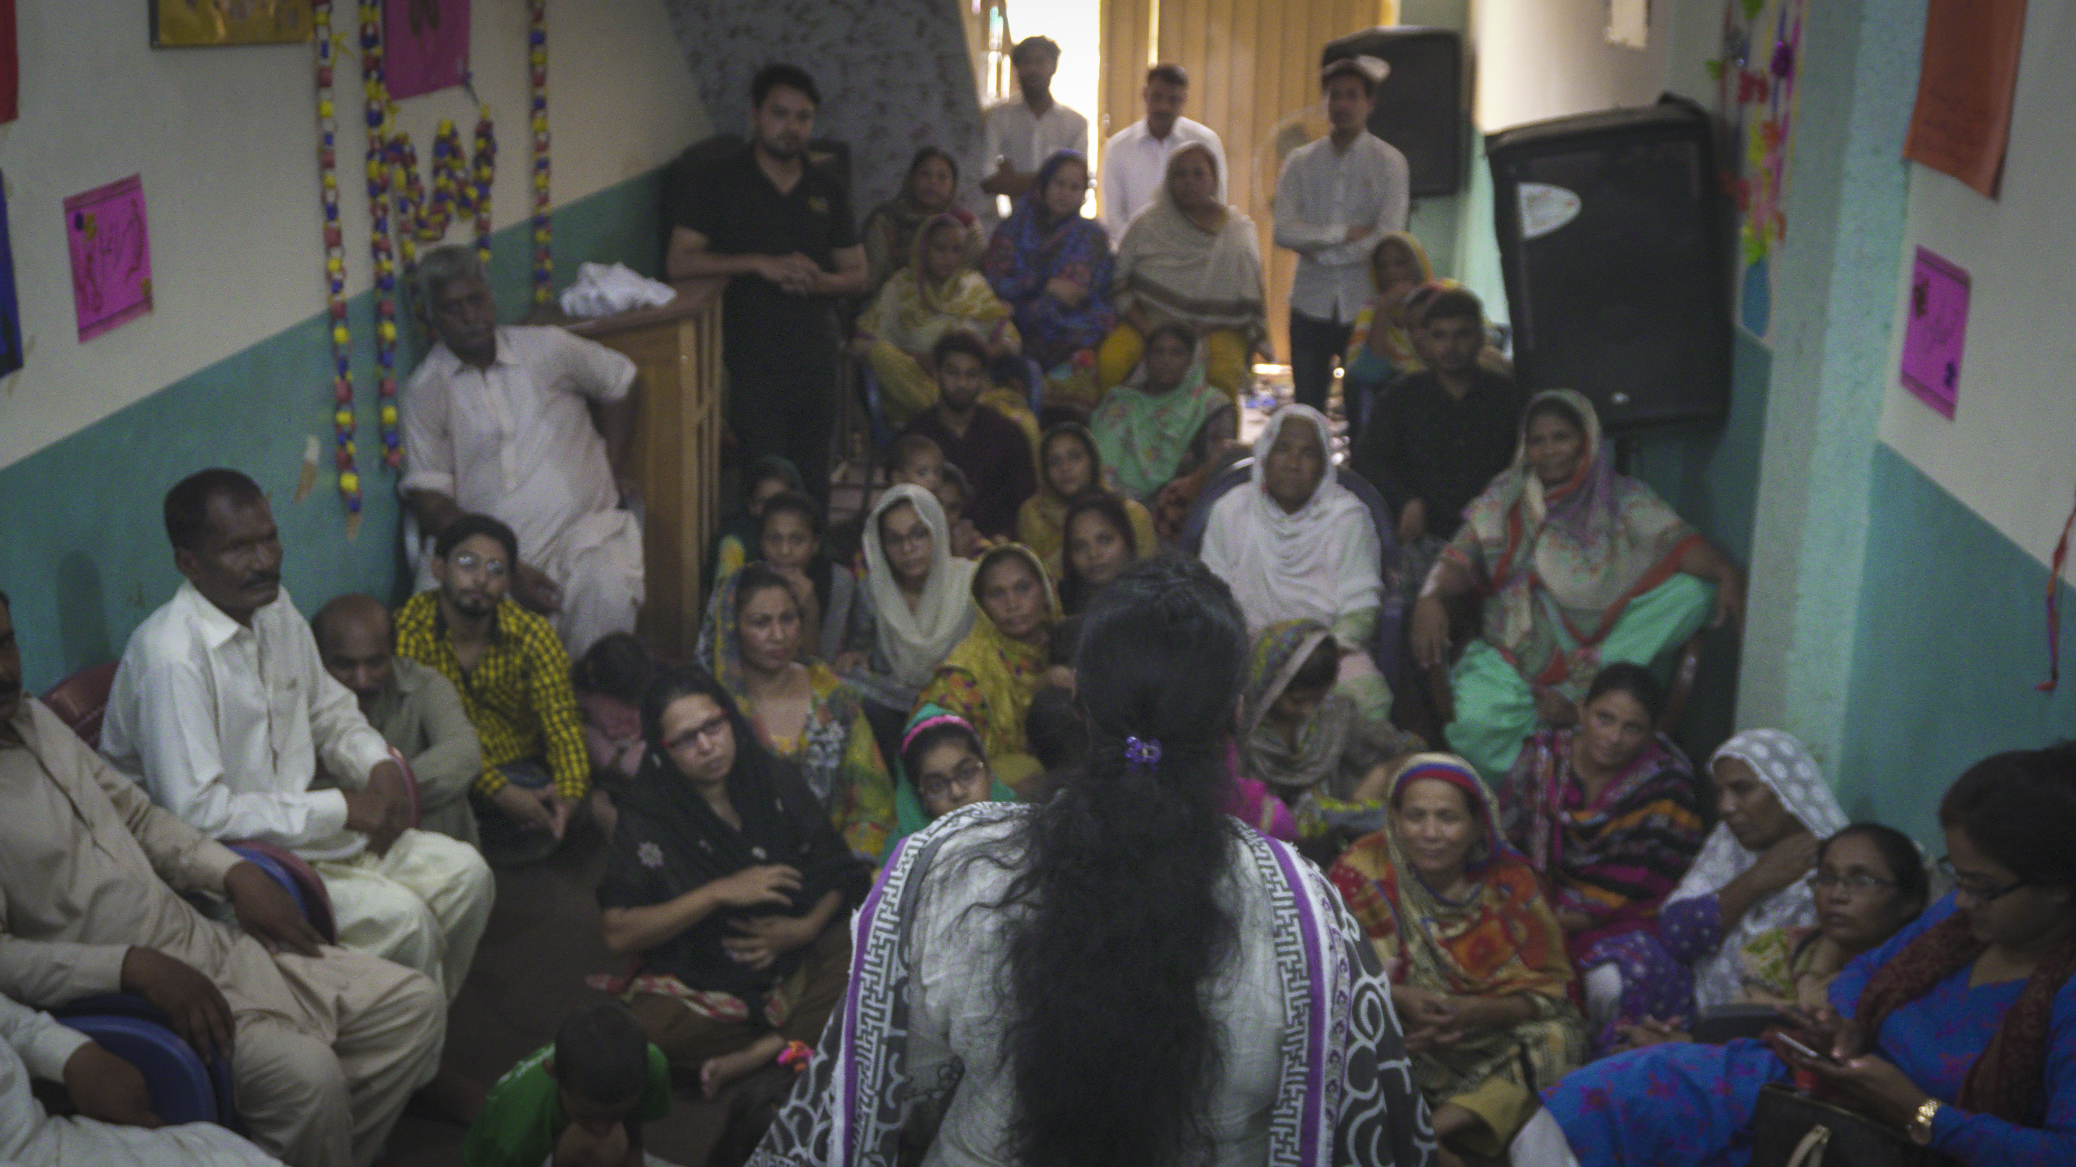
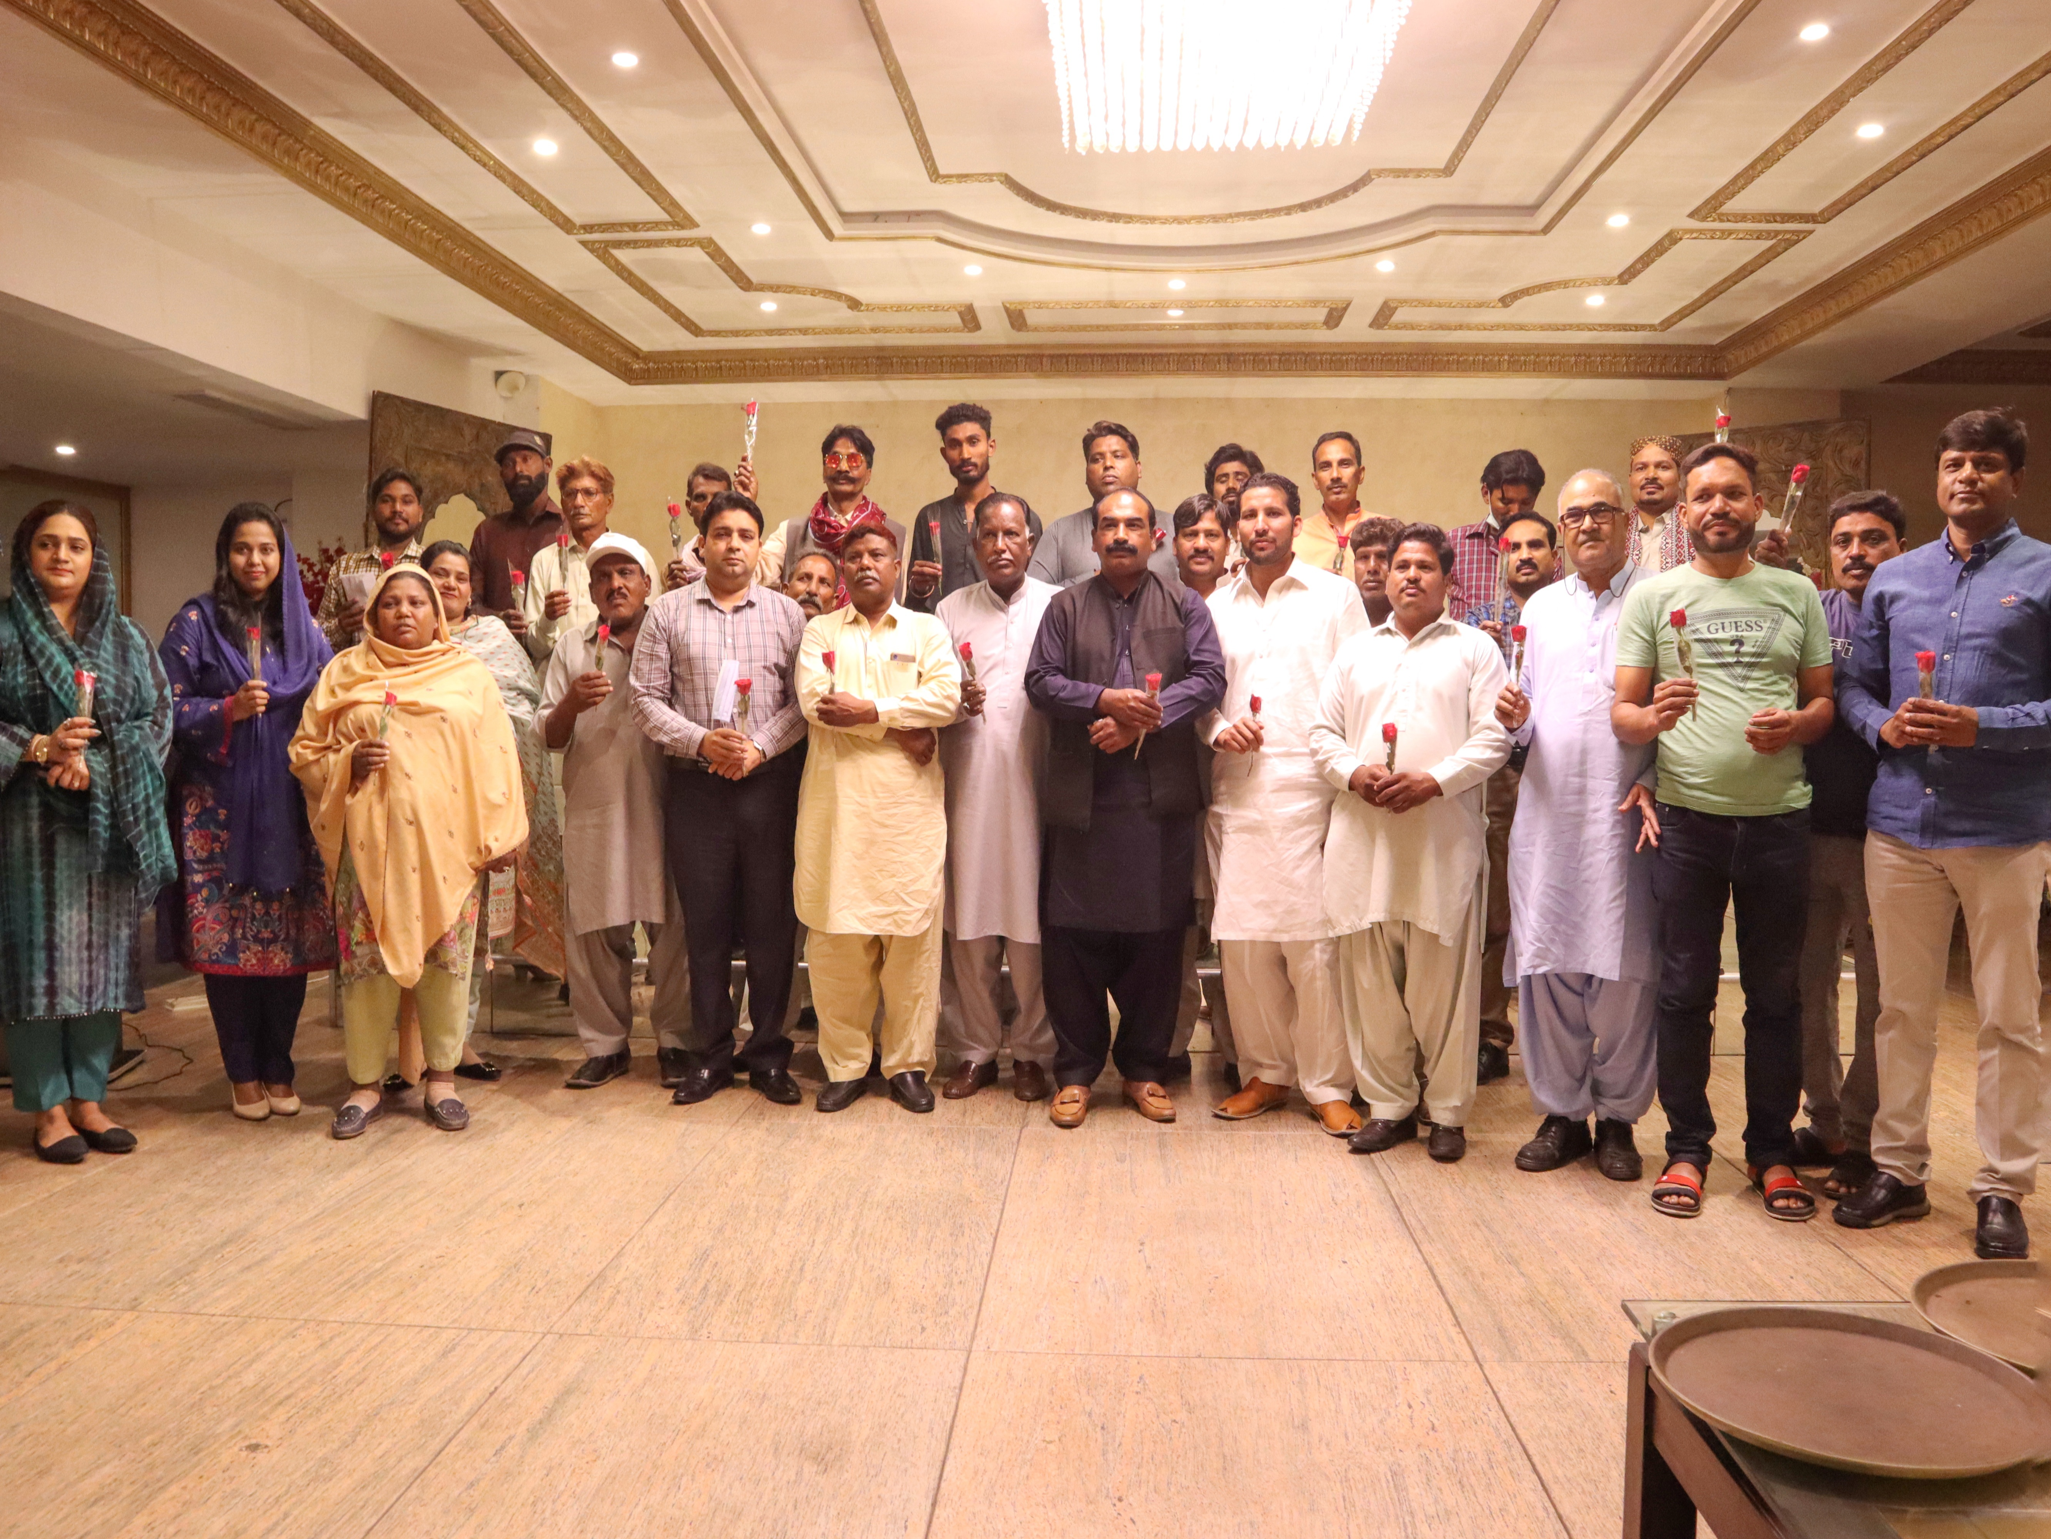
Manifesto for making sanitation a decent work: Enhancing Empowerment & Representation
A. Worker unions & associations:
Support worker-led organizations for rights advocacy
Ensure representation in decision-making processes
B. Open communication & dialogue:
Provide platforms for voicing concerns and suggestions
Foster trust and transparency between management and workers
C. Leadership development & capacity building:
Offer training and mentorship for sanitation workers
Encourage worker participation in leadership roles

Slide 12
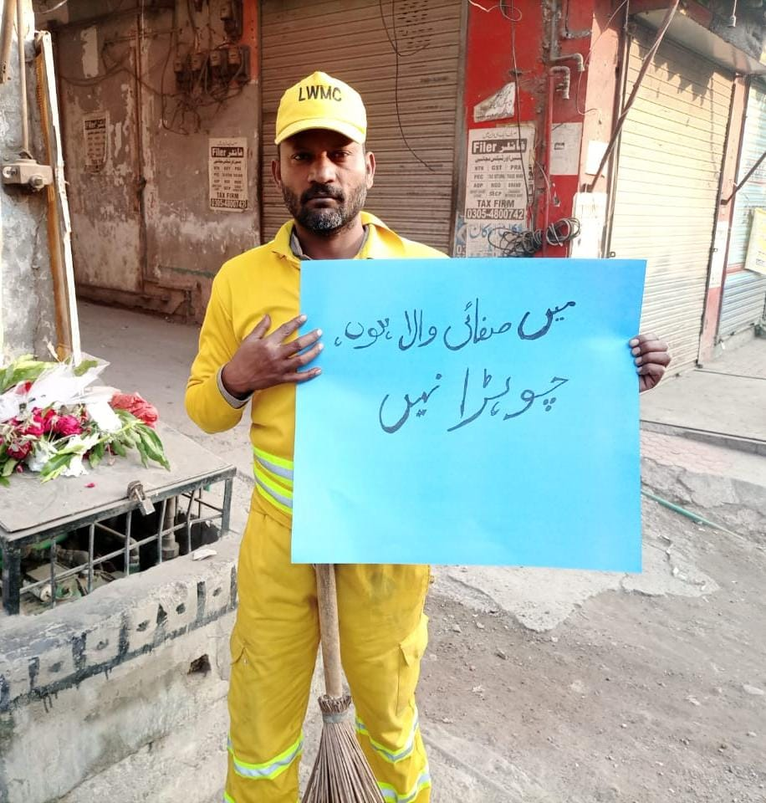
Conclusion
I am a #sanitationworker,
not a #Chuhra
Foster
Foster a society that values and respects the essential role of sanitation workers for public health and cleanliness
Address
Address discrimination and social stigma through awareness campaigns and inclusive policies
Prioritize
Prioritize safety and improved working conditions for sanitation workers
Ensure
Ensure economic stability through fair wages, benefits, and job security
Empower
Empower workers through representation, open communication, and leadership development

Slide 13
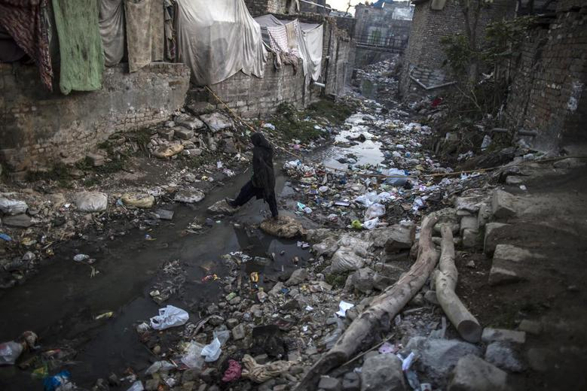
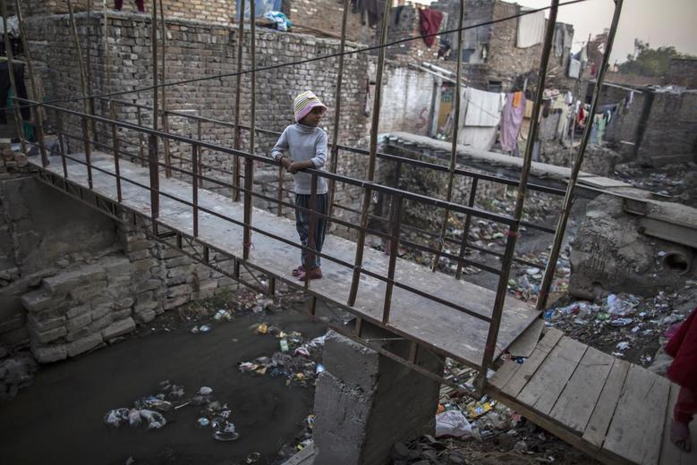
The Segregated Underdeveloped Ghettoes of Sanitation Workers in Pakistan:
France Colony: A Christian Sanitation Workers’ Ghetto Adjacent to a Posh Area of Pakistan’s Capital, Islamabad
A woman crosses an open sewer as she makes her way to her house
A girl looks back as she stands above an open sewer outside her house

Slide 14

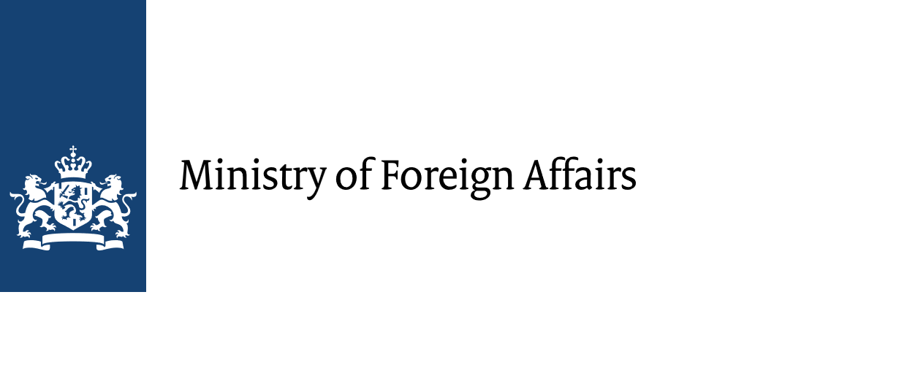














All Systems Connect 2023 is made possible thanks to the generous support of our partners including the World Health Organization and :

