Slide 1
What does it takes to achieve universal, sustainable WASH coverage
Catarina Fonseca
Nairobi, 5th November 2014

Slide 2
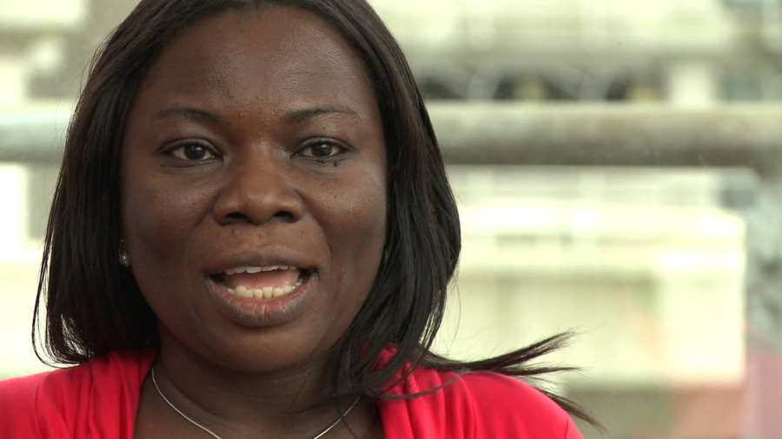
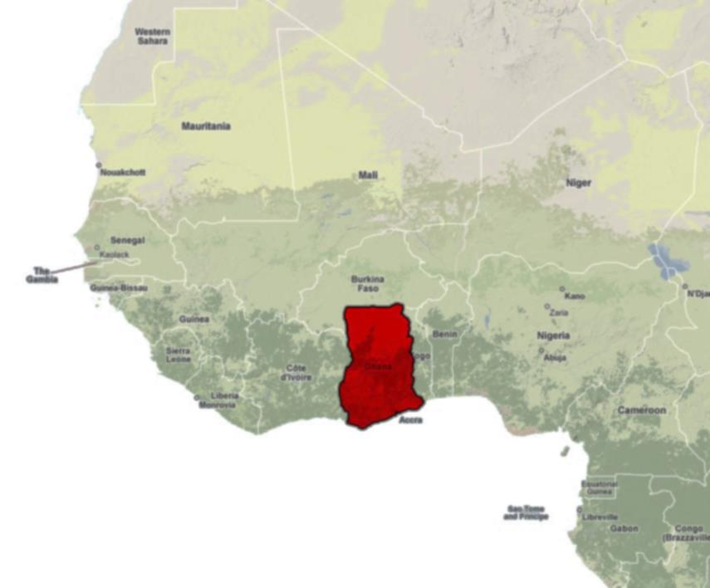
The story of Vida in Ghana

Slide 3
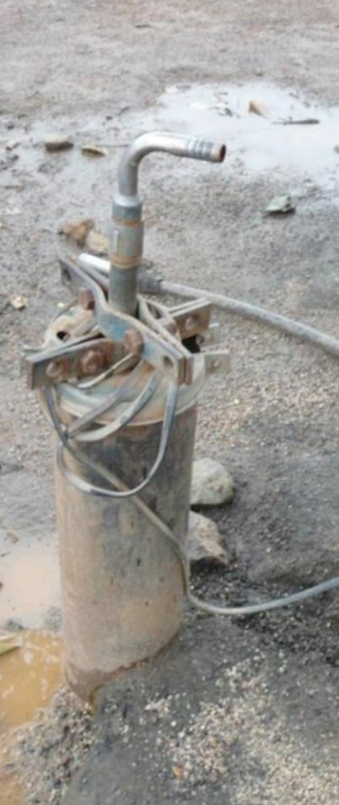
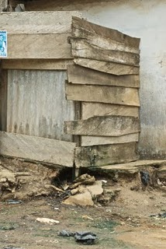
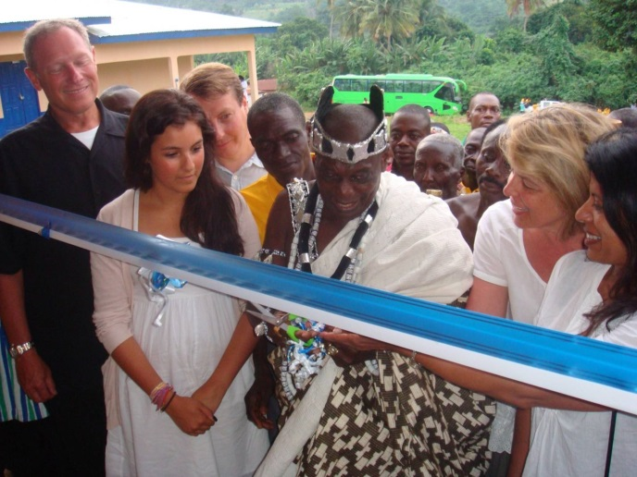

Expectations and reality of our WASH investments: slippage in Ghana 29%

Slide 4
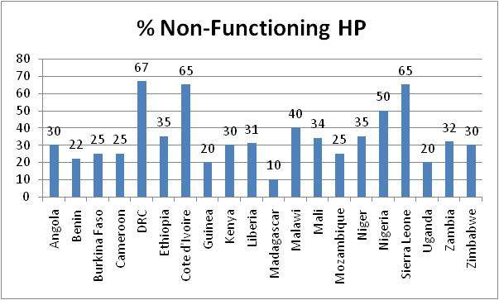
Sub-Saharam Africa: cost of failing handpumps
Investment loss in sub-Saharan Africa between
US$ 1.2 to 1.3 billion over 20 years
~36%
Information Collated by Peter Harvey, UNICEF Zambia, May 2007

Slide 5
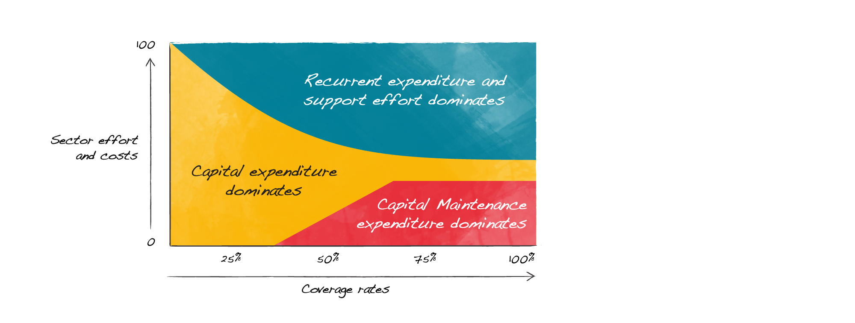
Sectors evolve…
Effort, costs and institutional requirements also change
Source: Moriarty, 2011

Slide 6
Sectors evolve…
Effort, costs and institutional requirements also change
Source: Moriarty, 2011

Slide 7
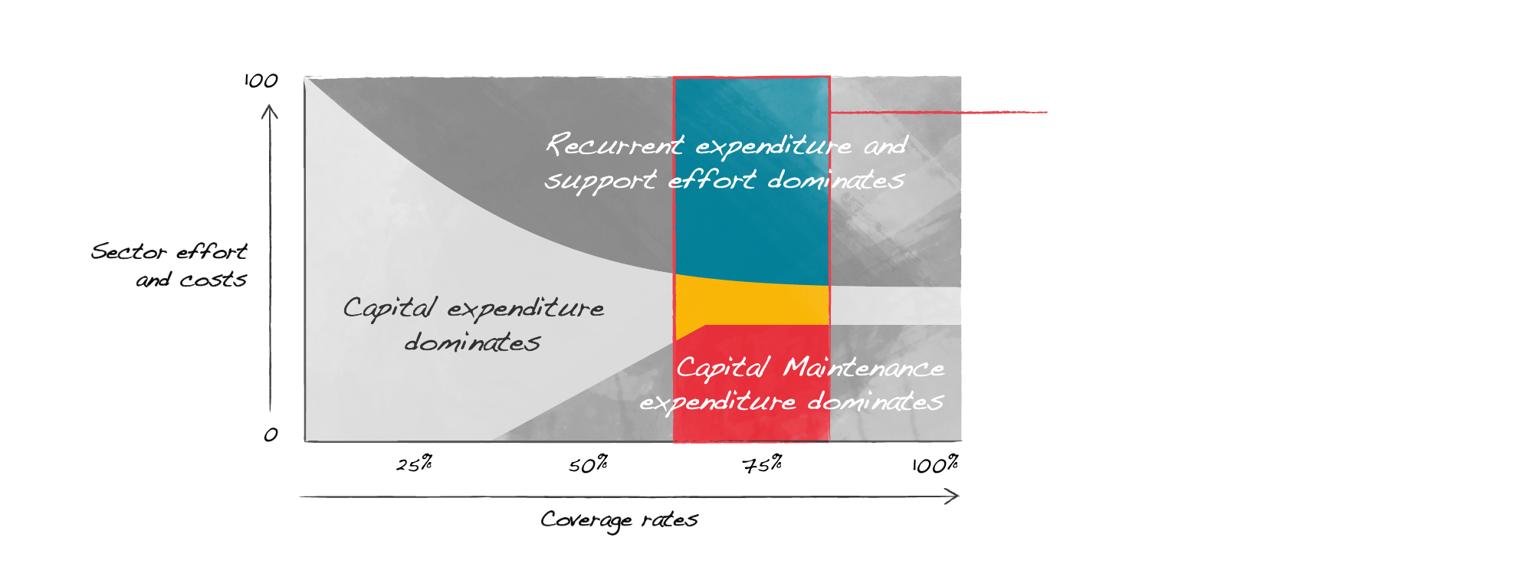
Danger zone of stagnation at 60%-80% coverage
Danger zone
Source: Moriarty, 2011

Slide 8
40 years trying to solve “the problem”: not leading to change required to achieve universal coverage
Increase payment for O&M
1970
1990
Increase coverage and ownership
Community management
Spare parts provision
Capacity building
2000
2010
Role of local government
Post construction support
Scale

Slide 9
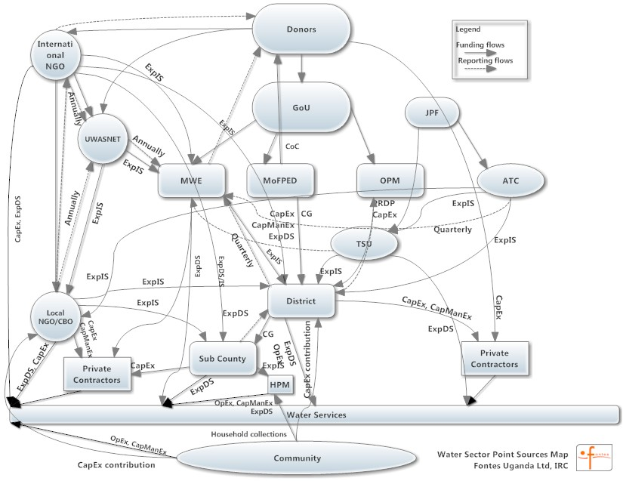
Help to get an idea of real expenditure in the sector
Mapping funding flows in the WASH

Slide 10
The WASH sector is a
complex adaptive system.
Fixing it requires systemic change, multiple stakeholders, relationships and entry points – and a whole system vision

Slide 11
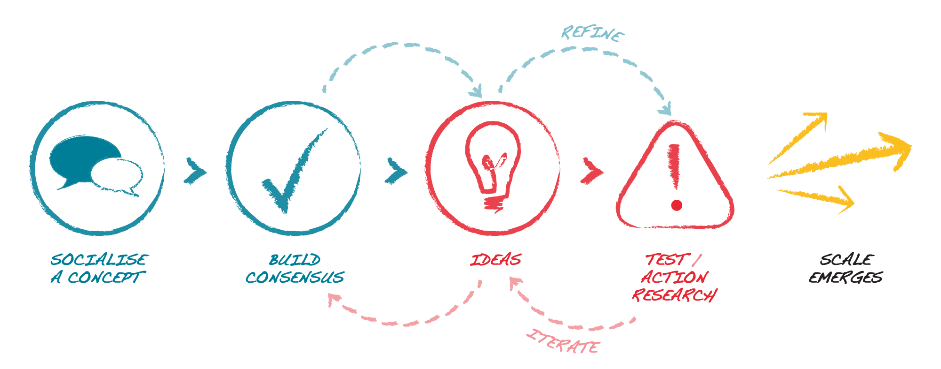
The change process: what does it take?

Slide 12




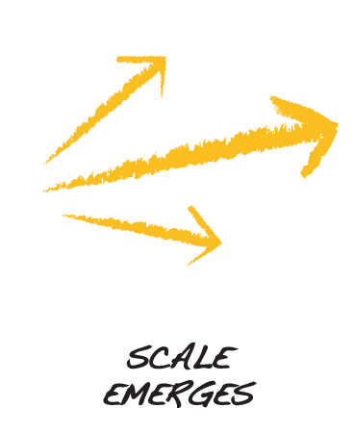
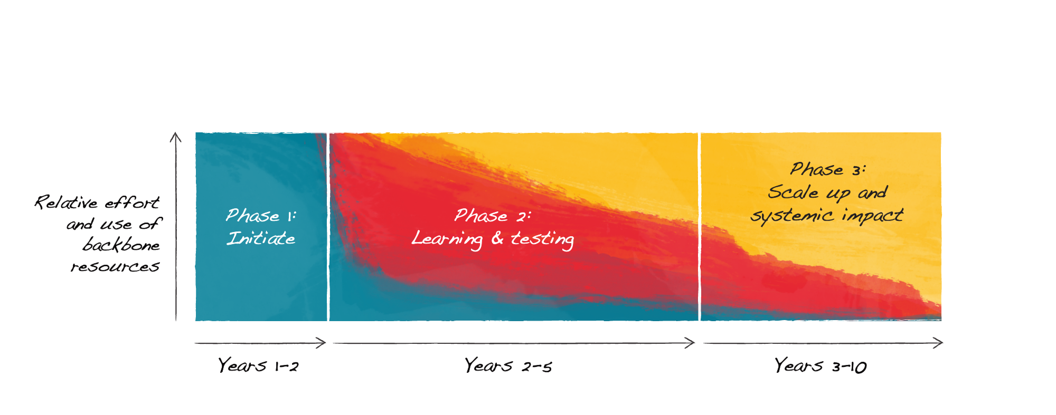
Sequencing the change process: how long?

Slide 13
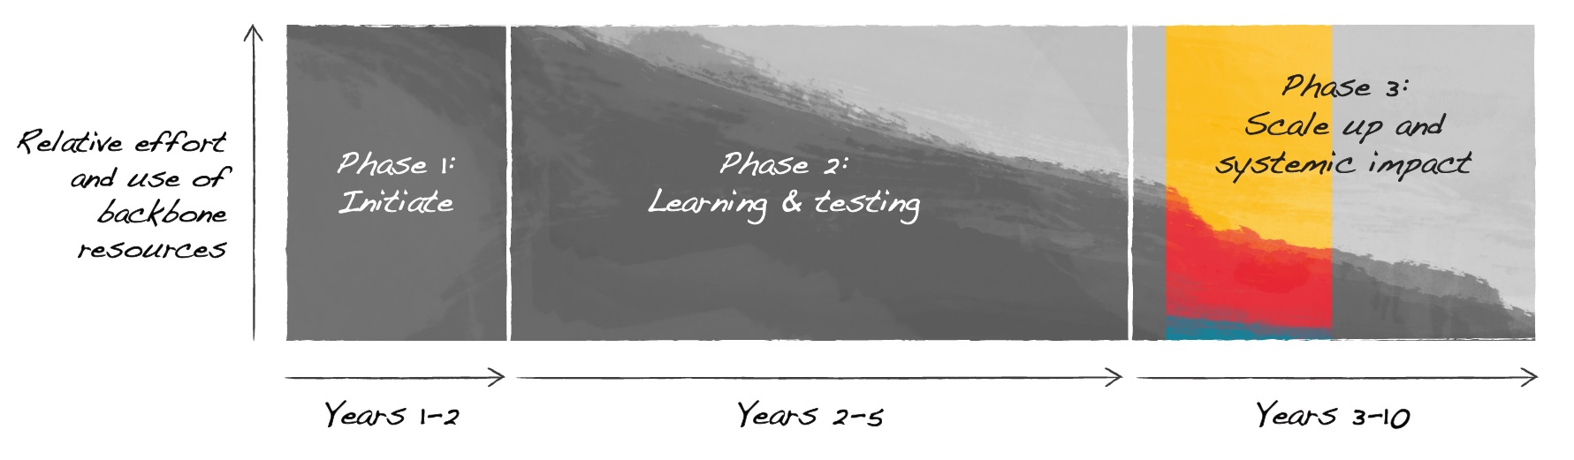
Ghana

Slide 14
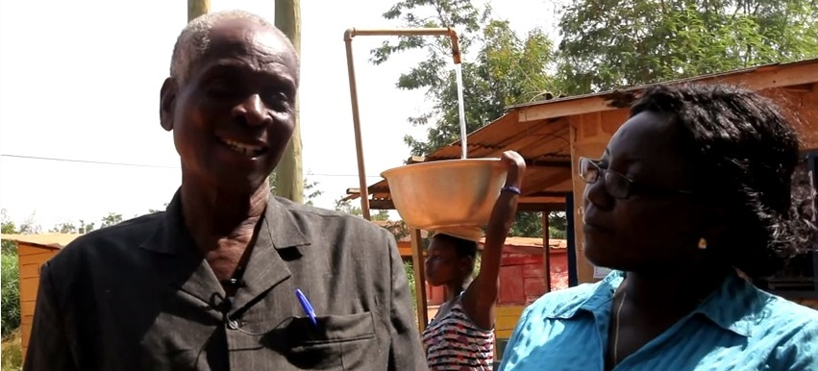
Government vision and leadership is critical
Notes:
Monitoring service delivery; · Service delivery indicators.

Slide 15
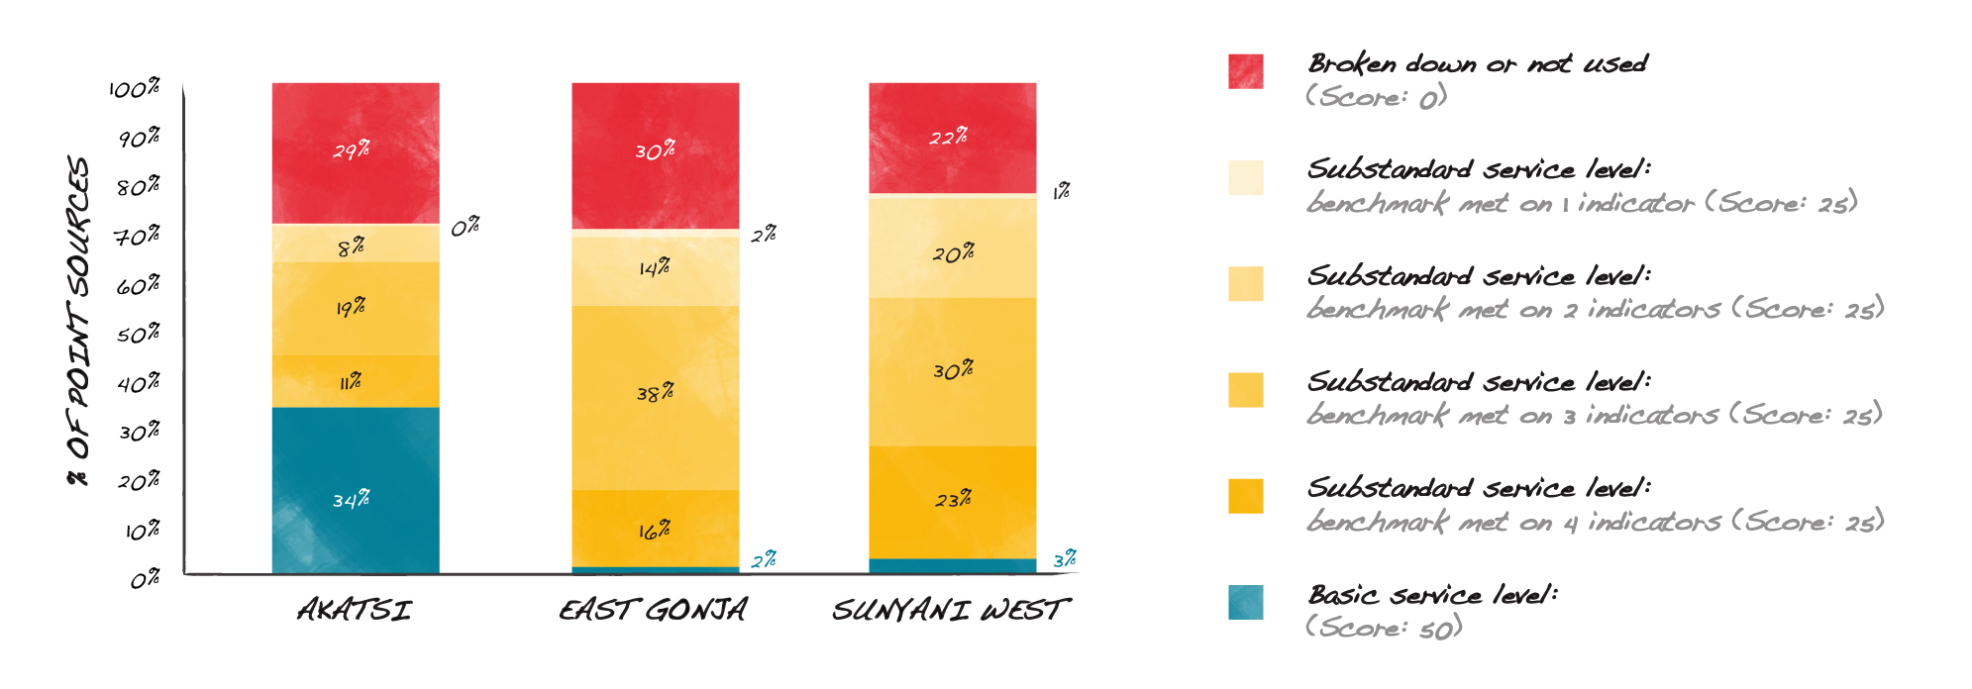
Comparing coverage with actual service delivered
Non-functionality is just the tip of the iceberg

Slide 16
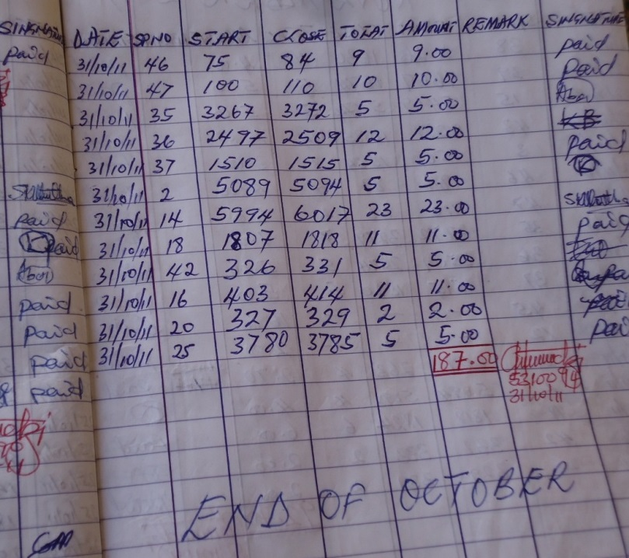
Better life cycle cost assessments and improved asset management are major challenges
Recurrent and replacement costs have often been ignored in the past
Notes:
Monitoring service delivery; · Service delivery indicators.

Slide 17
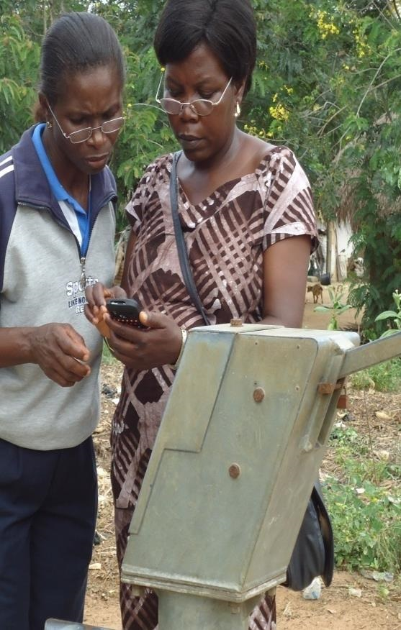
Learning & testing experiments at district level
Service Delivery monitoring (what indicators?)
Asset management (insurances?)
Spare parts supply (bulk supply and distribution?)
Lots of capacity development in the process

Slide 18
Ghana: District level expenditure support costs
  Direct support cost ranges from US$ 18,000 to US$ 32,000 per year (excluding salaries)
  Direct support cost per capita ranges from US$ 0.3 to US$ 0.4 per year – every year
Source: Nyarko, 2012. Tracking direct support cost and capital maintenance in rural water service delivery in Ghana,

Slide 19
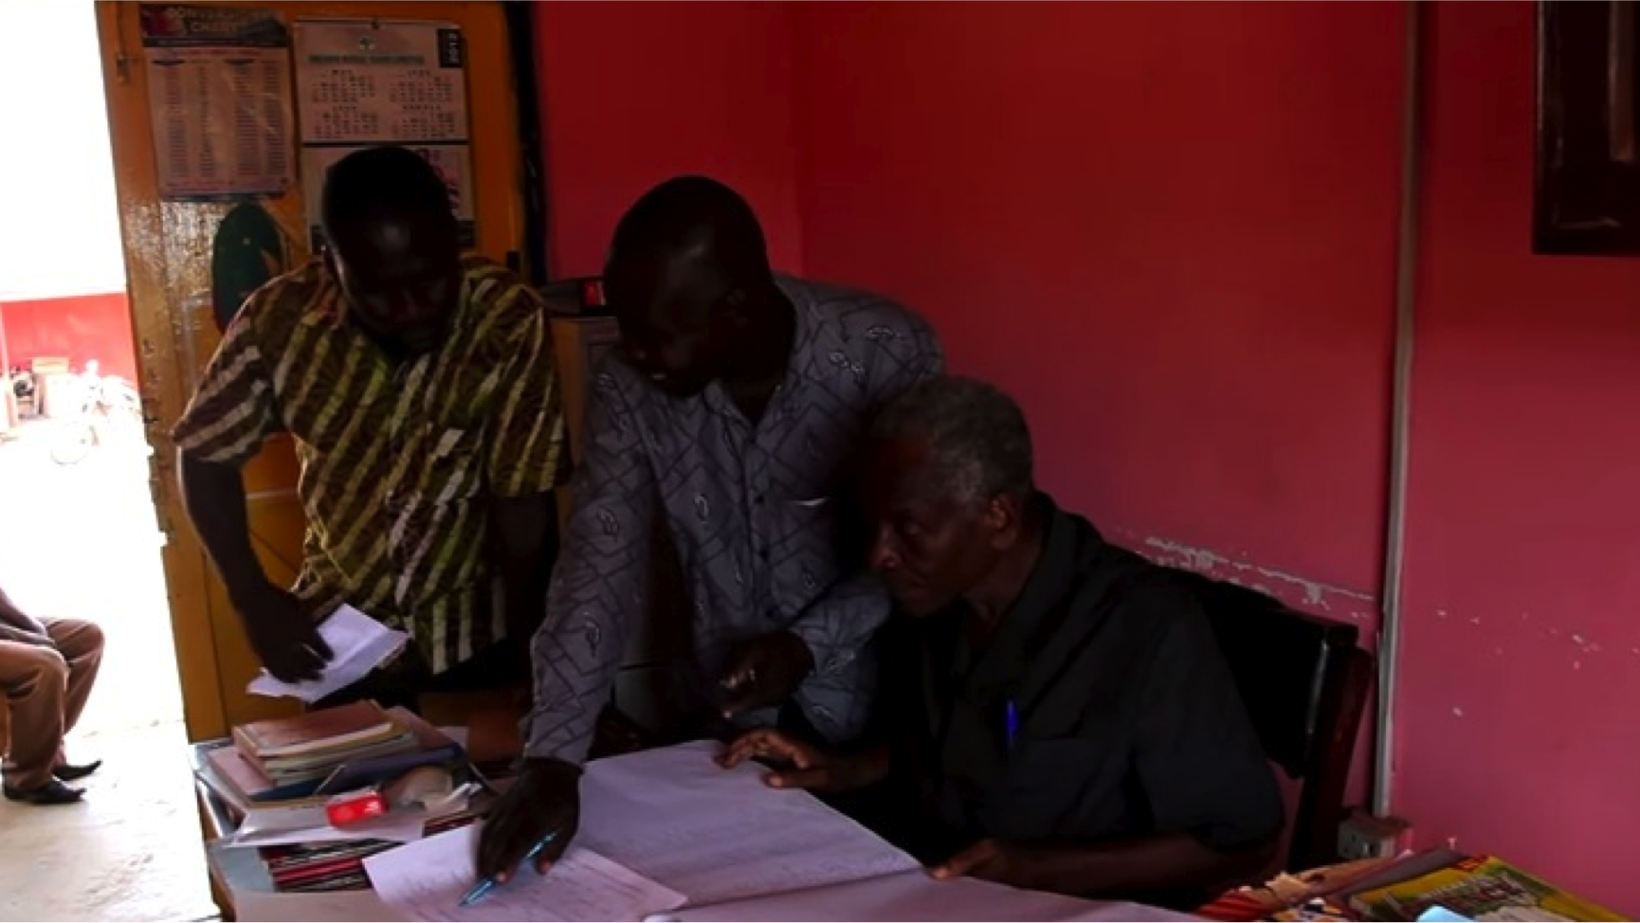
What have we achieved … and what not yet!

Slide 20
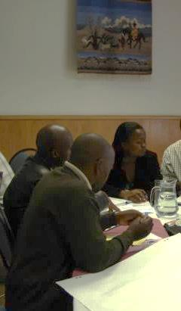
Scale emerging
  Monitoring services has expanded from 3 pilot districts to 78 districts all led by CWSA
  Embedded in CWSA and District Assembly operational guidelines
  Functionality and user satisfaction increasing
Notes:
Representing who has been involved in this

Slide 21
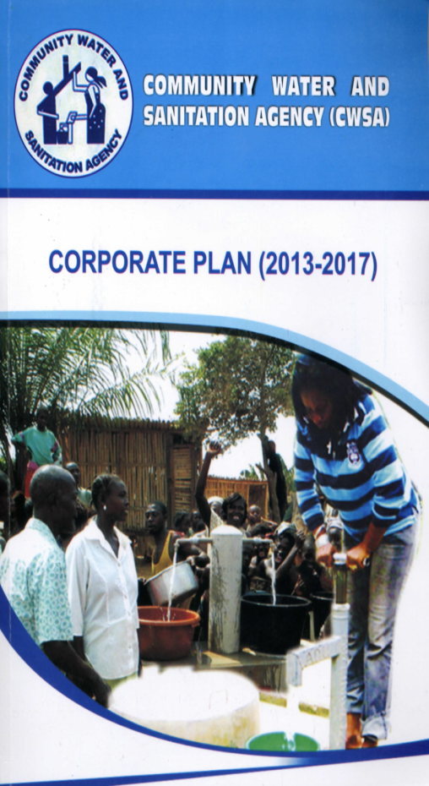
Systemic learning at national level
  Review of CWSA policy and corporate plan
  New operational guidance documents
  More effective sector financing

Slide 22
How much does it cost?
  ~$1 million per year
  (much less than what is wasted yearly)

Slide 23
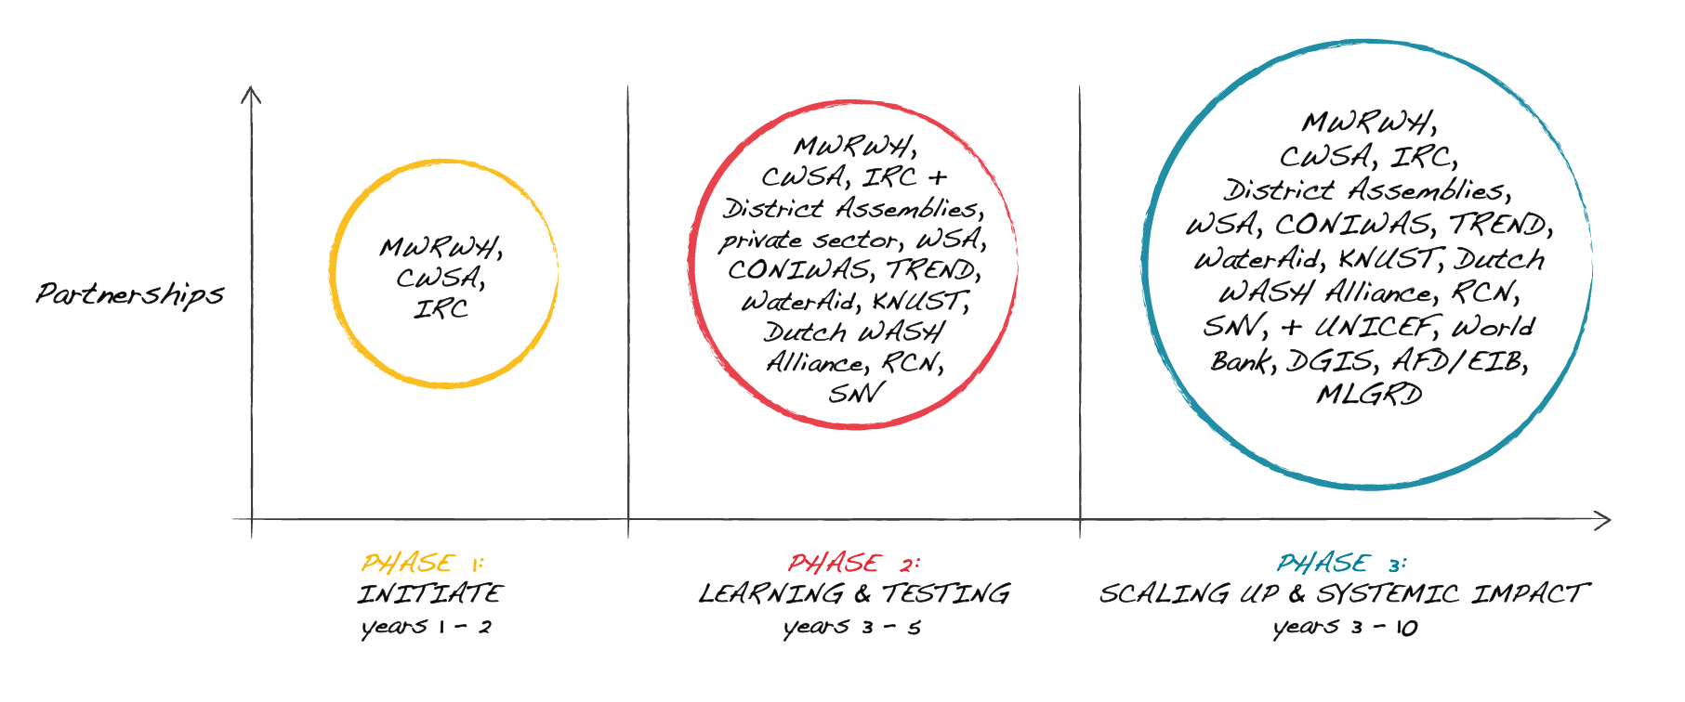
Evolution of collective action towards change in Ghana

Slide 24

Visualising the change process at different institutional levels

Slide 25























Multiple Stakeholders (roles)

Slide 26





Platforms

Slide 27

Communication within and between levels

Slide 28


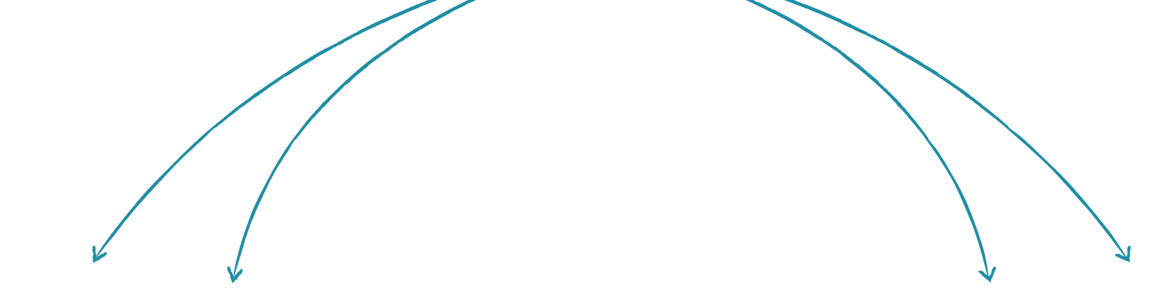








The process…

Slide 29
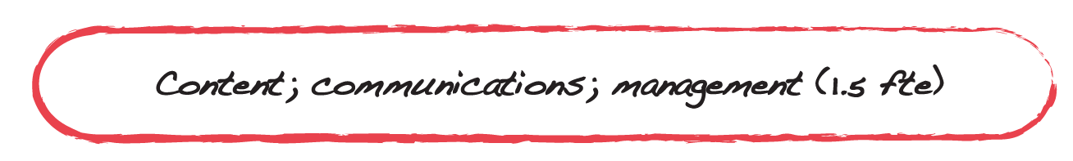


The team

Slide 30
Lessons from Ghana experience
  A dedicated (“backbone”) organization is critical; the costs of such an organization and facilitation are marginal to return
  Long term commitment is a must
  The benefits of working “too closely” with government outweigh the risks ……….. and it is the only ‘exit strategy’

Slide 31




Is it enough?
A shared vision of impact
Backbone organization
The process
(all actors)
Evidence
The context
Notes:
Gathering people around a shared vision of impact:
Driving change through a process of collective action and learning; driven by evidence. It has to be led by Government.
‘
Backbone’ organization:
Role is that of trusted (critical) friend;
Requires process facilitation;
People are critical to the change process (human skills and human capital)
Evidence:
Shared agreement on measure of success with continuous collection
Appropriate to the context (i.e. not always an RCT)
Stakeholders must be involved in gathering the data
The process (all actors)
Actors at different (institutional) levels
Partnership
Constant evidence based action and learning
Short/accelerated learning cycles
Context
The change process must respect the possible pace of change
There are limits to the pace of change possible in a given context
You can walk a few steps ahead – but too far and you lose everyone

Slide 32
We need more public finance
Tax revenues account for 10% to 14% of GDP in low income countries (high income countries 30%)
  In 2012, 32 African countries collected less than USD 1 of tax per person
  Public finance is critical to mobilise additional private finance
OECD (2014), Development Co-operation Report 2014: Mobilising Resources for Sustainable Development,
OECD Publishing.http://www.oecd.org/dac/development-co-operation-report-20747721.htm
Notes:
Gathering people around a shared vision of impact:
Driving change through a process of collective action and learning; driven by evidence. It has to be led by Government.
‘
Backbone’ organization:
Role is that of trusted (critical) friend;
Requires process facilitation;
People are critical to the change process (human skills and human capital)
Evidence:
Shared agreement on measure of success with continuous collection
Appropriate to the context (i.e. not always an RCT)
Stakeholders must be involved in gathering the data
The process (all actors)
Actors at different (institutional) levels
Partnership
Constant evidence based action and learning
Short/accelerated learning cycles
Context
The change process must respect the possible pace of change
There are limits to the pace of change possible in a given context
You can walk a few steps ahead – but too far and you lose everyone

Slide 33
Thank you!

Slide 34


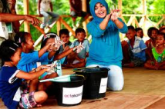

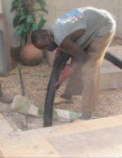
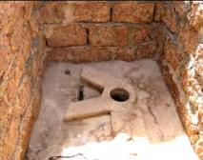
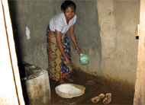

The life-cycle cost components

Slide 35
Cost benchmarks for basic water service levels
Cost component | Primary formal water source in area of intervention | Cost range US$ (2011) [min – max]
Total capital expenditure (total per person) | Borehole and handpump | [20 - 61]
 | Small schemes (serving less than 500 people) or medium schemes (serving between 500-5000 people) including: mechanised boreholes, single town schemes, multi town schemes and mixed piped supply | [30 - 131]
 | Intermediate (5.001-15.000) or large (more than 15.001 people) | [20 - 152]
Total recurrent expenditure (total per year per person) | Borehole and handpump | [3 - 6]
 | All piped schemes | [3 - 15]
Source: WASHCost Infosheet, October 2012
Notes:
If a basic level of service is being provided and expenditures are lower than the benchmark ranges, then most probably it applies to high densely populated areas with economies of scale or the enabling environment is exceptional and a good practice case study should be widely shared. In general, the lower cost ranges apply to India – but not always.
If a basic level of service is being provided and expenditures are higher than the benchmark ranges, then either the services are being provided in a difficult or remote area, or better value for money can be achieved. We are also aware that most of our data set comes from Africa and Asia. Some cost data from Latin America is higher, but most of the times also a higher service level is being achieved.

Slide 36
Breakdown recurrent expenditure for basic water service levels:
Not much, but much more that what is being spent at the moment.
Breakdown of recurrent expenditure* | Cost ranges US$ 2011 [min – max] Total per year per person
 | Borehole and handpump | All piped schemes
Operational and minor expenditure | [0.5 - 1] | [0.5 - 5]
Capital maintenance expenditure | [1.5 - 2] | [1.5 - 7]
Expenditure on direct support | [1 - 3] | [1 - 3]
Total | [3 - 6] | [3 - 15]
Source: WASHCost Infosheet, October 2012
Notes:
Monitoring cost data by local authorities and community based organisations (from Honduras and Mozambique): 0.30 US$ for baseline and 0.10$ for follow up per person per year

Slide 37
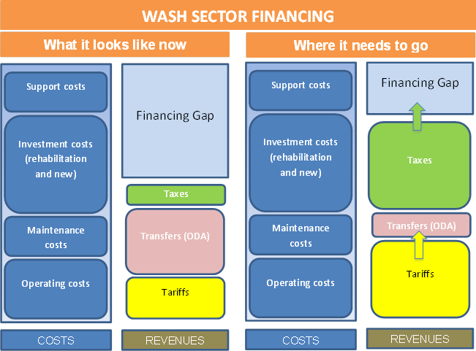
Norman et al. 2014. Mobilising Public Finance for WASH: a Call to Action

Slide 38
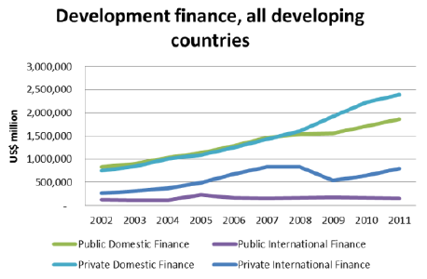
All types of finance have increased since 2002
Report to Intergovernmental Committee of experts on Sustainable Development Finance
http://sustainabledevelopment.un.org/content/documents/4588FINAL%20REPORT%20ICESDF.pdf
Notes:
This includes middle income countries
Public domestic finance in developing countries more than doubled between 2002 and 2011, increasing from US$ 838 billion to US$ 1.86 trillion.19In absolute terms, this growth mainly reflects developments in middle-income countries. Domestic public finance also doubled in low-income countries, though it remains insufficient to meet sustainable development needs.

Slide 39
Sources of funding for capital maintenance
Rehabilitation funds taxes
donations
Dedicated pooled funds
Insurance
funds
Rehabilitation funds taxes
donations
External agencies; DP; INGOs; philant.
National government
Regional government
Holder of capital maintenance “fund”
Regional/ local taxes
Local government or service provider
Private sector/delegated management
Tariffs/user charges
Community based organisations
Single front- loaded payments
Regular equal payments
Later accelerated payments
Single end-loaded payments
Number and size of payments for capital maintenance
Notes:
Slides needs to be turned into graph

