Slide 1
World Bank Assisted
JAL NIRMAL PROJECT
Karnataka Rural Water Supply & Sanitation Agency

Slide 2
Government of Karnataka has set up
Karnataka Rural Water Supply & Sanitation Agency (KRWS&SA) at State & District Support Unit at District Level as Nodal Agency with the Support of Zilla Panchayat Department for
Project Planning.
Procurement & Construction.
Operation & Maintenance.
Management of Rural Water Supply & Sanitation Facilities.

Slide 3
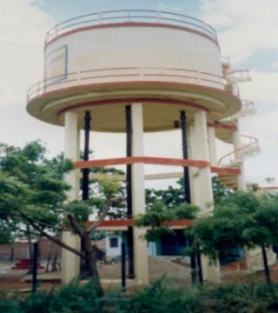
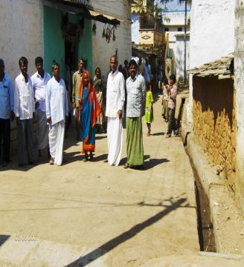
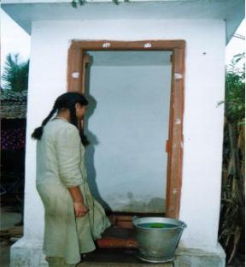
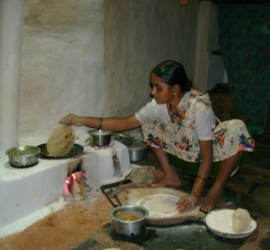
PROJECT
COMPONENTS
Water Supply
Recharge Measures
Water Quality Tests
Internal Road & Drains
Household Toilets
Smokeless Chullas
School Sanitation
GP Strengthening
Women Empowerment
Notes:
3

Slide 4
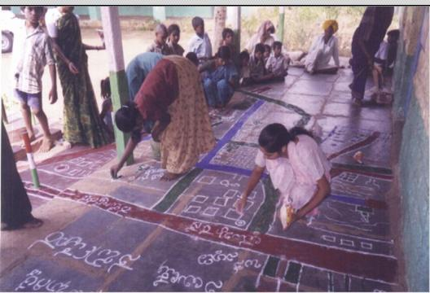
Strategy for conducting the PRA Activities:
Drawing the Village
Map.
Social Map.
Weather Map.
Economic Status.
Group Discussion.
Draft Project Report.
Notes:
4

Slide 5
Planning Process of the scheme , Conceptual plan for the
village in association with community.
Preparation of Preliminary Scheme report & deliberation
of the same in Gram Sabha & Conclusion of agree to
participate (ATP) Agreement.
Carrying out detailed survey/ leveling & collection of
technical data & proposal of development of additional
source, based on this Preparation of detailed project report
(DPR) including designing, cost estimate & time schedule.
Deliberation of detailed project report in Gram sabha &
Conclusion of agree to do (ATD) Agreement.
Motivating the community for contribution of 10% of the
project cost by community development specialists of support
agency & DSU.
On receipt of 50% contribution tender documents to be prepared
& processed.

Slide 6
VWSC Formation
As per Karnataka Panchayat Raj Act of 1993 section 61 A, Village Water Supply & Sanitation Committee (VWSSC) is formed through Gram Sabha as a sub- committee of Gram Panchayat. Members of VWSC include both elected & selected representatives from the village. VWSC will have 33% Women & 18% SC/ST.

Slide 7
Roles & Responsibilities of VWSC/JC Members
Collection of Community Contribution.
Conducted the VWSC/JC Meetings.
Involvement in Project Planning,
Implementation , Post implementation Phase.
Contractor Bill Payment.
Manage the Effective Operation &
Maintenance.

Slide 8
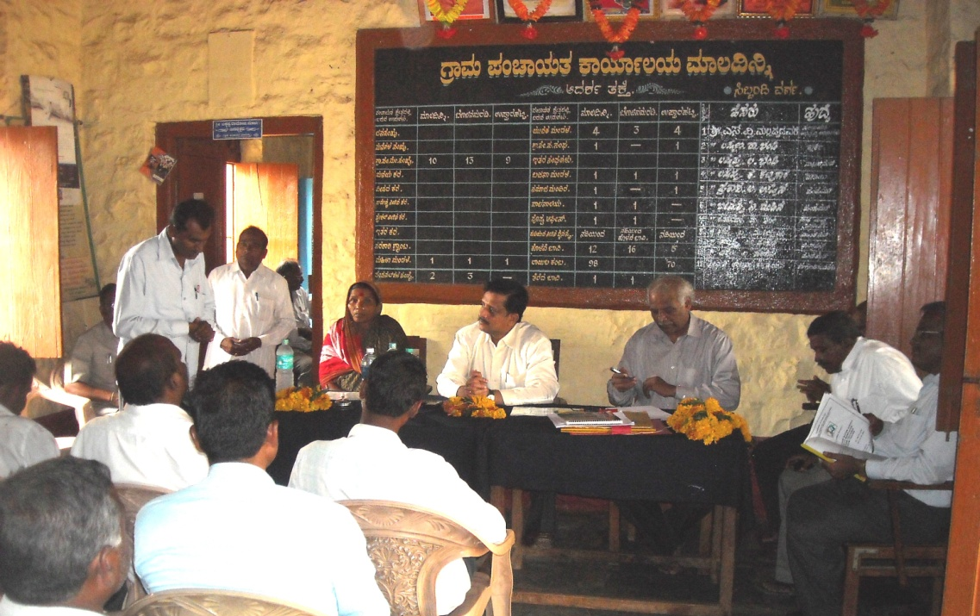
Joint Committee (JC) Formation for Multi Village Scheme
Joint Committee(JC) Operations & Maintenance
Right from the beginning the committee members followed the practice of adhering to the resolutions passed at the meetings. In the initial period, the Joint committee meet once a week and subsequently once a month.
The amount of water tax collected from the respective Gram Panchayat is calculated in each meeting. Apart from the president and members of the Joint Committee, the elders too participated in the meetings of the joint committee. Their suggestions provide useful inputs for the operations and management of the project.
A bank account of the Joint committee is opened. Remuneration for the project staff is paid from the operations and Management account.
Joint committee is formed as per section 79 of Karnataka Panchayat Raj Act 1993 for efficient implementation & management of Multi Village Scheme. It has representation from the concerned VWSCs/GP.

Slide 9
Sustainability Monitoring Exercise (SME)
SME is participatory tool to measure implementation results on the ground and intended impacts in terms of technical, financial & Institutional sustainability of schemes. SME was taken up initially in the World Bank Assisted 1st Project (1993-2000) in Karnataka which later continued through the 2nd Project (2002-2009) as a key participatory tool to measure project performance in the state. Encouraging from the early SME results, this exercise has been continued under Additional Financing Project villages also as an in-built learning process to further enhance accessibility, reliability, equitability & Sustainability if investments in water & sanitation sector in the state.

Slide 10
Methodology for SME
SME is conducted through a multi disciplinary team comprising Engineer, social development specialists, finance persons, NGO/consultants, representatives of VWSC/GP/JC, village leaders (Men & Women) representatives of PRIs etc. Each SME will be of one day duration covering water supply hours of both morning and evening. Besides, collecting information about the schemes using structured questionnaires, the exercise also focuses on monitoring and analyzing of
System functioning.
User’s perceptions.
Operation, Maintenance & Management
Organization & Governance
For the sustainability assessment result of the completed schemes representing in terms of highly likely sustainable, likely sustainable, uncertain and unlikely sustainable.

Slide 11
Measurement of Scheme Sustainability
Project had adopted Sustainability Monitoring Exercise (SME) which was a Participatory Tool to measure sustainability of all the completed schemes from Technical, Institutional & Financial angles.
1st round SME conducted in-house and subsequent rounds through external consultant on sample basis.
SME was carried out through a multi disciplinary team representing Project Stakeholders focusing on :-
Functioning of VWSC
System Functioning
User’s perception
O & M

Slide 12
SME Results
SME | Year | Schemes Nos
1st round SME (In-House) | From 2008 | 2460
2nd round SME (External Consultant) | 2009 | 300
3rd round SME (External Consultant) | 2010 | 300
SME Out Come | Rating
 | 1st Round | 2nd Round | 3rd Round
Highly Likely | 56% | 51% | 70%
Likely | 35% | 40% | 27%
Uncertain | 7% | 8% | 2%
Unlikely | 2% | 1% | 1%
Average of 93 % schemes fall under likely to highly likely sustainable categories

Slide 13
Operation & Maintenance Budget
Scheme wise preparation of Operation & Maintenance Budget.
Scheme Maintenance Expenditure meet through tariff.
Each house hold, community paid the water tariff monthly.

Slide 14
Capacity Building And Sanitation
Conducting VWSC orientation meetings/ Trainings.
Conducting JC Orientation meeting/ Trainings.
Conducting PRA for all project villages.
Conducting ATP,ATD & ATI Programme.
Conducting GP Members orientation meetings/ Training & SHG’s Mela.
Conducting Procurement Trainings.
Ward/ Street Meetings, HHL, SLC awareness Programme.
Education for Sanitation (HHL, SLC, Drainage, Garbage, Washing Plat form, Cattle trough etc.)

Slide 15
O&M
O&M collection & management
Incentivization of water tariff collection.
Computerization of water tariff collection & issue of computerized receipts.
VWSC puts notice board in the village regarding timing of water supply & disruptions of services if any.
Process initiated for disconnection of defunct bore wells resulting in reduction of power charges.
Women in development: decision making, bill collector, water quality testing person, Promotion of Sanitation facilities & Smokeless Chullas

Slide 16
Case study of Belawadi Village in Belgaum District
Description of the water supply scheme costing 112.52 lakhs
The scheme has very vital features they are
Mobilisation of resource
85 % of fund available from project
10 % of fund mobilized by users community ( It was collected from all the house holds of the village)
5 % of fund mobilized by concerned GPs from their income.
Gram Panchayat has taken responsibility of scheme implementation. In W2 document, Technical support given by PRED & ZP-DSU
i) Decentralize the powers implementation mechanism is to implement
from bottom level to top level it implement through Gram Panchayat
so far maintain by them only.
ii) People’s active participation and their involvement is major role to
achieve the goal and seek the project.
iii) There is no political interpenetration in development works all are co
operate very well therefore these villages water supply and sanitation
project has been success.

Slide 17
Evidence of Performance:
1) Before initiate the tender 100% Community Contribution was made
2) 6.5 lakh Community Contribution was made before invite the tender
3) Out of 1565 HH all have contributed except EWS contribution has made by community before intervention of Tender.
4) VWS Committee has collected the Beneficiary contribution them selves voluntarily with out any pressure.
Total Population : 8061
Total House holds : 1565
Total House connections: 1327
Total Non House connections HH : 238
Annual O&M Budget : Rs,7.92 lakh
Water tariff for HC : 50.00 ( Up to 10,000 ltrs above this Rs. 8/- per 1000 ltrs )
Water tariff for Non HC : 30.00

Slide 18
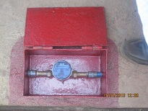
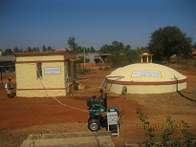
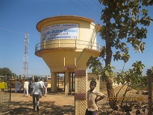
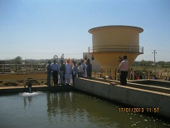
BELAWADI VILLAGE PHOTOS
Water meter
Pump House & Pure Water Sump
Balancing Tank
Slow sand filter

Slide 19
THANK YOU

