Slide 1
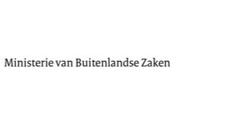
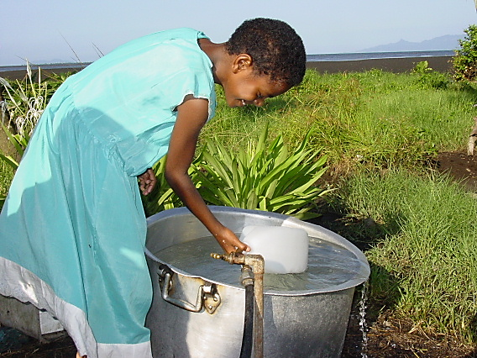
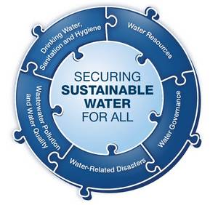
SDGs for water and sanitation;
What’s new? What’s Different?
Universal Access
Notes:
The decision on the new SDGs is just around the corner.
We are very pleased that water (in the broad sense) features strongly in the plans for new goals and targets.
Universal access to water and sanitation is the new ambition level. This reflects properly that we consider WASH a HUMAN RIGHT!
What does that mean? Will we have to do different things? Will we have to do things differently?
I will give you the DGIS perspective on this.

Slide 2
SDG 6.1 and 6.2
6.1By 2030, achieve universal and equitable access to safe and affordable drinking water for all.
6.2 By 2030, achieve access to adequate and equitable sanitation and hygiene for all and end open defecation, paying special attention to the needs of women and girls and those in vulnerable situations
Notes:
Key words in the SDGs for WASH as per the OWG advise to the SG point out the new level of ambition and immediately give you an idea of the difference to the MDGs. Universal access for all vs. Halving the population without access to sanitation and water.
This shows that the SDGs do more justice to the fact that water and sanitation is a human right.
It also addresses shortcomings in the MDGs (Focus on numbers/access only) by adressing inequality and behaviour change (hygiene) and attention to vulnerable groups and improving service levels (water quality IOB!! And affordability).
Levels of ambition are up!
Level of complexity too!

Slide 3
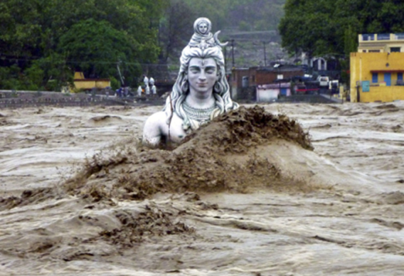
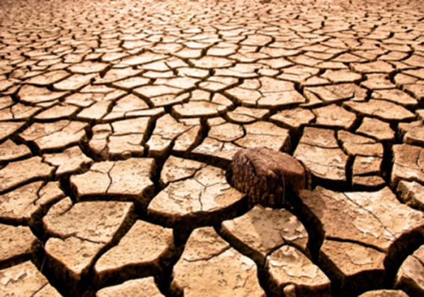
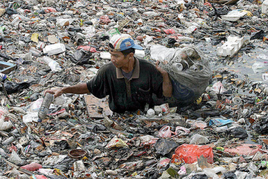
Additional challenges!
Notes:
Ambition level up on numbers of people to be reached;
-2.5 billion lack access to sanitation
-750 mln water
-1 billion ODF
Ambition level has to be seen in light of additional challenges: Economic growth, climate change, rapid population growth and urbanisation (e.g. Kenya population will double by 2045 but urban share will quadruple by 2035!) . Resulting in too much too little too dirty water! Thats why the linkage with water management (other goals and targets SDG 6!) is so important.

Slide 4
Destination:
2030
Kidatu, Tanzania
Notes:
Who recognises this picture?
To give an impression of what the new SDGs and universal access to WASH might mean I invite you to take place in the time capsule an travel to 2030 with me to the village of Kidatu in Tanzania.

Slide 5
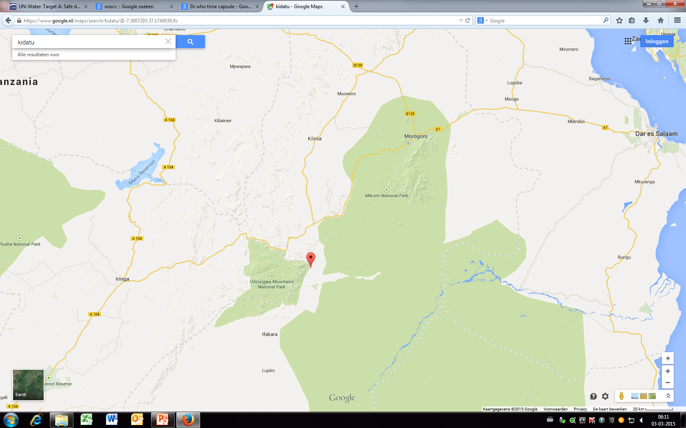
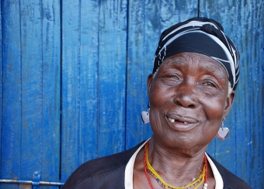
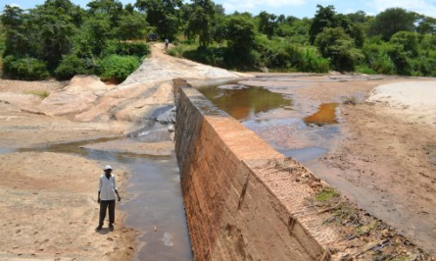
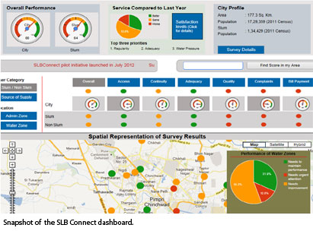
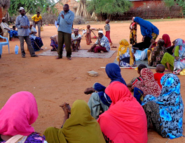
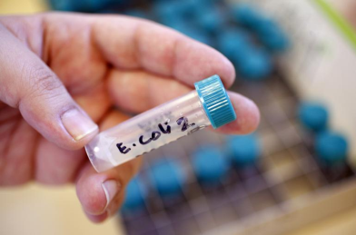
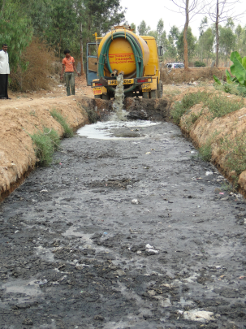
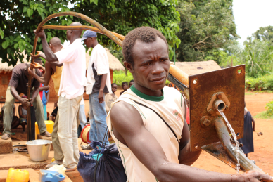
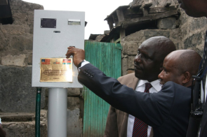
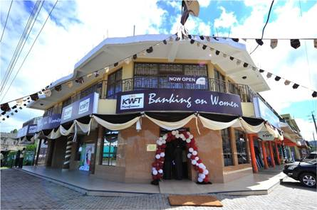
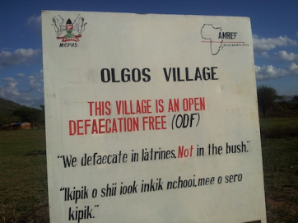
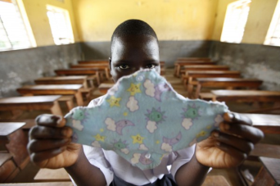
Theory of Change: Het ABCDE van Verbeterd Stroomgebiedbeheer
Kidatu
Notes:
-Alle huishoudens hebben toegang tot veilig drinkwater. Prepaid system
-Zelfs de oude weduwe heeft een latrine op haar plot.
-Participation is ensured by NGO and water users have a voice to hold service providers accountable.
-Prijzen zijn betaalbaar voor allen.
- Borehole functions also properly in dry season. Due to careful water management and new checkdam.
-A local company is contracted (by the water committee of Kidatu and surrounding villages) for maintenance of the local waterpoints and communal sanitation facilities. Called in automatically if there is a technical problem or if e-coli levels are too high.
-Finacial sector fully engaged: MFI provide small loans to assist SMEs and households.
-Kidatu is al 10 jaar ODF!
-Goede sanitaire voorzieningen op de lokale dorpsschool met aparte toiletten voor meisjes. Op school wordt voorlichting gegeven over Menstrual Hygiene Management
-A small local company ensures sceptic tanks of the school are emptied and sludge disposal at a drying field for processing into manure which is locally sold.
-.
-De Health extention workers retrigger the community on OD as part of their mainstream work.
-Local government oversight role set standards and tracks/oversees functionality of WASH facilities via online Dashboard and monitors the local water committees, SME companies providing services. Is provided by central gvt with adequate resources and ensures social safety nets for most vulnerable.

Slide 6
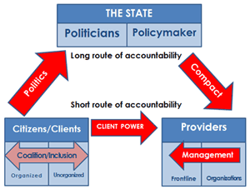
SDGs and policy developments
Ambition level means other/more/different financing needed for the sector.
Equity/service levels means more focus on participation and governance aspects.
Assisting partner countries
to identify delivery mecha-
nisms at scale
Notes:
To achieve the future situation in Kidatu. Some major shifts in policy focus, partnerships and efforts are needed. Let me share some of our thoughts on this:
ODA, current domestic finance and private sector capital not adequate! Need to come up with mechanisms with the potential to attract large scale funding (e.g. pension funds) Improve domestic resource mobilisation, access to WB loans, attracting funds from EIB etc. Also need to support governments and financial sector to see the water sector as an important one and stimulate investments and SMEs.
Promising examples (Utilities), Work of US-AID. FINISH programme, Several FDW projects Ideas Roy Torkelsen (Water Bank) (UNSGAB)
We have set in motion a workstream around this with NWP/Several embassies and work towards FFD conference in july in Ethiopia.
Working towards equitable service delivery and increased service levels require more attention to governance aspects: Participation needs to be stepped up, People (also vulnerable ones) need to be given a voice to be heard and need to be able to hold service providers to account, directly or via their governements. In that sence the new Lobby and Advocacy programme WASH-IT granted to the consortium IRC/AKVO/Wetlands /Simavi is a welcome, timely new initiative!

Slide 7
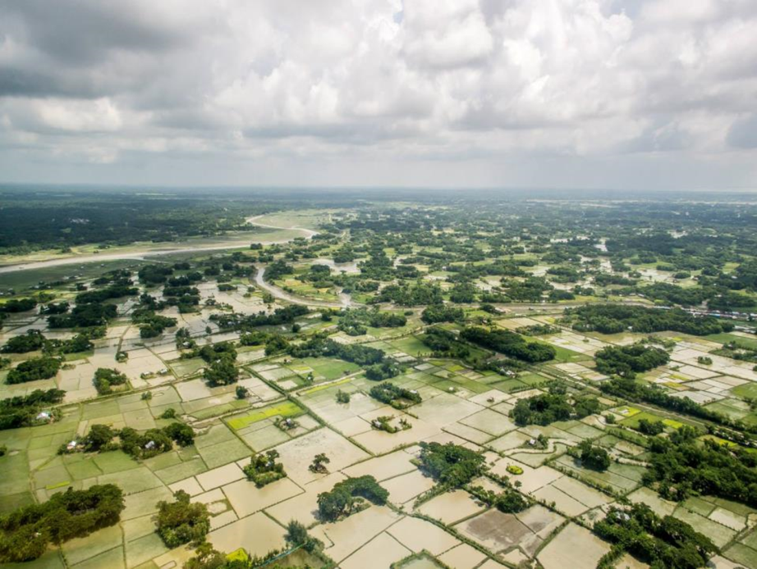
SDGs and policy developments
More integrated (holistic) approach to programmes; firmly linking IWRM and WASH.
Continued/Intensified focus on sustainability needed!
Local M&E: central role, more complicated.
Lesson MDGs: Local ownership goals and targets essential, local capacity to be built to deliver at scale.
Notes:
More focus on linking IWRM principles to WASH programmes. We do not have many programmes in our portfolio where this is obviously done. New standards needed? EIA for WASH? Looking at both up and downstream implications and implications for other water users (domestic en productive).
Universal access for all means sustaining service levels: Our efforts (with IRC, WASH-cost and others) and development of sustainability tools (Check) need to be expanded but/more importantly be incorporated by local institutions and mechanisms.
Local capacity for M&E will become more and more important: The new goals require a new level of sophistication: identifying and monitoring specific population strata, real time tracking funcitonality, providing transparent information to cititzens on service levels/quality. Some initiatives will become more prominent e.g. AKVO mapping tools.

Slide 8
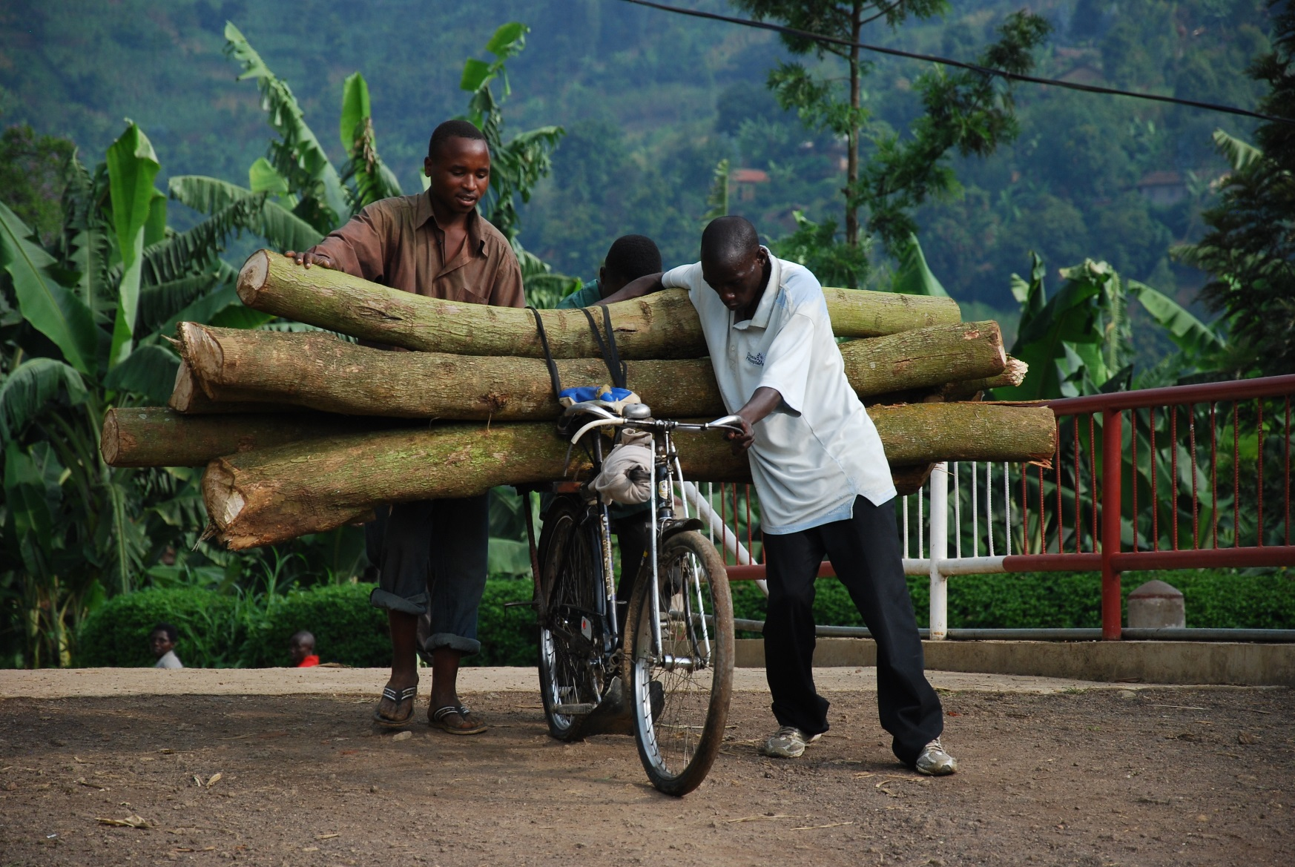
Thank you!
Notes:
SDGs: High Ambition level, added complexity, We have some heavy lifting to do the coming years.
But the SGDS provide interesting new momentum and dimensions to our work and we trust we do the heavy lifting with many partners, including yourselves!

