Slide 1



SWASH+ impacts and outcomes
2006-2012
December 5th, 2012

Slide 2

The Team
CARE: Peter Lochery, Brooks Keene, Malaika Wright, Ben Okech, Alex Mwaki, Betty Ojeny, John Migele, Jason Oyugi, Peter Waka
Water.org: Liz Were, Caroline Teti, Patrick Alubbe
GLUK: Richard Muga, Emily Awino, Imelda Akinyi
Emory: Matthew Freeman, Robert Dreibelbis, Leslie Greene, Shadi Saboori, Kelly Alexander, Victoria Trinies, Bethany Caruso
UF: Richard Rheingans
GoK: Leah Rotich and the MoE team

Slide 3
The program
Research Question
Sustaining and scaling school WASH + community impact
Research Question: What is the impact of a school-based WASH intervention on pupil absence, helminth infection, and diarrhea?
Objective 1: Develop and test a scalable model for school WASH
Objective 2: Determine how to get the government to “take up” proven interventions
Implementation packages based on previous pilots
Post-election violence in 2007-08
All findings in addition to effect seen with deworming

Slide 4
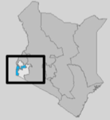
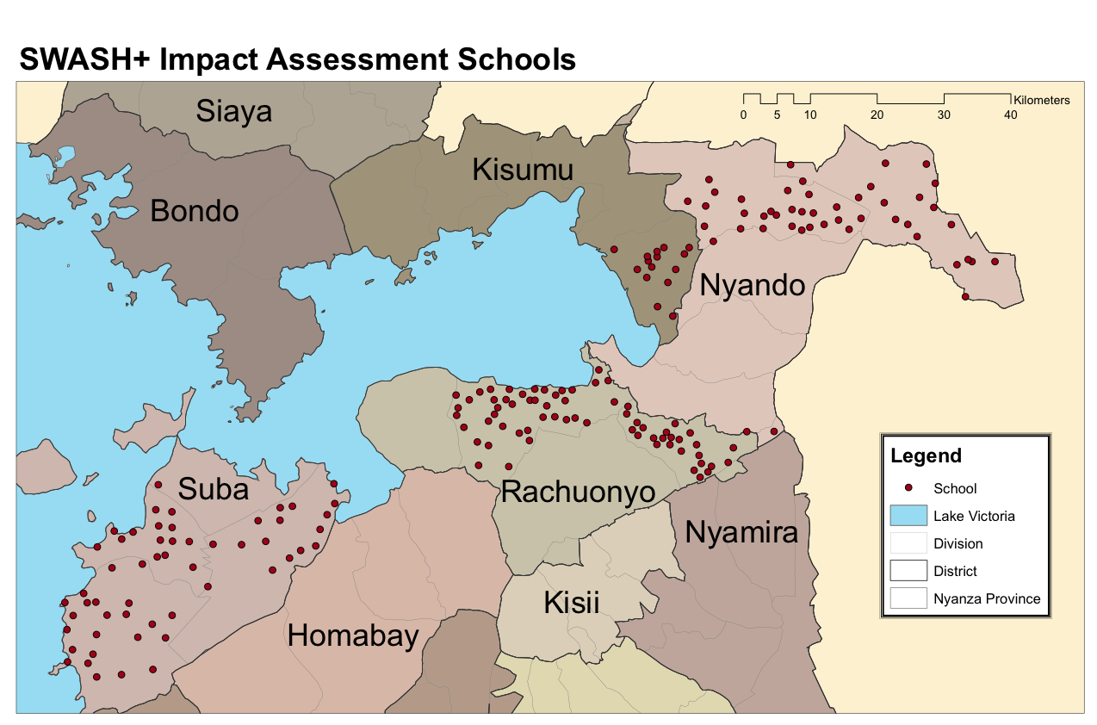
Where we worked
School locations in Nyanza Province, Kenya

Slide 5
Methods
Study arms
Water “available” schools (n=135)
Hygiene promotion and water treatment (HP&WT) (n=45)
HP&WT + Sanitation arm (n=45)
Control (n=45)
Behavior change education
Handwashing promotion
Water treatment
Helminth schools (n=40) randomly selected
Behavior change education
Handwashing promotion
Water treatment
Sanitation

Slide 6
Methods
Study arms
Water “scarce” schools (n=50)
HP&WT, Sanitation + Water supply (n=25)
Control (n=25)
Behavior change education
Handwashing promotion
Water treatment
Sanitation
Water supply
All students received deworming (3 rounds) regardless of intervention status

Slide 7
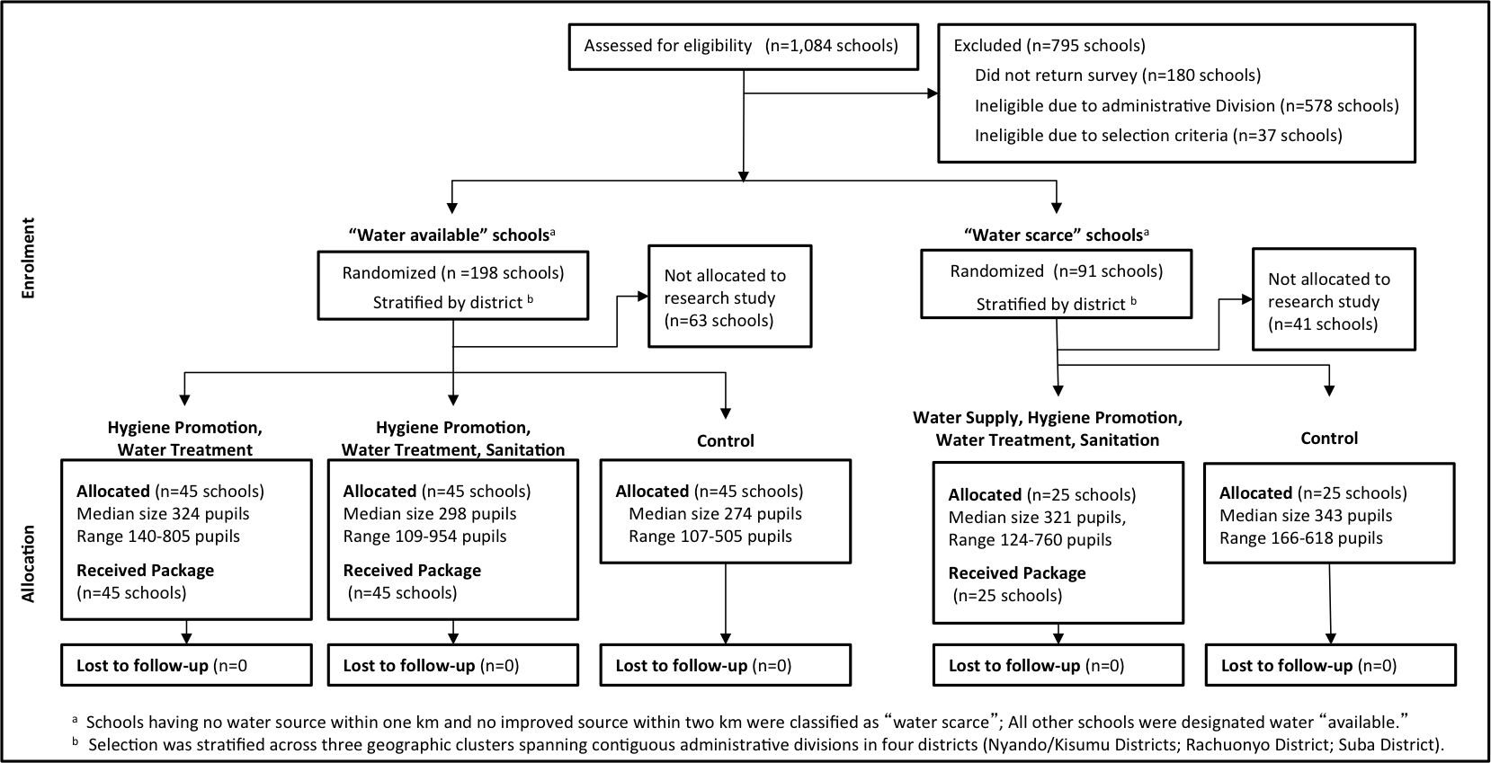
Methods
Study arms

Slide 8
Results: Absenteeism
Modeling overall effect
37% reduction for HP, WT. Significant at <0.1
29% reduction for HP, WT + Sanitation, NS
No sig. effect of basic intervention on school absenteeism
Controlling for pupil grade, gender baseline school and community covariates, SES,
secular trend, baseline imbalance
Freeman MC et al 2012 TMIH

Slide 9
Results: Absenteeism
Modeling effect on girls
Impact of school WASH on absence from school among girls
58% reduction in the odds of absence for the basic intervention
Similar reduction in the schools that also received sanitation
3.4 days of absence avoided per year
Controlling for pupil age, baseline school and community covariates, SES, secular trend, baseline imbalance
Freeman MC et al 2012 TMIH
Notes:
TITLE!

Slide 10
Impacts for CRT
 | HP&WT | HP&WT+San | HP&WT+San+WS
Absence | OR 0.63 | OR 0.71 | OR 1.35
Enrollment - Gender parity | +6 pupils per school PR 1.00 | +8 pupils / school PR 1.00 | +26 pupils per school PR 1.03
Helminth - A. lumbricoides - Hookworm | - - | OR 0.56 / IRR 0.34 OR 0.80 / IRR 0.58 | - -
Pupil Diarrhea | RR 1.00 / IRR 1.03 | RR 0.95 / IRR 0.94 | RR 0.39 / IRR 0.43
Under 5 diarrhea | RR 1.21 / IRR 1.03 | RR 0.76 / IRR 0.94 | RR 0.44 / IRR 0.43
Under 5 clinic | OR 0.64 | OR 0.65 | OR 0.36
OR = Odds ratio
RR = Risk ratio
PR = Prevalence ratio
IRR = Incidence rate ratio
Significant <0.01
Significant <0.05
Significant <0.1

Slide 11
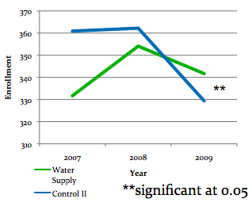
Results: Absenteeism
Water supply
Water supply has no effect absence
  OR 1.35 (95% CI 0.91-2.00)
School enrollment over time by intervention
12.5% increase in enrollment
relative to controls
26 pupil increase
Increase was among girls
Garn, J et al 2012 sub.

Slide 12
Methods
Helminth analysis
Deworming
All children
Measure the difference
STH infection
Control
Helminth infection
STH infection
Intervention
Baseline
Followup 1
Followup 2
Control for baseline values

Slide 13
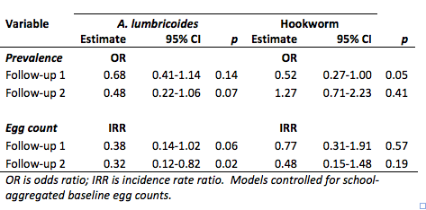
Results
Complicated effects
A. lumbricoides: Similar reduction for both rounds
Hookworm: Only impact after first follow-up

Slide 14
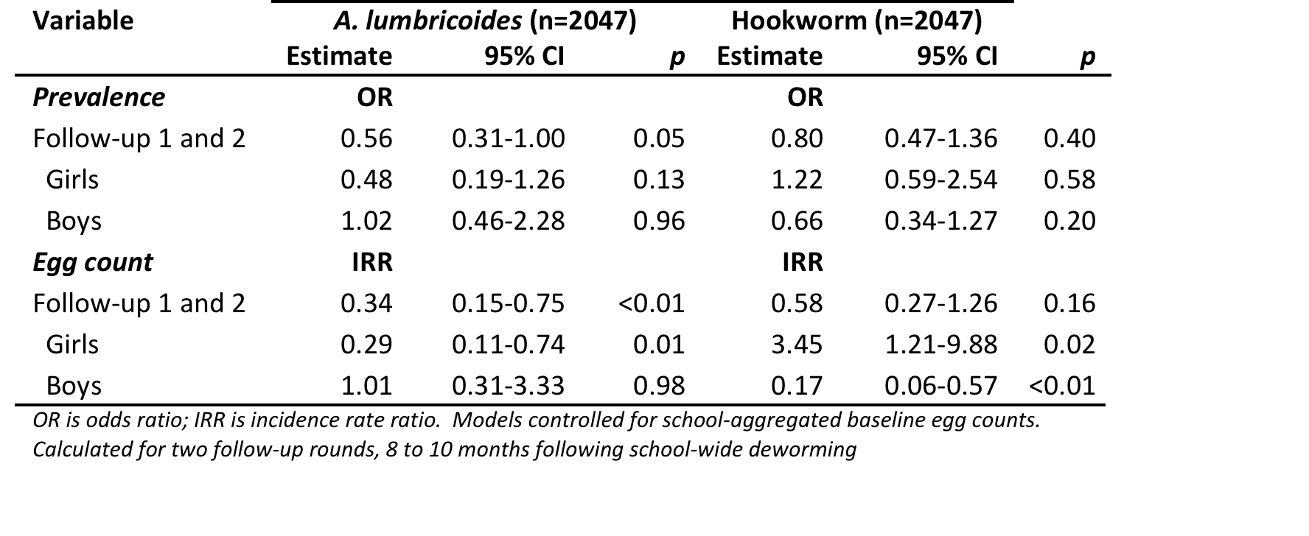
Results
Helminth infection
A. lumbricoides: Reduction of prevalence and egg count - girls
Hookworm: Differential effect for egg count
Freeman MC et al 2012 sub.

Slide 15
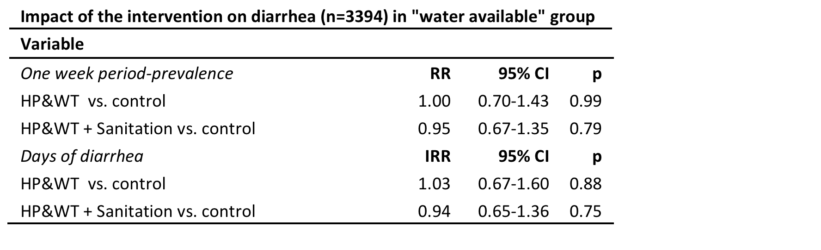
Results: Pupil diarrhea
HP&WT with and without sanitation
No effect of intervention on pupil diarrhea
Freeman MC et al 2012 sub.

Slide 16
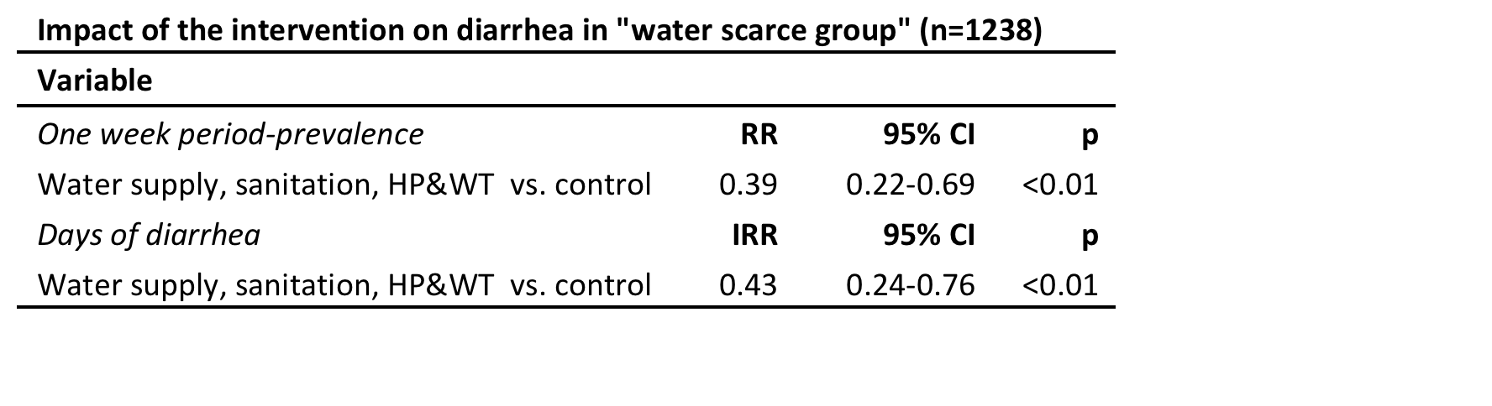
Results: Pupil diarrhea
HP&WT, Sanitation, + Water supply
61% percent reduction in the risk of diarrhea
57% reduction in the days of diarrhea
No difference by gender
Freeman MC et al 2012 sub.
Notes:
TITLE!

Slide 17
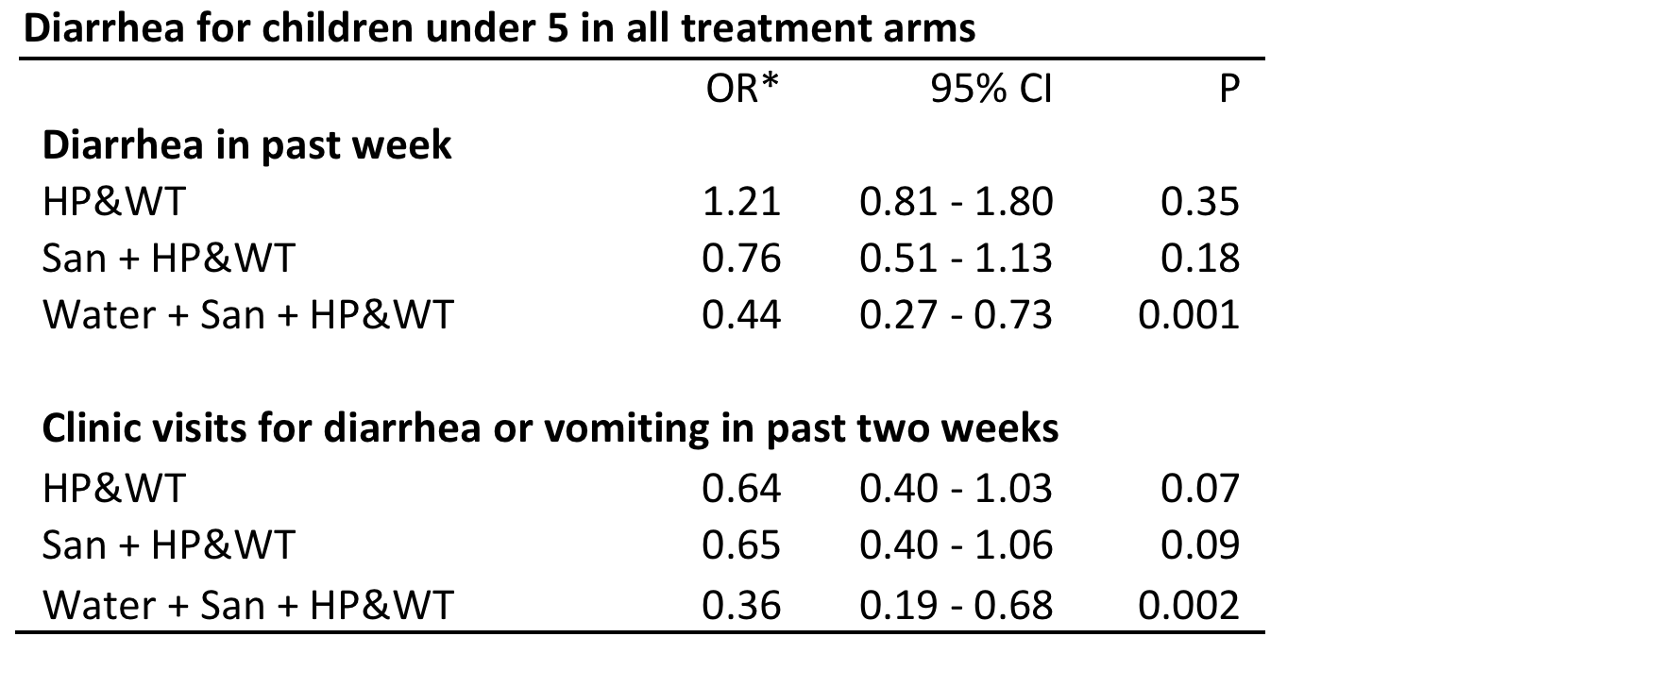
Results: Diarrhea in children u5
Similar findings for children under 5!
No effect for HP&WT with or without sanitation
Impact on with water supply improvement
Impact on full package and some suggestion of effect for HP&WT w/and w/out sanitation
Dreibelbis RD, Freeman MC et al 2012 sub.

Slide 18
Session 1
What did we find from the original CRT?
Absence
  Reduction for HP&WT w/wout Sanitation for girls only
  Strong regional effect
Enrollment
  Increase of 26 pupils/school for HP&WT, san, water supply
  Significant increase in gender parity of enrollment
Helminths
  Reduction in A. lumbricoides for girls
  Reduction in hookworm for boys
Diarrhea for pupils and under 5
  No effect for HP&WT w/wout San
  Strong effect in HP&WT, san, water supply

Slide 19
Session 1 discussion
All results are in context of school-based deworming
Complexity of compliance and heterogeneity
Strong sex-differentiated effects related to behaviors
Outcomes varied by
  Level of intervention
  School/community type (water access)
Did not see similar effects found by Fewtrell and Colford
  Schools may need water to “unlock” some benefits but not others
What data do we have or what can we do for diving deeper?

Slide 20
Session 2
What did we learn and how can we improve school-WASH provision?
The role of latrine cleanliness
The role of hand cleanliness
Gender dimensions
  Menstrual hygiene management is a considerable challenge to attendance, concentration and participation
  Need a better understanding of the behavioral drivers that resulted in observed impacts

Slide 21
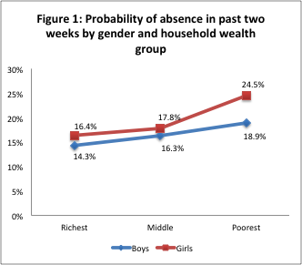
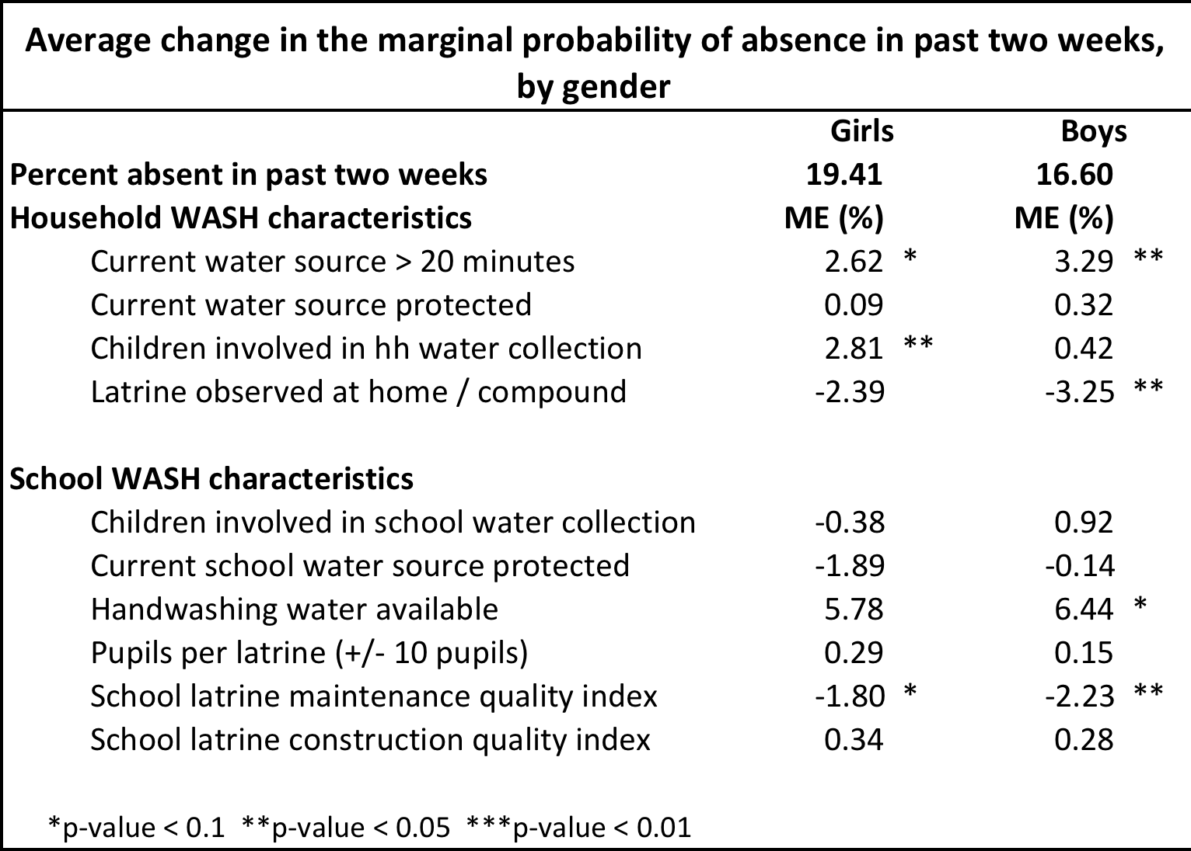
Role of Latrine Cleanliness
Baseline cross-sectional survey
Age, gender, and household wealth significant predictors of recent absence.
Household WASH characteristics had a strong association with recent absence
At the school-level, only the quality of school latrines were associated with reduced absence
Dreibelbis, R et al IJED
Notes:
Three-level logistic regression model used to calculate average marginal effect of selected individual, household, and school characteristics by gender

Slide 22
Role of latrine cleanliness
Increased comfort and use
Sanitation intervention did not meet standards
Latrine conditions did not improve
Girls per latrine
Boys per latrine
**
**
**significant at 0.05
Even so, we see an increase in comfort and reported use
Porter S, et al, unpublished data

Slide 23
Role of latrine cleanliness
Proportion of use by latrine for girls

Slide 24
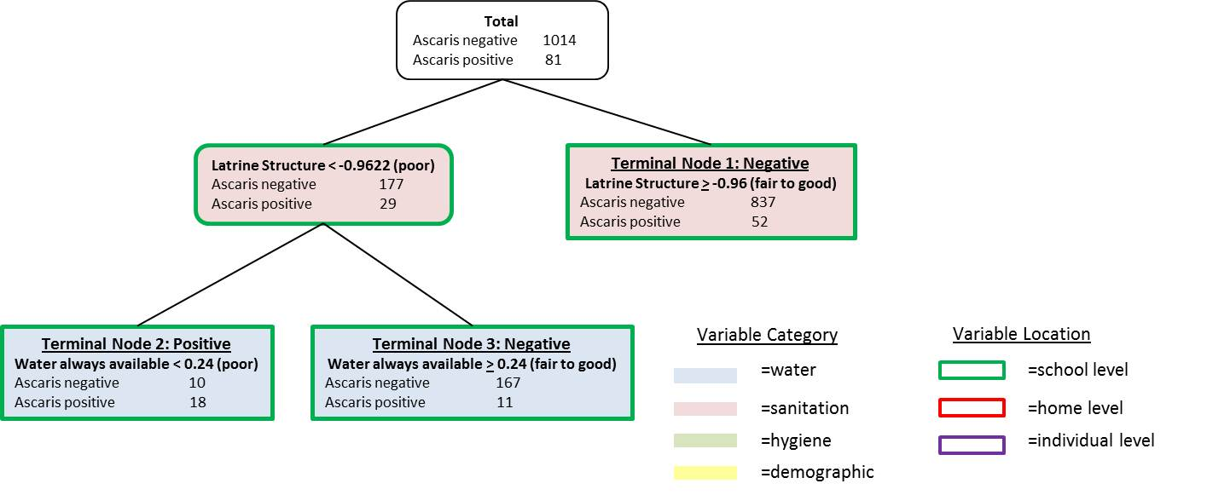
Role of latrine cleanliness
Important for predicting helminth outcomes
CART analysis

Slide 25
Role of hand cleanliness
Soap provision is low, handwashing was low
Soap always available
Inconsistent availability of soap (less than 40% schools)
Increased hand contamination in schools with sanitation¹
No major changes noted in hygiene behavior indicators. Common TOT approach not robust enough?
**
**
**significant at p<0.05
Greene L, Freeman MC, et al 2012 AJTMH

Slide 26
Role of hand cleanliness
Soap provision is low, handwashing was low
Inconsistent availability of soap
Handwashing water always available
Soap always available
**
**
**
**
**significant at 0.05
This is one of a few studies that have shown that achieving and sustaining handwashing is a critical challenge

Slide 27
Role of hand cleanliness
Sanitation schools: higher hand contamination
Any E. coli
High* E. coli
* ≥ 100 CFU/hand
Significant increase in hand contamination in sanitation package schools
No change in schools with basic hygiene promotion
¹Greene L, Freeman MC, AJTM 2012
Notes:
MATT: this and the next are the main slides that are most informative. Be sure to give enough time to these.

Slide 28
Role of hand cleanliness
Anal cleansing materials is a key issue
Methods
Survey of head teachers in 114 schools.
6 Focus Group Discussions (FGDs) with girls and boys (age 12-15) in 3 schools.
Results
111 (97%) reported never providing materials for anal cleansing.
Only 9 schools (8%) actually provided soap & water on the day of the unannounced visit.
Students confirmed lack of access to anal cleansing materials.
Desired materials, such as tissue paper and schoolbook paper, were described as difficult to acquire.
‘I find it difficult to get the materials for bottom cleaning. Maybe you have money for food only. Do you go hungry and buy wiping tissue?...
…Maybe your younger sibling in class 1 sees you tearing your book, just a sheet or two, but they may get the wrong idea and pluck sheets ruthlessly’
  – female student, grade 7, School 1.
McMahon, et al, TMIH 2010
Notes:
We could say we are looking at use now.

Slide 29
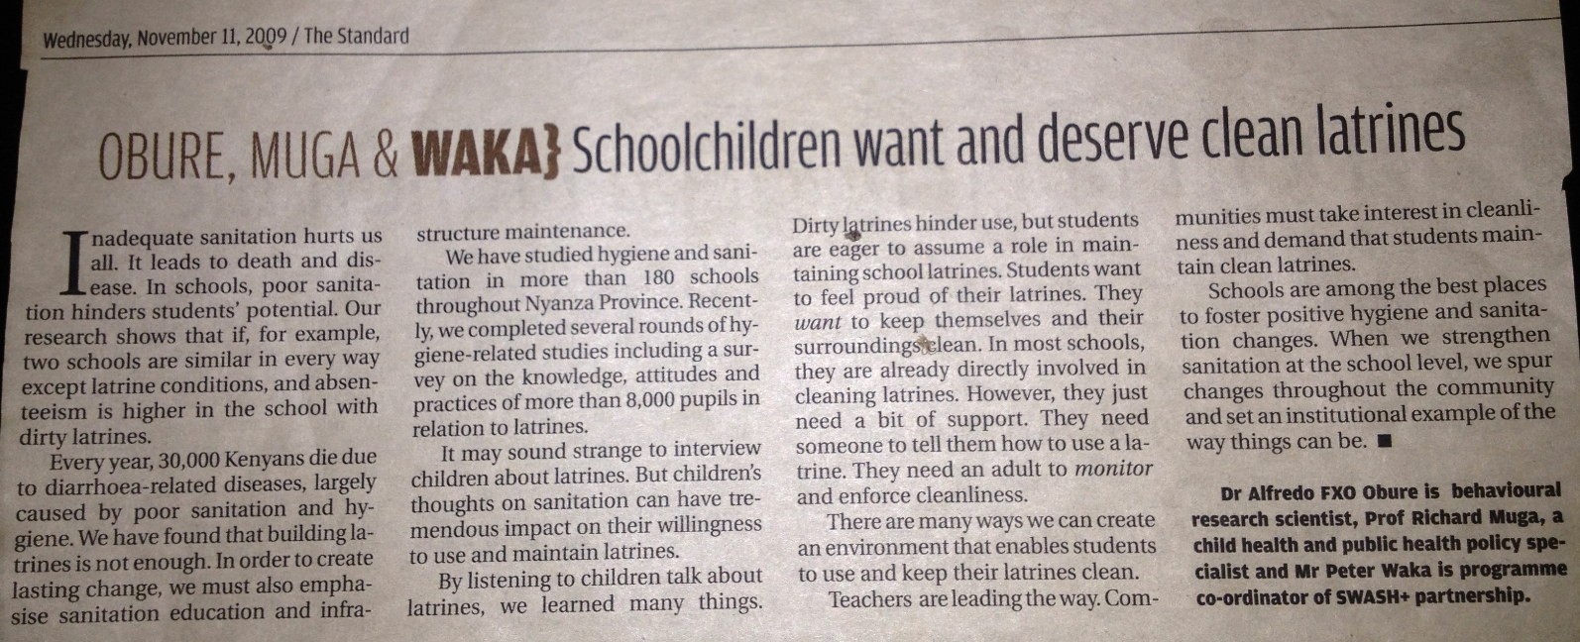
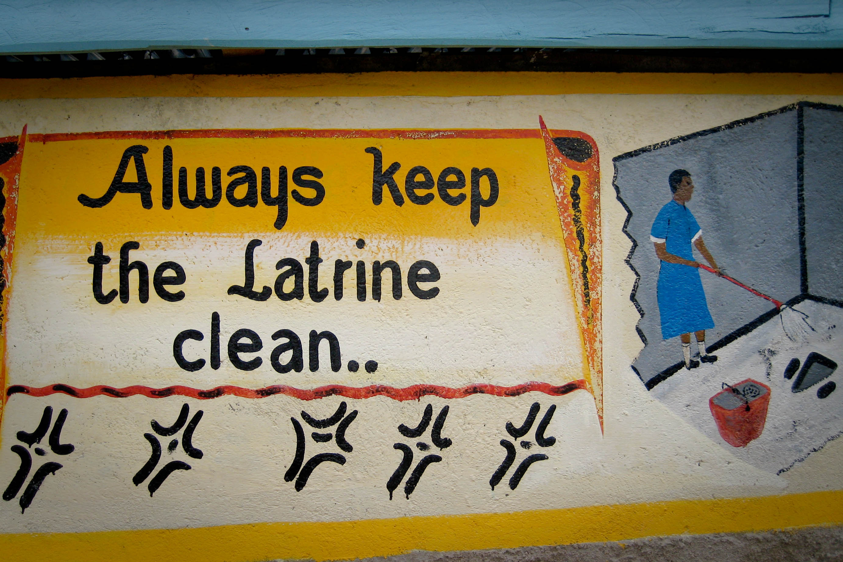
Role of latrine cleanliness
Latrine maintenance trial
Intervention
Intervention design was informed by formative research and piloting.
3 Arms:
Provision of hand washing and Latrine Cleaning Supplies
Provision of hand washing supplies
Control
Methods
60 schools targeted, 20 in each intervention arm
Absenteeism recorded and School WASH characteristics observed 8 times (May-Nov)
Use observations conducted at baseline, final, and 3 rounds between (5 total per school)
Results
No significant reductions in absenteeism as hypothesized
Schools that received the LC+HW package had significantly
cleaner latrines at follow-up rounds compared with those
that did not receive the intervention.
Caruso B, Freeman MC, et al
Notes:
We could say we are looking at use now.

Slide 30
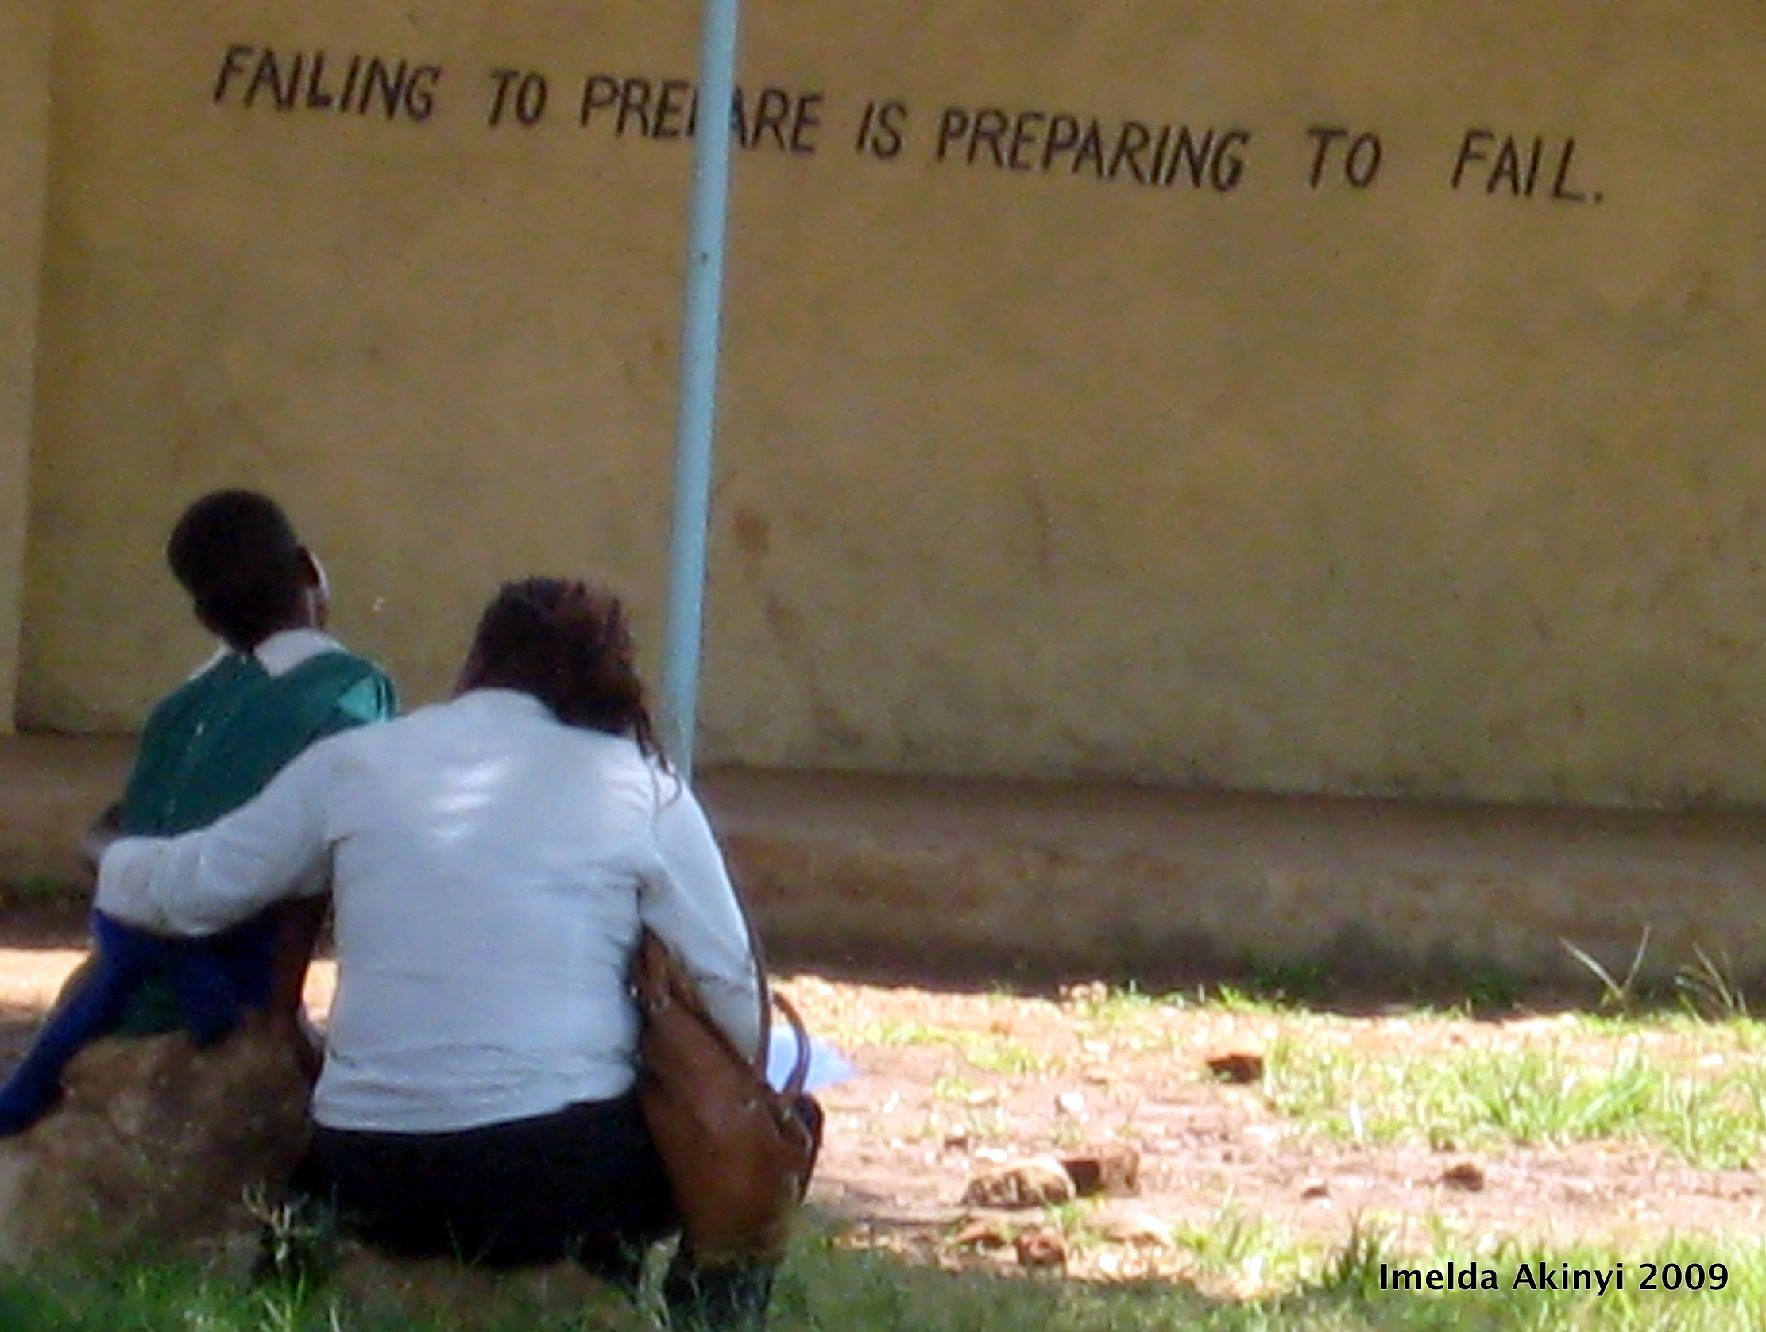
Gender dimensions
Menstrual hygiene management
Methods
6 Schools: Focus Group Discussions (FGDs) and In-depth Interviews (IDIs) with girls and IDIs with teachers.
Results
Menstruation is difficult for girls to manage in the school setting
“A girl will be among the most lively in class, she will participate and make good marks. Then she turns a corner and she will not partake and she is gone.”
- Teacher
“You will not be free even when you are in class, you will be thinking about your period and not pay attention to the teacher.”
-Pupil, Standard 8
“The girl with her period is the one to hang her head.”
-Pupil, Standard 7
McMahon, et al, BMC 2010
Notes:
We could say we are looking at use now.

Slide 31
Session 3
How can we improve the sustainability of school WASH?
Recognizing the challenge – SWASH Pilot sustainability
Identifying barriers
Tracking progress
Testing solutions

Slide 32
Evaluating Sustainability of SWASH Pilot
SWASH pilots established in 2005
  Short-term follow up of SWASH pilots showed high level of continued provision of water treatment and soap
In 2008 we conducted follow up in 60 schools (2.5 yrs)
Results were disappointing to partners and others
  38% provided water for drinking
  9% had chlorine
  18% had handwashing water
  1 school provided soap
Key opportunity for learning within SWASH and beyond
Notes:
Working with CARE to better understand the

Slide 33
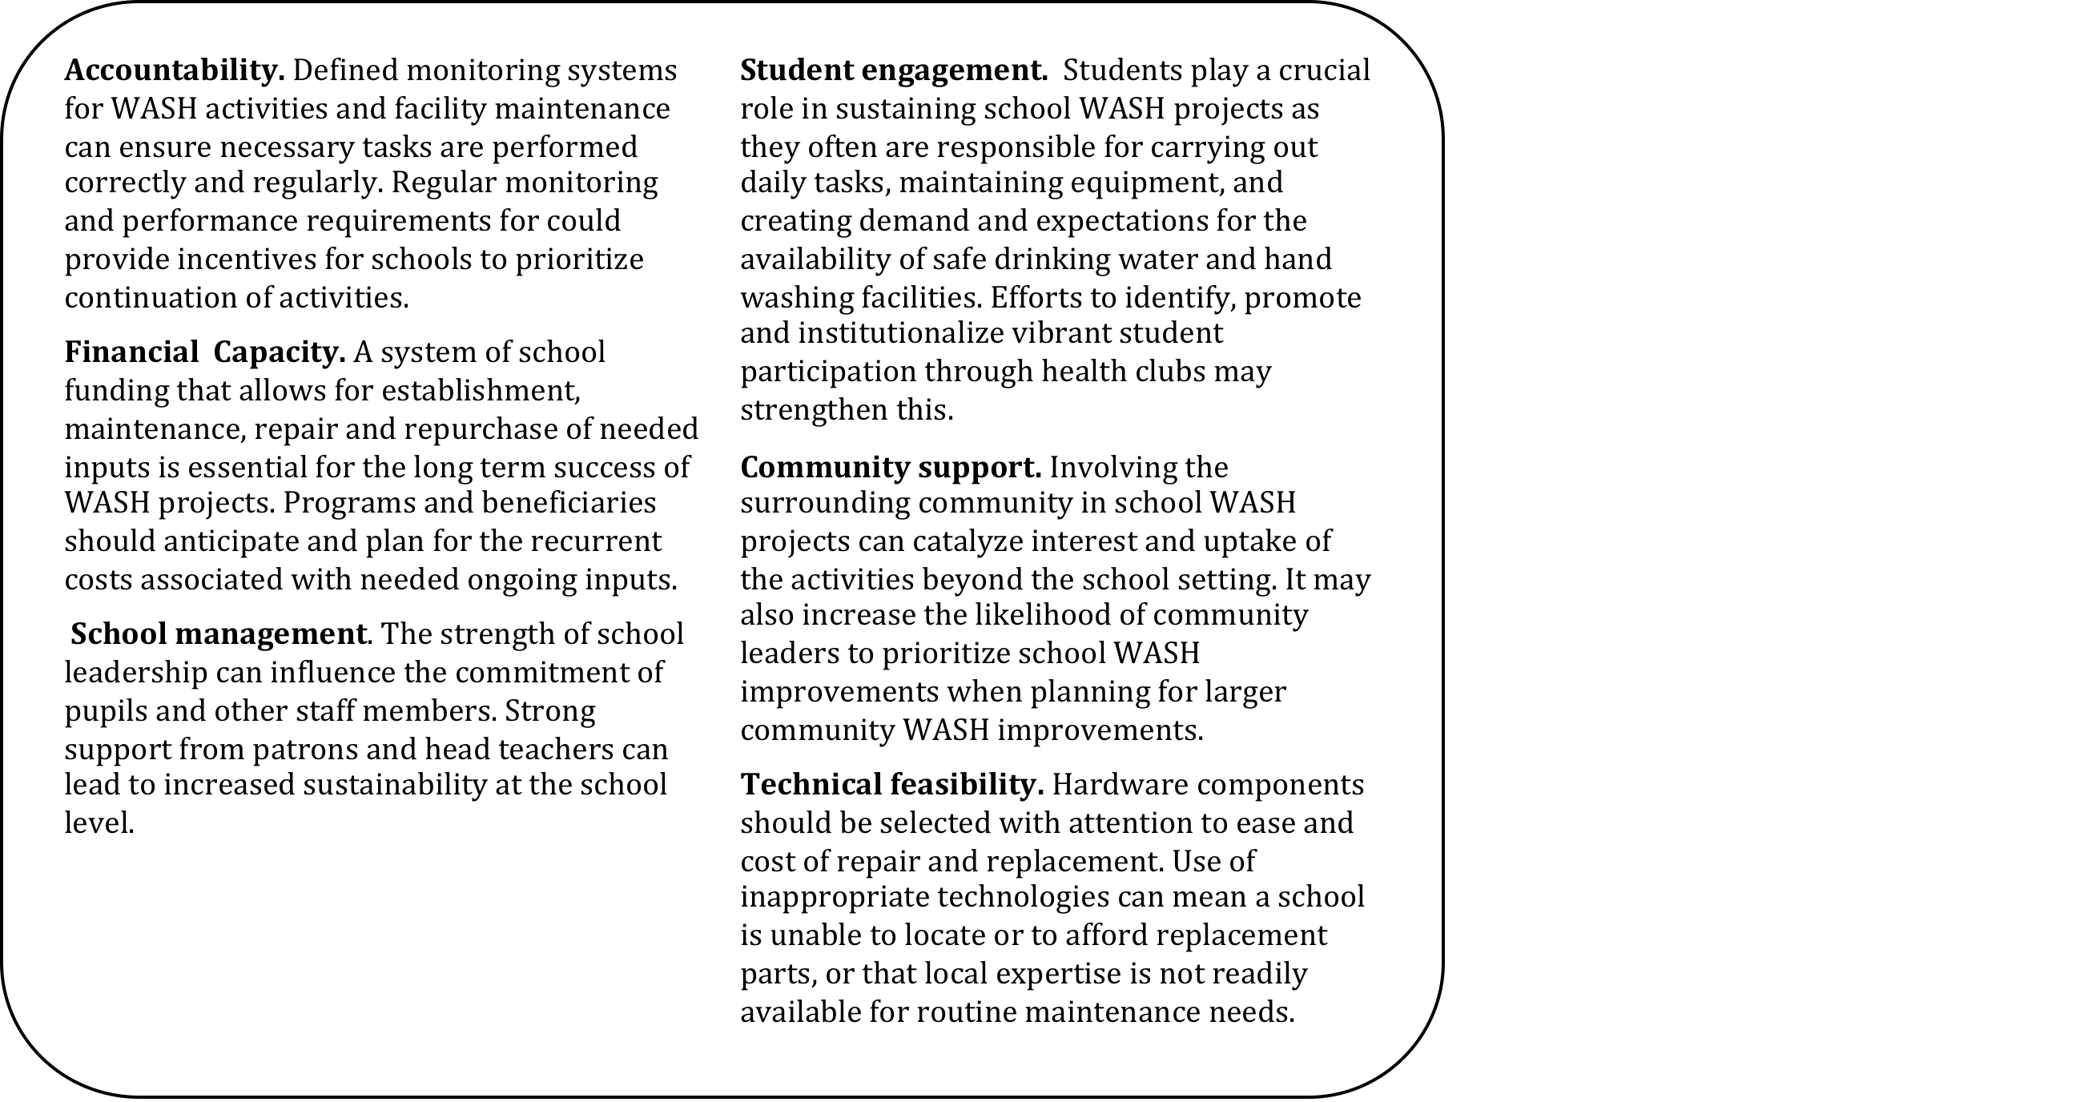
Domains of an Enabling Environment for Sustaining School WASH
Identified barriers to sustained services: internal and external environment
Identified potential solutions (e.g. soapy water) to address them within SWASH schools
Identified ways to monitor these within sustainability toolkit

Slide 34
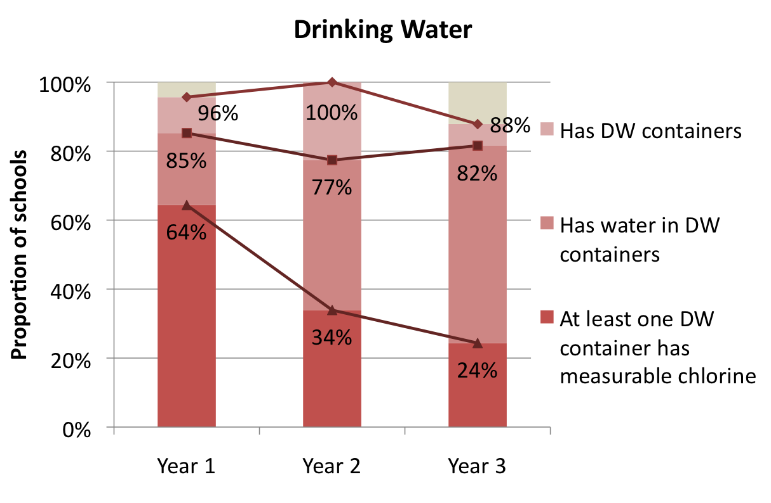
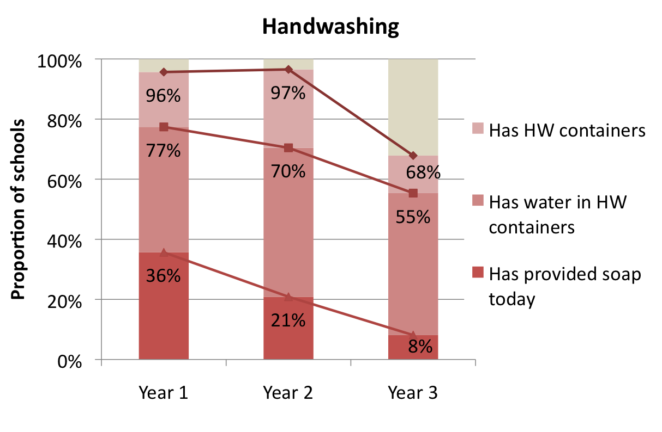
Tracking Sustainability for SWASH Trial School
Improved provision over time compared to the pilot, however still low
Over 80 % of schools budgeted for key inputs, but less than 25% budgeted enough
Supply chain for spare parts remained a barrier
Community wealth and nearby water source associated higher level of sustaining

Slide 35
Testing Strategies for Improving Sustainability
Develop interventions to address sustainability challenges
  Improved service delivery through funding of recurrent and maintenance costs and service staff (janitors)
  Improved roles and responsibilities trial to test the effects of improved accountability
Key findings
  Improved funding can improve provision of basic services such as treated drinking water and soap for handwashing
  Schools have diverse funding needs based on their conditions → solutions for some may not work for others

Slide 36
Sustainability: Key Messages
Sustainability strongly constrains impacts
School-level and administrative solutions (e.g. better planning and M&E) can increase awareness and accountability
Remaining external constraints
  Costs: recurrent, maintenance and improvements
    School cannot do it on their own
  Environmental and infrastructure
    While some schools can benefit from increased provision of supplies such as drinking water treatment, soap and latrine cleaning supplies, others require basic water and sanitation infrastructure

Slide 37
Beyond SWASH+
UNICEF funded a 4 country study on MHM in schools
WASH-B ran a trial of soapy water in B’desh
SHARE funded WASH indicators as part of longitudinal surveillance of STH in Kenya
Development of WASH in schools Mapping
WASH in schools online course for practitioners and policy makers: 170 students from 50 countries
SPLASH Zambia running an impact study of school WASH, focusing on sustainability
Dubai Consortium in Mali has funded evaluation of country-wide program (16m) on educational impacts

Slide 38
Results: Soapy Water Pilot
Soap theft was cited by head teachers as one of the major barriers to providing soap for hand washing in schools (results from our first sustainability study)
Piloted provision of powdered soap and taught schools how to mix with water in locally available bottles to create soapy water for hand washing in 11 pilot schools
  High uptake observed the first six months (10 schools)
  The majority of schools (10) reported repurchasing powdered soap instead of bar soap because it was easier to use, longer lasting, and reduced soap theft
Next steps taken:
  Powdered soap was provided during the latrine maintenance trial to intervention schools (40). The proportion of pupils observed practicing hand washing with soap after latrine use was significantly higher in schools that received a soap provision intervention (32%) and schools that received soap + latrine cleaning materials (38%), compared to controls (3%).
  Colleagues from the WASH Benefits study have used these results as a springboard for further studies including:
    “Soapy Water: A Low-Cost Solution for Hand Washing Promotion” presented by Dr. Steve Luby at the 2012 Trop Med conference held in Atlanta, GA. Significantly higher uptake was observed among households in the three intervention arms versus controls in Bangladesh.
    Ongoing work in Kenya of scaling up the use of soapy water along with tippy tap technology in households- led by Dr. Clair Null and colleagues

Slide 39
Discussion
Study provides limited evidence of impact
School WASH may reduce diarrhea in certain circumstances
Comprehensive intervention – including water supply – reduced diarrhea
No significant impact from HP&WT, sanitation improvement on diarrhea
Similar impacts for pupils and children under 5
Water supply improvements are essential to “unlock” effect of other HP&WT, sanitation for diarrhea impact
Impact is different than what we found for absence

Slide 40
Results: Absenteeism
Why do we impact girls?
Absenteeism by gender and socio-economic status
% absent in previous two weeks
Total | 19.2%
Boys | 17.7%
Girls | 20.8%
With school WASH we are reaching a marginalized group
Dreibelbis, R et al IJED
Notes:
Add name, fix chart, titles

Slide 41
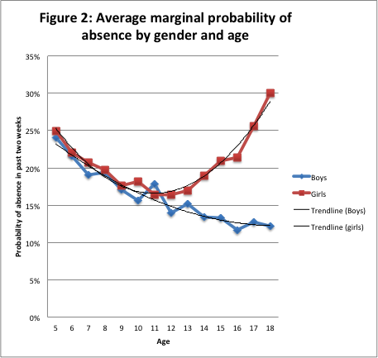
Baseline cross-sectional analyis
Why don’t we see an impact with hygiene promotion?
Three-level logistic regression model used to calculate average marginal effect of selected individual, household, and school characteristics by gender
Age, gender, and household wealth significant predictors of recent absence.
Household WASH characteristics had a strong association with recent absence
At the school-level, only the quality of school latrines were associated with reduced absence
Dreibelbis, R et al IJED

