Slide 1


Slide 2

An area-wide approach for programming rural sanitation
Understanding core components and change pathways

Slide 3

Session plan
Welcome, opening and introductions, poll
FINISH Mondial approach and results
A focus on area-wide sanitation – presentation and participatory exercise
Inclusive programming in Tanzania through GESI barrier analysis
The critical role of sanitation centers and community showrooms in effective sanitation services delivery – Rwanda’s experience
Area-wide sanitation and ecosystem learning and research agendas
Key takeaways and next steps

Slide 4
Area-wide sanitation poll
How many of you are working on rural sanitation and hygiene?
How many of those are working on multi-intervention, at-scale programs?
How many of those programs are really designed and planned to reach area-wide outcomes?
How many of those have actually achieved area-wide results?
Notes:
After poll: Brief discussion with one or two of those still holding up their hand by question 4, on the program/country/district they represent and one or two of their key take-aways on AWS.

Slide 5
The FINISH Mondial approach and results

Slide 6
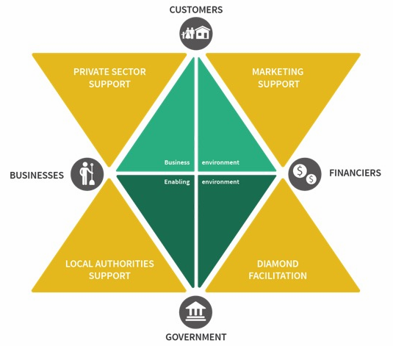
FINISH Mondial
Proven Model on Sanitation Market Development for BoP
People knowing they need a toilet (through health awareness creation)
People wanting a toilet (through demand creation)
People wanting to buy a durable toilet with safe management
of human waste (through sanitation marketing)
Local people building those (through mason training)
People being able to afford those (through financial
inclusion & loans, design improvements and
economies of scale)

Slide 7
FINISH Mondial
Proven Model on Sanitation Market Development for BoP
(233) What is Finish Mondial - Animation video (new version 2023) - YouTube

Slide 8
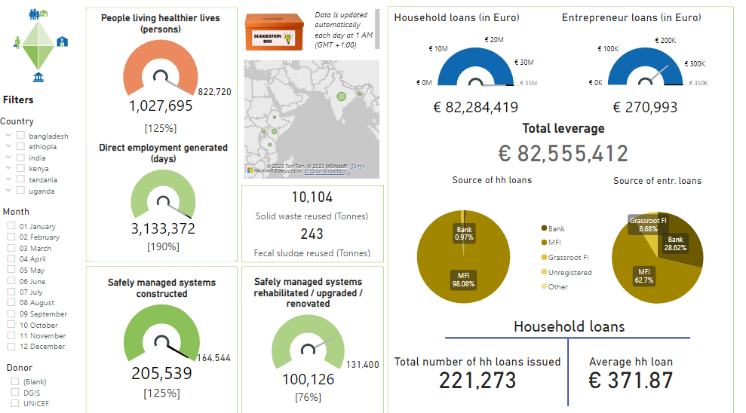
FINISH Mondial Results 2022

Slide 9
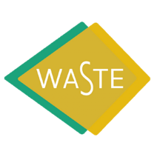











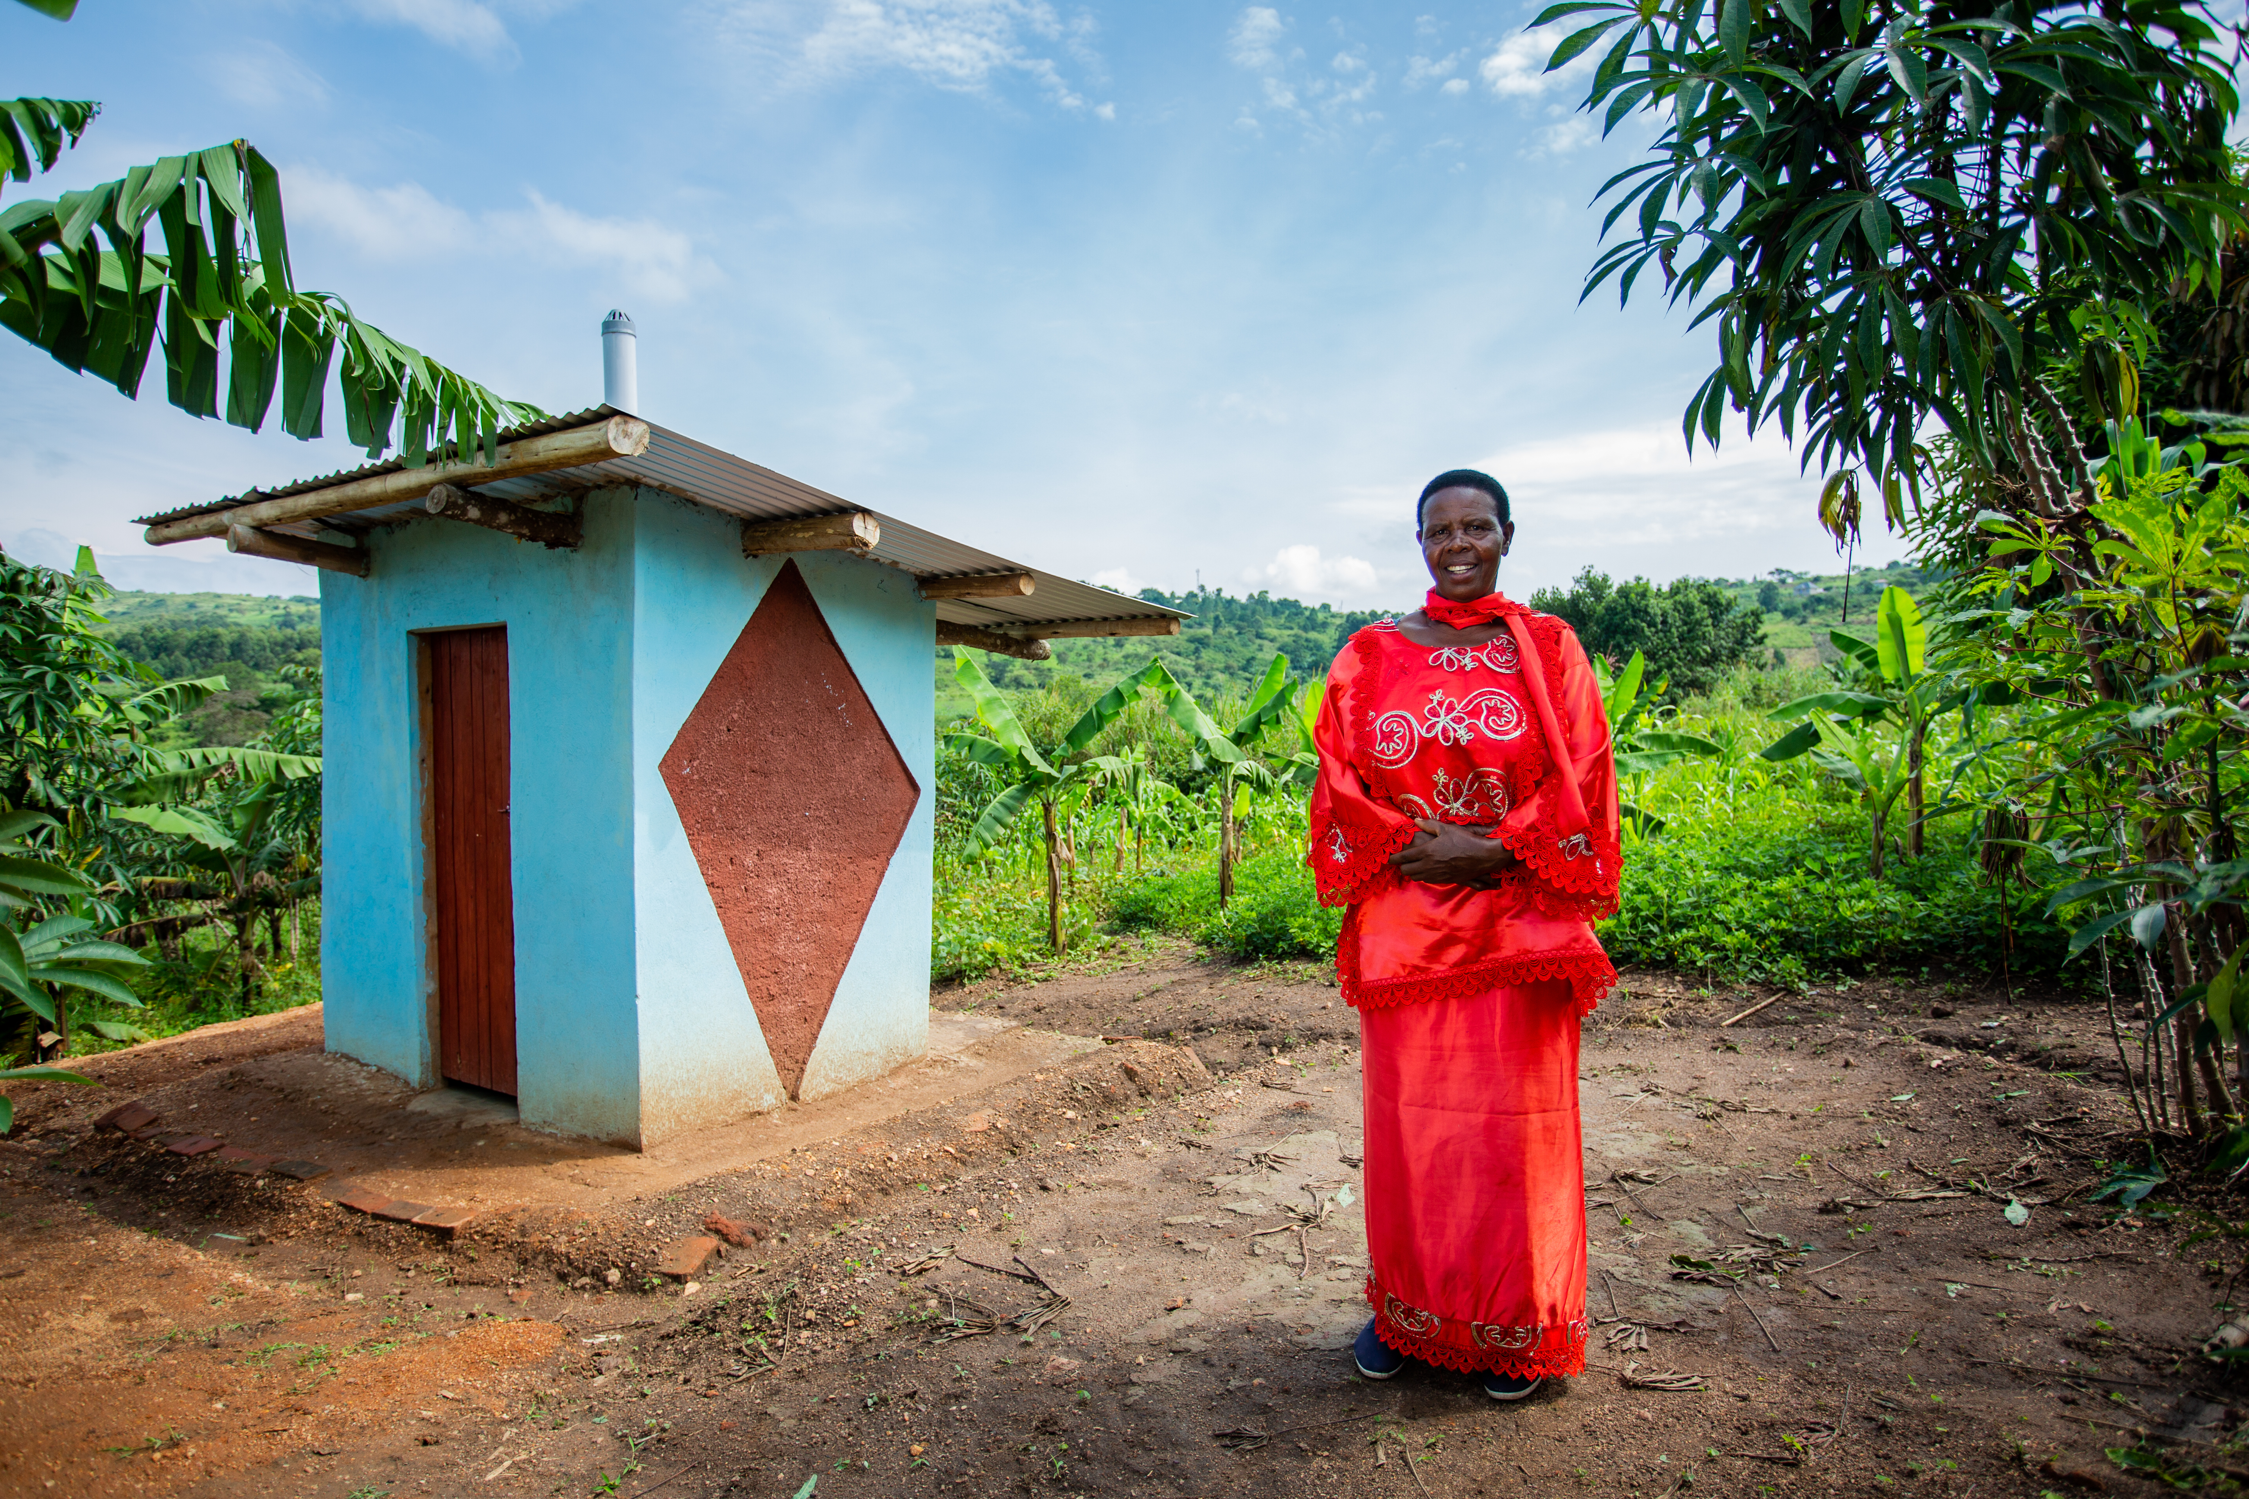










FINISH Mondial
FM targets 10 million people with access to safely managed sanitation (2021-2025)
Financial inclusion & leverage are next to climate adapted safely managed sanitation USPs

Slide 10
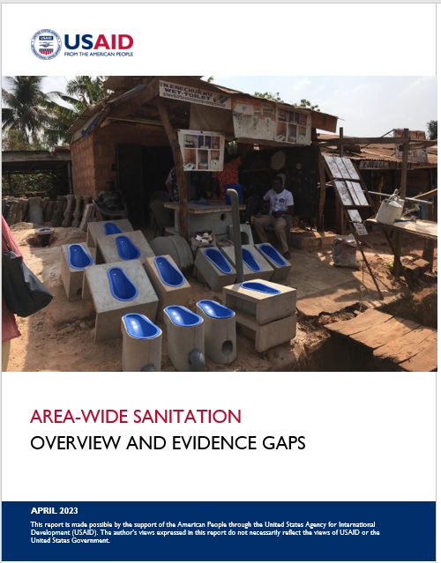
Area-wide Sanitation – why, what and how?

Slide 11





USAID Water, Sanitation, and Hygiene Partnerships and Learning for Sustainability (WASHPaLS) #2
WASHPaLS #2 is a 5-year (2021-2026) project with the goal of improving WASH programs by ensuring quality, equity, sustainability, and scale of sanitation products and services and adoption of sound hygienic practices, particularly in rural areas.
Area-wide Sanitation is the overarching theme for WASHPaLS #2 Research and Learning
Area-wide sanitation
Market-based sanitation
Social behavior change
Gender Equality and Social Inclusion

Slide 12
The goal
By 2030, achieve access to adequate and equitable sanitation and hygiene for all and end open defecation, paying special attention to the needs of women and girls and those in vulnerable situations:
Elimination of open defecation
Universal access to safely managed sanitation and hygiene
Progressive reduction of inequalities among population sub-groups; reduced sanitation and hygiene burdens for women and girls

Slide 13
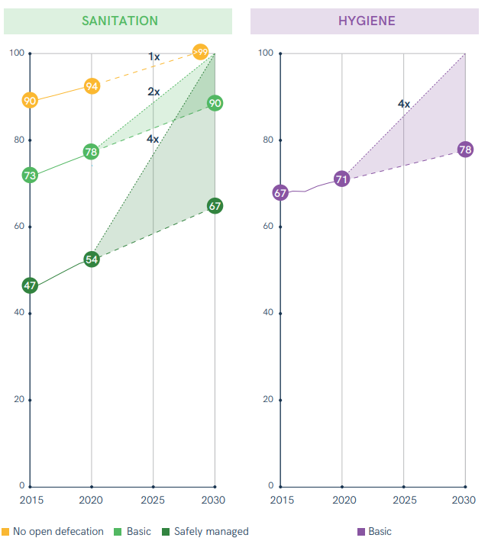
The reality
Progress has been substantial, but many countries are off track to meet their Sustainable Development Goal (SDG) 6.2 targets.
A concerted effort is needed to broaden, combine, and strengthen existing approaches throughout the sector to accelerate progress.

Slide 14
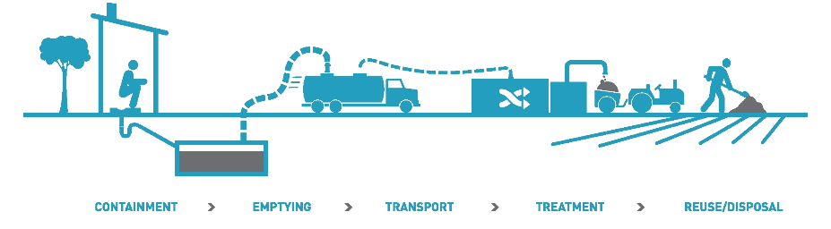

A response
Area-wide sanitation (AWS):
A systems-based, outcome driven framework to achieve universal access and use of safely managed sanitation and hygiene in a given administrative area, such as a district
Notes:
Universal services require access and use across the life-cycle, accounting for special needs in different life-stages
Achieving universal use requires identifying the potentially marginalized and disadvantaged groups and intersectionality
Achieving universal services requires faster progress among disadvantaged groups; prioritization
Safely-managed requires attention across the sanitation service chain
At scale requires systems strengthening and public sector leadership, thoughtful/careful planning and coordination of multiple interventions by multiple actors; need for strong M&E, oversight and adaptive management

Slide 15




AWS principles – what’s different?
SCALE
UNIVERSAL COVERAGE
GOVERNMENT LEADERSHIP
SUSTAINABILITY
Sanitation service provision is coordinated and implemented at an administrative level above individual communities or specific populations
“Area” may include: commune, district, municipality, county, province, etc.
Intentionally identify marginalized or at-risk populations and adapt interventions to the needs of the most vulnerable
Tailor and combine sanitation interventions to address multi-dimensional deprivations
Governments are the “duty bearers” for ensuring access to sanitation services
Local governments ensure capacity to oversee coordination of stakeholders, design and implement interventions, and strengthen M&E systems
Toilet use and safe management are sustained through a focus on durability, service delivery, and systems strengthening
Programming is aimed at achieving sustained access to safely managed sanitation services
Notes:
At their core, area-wide programs are deliberately equitable and inclusive by focusing on sanitation and hygiene outcomes that everyone within that area must achieve, rather than only a specific target population. This focus on universal and inclusive coverage goes beyond existing approaches and projectized practices (whether community-led total sanitation [CLTS], sanitation marketing, market-based sanitation [MBS], or others), which have often focused on selected population groups or specific geographies within a wider area or have been implemented in silos. The main benefit of AWS is that it forces governments and implementers to start thinking about and planning, from the beginning, how best to reach all people and communities, including those in more challenging contexts or who face specific barriers to adequate sanitation and hygiene.

Slide 16
How to implement AWS?
WASHPaLS #2 set out to answer two questions:
What sanitation interventions are required in different contexts to ensure long-term access to safely managed sanitation services in rural areas, and how can we target, integrate, phase, monitor, and finance those interventions at an area-wide level?
What is needed to achieve equitable access to sanitation under an area-wide approach?
Extensive desk review identified a set of core components of AWS.
A Theory of Change can outline how we think these core components connect and interact and can be a framework to guide further learning.

Slide 17
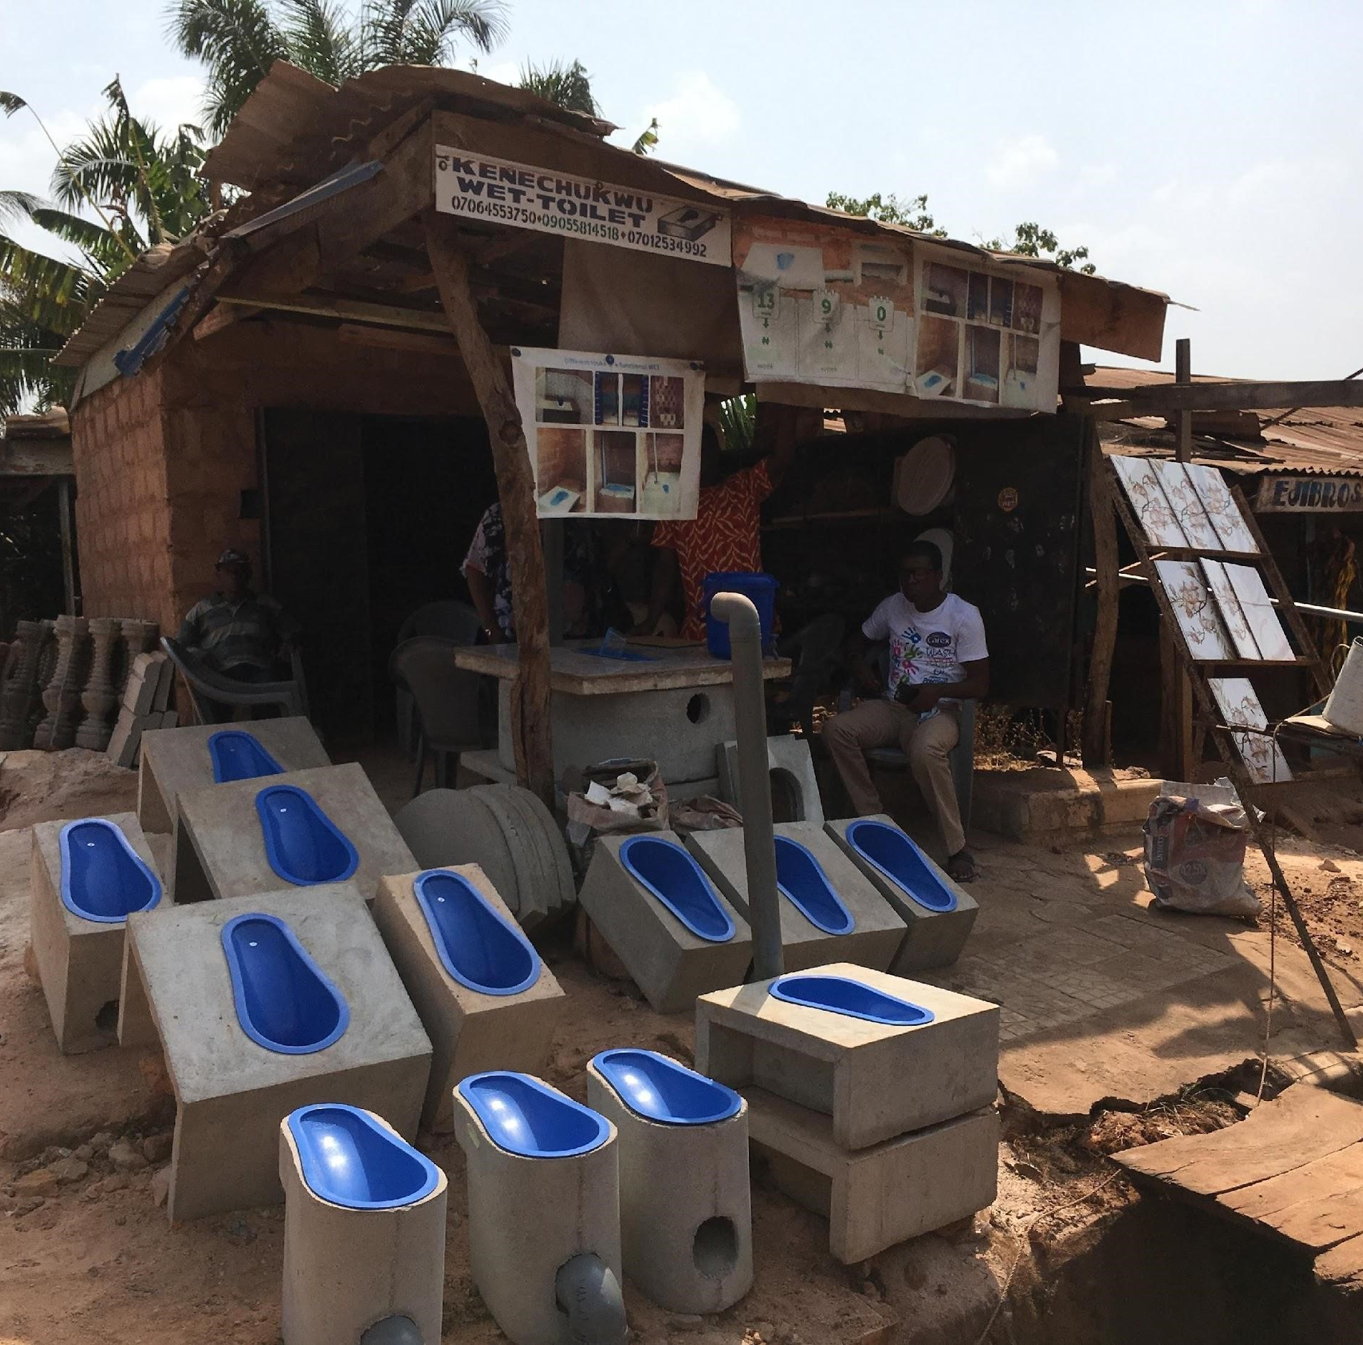
AWS Theory of Change
exercise

Slide 18
Summary ToC
IF guiding principles ensure a focus on
scale,
universal and inclusive coverage,
government leadership, and
sustainability;
AND IF a range of proven, available sanitation and hygiene interventions, products, and services exist that can be applied in the administrative area;
THEN local government and implementing partners can ensure application of a mix of sanitation and hygiene interventions and services at scale, properly adapted for the different rural contexts and target populations, and adapted over time to achieve planned outcomes;
AND IF a national enabling environment for AWS and subnational building blocks are in place;
AND IF THAT, THEN behaviors, demand and access to appropriate, affordable materials and markets across all population groups can lead to universal, equitable, and sustained area-wide use of safe sanitation services and practice of hygiene.
Notes:
This is the narrative TOC…

Slide 19
IF guiding principles ensure a focus on
scale,
universal and inclusive coverage,
government leadership, and
sustainability;
AND IF a range of proven, available sanitation and hygiene interventions, products, and services exist that can be applied in the administrative area;
THEN local government and implementing partners can ensure application of a mix of sanitation and hygiene interventions and services at scale, properly adapted for the different rural contexts and target populations, and adapted over time to achieve planned outcomes;
AND IF a national enabling environment for AWS and subnational building blocks are in place;
AND IF THAT, THEN behaviors, demand and access to appropriate, affordable materials and markets across all population groups can lead to universal, equitable, and sustained area-wide use of safe sanitation services and practice of hygiene.
National system building blocks:
Sector policies and strategies
Planning, monitoring, and financing
Legislation, regulation, standards, and guidelines
Capacity development and technical assistance
Functioning market systems
Subnational system building blocks:
Planning and budgeting
Local regulation, standards, and guidelines
Capacity and HR
Political will and ownership
Institutional arrangements and partnership
MEL
Sanitation and hygiene interventions:
Community mobilization, demand creation, and behavior change
Market and supply side interventions
(Financial) support mechanisms for the most vulnerable
Components activities and processes
System strengthening
Adaptive management
GESI mainstreaming
Notes:
Here we explain what the actions linked to the grey and green boxes of the TOC are…

Slide 20
IF guiding principles ensure a focus on
scale,
universal and inclusive coverage,
government leadership, and
sustainability;
AND IF a range of proven, available sanitation and hygiene interventions, products, and services exist that can be applied in the administrative area;
THEN local government and implementing partners can ensure application of a mix of sanitation and hygiene interventions and services at scale, properly adapted for the different rural contexts and target populations, and adapted over time to achieve planned outcomes;
AND IF a national enabling environment for AWS and subnational building blocks are in place;
AND IF THAT, THEN behaviors, demand and access to appropriate, affordable materials and markets across all population groups can lead to universal, equitable, and sustained area-wide use of safe sanitation services and practice of hygiene.
TOC
National system building blocks:
Sector policies and strategies
Planning, monitoring, and financing
Legislation, regulation, standards, and guidelines
Capacity development and technical assistance
Functioning market systems
Subnational system building blocks:
Planning and budgeting
Local regulation, standards, and guidelines
Capacity and HR
Political will and ownership
Institutional arrangements and partnership
MEL
Sanitation and hygiene interventions:
Community mobilization, demand creation, and behavior change
Market and supply side interventions
(Financial) support mechanisms for the most vulnerable
Components activities and processes
System strengthening
Adaptive management
GESI mainstreaming
National government institutions, DPs, civil society and private sector collaborate to build a strong national enabling environment that provides direction, resources, and oversight to local governments.
Local government institutions provide leadership, resource and implement/ coordinate the system, and oversee the partnerships required to achieve/ensure sustained service delivery.
DPs support local governments to plan and budget, build, use and sustain M&E systems, apply a GESI lens, coordinate all partners, and apply adaptive management across programs, interventions and services.
A mix of local government, civil society and private sector partners - including volunteers and the informal sector – implement the sanitation and hygiene interventions and services, with DP support.
Actors and key roles
Notes:
And here we add an overview of the key actors.

Slide 21
IF guiding principles ensure a focus on
scale,
universal and inclusive coverage,
government leadership, and
sustainability;
AND IF a range of proven, available sanitation and hygiene interventions, products, and services exist that can be applied in the administrative area;
THEN local government and implementing partners can ensure application of a mix of sanitation and hygiene interventions and services at scale, properly adapted for the different rural contexts and target populations, and adapted over time to achieve planned outcomes;
AND IF a national enabling environment for AWS and subnational building blocks are in place;
AND IF THAT, THEN behaviors, demand and access to appropriate, affordable materials and markets across all population groups can lead to universal, equitable, and sustained area-wide use of safe sanitation services and practice of hygiene.
TOC
National system building blocks:
Sector policies and strategies
Planning, monitoring, and financing
Legislation, regulation, standards, and guidelines
Capacity development and technical assistance
Functioning market systems
Subnational system building blocks:
Planning and budgeting
Local regulation, standards, and guidelines
Capacity and HR
Political will and ownership
Institutional arrangements and partnership
MEL
Sanitation and hygiene interventions:
Community mobilization, demand creation, and behavior change
Market and supply side interventions
(Financial) support mechanisms for the most vulnerable
Components activities and processes
System strengthening
Adaptive management
GESI mainstreaming
National government institutions, DPs, civil society and private sector collaborate to build a strong national enabling environment that provides direction, resources, and oversight to local governments.
Local government institutions provide leadership, resource and implement/ coordinate the system, and oversee the partnerships required to achieve/ensure sustained service delivery.
DPs support local governments to plan and budget, build, use and sustain M&E systems, apply a GESI lens, coordinate all partners, and apply adaptive management across programs, interventions and services.
A mix of local government, civil society and private sector partners - including volunteers and the informal sector – implement the sanitation and hygiene interventions and services, with DP support.
Actors and key roles
Notes:
Final overview.

Slide 22
Questions – elements and pathways of change
Are we missing any elements? (building blocks, interventions, processes)
Are some national building blocks more important than others to implement AWS at a subnational level?
Are some subnational building blocks higher priority than others? Do some need to be in place before others?
Other thoughts on this high-level TOC?
Notes:
Questions for groupwork. Handouts of the slide 17 schematic will also be made available to help group discussions.

Slide 23
Nice, this TOC, but how to implement, sequence and combine all these different processes, interventions and activities?
Notes:
Transition slides after the group work, to get everybody back to plenary.

Slide 24
An example on market-based sanitation
Development approaches
CLTS/SBC | MBS | Subsidy | ….
Extend the reach of markets to less-served contexts...
…and less served customer segments
Rural mixed | Rural on-road | Rural remote | Difficult contexts
Geographic
    Liberia¹
    Western
    Kenya²
Community- level exclusion
Physical distance
Social distance
    Senegal³
Vulnerability
    Bihar (India)⁴
Intra-household exclusion
Gender
Age
Physical disability
….
    Require Subsidy
    Require Subsidy and/or Loan
    Can afford IBT⁵
  1, 2, 3 USAID WASHPaLS sanitation market assessments conducted in Liberia, Western Kenya, and Senegal (2021); 4. Monitor Group (2012). Market-led, Evidence-based, Solution to Rural Sanitation; 5. Improved Basic Toilet: Sanitation facility that hygienically separate excreta from human contact and are not shared with other households
Notes:
An example of some of the questions around implementing, sequencing and combining different interventions. Shows the different development approaches a program could use, some of the key questions a program needs to consider in an AWS context (geographic diversity, different types of vulnerability, different ability/willingness to pay levels), and that if you go in via an MBS program, the red and grey indicate where that might not be enough to reach everyone.
MBS is one among a suite of approaches to address select contexts, vulnerabilities, and customer segments, and contribute to AWS goals. This slide outlines an area of research of WASHPaLS #2 which focuses on some key questions around expanding services in an area-wide context. Questions such as: How to adapt product systems to reach more geographically remote communities and households? Or how to deal with intra-household exclusion? How to bring in subsidies for those who require them? The next few presentations discuss some program experiences addressing some of these questions, focusing specifically on GESI and MBS.

Slide 25
Finish Mondial LNOB
45% of sanitation constructed under FM Uganda are built by female masons, breaking down taboos for instance Tweheyo Naume is 23-years-old and has already constructed over 80 sanitation systems. For her, setting up her own business is a dream come true.
Jayshree Yona has lived all her life without a toilet in Wadjhakan Gram Panchayat. While the men of her family can go outside anytime, Jayshree and her mother-in-law had to wait till it gets dark, making their walk to the “bush toilet” a risky endeavour. Vulnerability to violence is a real threat faced by women who practice open defecation. Stories from: Leave No One Behind: Working for socially and gender inclusive sanitation – FINISH Mondial
BBC News Africa on Twitter: "It's a basic human function, but for some it's not easy getting to a toilet. This is how a group of women in Uganda are helping those with disabilities get the access they need 🚽⬇️ https://t.co/uNfGo4rl74" / Twitter

Slide 26
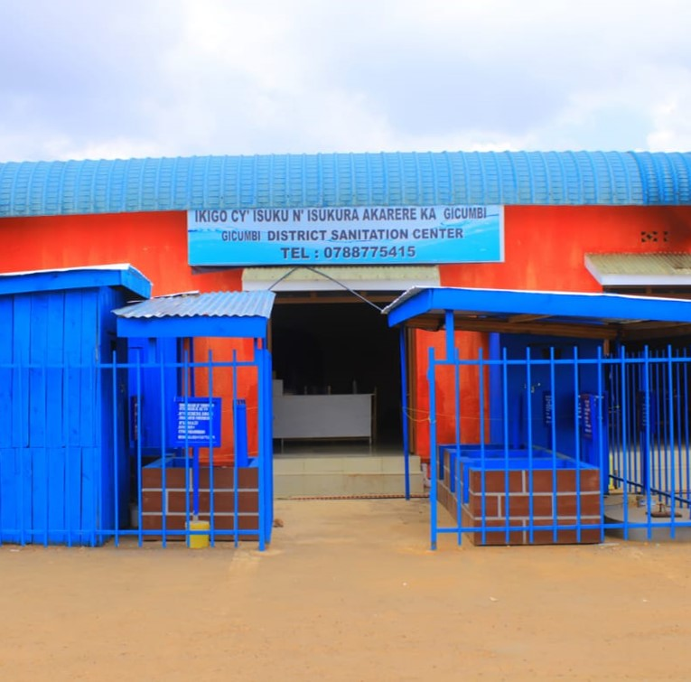
The critical role of sanitation centers and community showrooms in effective sanitation services delivery – Rwanda’s experience

Slide 27
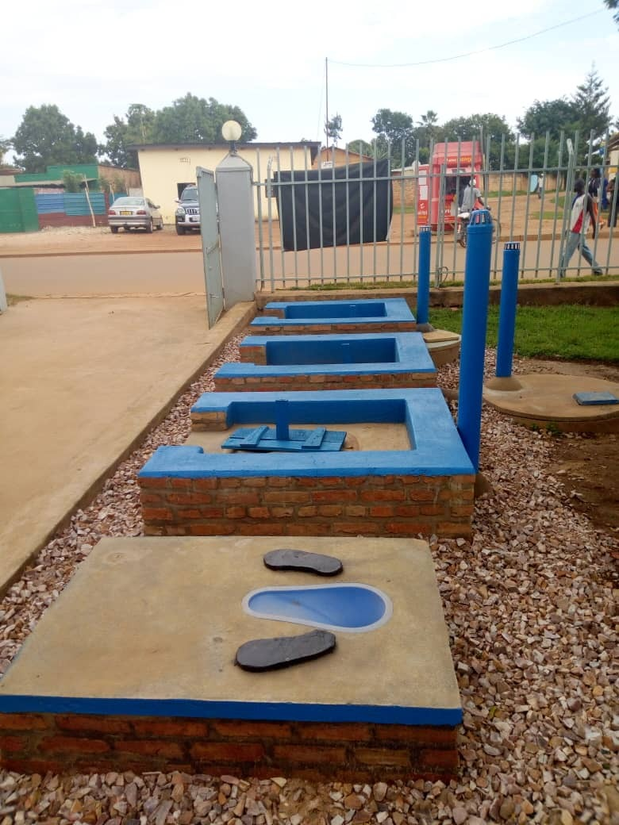
Contents slide
Rationale of the DSC establishment;
Main functions
Current status and impact
Roles and responsibilities
Roles played to broader sanitation & Hygiene promotion approach
Challenges, opportunities and lessons learnt
Conclusion and way forward

Slide 28
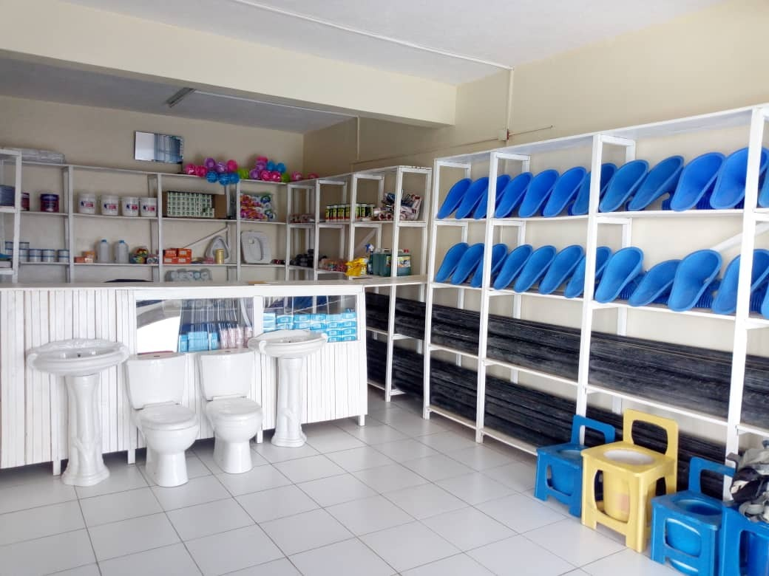
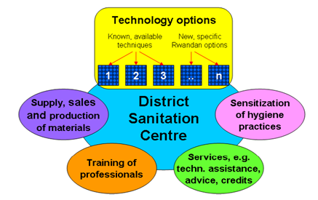
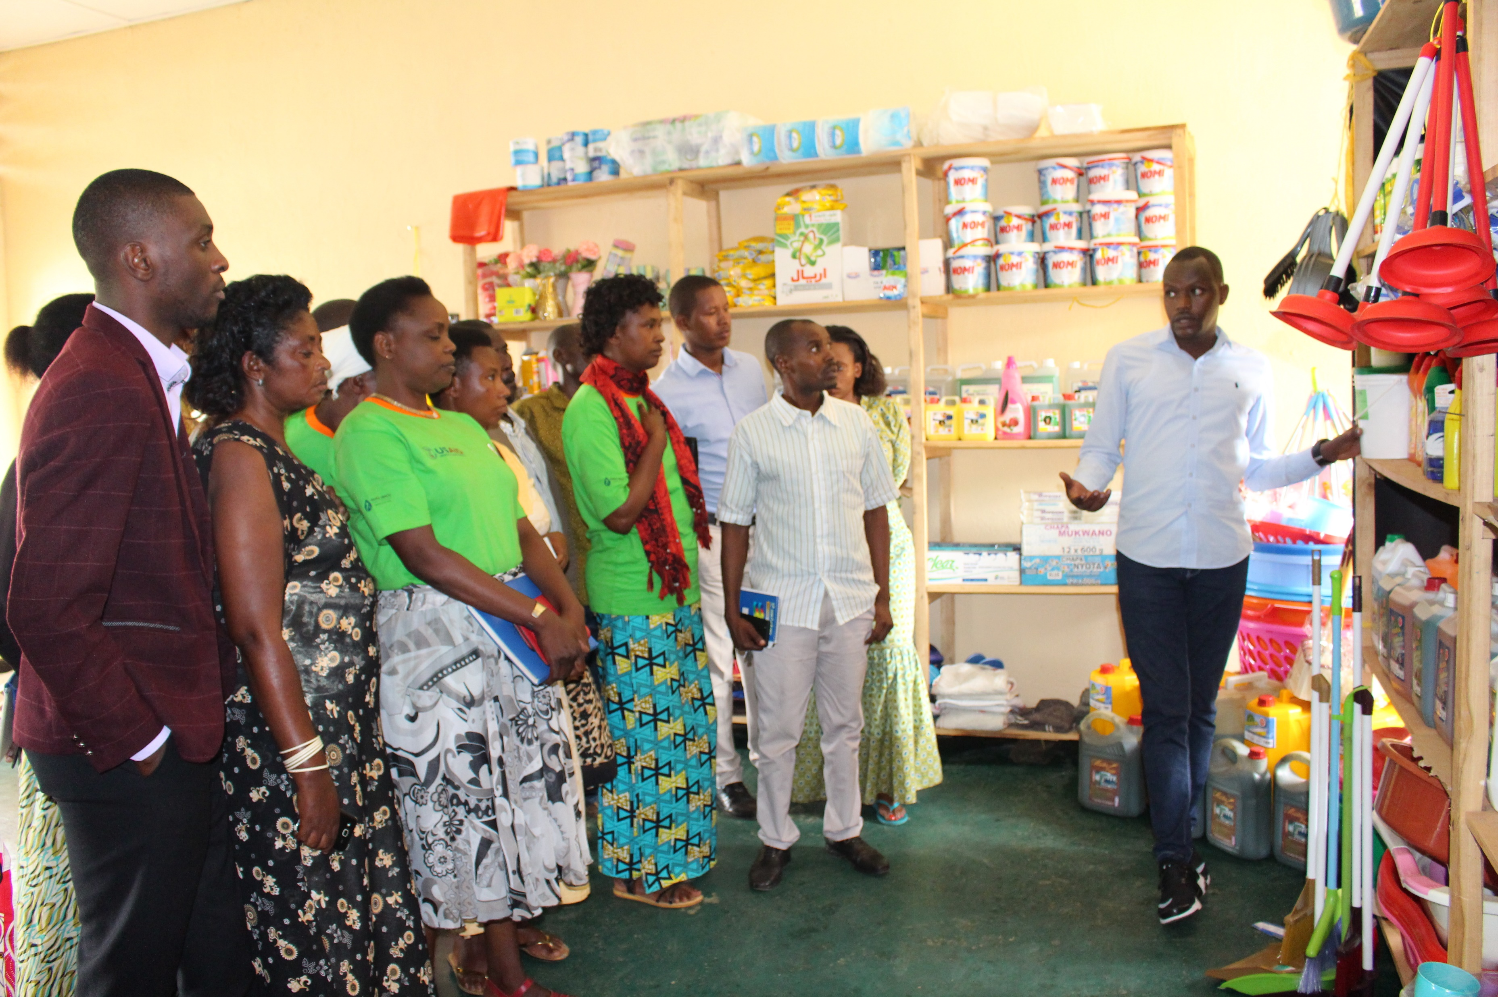
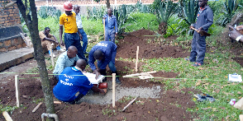
Rationale of the DSCs establishment
Concept highlighted in the National Sanitation Policy (2016) to solve challenges related to the sanitation supply chain and transmission of knowledge
Policy objectives:
Supply chain
Display
Capacity building
Business and marketing

Slide 29
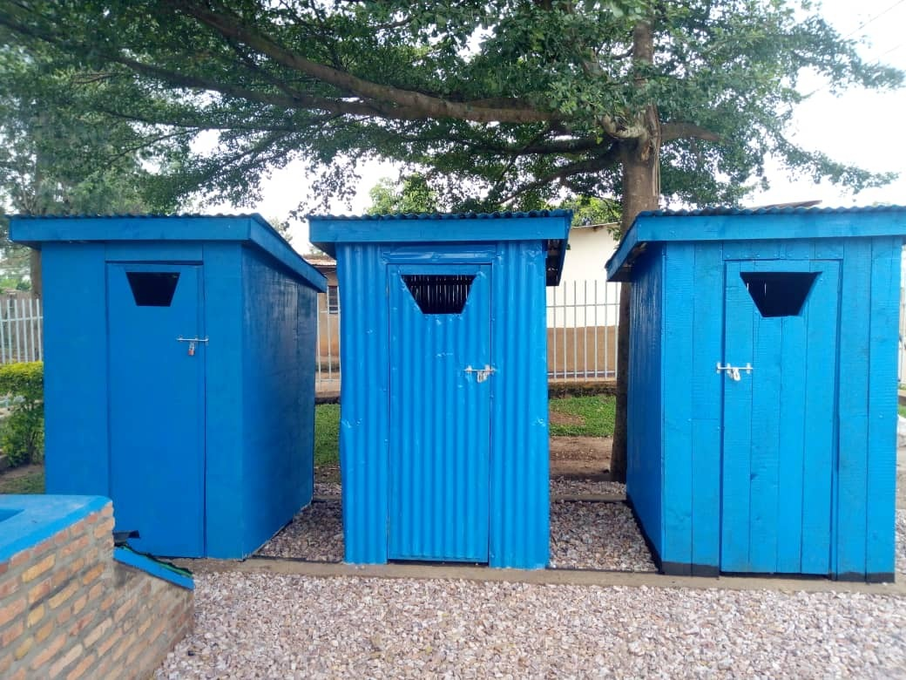
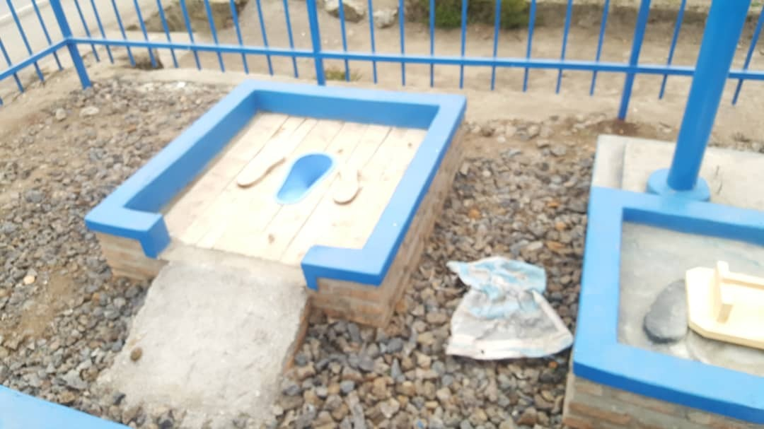
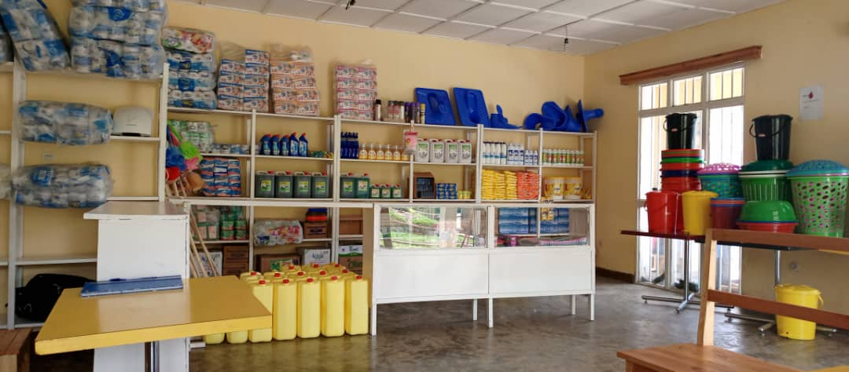
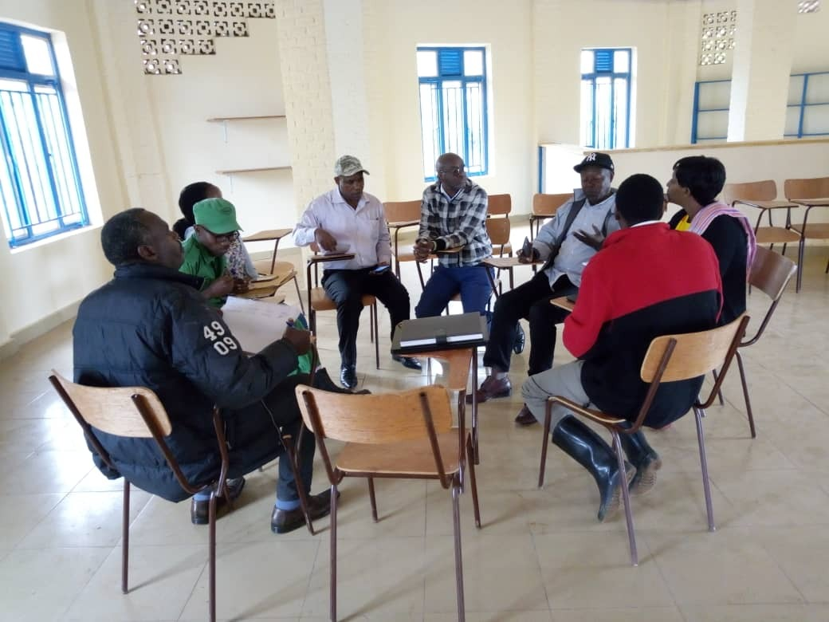
What are the components and functions of the DSC?
Three main components:
  Technologies demonstration
  Sanitation shop
  Training room
Functions
  A business outlet: to visualize different technical options of sanitation and hand-washing facilities, inform visitors about techniques, construction methods, prices and conditions
  Facilitate marketing & training, meetings, awareness and (social) marketing campaigns
  Storage for private sector products. (SaTo pan, toilet seats and slabs, hand washing equipment, ventilation pipes, insect screens, Hand Sanitizers, water filters, chlorine tablets, hand washing facilities and pumps, Hygiene product such as soaps

Slide 30
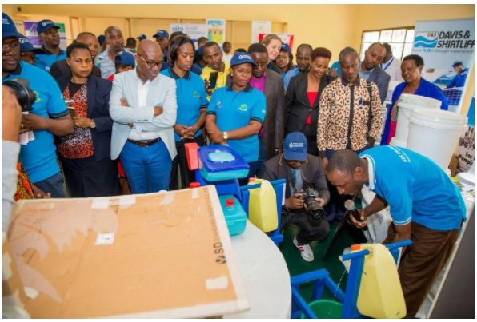
DSC and Community showrooms Parts
A showroom: visitors get to view various existing and the latest sanitation products and technologies, such as new and affordable latrine prototypes, or an innovative handwashing station that is suitable for rural settings.
A selling point: this part is where customers can purchase products and enquire information about sanitation services, such as latrine construction and emptying services.
A training room is the site used to mentor and pass on innovative technical skills to local artisans and engineers.

Slide 31
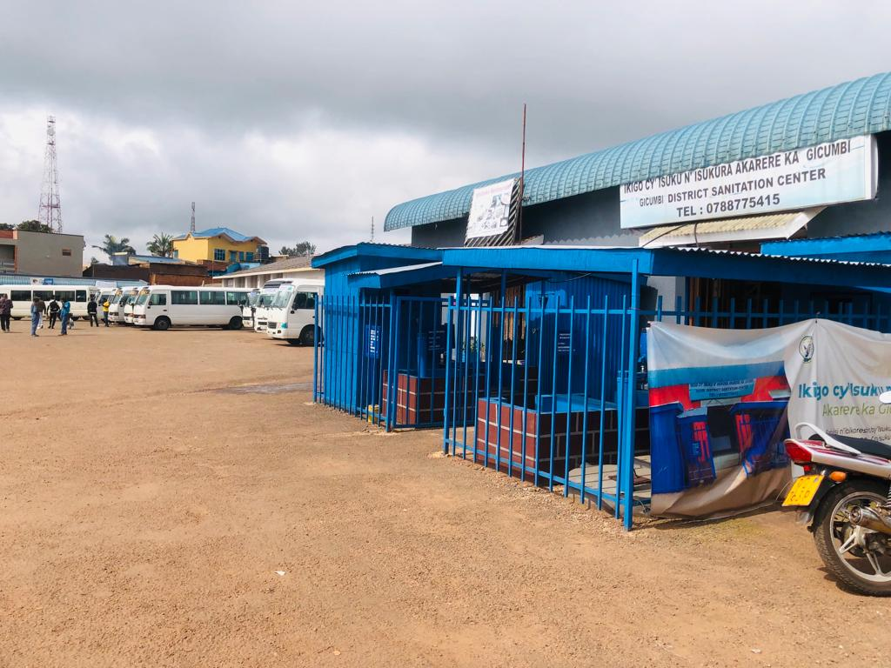
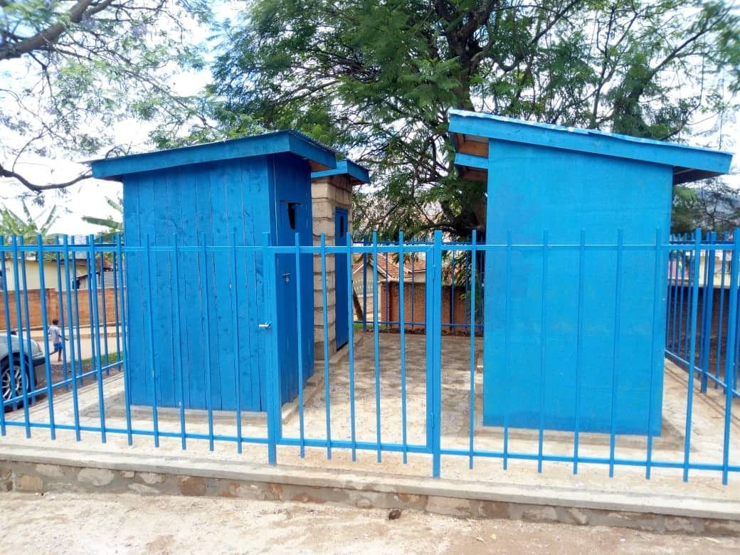
Location and management the DSCs
The DSC is ideally located in a busy part of town and accessible for all clients, including elderly and disabled.
It provides enough outside space for display of latrine prototypes, exhibition room & training and meeting space for around 25-30 people.
The center is operated by a private local entrepreneur in close cooperation with the Private Sector Federation under a PPP scheme.

Slide 32
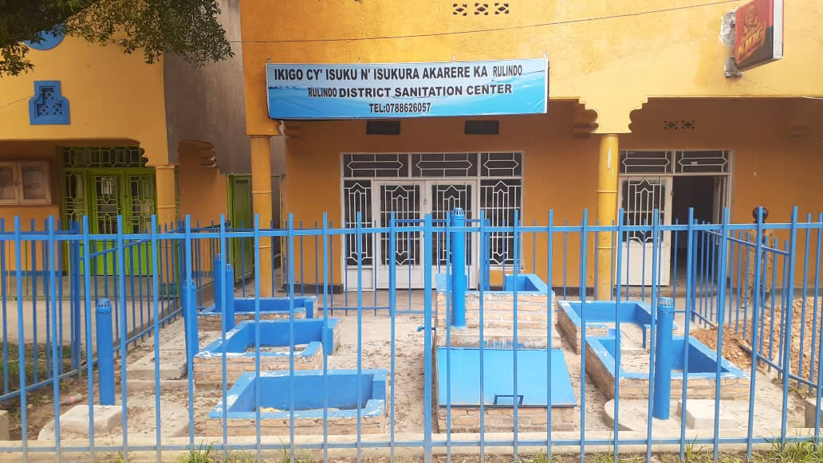
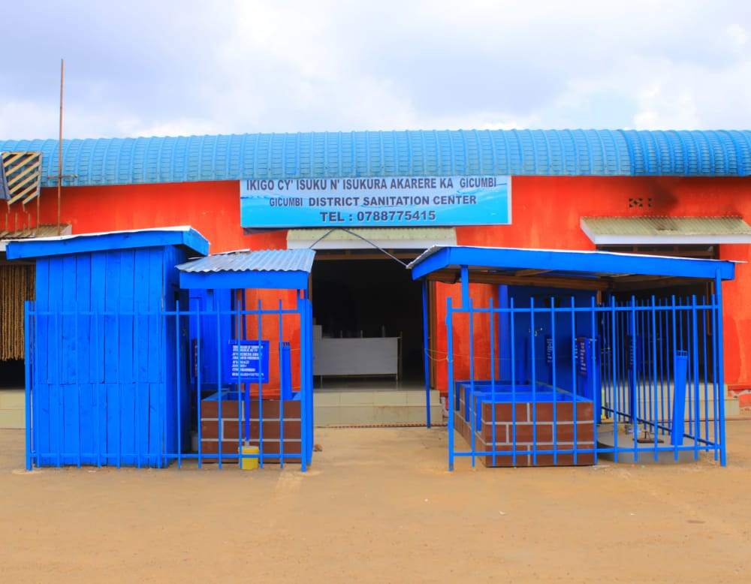
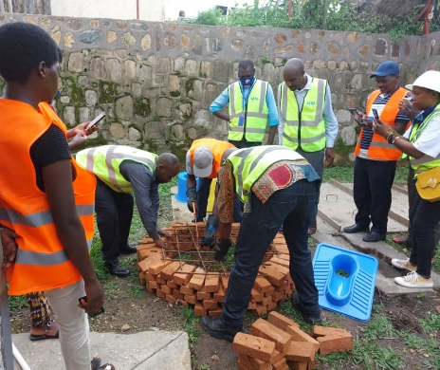
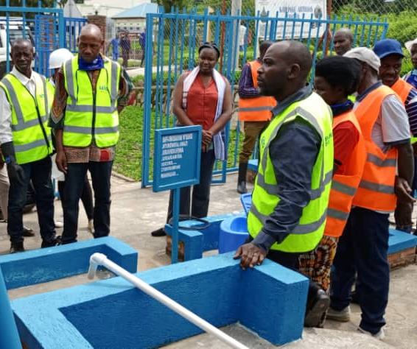
Current status and impact
Eleven (11) DSCs have been established and are functional
Seventy-one (71) community showrooms established
Over 20,000 Sato pans sold through this initiatives
271 trained local masons
Sanitation awareness activities done through the private sector
Over 2,000 latrines improved by trained masons

Slide 33
Partners roles & responsibilities
Providing an enabling Environment through the
Development of policies and guidelines
MINISTRY/ Agencies
Availing the building in a pro-business area
Selection & contracting the DSC/Community showroom operator
WATER FOR PEOPLE
Other Partners
Financial support
Rehabilitation of the building & installation of latrine prototypes
Technical support
Capacity building (Financial mgt)
Business linkage with WASH suppliers/manufacturers
DISTRICT

Slide 34
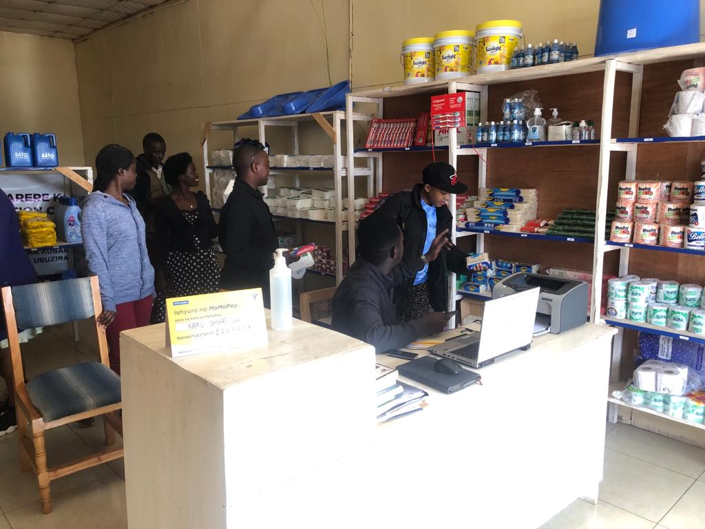
Operator’s Responsibilities and Qualities
Responsibilities
Qualities
Avail innovative and affordable products and services
Good knowledge in business, financial management and marketing, of the local language
Ensure products and services reach the community
Business oriented and networking skills
Provide guidance and explanations to clients on all products and services provided
Skills in aggressive promotion and marketing and works ethics
Conduct business marketing for the growth of the business
Make a day-to-day financial track for a smooth management
Knowledge on local sanitation and hygiene context (demand, ….)
Ensure that the center is well maintained, cleaned and open

Slide 35
Roles played by DCSs to Broader Sanitation and Hygiene Promotion Approach
National Sanitation Policy and Strategy
DSC as a tool of the strategy to reach NST1 by 2024 and SDG#6 by 2030
D30 Strategy
Enabling environment, Innovations
Influencing
CBEHPP
Sector working Group
Planning and implementation
DSC
EF DISTRICT
DISTRICT
supported by Partners
is responsible for Planning, Technical Assistance, M&E
Micro franchising model
WASH Board
Community Showroom
Service provider Involvement
WASH Service delivery
Demand creation
Community saving groups
Community involvement
User committees
Self-construction of latrines

Slide 36
Challenges, Opportunities and
Lessons learnt
Challenges | Opportunities | Lessons learnt
The concept of sanitation marketing is still new to interest local investors Little investment capital Require an operator who is committed to not only business but also to social development | Support from the local authorities Existing WASH structures at the lowest community level, to boost the sanitation demand Existence of other WASH development partners | Uniformity is not always a good solution, each community is able to select what is good for them. Private sector should be given a room to market innovations in sanitation The support from the local authorities is key to the achievement of the DSCs and Community showrooms success.

Slide 37
Conclusion and Way forward
DSCs contribute to sanitation policy
District Sanitation Centers/showrooms are
DSCs can strengthen the Sanitation Supply Chain
Positive impacts to achieve the Sanitation
There are partnerships to scale up
WFP in collaboration with other actors committed to support the scale up of District Sanitation Centers and Sanitation Showrooms to become a clear supply chain for WASH from the manufacturers/suppliers to the community
policy objectives
playing a clear role in the Sanitation
Supply Chain
Notes:
Discuss sustainability of the model

Slide 38
Where next?
AWS and ecosystem learning and research agenda’s

Slide 39
WASHPaLS #2 AWS research & learning agenda
What?
Implementing AWS core components
MEL and adaptive management
Planning for safe containment and management of waste
Ensuring GESI outcomes
How?
WASHPaLS #2 core research
Small grants program
AWS collaborative learning platform
  Shared learning and reflection
  Systematic documentation
Find the AWS desk review report and brief here:
https://www.globalwaters.org/resources/assets/Area-wide-Sanitation-Desk-Review
https://www.globalwaters.org/resources/assets/Area-wide-Sanitation-brief
Notes:
The aim: that WASHPaLS #2 learning will inform how to do AWS, but also help us further develop the TOC
Implementing AWS core components. Specific questions could be:
How to undertake context analysis and what key parameters to assess to inform AWS planning and implementation
How to effectively implement integrated (sequenced, phased, and parallel) sanitation interventions
How to ensure sustained service provision over time
Which target populations to reach first

Slide 40
Monitoring, Evaluation, Accountability & Learning (MEAL) in FINISH Mondial
Reporting: dynamic dashboard
Strengths: learnings and experience from 6 countries
Agility: more than a decade’s intervention with adaptive strategies at local level
What’s next: building a structured framework for with a dedicated taskforce
Approach: enabling a culture of knowledge sharing with collaborative strategy,
The main goals of knowledge management in FINISH Mondial to improve efficiency, effectiveness, and innovation by maximizing the use of our experiences, learning and knowledge assets.

Slide 41
Learning and knowledge initiatives under FM
Financing sanitation paper series
Immersion research on challenges with access to safely managed WASH in India
Solid and Plastic Waste Assessment in Udaipur India
Blogs and articles on FINISH Mondial
Orientation on improved FSSM solutions
Co-composting process flow document
Technical manual on climate and terrain appropriate sanitation technologies and retrofitting options
Guidelines on O&M for WASH in School facilities
Guidelines for faecal sludge management plan
Technical training & business coaching module on WASH entrepreneur’s capacity building
WASH value chain analysis in India
Climate change position papers-India, Kenya, Tanzania, Uganda
GESI position paper-India, Kenya, Tanzania

Slide 42
Get in touch
Connect with FINISH Mondial to discuss on
learning and research on FM:
Santwana Sneha, FINISH Mondial MEAL working group secretary
programmemonitoring@yahoo.com
Valentin Post, FINISH Mondial CEO
vpost@waste.nl
Nouria Ouibrahim, FINISH Mondial COO
nouibrahim@waste.nl
Connect with WASHPaLS #2 to discuss learning and research on AWS:
Jesse Shapiro, Environmental Health Team Lead and Senior WASH Advisor
Jeshapiro@usaid.gov
Morris Israel, Chief of Party WASHPaLS #2
Morris.Israel@tetratech.com
Carolien van der Voorden, Deputy Chief of Party WASHPaLS #2
c.vandervoorden@tetratech.com

Slide 43
















All Systems Connect 2023 is made possible thanks to the generous support of our partners including the World Health Organization and :

