Slide 1
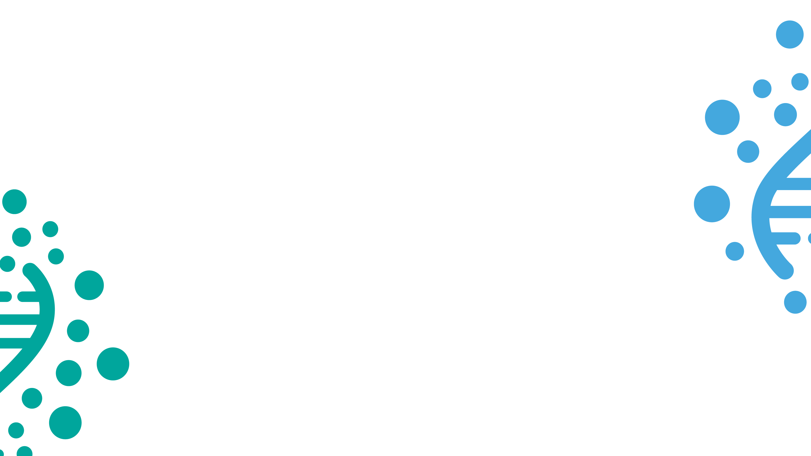

Slide 2
Using well water level monitoring data to fight the impact of climate change
The case of Villa Rivero, Bolivia

Slide 3
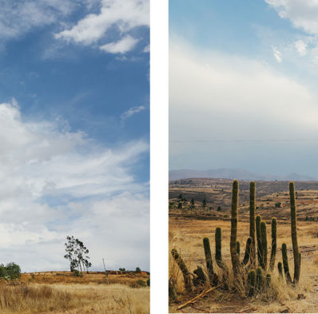
The story of a place
with no surface water:
Villa Rivero

Slide 4
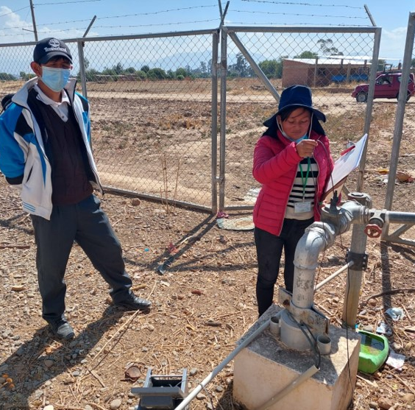
Well water level monitoring
2020-2021:
Almost four meters below previous water levels

Slide 5
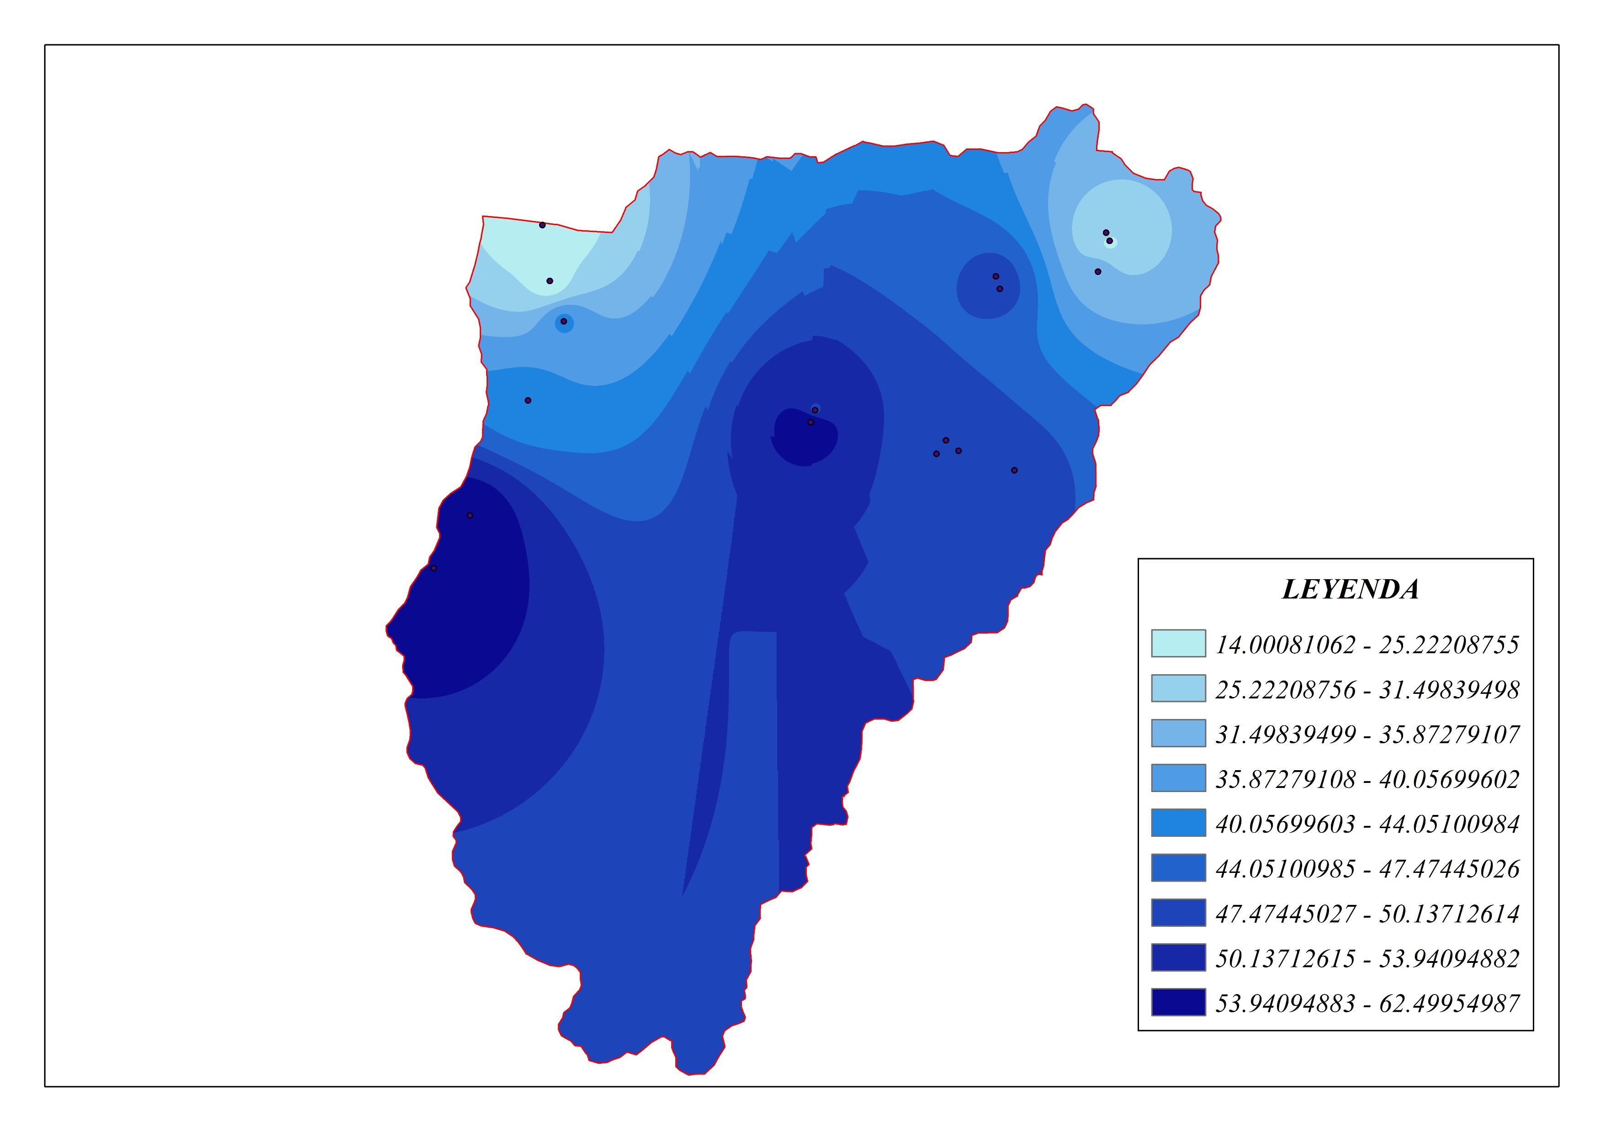
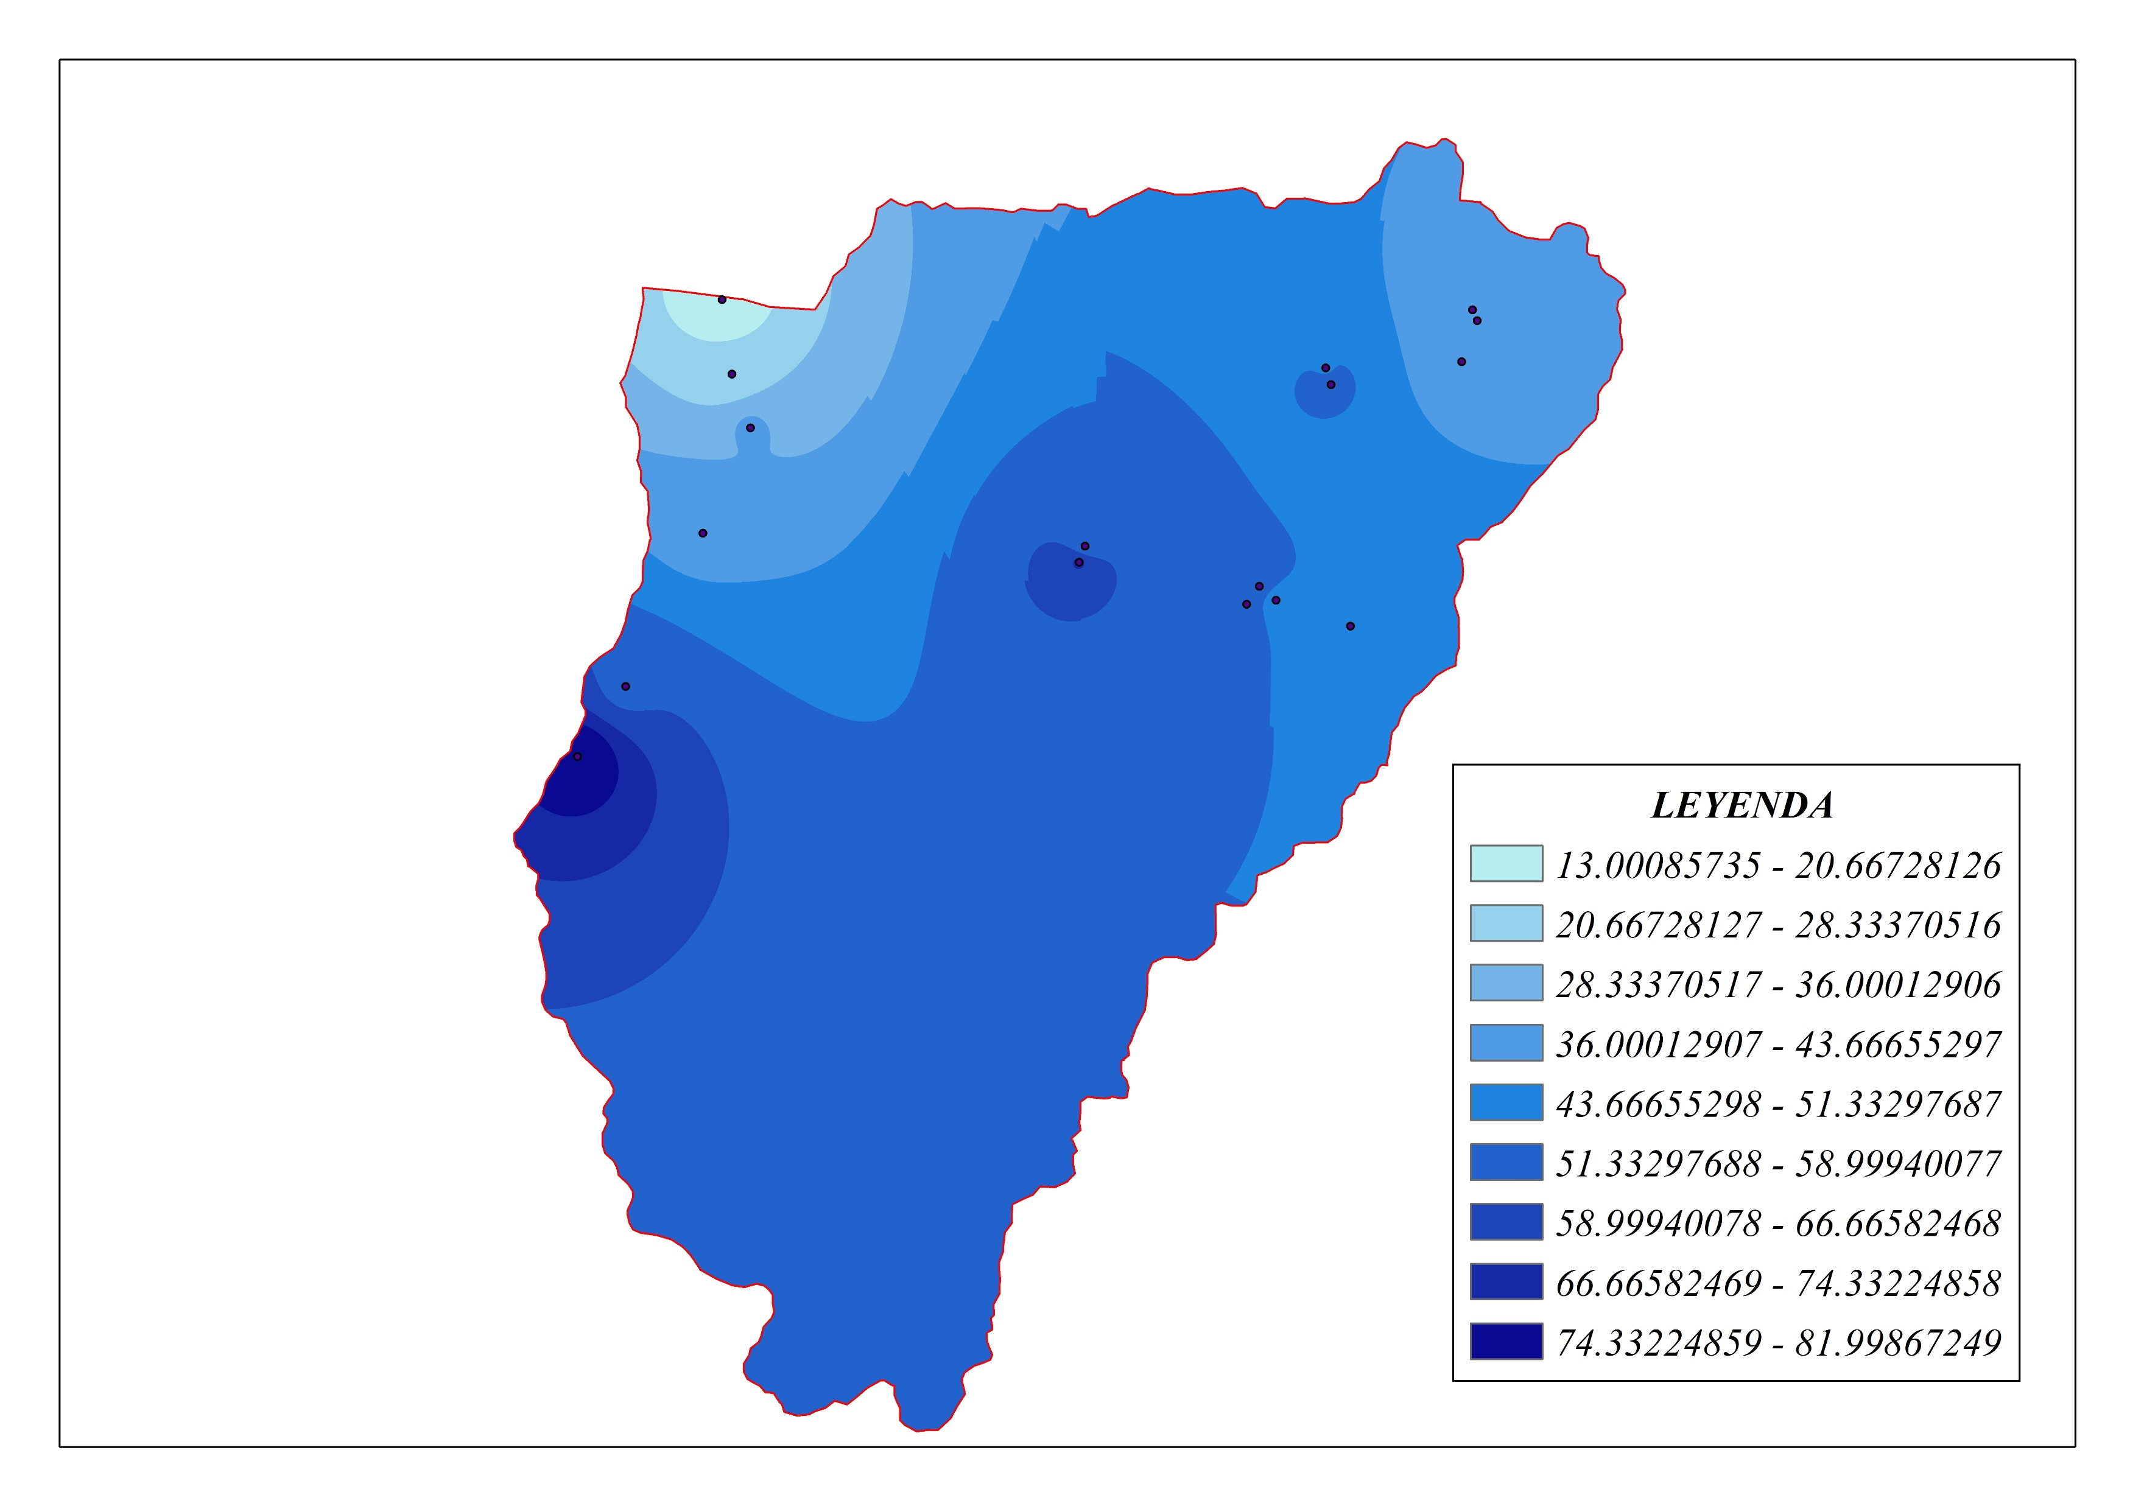
The greatest decreases occurred in areas where there are wells
are used for
crops irrigation

Slide 6

What we are doing?
Mitigate risks
  Defined responsibilities for authorities
  and communities for reforestation
  Coordinated work with government stakeholders and ministries
  (water and agriculture)
  Use of monitoring data to promote afforestation and reforestation in
  water recharge zones
Prevent
A new local water policy to regulate well extraction
Monthly monitoring in three additional municipalities
Community awareness raising process

Slide 7

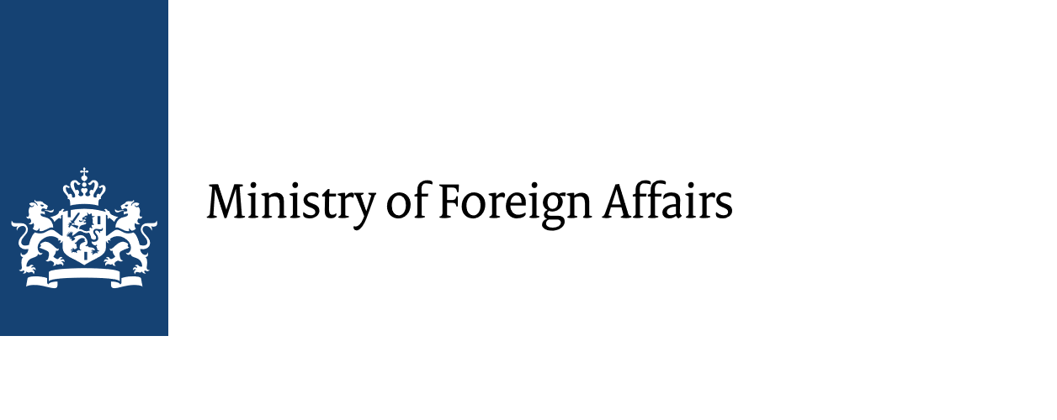


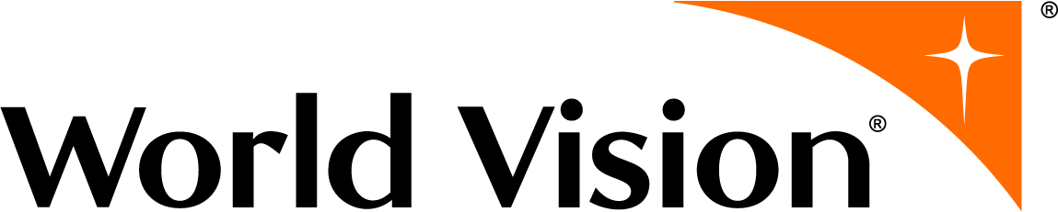

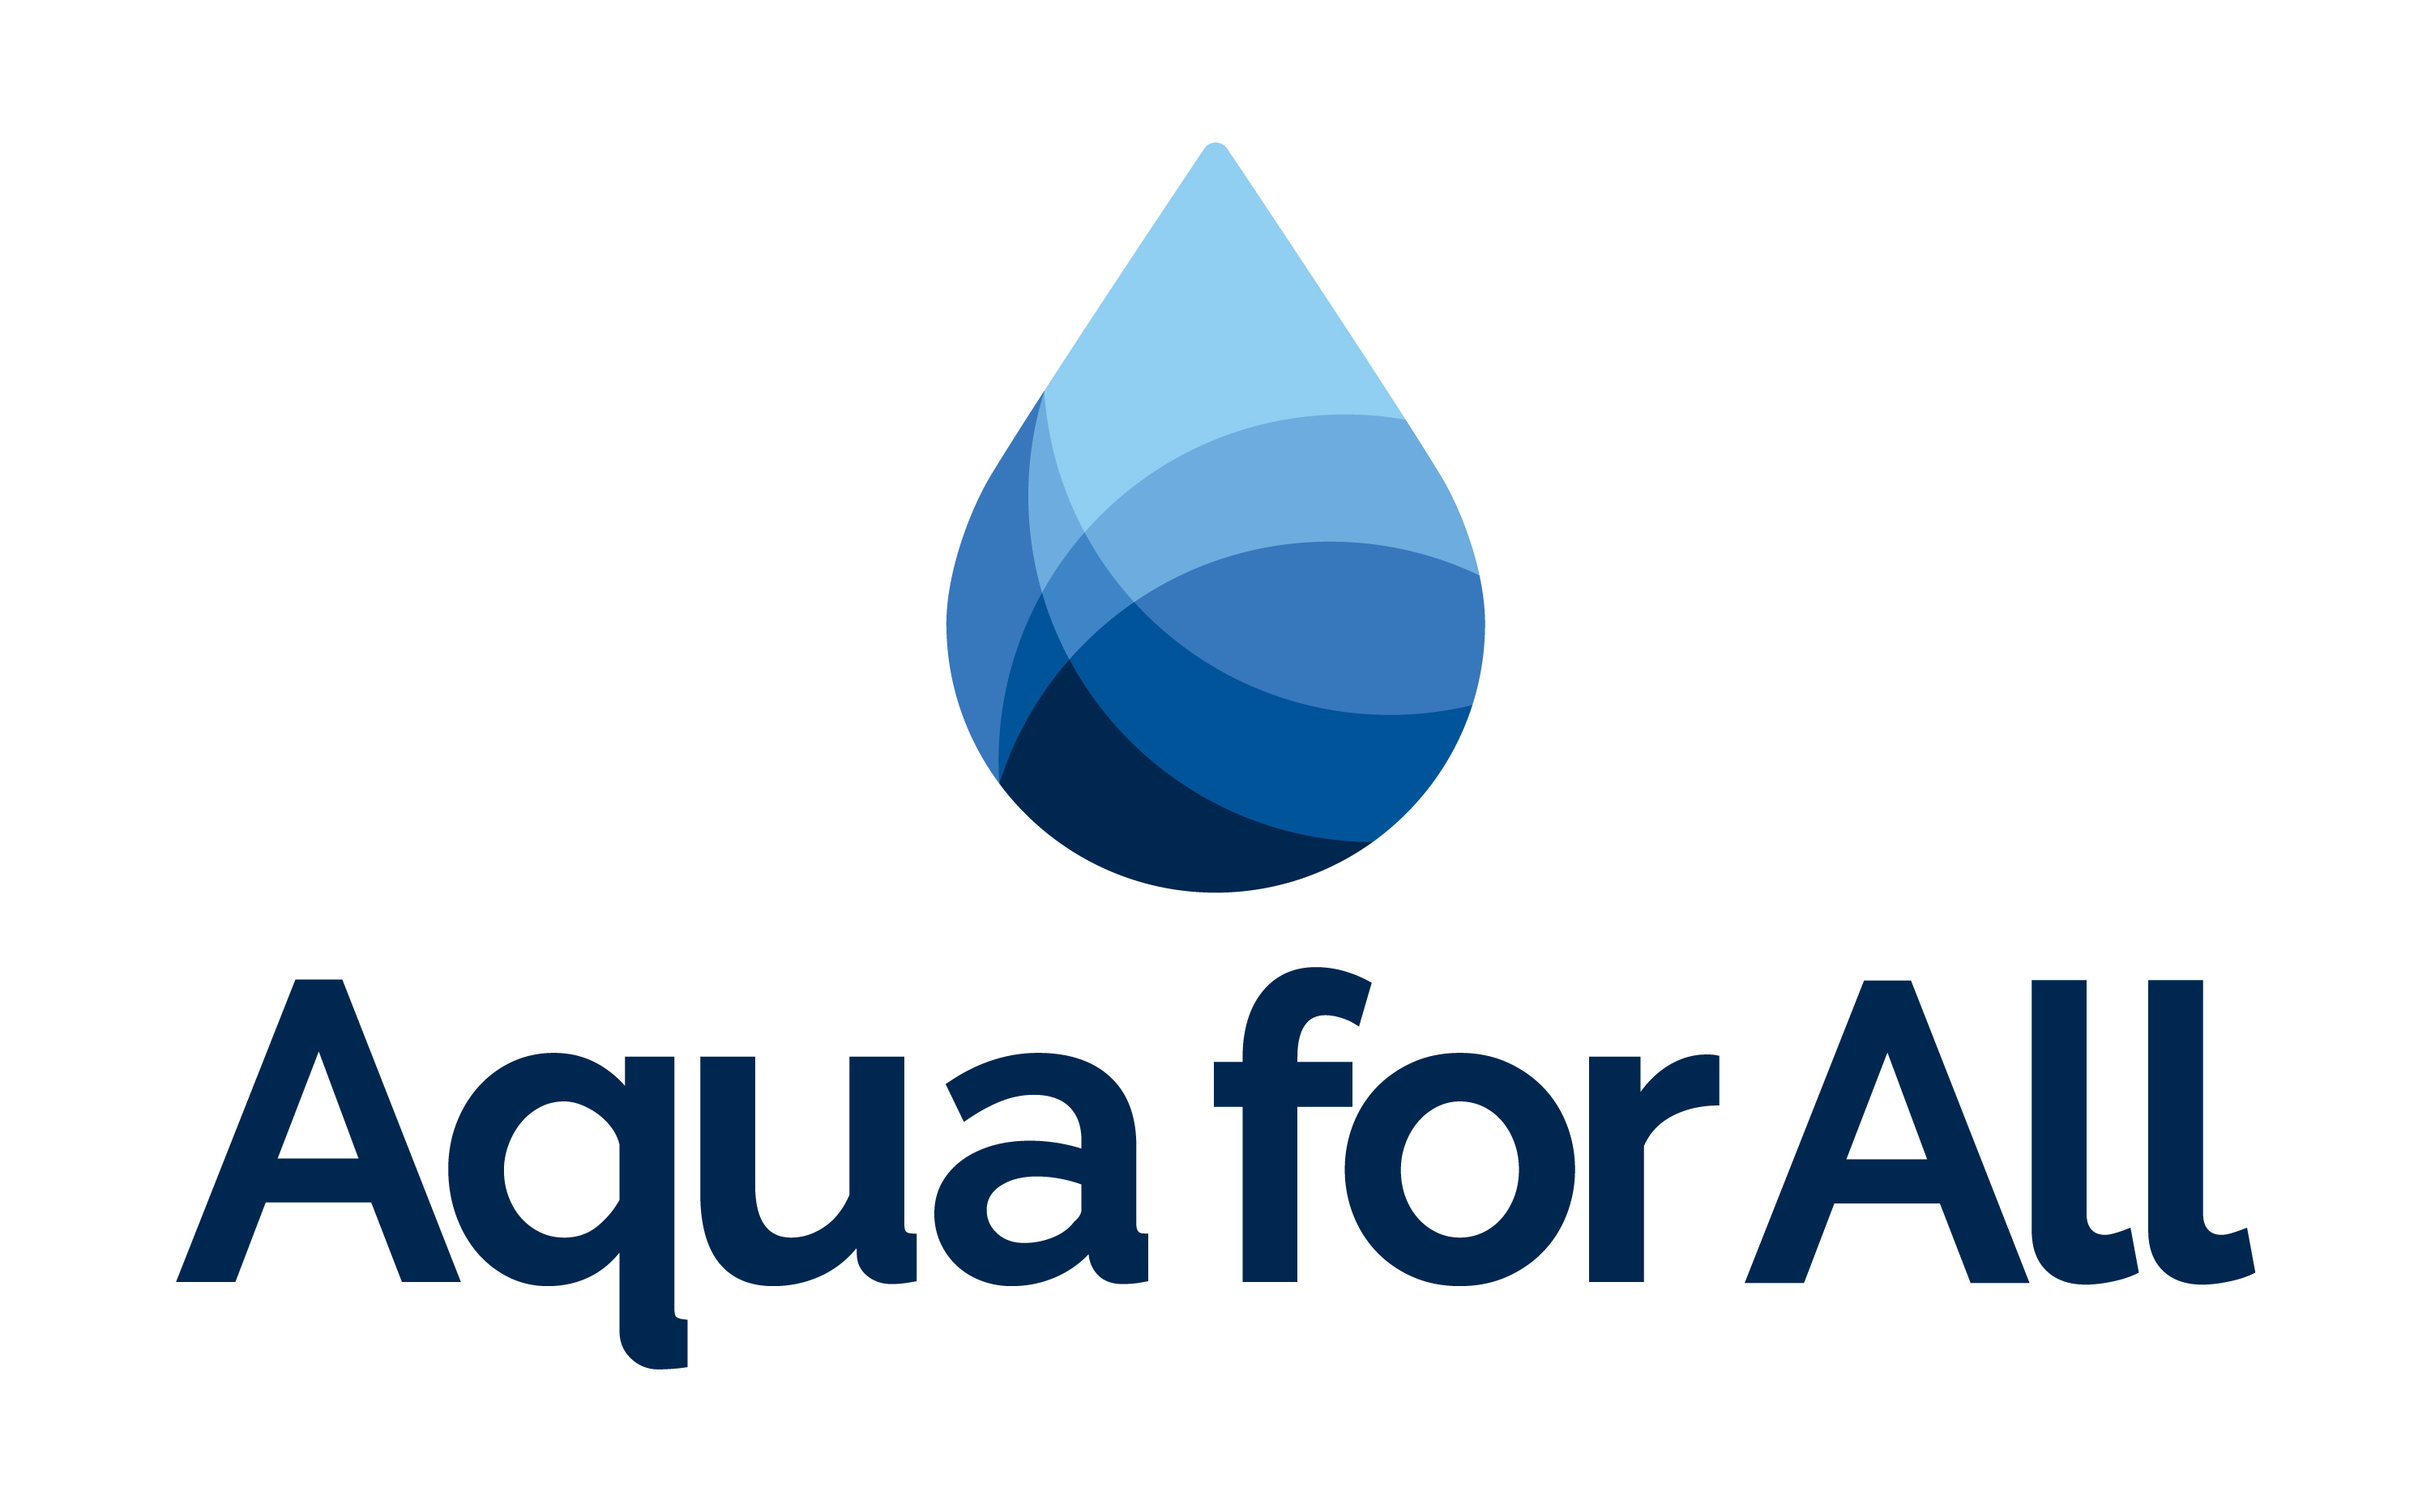
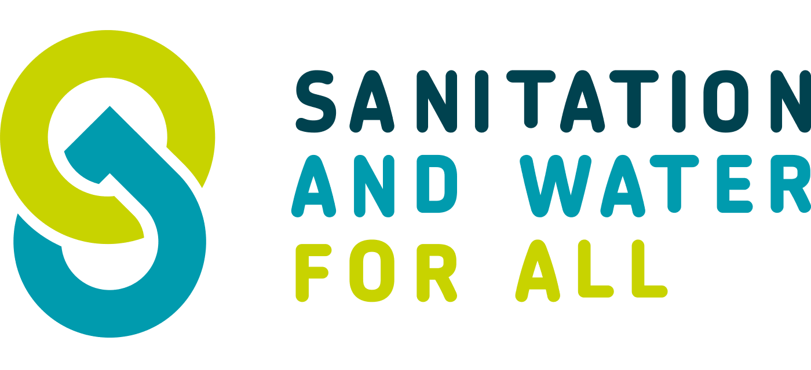

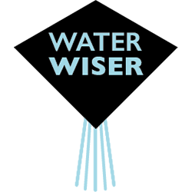
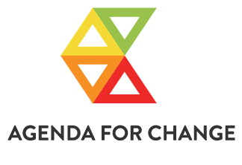
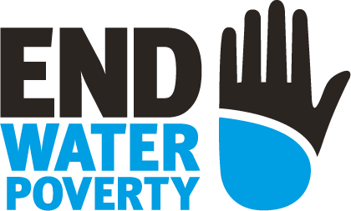



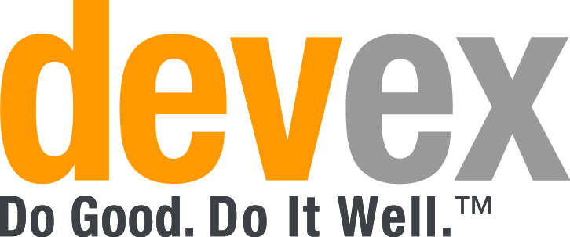
All Systems Connect 2023 is made possible thanks to the generous support of our partners including the World Health Organization and :

