Slide 1


Slide 2

Who will deliver?
Tackling Human Resource needs to deliver rural sanitation and hygiene

Slide 3
Contents
Introduction to USAID WASHPaLS #2
Brief introduction to the sanitation and hygiene capacity needs assessment
Key takeaways and next steps

Slide 4





USAID water, sanitation, and hygiene partnerships and learning for sustainability (WASHPaLS) #2
WASHPaLS #2 is a 5-year
(2021-2026) project with the goal of improving WASH programs by ensuring quality, equity, sustainability, and scale of sanitation products and services and adoption of sound hygienic practices, particularly in rural areas.
Area-wide Sanitation is the overarching theme for WASHPaLS #2 Research and Learning
Area-wide sanitation
Market-based sanitation
Social behaviour change
Gender Equality and Social Inclusion

Slide 5
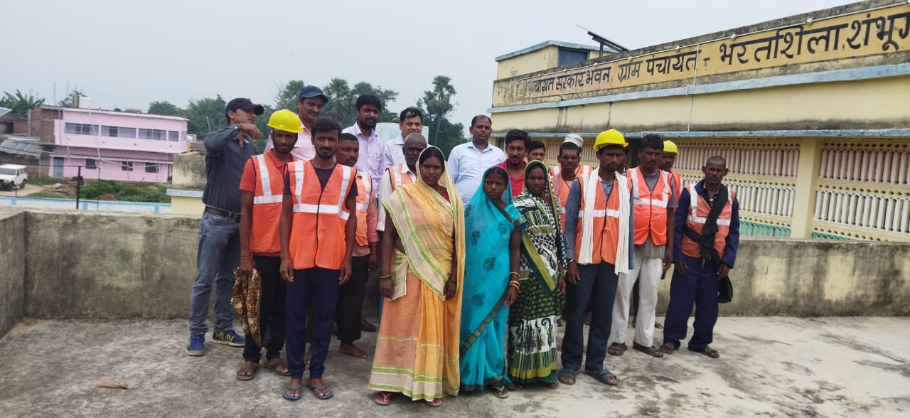
Sanitation and hygiene workforce capacity needs assessment and roadmap
Purpose: To understand the Human Resources (HR) capacity needs required to deliver universal access to sanitation and hygiene, the existing gaps, and the dynamics at play in trying to address them
Scope: Sub-Saharan Africa, South and Southeast Asia, focused on delivery of area-wide sanitation with emphasis on rural on-site sanitation
Planned output: A roadmap of agreed priority actions and pathways for the sector at
multiple levels
Notes:
Global assessment involved a desk review, analysis of datasets from AMCOW, GLAAS and WALIS, and engagements with 42 reps from more than 24 organizations: Knowledge and Training Institutes, INGOs, Development Partners, Regional Associations and Training Centers.
Six country assessments in Ghana, Nigeria, Rwanda, India, Nepal and the Philippines included desk review, FGD/KIIs, and (validation) workshop for key sector stakeholders. Total of over 400 informants.
Assessment focused on sanitation and hygiene functions:
Policy, strategy & coordination
Regulation
Monitoring
Oversight and support
Community mobilization & engagement
Construction
Emptying & transport
Operation & Maintenance (incl. treatment, disposal & reuse)
Research and design
Business development
And uses capacity development framework to assess barriers: enabling environment, organizational capacity, individual capacity and societal capacity

Slide 6
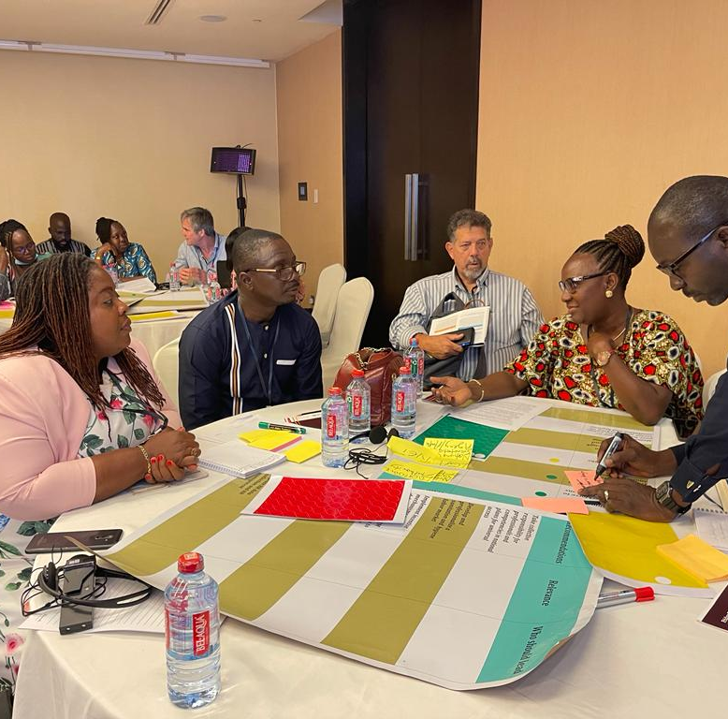
Key findings

Slide 7
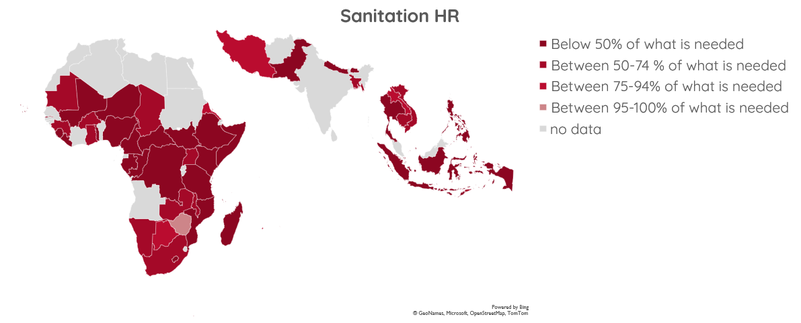
Countries report a significant shortage of human resources to deliver sanitation…

Slide 8
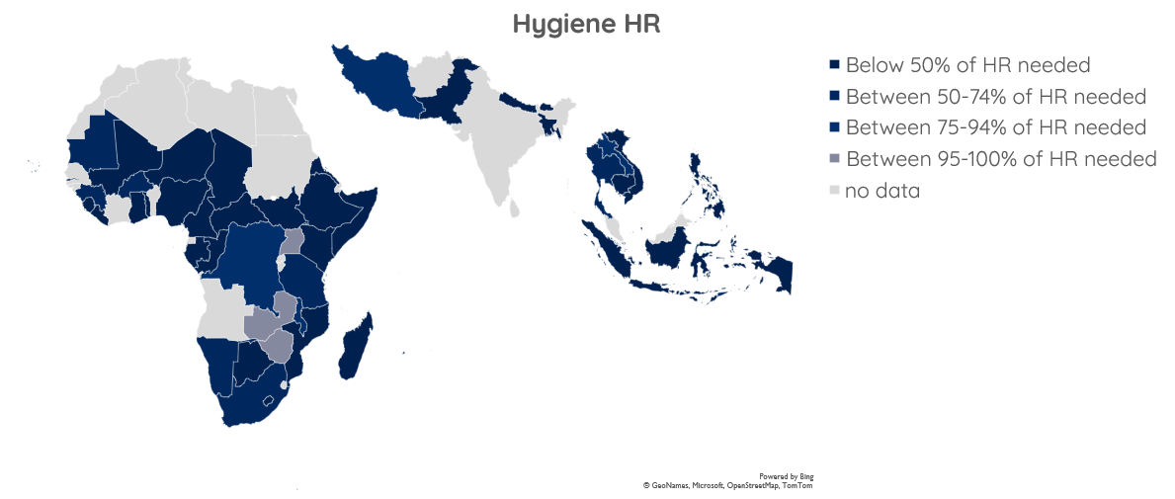
…and hygiene
Notes:
The country assessments showed the biggest HR shortages across the board in policy, strategy, and coordination; regulation; emptying and transport; O&M, treatment, disposal and/or reuse; and business development.

Slide 9
There is lack of a dedicated sanitation and hygiene labor force, little standardization, and limited data
Notes:
There are limited career paths in sanitation and hygiene specifically and a strong dependence on other sectors
HR assessments and strategy development are not yet commonplace
Lack of standardization means different jobs are used interchangeably for similar roles, there is limited data tracking, and variation in remuneration and promotion opportunities.

Slide 10
There is strong (public) sector reliance on NGOs, volunteers, and the informal sector, but the latter two have been overlooked in
HR assessments
Notes:
There are limited career paths in sanitation and hygiene specifically and a strong dependence on other sectors
HR assessments and strategy development are not yet commonplace
Lack of standardization means different jobs are used interchangeably for similar roles, there is limited data tracking, and variation in remuneration and promotion opportunities.

Slide 11
In absence of an enabling business environment the role of the private sector is still limited and largely informal, and actors need capacity on sanitation technologies and entrepreneurship
(Local) government is mandated but under-resourced, and women and youth are underrepresented in public sector sanitation and hygiene jobs
Development partners play key roles and positively impact local investment in hr, but disturb local systems and processes through projectized approaches, a brain drain to ingos and dps, and uncoordinated, misaligned capacity development efforts
Sanitation workers work across the sanitation service chain, are employed across actors, but remain largely informal and still face large societal stigma and discrimination
Dependence on volunteers is high and often essential, but programs, remuneration and motivations vary and affect sustainability and quality of volunteer contributions

Slide 12
There is an overall lack of diversity in disciplines and skills of staff at national, district, and local levels
Gaps include skills and understanding related to:
Safely managed sanitation
Regulation for (rural, on-site) sanitation and hygiene
(Digital) data collection, analysis, and application in decision making and course correction
Business development (support), e.g., business administration, marketing & sales, financing, procurement and contracting
Cross-cutting skills related to adaptation and flexibility, problem solving and critical thinking and GESI

Slide 13
HR capacity supply, need, and demand often don’t match…
Graduates lack skills and knowledge relevant to rural on-site sanitation and hygiene, particularly transferable skills and practical experience
Insufficient supply of graduates from training institutions on on-site sanitation and hygiene
Limited jobs are created by the sector to absorb needed capacity or capacity supplied
There is a gap in capacity development opportunities and formal recognition for lesser-educated staff and low-level skills picked up on the job (e.g., volunteers and informal workforce)
…but there are openings to improved sanitation and
hygiene education

Slide 14
Recommendations
1. Increase understanding of the HR needs and planning in the sector
2. Coordinate, incentivize, and create new jobs to ensure sufficient local sanitation and hygiene HR
3. Diversify the public sector workforce
4. Dignify sanitation and hygiene roles and break down barriers and stigma
5. Develop and professionalize the sanitation and hygiene labour markets
6. Formalize the informal private sector workforce in sanitation
and hygiene sectors

Slide 15
Recommendations
7. Strengthen organizational systems and policies for data, GESI, and knowledge management
8. Coordinate capacity development across sectors and actors
9. Strengthen capacity development institutes and diversify capacity development efforts
10. Develop specific competencies that were identified as gaps
11. Improve public sector remuneration, incentives and career development and allow local governments to lead on HR

Slide 16
Call to action
Connect with WASHPaLS #2 to discuss proposed recommendations and actions, and how to engage:
Jesse Shapiro, Environmental Health Team Lead and Senior WASH Advisor
Jeshapiro@usaid.gov
Morris Israel, Chief of Party WASHPaLS #2
Morris.Israel@tetratech.com
Carolien van der Voorden, Deputy Chief of Party WASHPaLS #2
c.vandervoorden@tetratech.com
The lack of a sufficiently skilled sanitation and hygiene workforce hampers the achievement of universal sanitation and hygiene goals and outcomes.
USAID seeks to engage with partners at global, regional and local levels in the development of concerted, coordinated actions to address HR capacity gaps in the rural sanitation and hygiene sectors.

