Slide 1
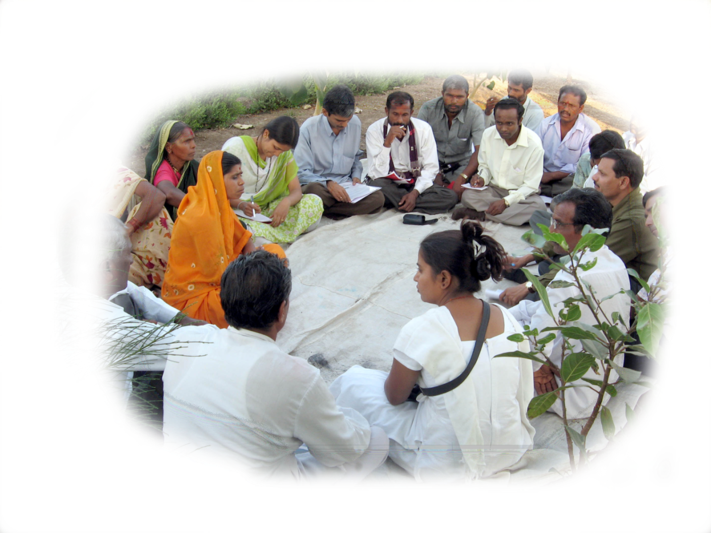
Water and Sanitation Management Organisation
September 20, 2013

Slide 2
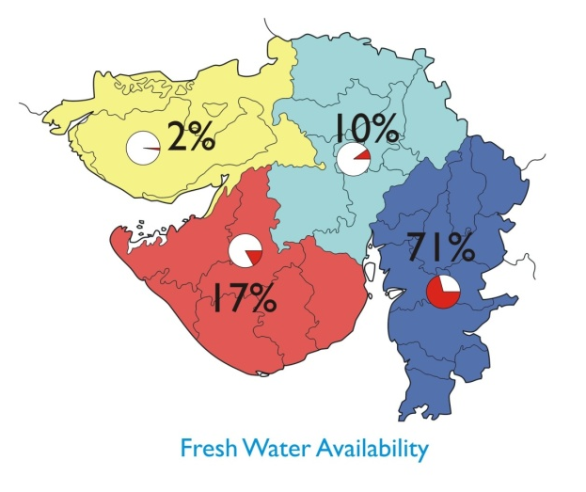
Demography and Fresh Water availability
No. of Districts | 26
No. of Talukas | 226
No. of Villages | 18225
No. of Towns | 348
Total Populations | 6.03 Cr.
Rural Populations | 3.46 Cr.
Urban Populations | 2.57 Cr.
Decadal Growth Rate | 19.17%
Uneven water availability in the State ( Cum/ person/ annum)
India 2,000
Gujarat 1,137
South & Central Gujarat 1,932
North Gujarat 342
Saurashtra 734
Kutch 875
Reference :census : 2011
Except South Gujarat, paucity of water in rest of the State
Drinking water scarcity felt in almost 2/3rd part of the State

Slide 3
Gujarat before 2002
Issues of water scarcity
Drying up of sources
Recurrent droughts
Repeated failure of tube wells and need for re drilling
Water Quality Issues in >50% habitations
Water supply to scarce area especially in summer or drought period by Tankers and Trains
Mass migration of human and cattle
Drudgery of fetching from long distance
Water Borne Diseases

Slide 4
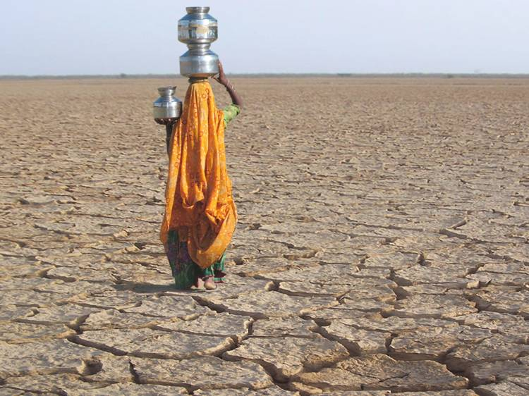
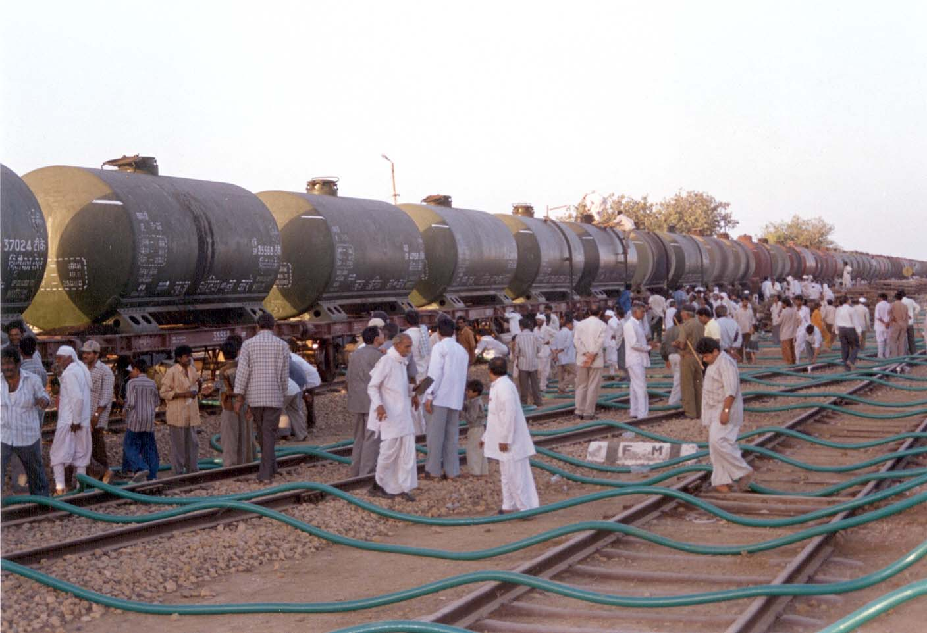
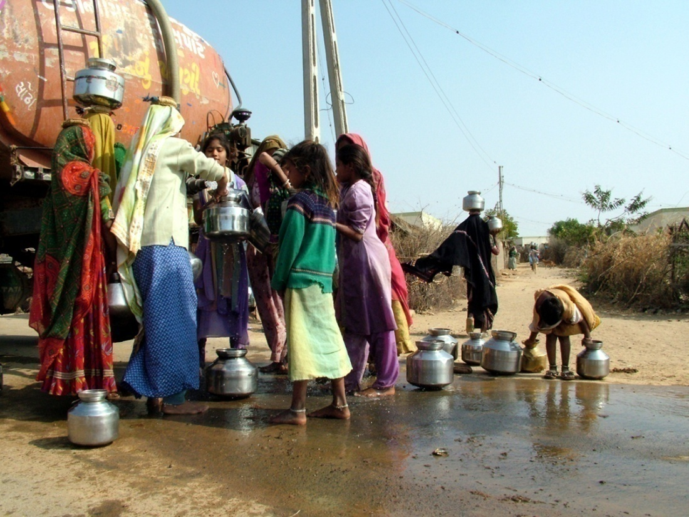
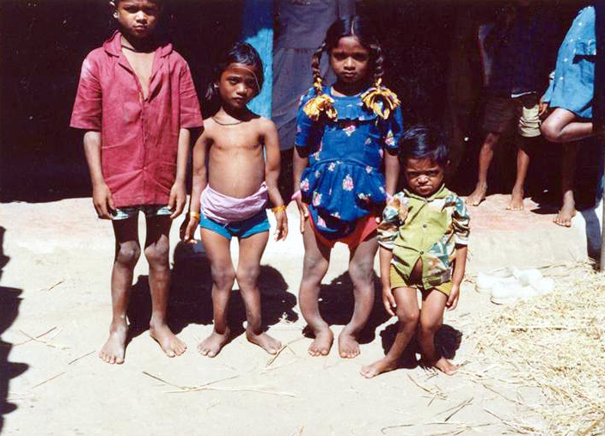
Drought Prone Areas
Supply Through Railways
Problem Areas
Quality Problems – Fluorosis,Salinity, Nitrate
Supply Through Tankers

Slide 5
Water Supply Department, Govt of Gujarat
(Headed by Principal Secretary (Water Supply)
Gujarat Water Infrastructure Limited (GWIL)
Gujarat Water Supply & Sewerage Board (GWSSB)
Water And Sanitation Management Organisation (WASMO)
A company registered under Indian Company Act
(Headed at State Level – Chairman & Managing Director and Division/ Project level – Senior Manager)
A Board constituted through an Act of Govt of Gujarat
(Headed at State level by the Chairman, Head of Department – Member Secretary, Zonal Level by Chief Engineer, Divisional Level by Executive Engineer)
An autonomous organisation registered under Indian Society Act
(Headed at State Level by Chief Executive Officer and at district level by Member Secretary of District Water and Sanitation Committee)

Slide 6
Working towards drinking water security and habitat improvement by empowering communities to manage their local water sources, drinking water supply and environmental sanitation
WASMO’s Vision
Our philosophy
Users are the best managers
Building partnerships and working together
Notes:
6

Slide 7
Vision - Achieving Drinking Water Security
Water delivery at household
Water Security at habitation level
Water security at Village level
Source development
Water scarcity

Slide 8
STRATEGY
Facilitating village to create Pani Samiti democratically.
Bring out maximum information through Participatory Rural Appraisal (PRA)
Develop low cost, sustainable, low maintenance, and manageable schemes with people's involvement.
Implementing a transparent, speedy and quality work by Pani Samiti.
Training Pani Samiti for total Operation and Maintenance.
Improvement of habitat with sanitation improvement and increased hygiene awareness
Empowering the Pani Samiti through capacity building exercises for work organization and implementation

Slide 9
Approach
Sustainability
Assured safe water availability (DTH)
Decentralized service delivery
Community Participation
Demand Driven
Cost Sharing principle

Slide 10
Organogram of WASMO

Slide 11
Reforms
Policy
Principle of subsidiary and decentralization
Legal status to Village Water and Sanitation Committee
Organizational
Systemic changes for enabling facilitation
Culture – a mix of corporate, NGO and Government
NGOs as facilitation partners and process managers
Institutional
Community based VWSC formed by consensus
Representation of women and all sections of society mandatory
Process
Reducing levels of hierarchy
Complete community control over finances
Extensive IEC and rigorous social processes

Slide 12
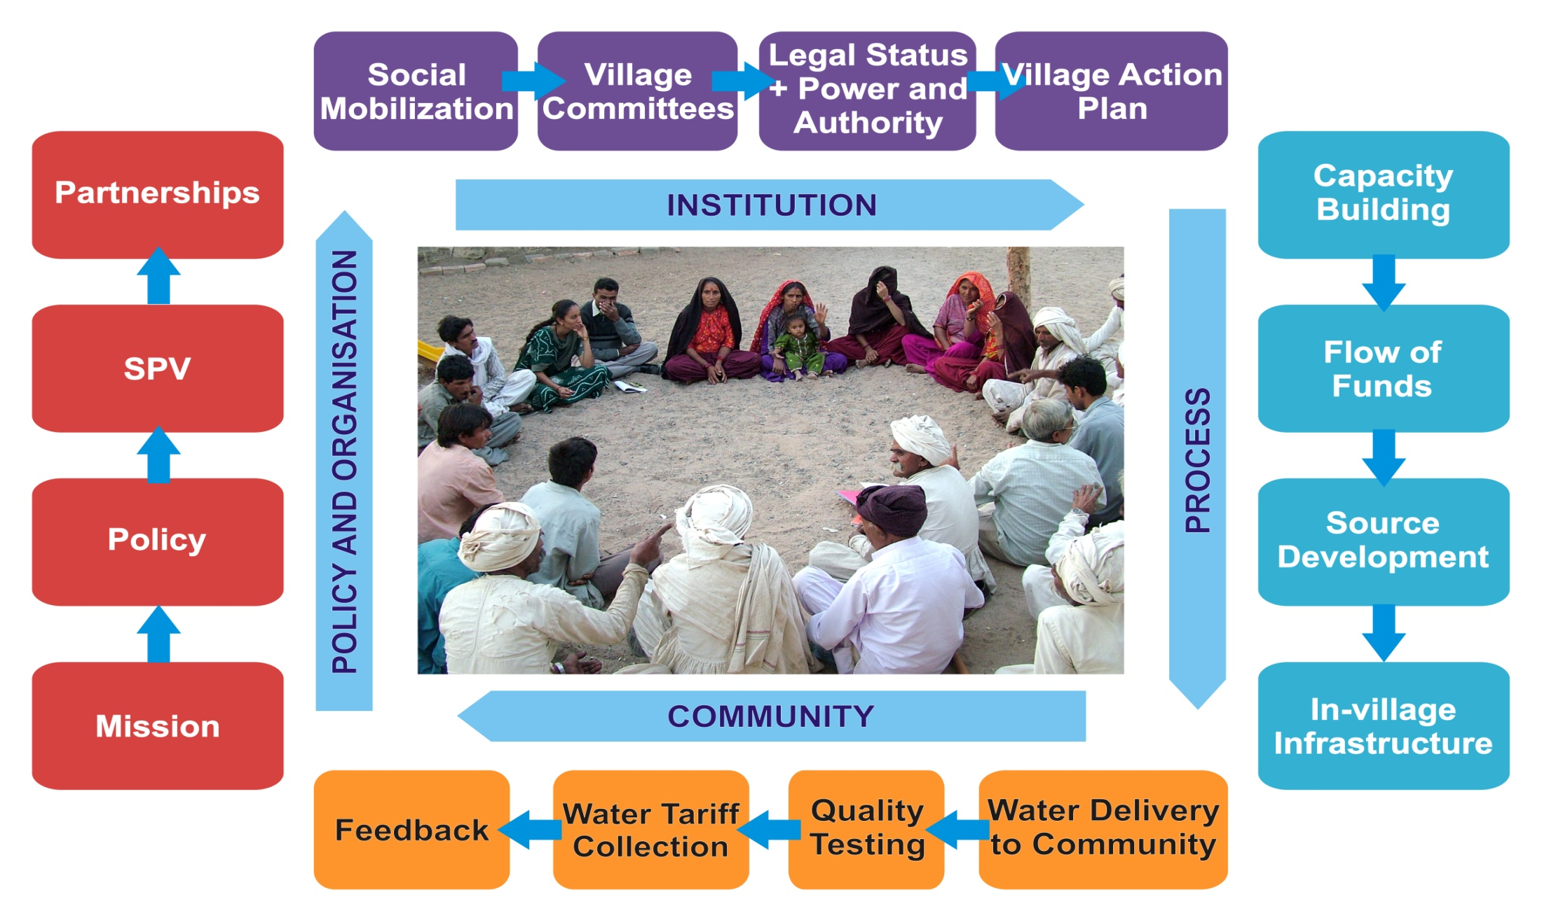
Empowering PRI Social Process Driven Approval

Slide 13
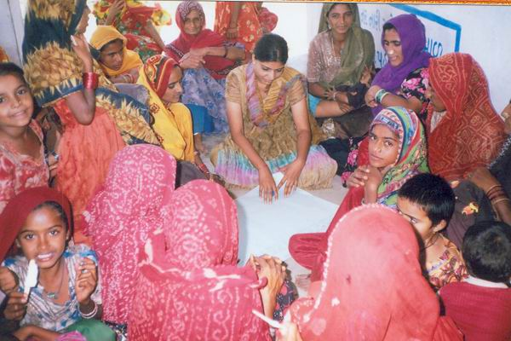
First Programme cycle of 3-6 months with software activities
Programme Introduction
Pani Samiti formation
PRA, Needs Assessment, Resource Mapping
Development of Village Action Plan (VAP)
Approval of VAP by the Gram Sabha & Fixing community contribution
Planning for work execution
Entire Process taken in Public Domain – GRAM SABHA

Slide 14
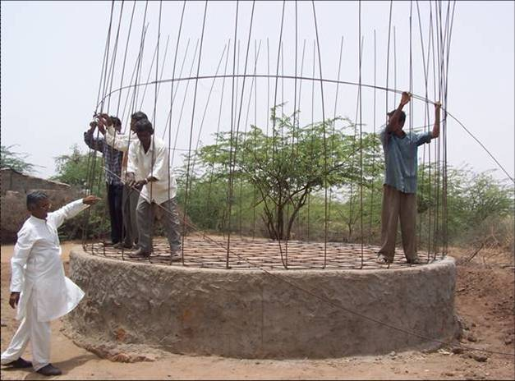
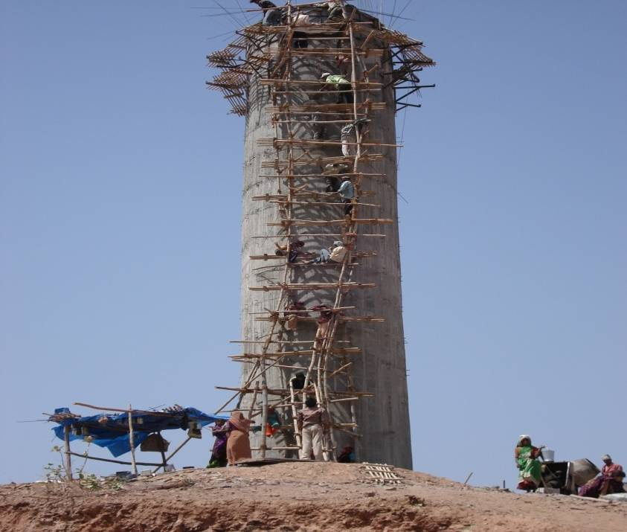
Second cycle of 12 months for work implementation and service delivery
Implementation of work under Pani Samiti supervision
Continuous capacity building
Technical support guidance by Engineers of WASMO and ISA
Monitoring of physical progress, transparency in programme
Water tariff setting and its approval in the Gram Sabha
Decisions belong to the community
WASMO and ISA only facilitate implementation

Slide 15
Continuous Efforts with Community through Social Processes
Initial phase – Programme introduction and need analysis
Formation of Pani Samiti with consensus of people in Gram Sabha
Participatory Rural Appraisal with community involvement
Preparation of Village Action Plan by community
Capacity building of the Pani Samiti
Sharing of information with villagers
Implementation of the Scheme by community
Independent Financial Operations by Pani Samiti with guidance of WASMO
Operation & Maintenance of System by Community

Slide 16
Decisions and Discretion of Pani Samitis
Annual Tariffs based on estimated expenditure.
Frequency of tariff collection
Responsibility of collection
Penal provisions for late payment or non-payment
Separate charges for connection based on size
Concessions for weaker sections
Separate tariffs for construction and commercial
Receipt and expenditure Accounts presented in Gram Sabha for discussion and approval
Tariffs for animal heads (separate for Goats/ sheep/ cows)
Giving of receipt against money received
Tariffs for sanitation also levied
Separate tariffs for house-connection and stand posts
Operation procedures different (House-wise responsibility or keeping operator)
Specific permission for use of water during marriage or religious ceremonies.

Slide 17
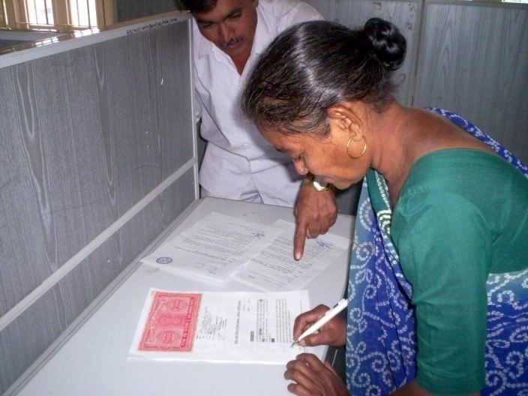
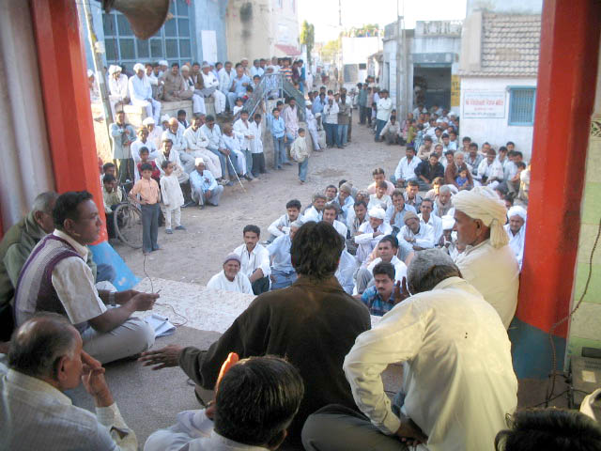
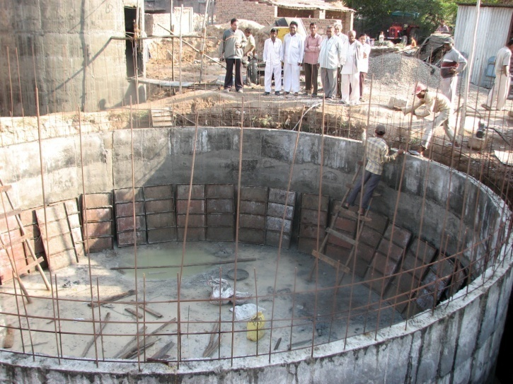
Programme Uniqueness and Process encompasses…
The four ‘Fs’ of decentralisation
Funds – directly transferred to the Village Water and Sanitation Committee (VWSC) - First instalments of 30% released to VWSC just after arranging proportionate contribution by the community. Subsequent release of funds to VWSC on need based
Functions – decisions by community executed by the VWSC including resorting to tender process or option for direct work
Functionaries – community representatives carry out different functions. Women participation is must to include their demands and voices in managing schemes
Facilitation – by the Government and NGOs
Empowerment and capacity development of local community
Local leaderships, micro-links and volunteerism

Slide 18
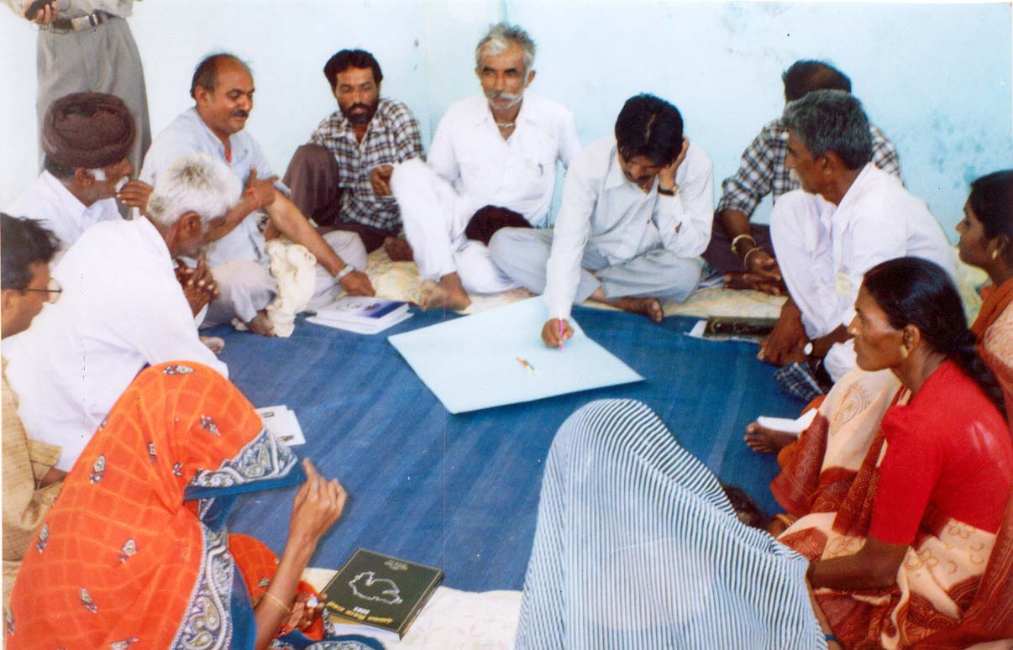
Transparency and accountability
Sharing capital costs
Gram Sabhas as Social audit
Community control over finances
Commissioning- Atmarpan by Community

Slide 19
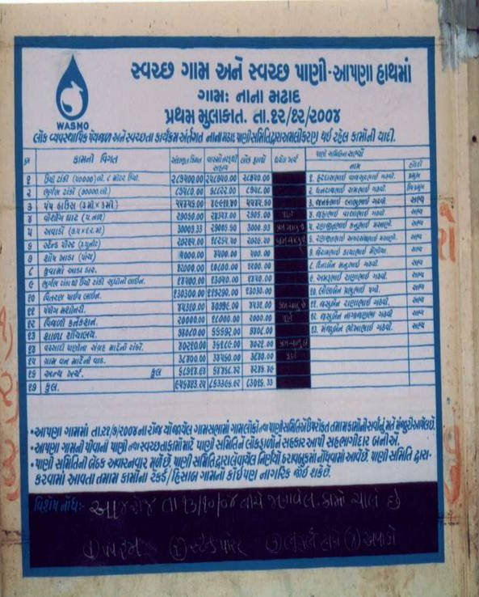
Transparency and accountability
Community control over finances
Transfer of fund directly to the PRI; taluka Panchayat is bypassed
Pani Samiti has full control over their funds
It can receive advances up to 50%
People have right to question decisions in the village assemblies
Sharing project information (physical & financial) -environment of trust and transparency

Slide 20
Information, Education and Communication (IEC)
Publications Loksamvad magazine - a dialogue with the community, cross learning Posters Pamphlets Manuals – for trainings Theme based Documents | Audio-Visual Material (broadcast mode and CDs) Radio spots Radio programme Video Spots Video programme
Inter Personal Communication Gram Sabha Pani Samiti Meetings Falia/ Mohalla Meeting Separate Meetings with women Meeting with Self Help Group/ elders/ village leaders | Folk media Bhavai Tamasha Puppet Show Lok-dayro Street plays Skits
Displays Slogan writing & Wall Paintings Participation in Fairs Exhibitions
contd…
Notes:
20

Slide 21
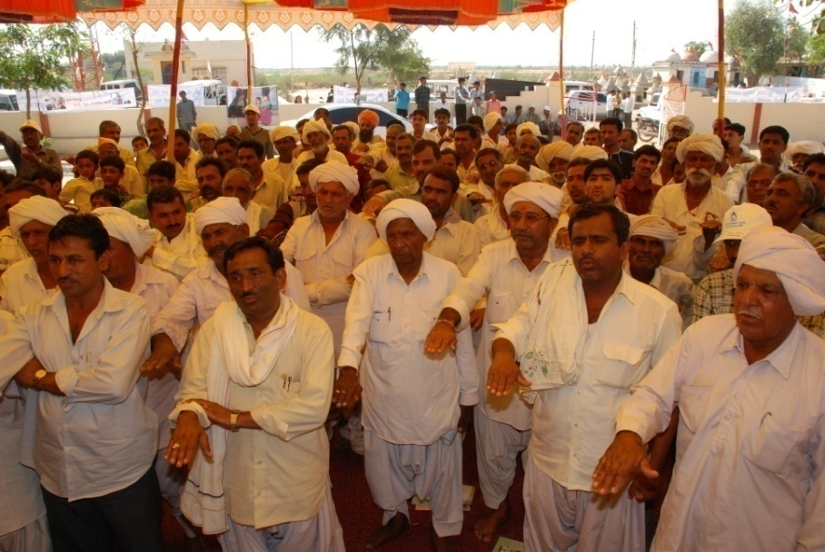
Reaching out to the Community (IEC)

Slide 22
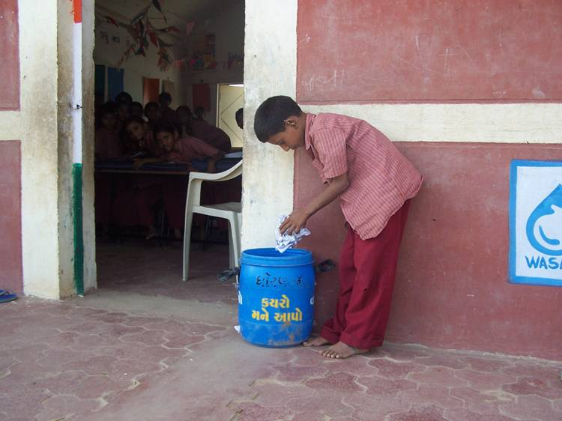
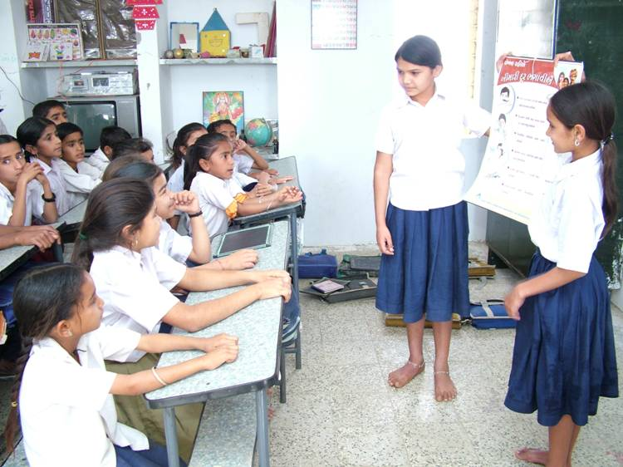
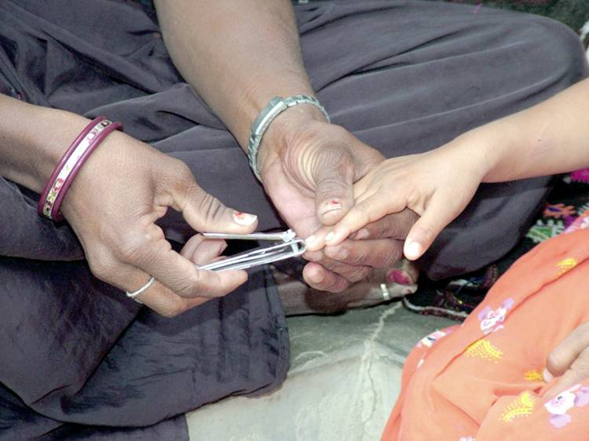
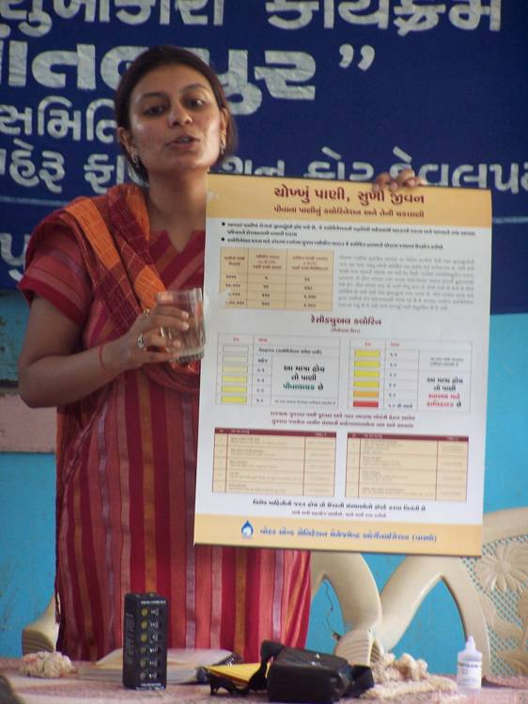
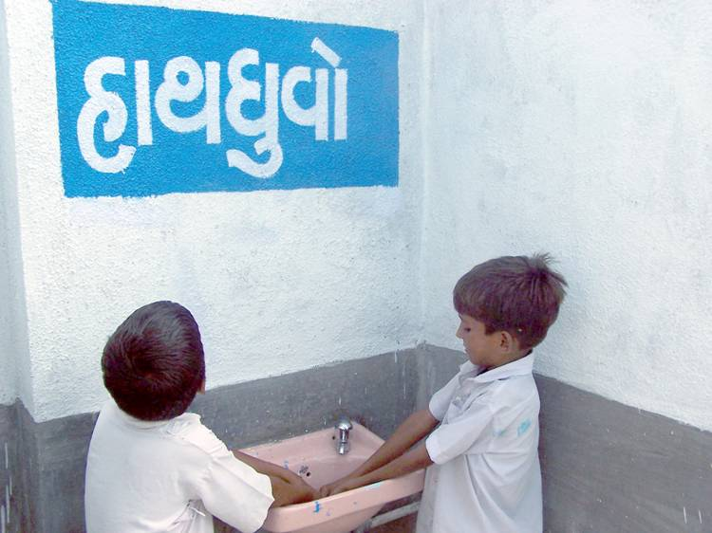
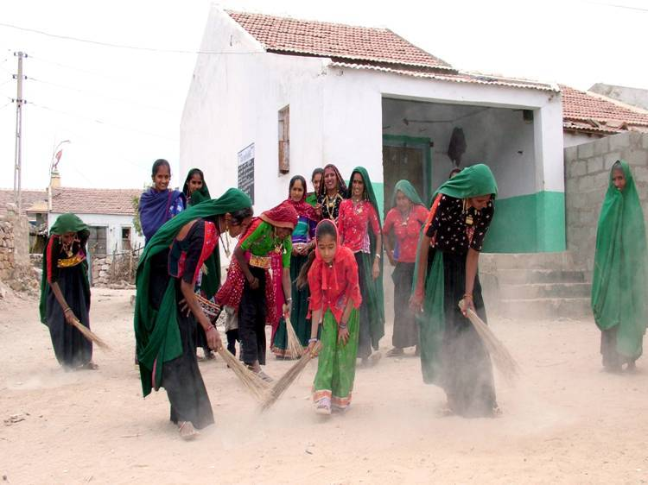
Sanitation, Health and Hygiene (IEC activities)

Slide 23
Progress Achieved under community managed In-village Water Supply Programme

Slide 24
Formation of Village Water and Sanitation Committee – Pani Samiti
Total Number of Villages - 18066

Slide 25
Progress of Community Managed Drinking Water
Village Schemes

Slide 26
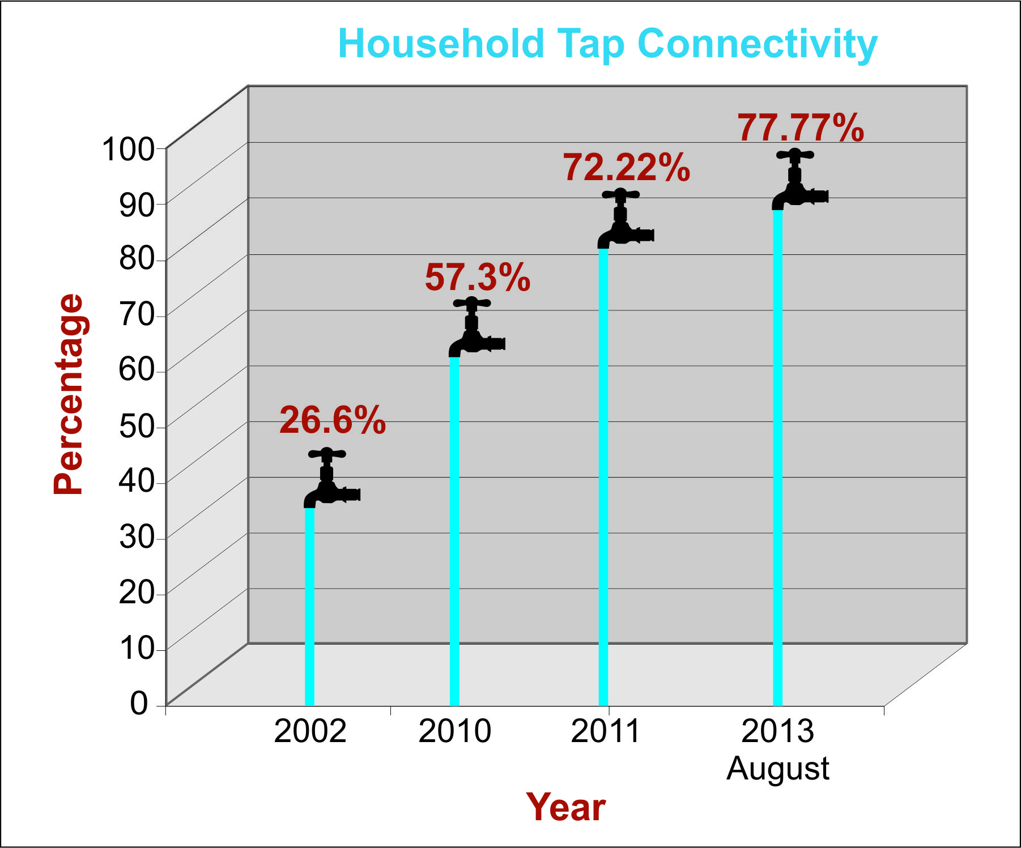
Household Tap Water Connectivity

Slide 27
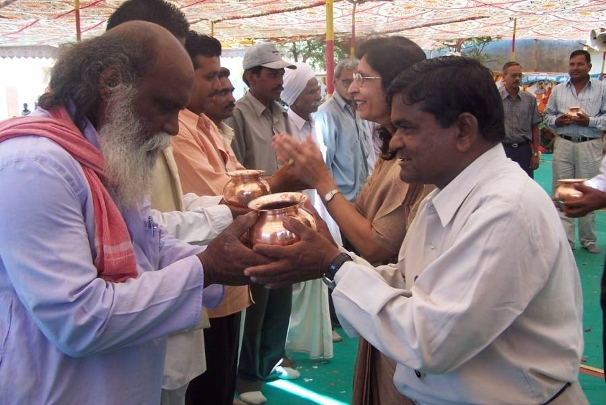
Atmarpan

Slide 28
Sustainability by Effective O & M and Water Tariff Plan
Charges fixed for, as decided in Gram Sabha:
One time household connection.
Regular domestic consumption.
Commercial utilization.
Consumption by Cattle
Special occasions (Marriages, Construction activity etc.)
Tariff rate ranges from Rs. 10/- to Rs. 70/- per household connection per month.
Most popular tariff plan – Rs. 1/- per day per connection.
Tariff account and operation is done mainly through bank accounts, a pre-condition for availing one time O&M incentive.
Visible Achievements through community participation
7074 villages have fixed and are collecting water tariff
2471 villages have been paid one time O&M assistance (10% cost of schemes)
Users are the best Managers

Slide 29
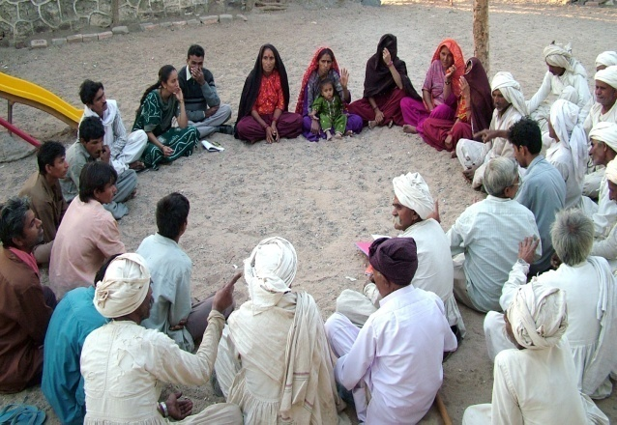
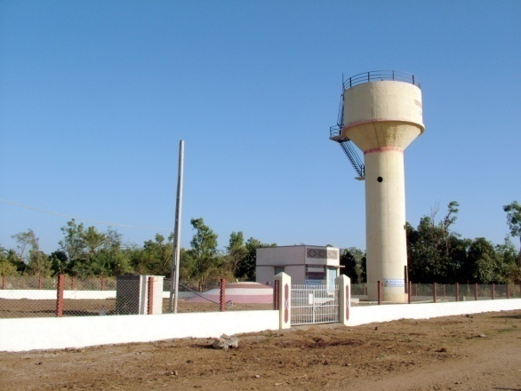
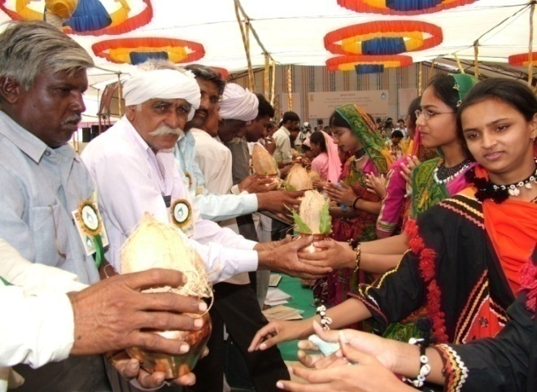
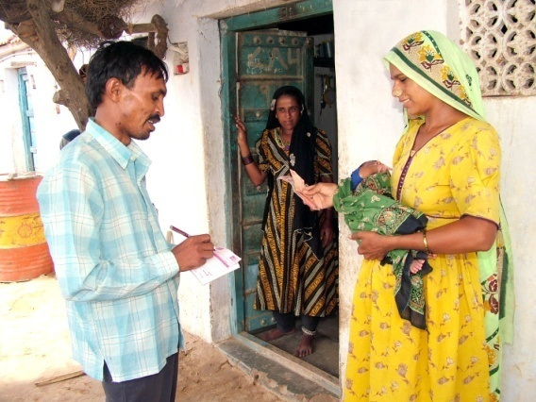
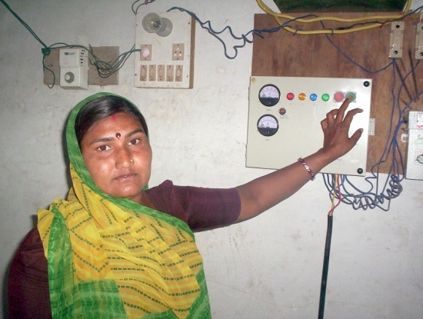
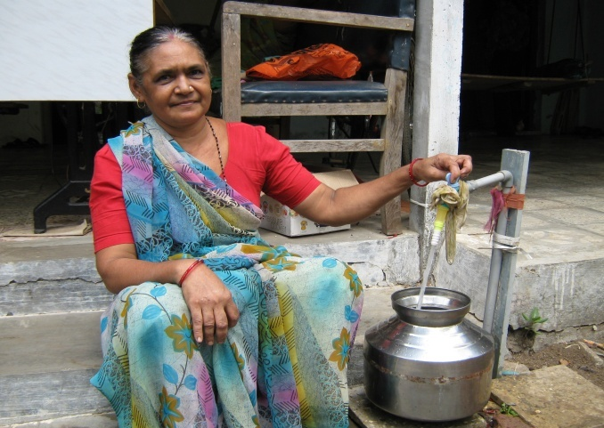
Decentralized Community Managed Water Delivery
Community Organization
Infrastructure creation
Community owning responsibility
Tariff Collection
Operation & Maintenance by community
Water delivery upto Household

Slide 30
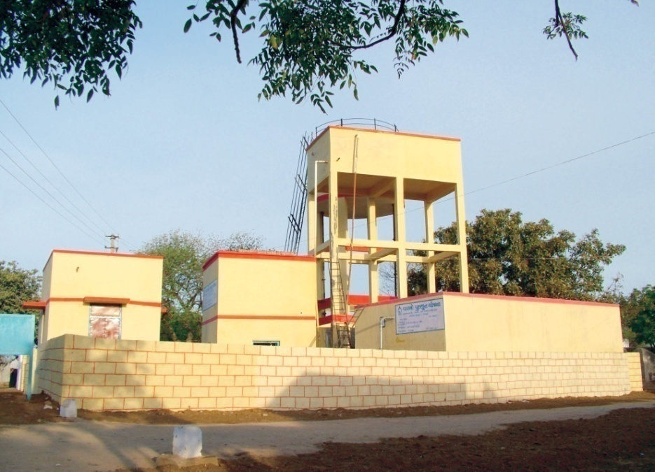
In-village drinking water systems

Slide 31
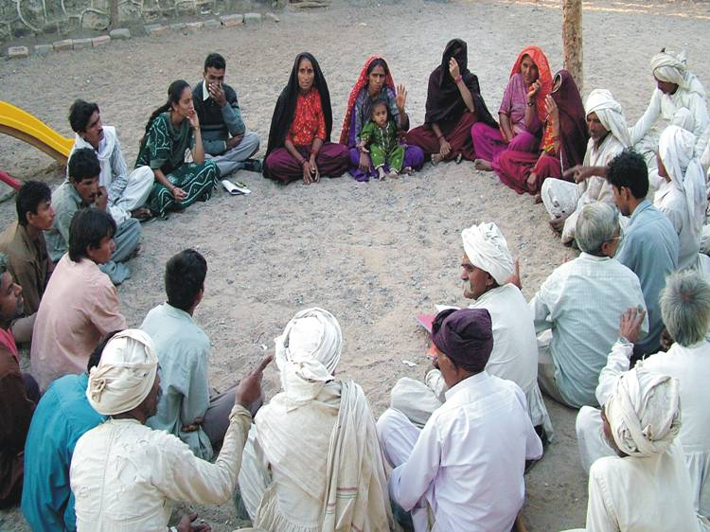
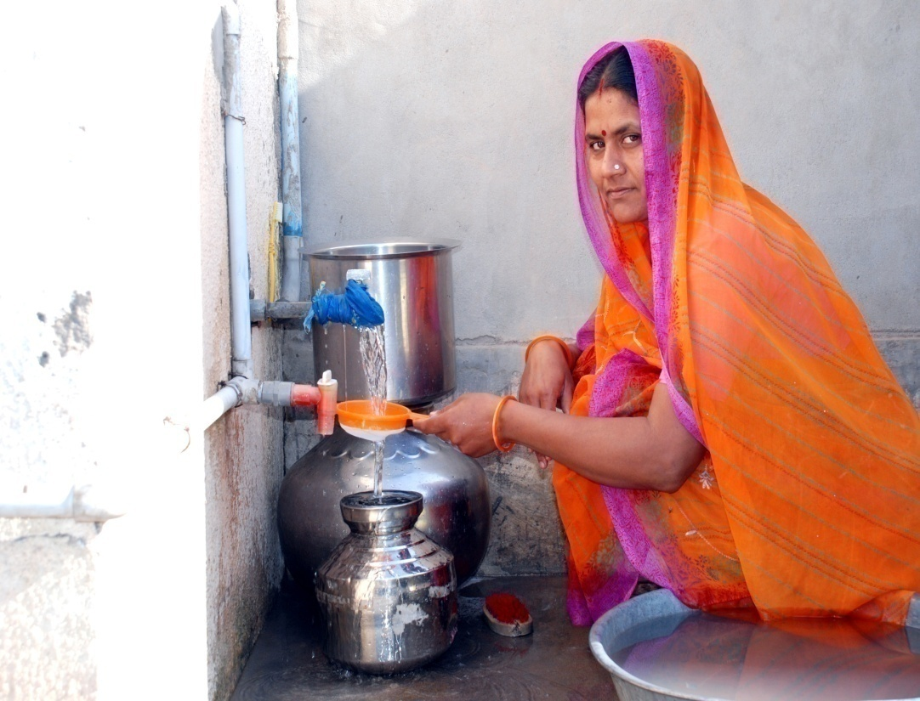
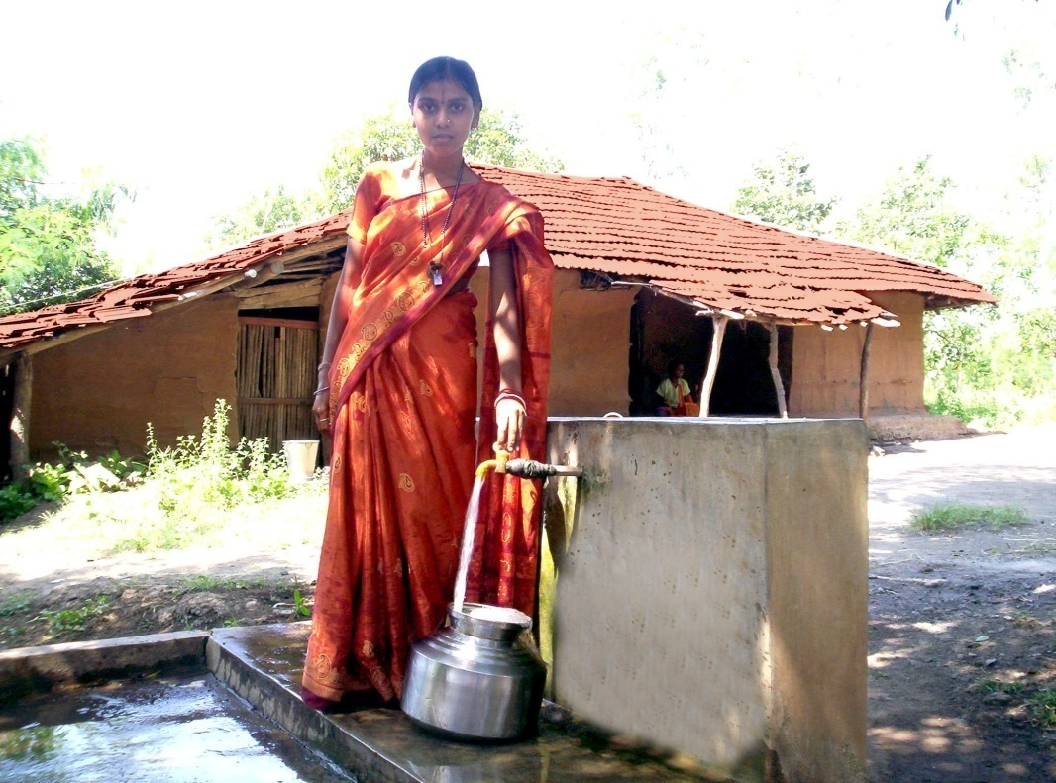
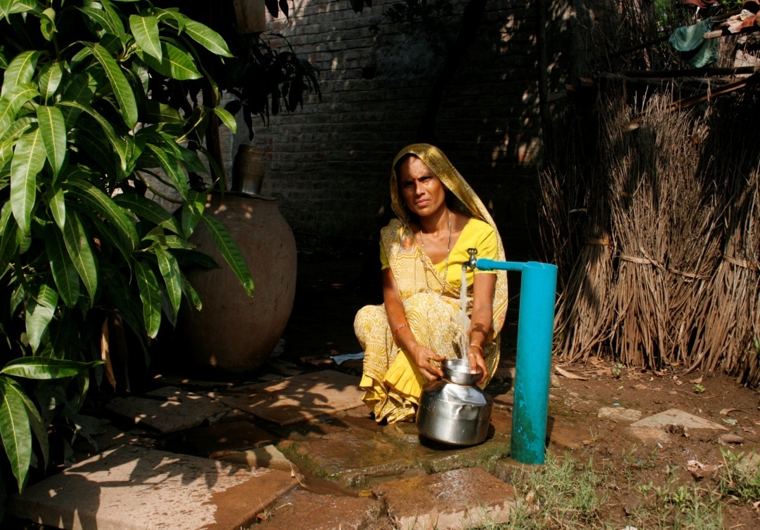

Slide 32
Lessons learnt
Community participation brings satisfactory and sustainable water supply services
Engineering solutions are not enough, Social solutions result in effective management
Community water wisdom, when scientific and applied, helps in improving services at lower investment.
Conjunctive use of water and multiple sources for sustainability
Participatory processes improve motivation
Social processes reduce public apathy
By involving community traditional knowledge base can be tapped
Community can take care for underprivileged sections better
Ultimate users’ satisfaction - Efficient tap water delivery at household level
Recoveries evaded when in government control but paid when controlled by community
Social audit is effective tool for transparency

Slide 33
Has the innovation been sustainable ?
1. Source Sustainability-
Multiple sources
Recharge and water harvesting
Community led regulations and water budgeting
2. Institutional sustainability
Capacity building
Facilitation
Follow up support
Award to Better Performing Pani Samiti
3. Financial sustainability
Corpus generation
O&M tariff mechanism
Performance based incentive for O&M
4. Technologies
Linkages for O&M with nearby repairers
Simple technology with availability of spares

Slide 34
Introduction of Pani Samiti Award in Gujarat State
To motivate and strengthen local institution involved in managing improved water supply services in the village, Pani Samiti Award has been instituted by WASMO
Assessed after field survey and finding facts on 37 relevant criteria with 160 marks in aggregate.
Certificate and cash prize of Rs. 50,000, 35,000 and 25,000 for first, second and third prize winners respectively.
At the State level, Pani Samitis Awards for the year 201213:
Sr No. | Name of village Pani Samiti | District | Award Position | Cash Prize (Rupees)
1 | Shinay | Kachchh | First | 50,000
2 | Motipura Veda | Gandhinagar | Second | 35,000
3 | Khirmani | Dang
4 | Kanakpar | Kachchh | Third | 25,000

Slide 35
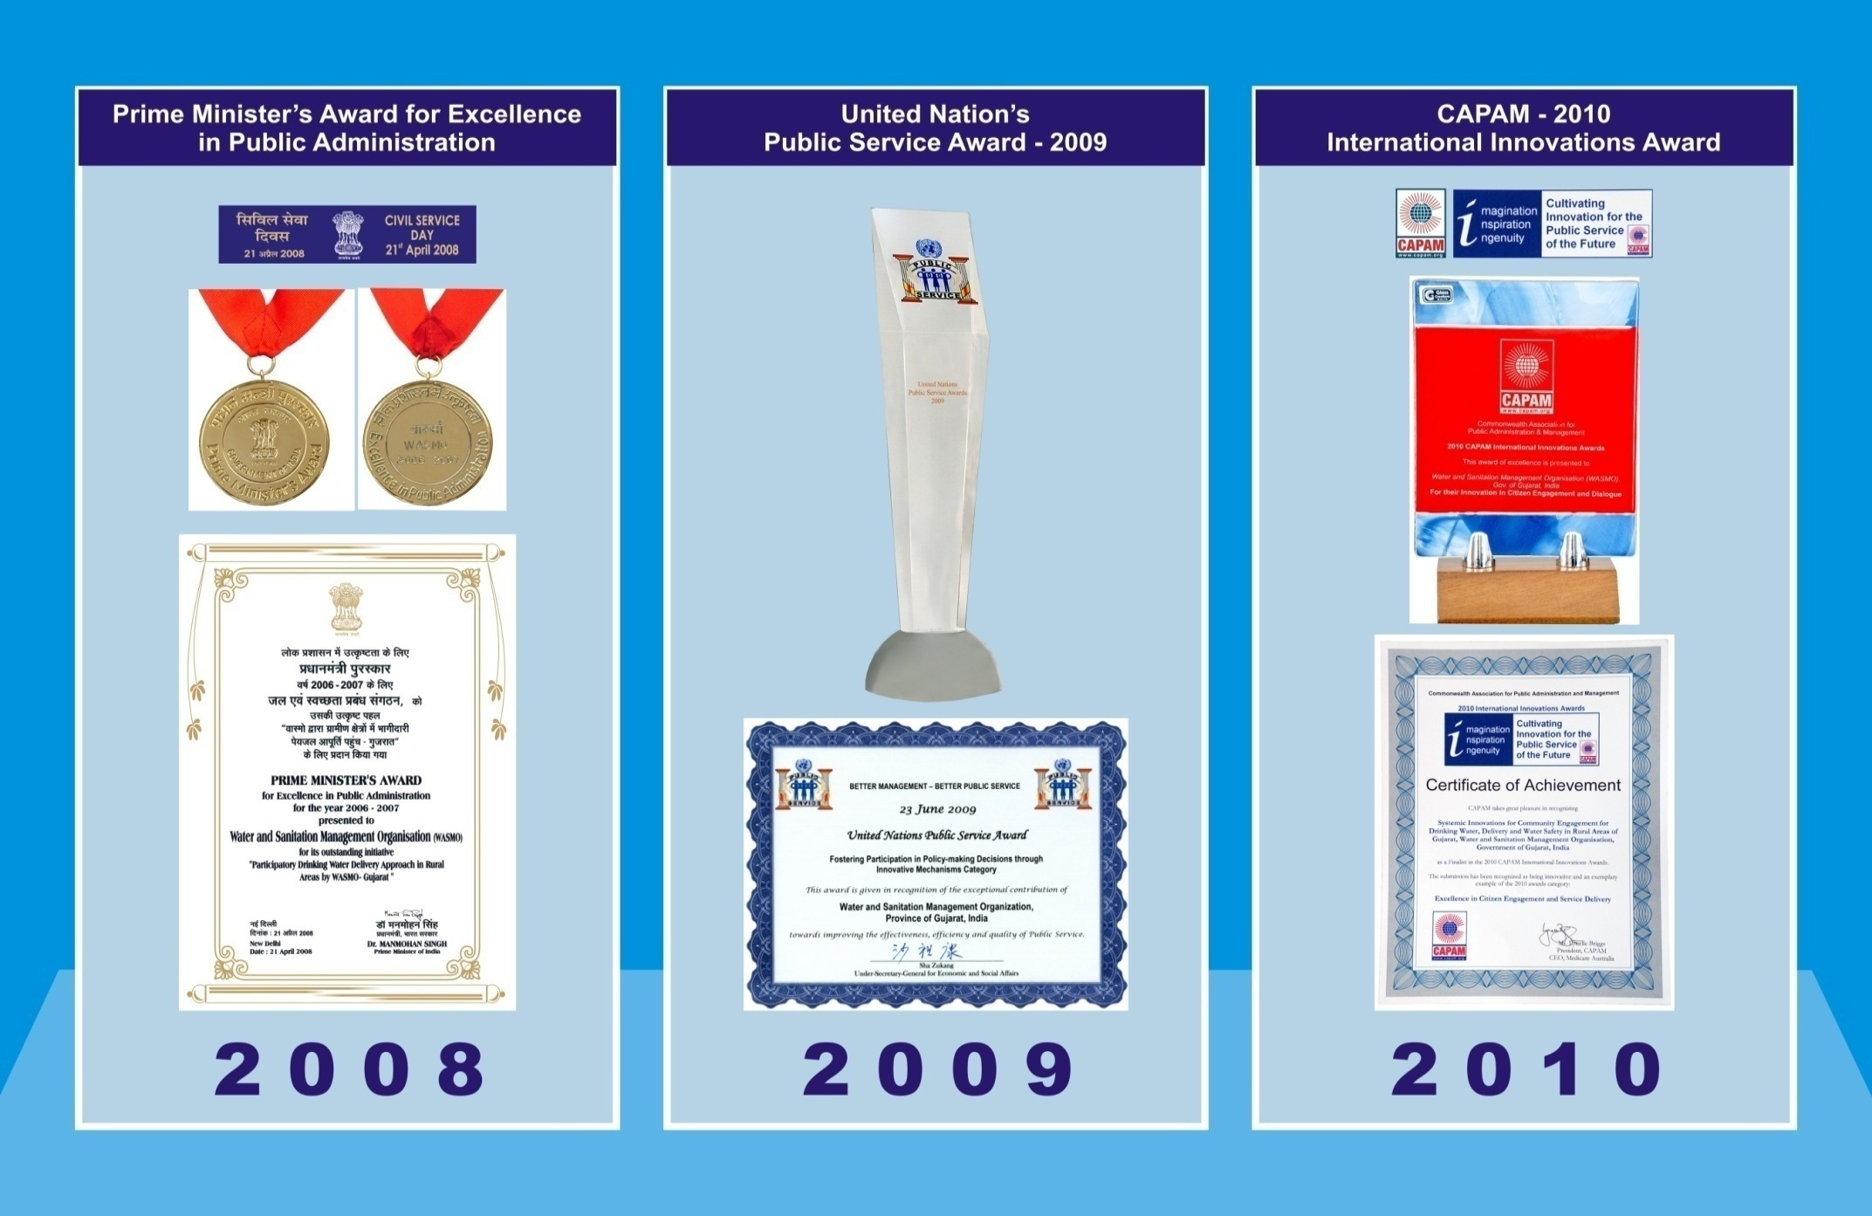
Recognition

Slide 36
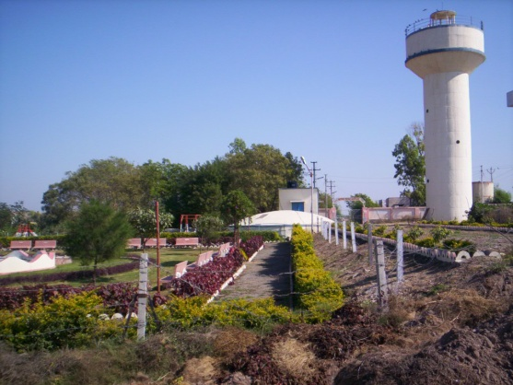
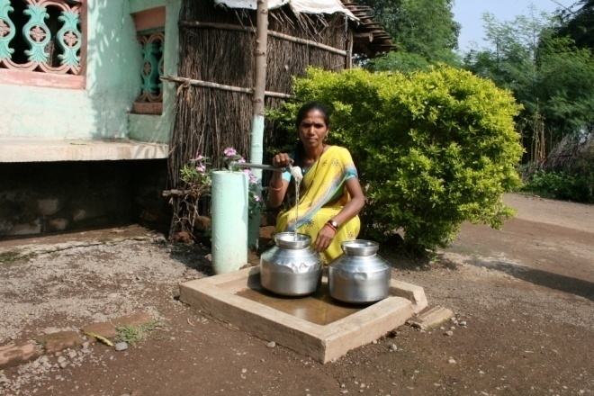
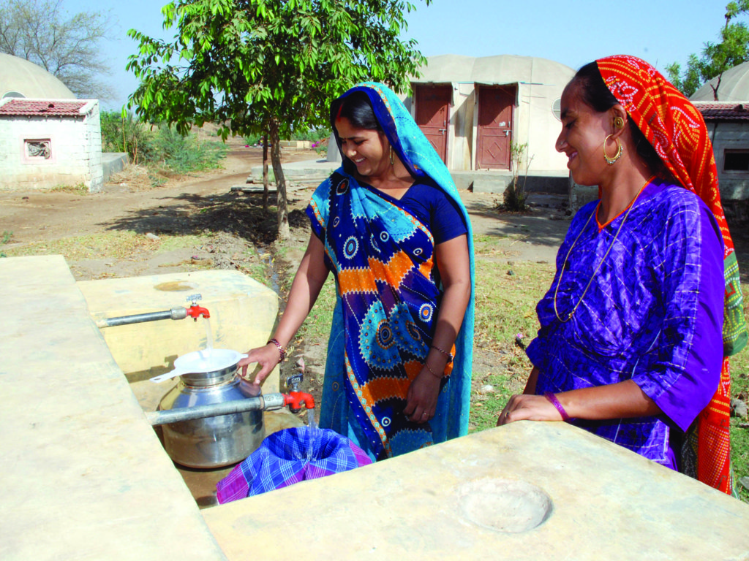
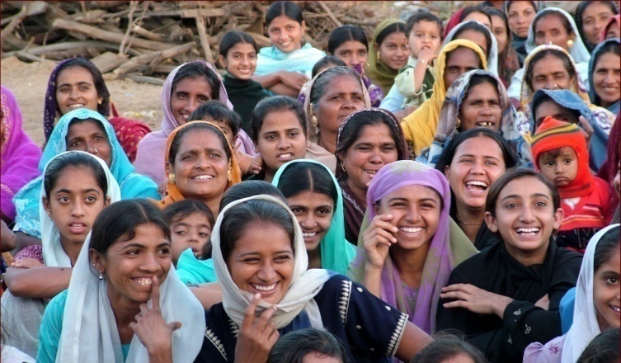
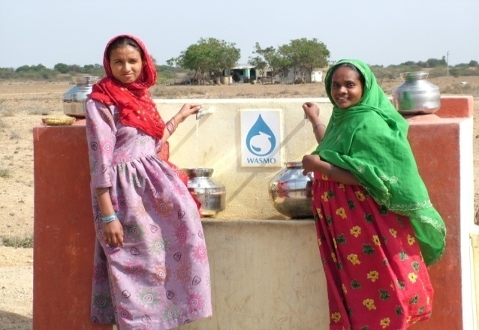
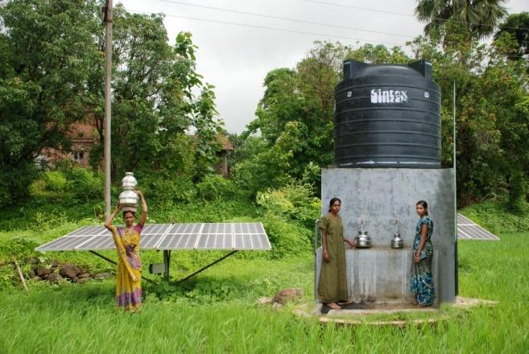
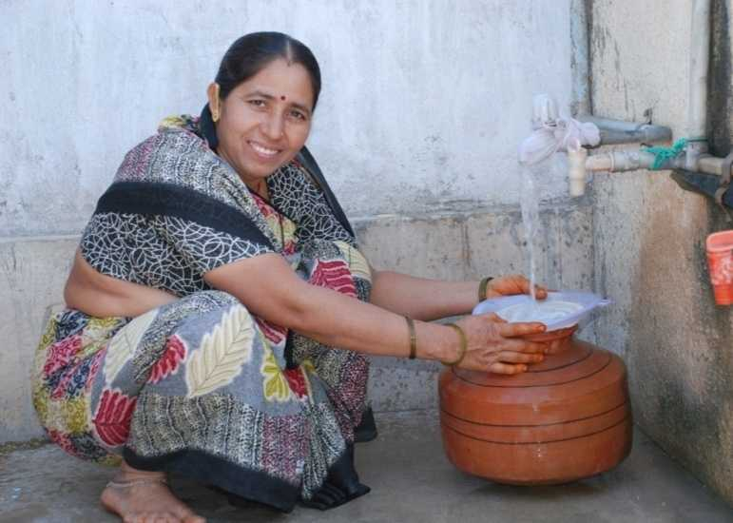
....................Thank you

Slide 37
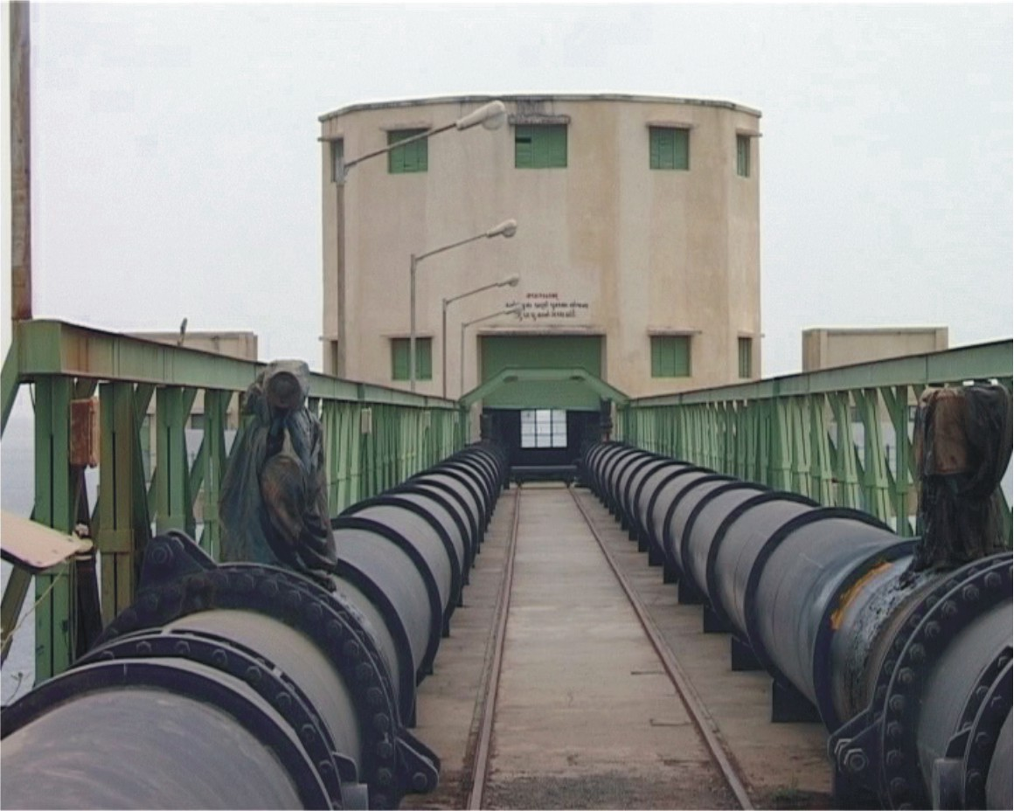
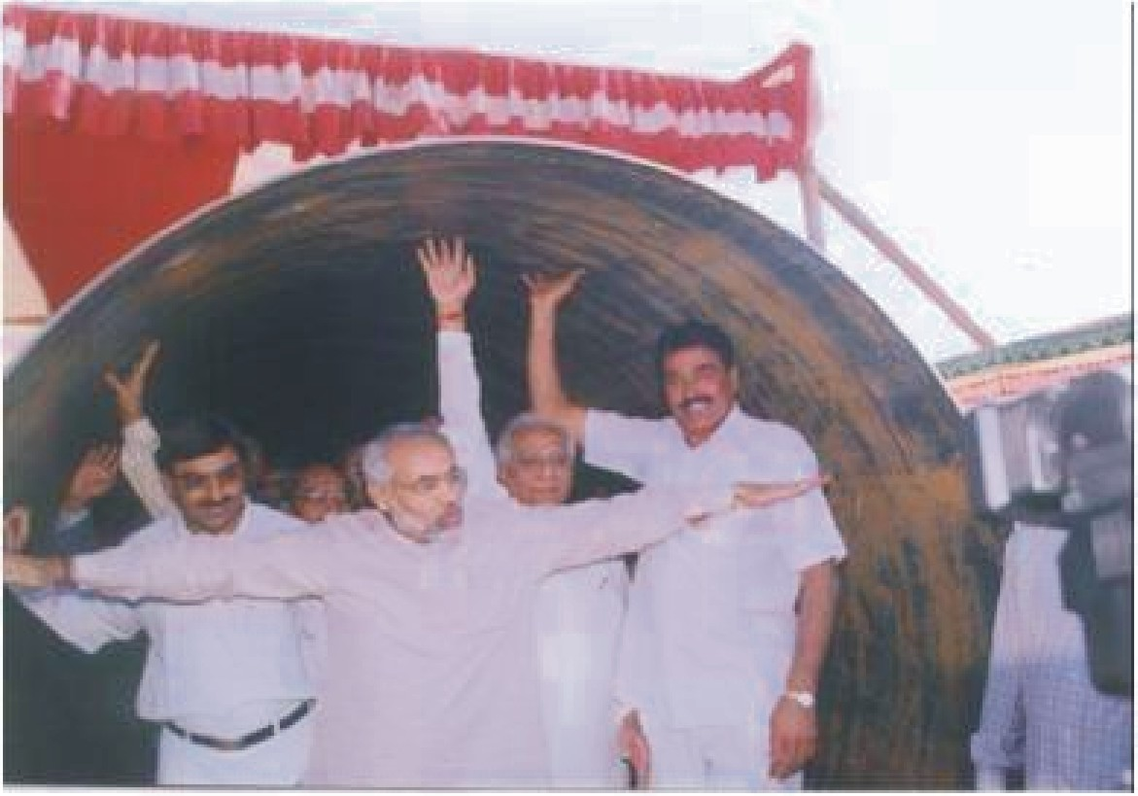

Slide 38
